Slide 1

PAPER PRESENTATION: Object Detection, Recognition, Deep Learning, and the Universal Law of Generalization
Group 3
Md. Wahidur Rahman Araf-17101404
Ali Muhtasim-17301163
Mohammed Abrar Ahasan Chowdhury-18201031
Ahmed Nur Merag-19101382
Siam Sadman-20141002
Md. Tawsifur Rahman-20141027
Asif Tazwar-21301732

Slide 2
Abstract
The question: Object detection and recognition are fundamental functions underlying the success of species. Because the appearance of an object exhibits a large variability, the brain has to group these different stimuli under the same object identity, a process of generalization. Does the process of generalization follow some general principles or is it an ad-hoc “bag-of-tricks”? The Universal Law of Generalization provided evidence that generalization follows similar properties across a variety of species and tasks. Here we test the hypothesis that the internal representations underlying generalization reflect the natural properties of object detection and recognition in our environment rather than the specifics of the system solving these problems.
Findings: By training a deep-neural-network with images of “clear” and “camouflaged” animals, it was found that, with a proper choice of category prototypes, the generalization functions are monotone decreasing, similar to the generalization functions of biological systems. The findings support the hypothesis of the study.

Slide 3
Introduction
Object detection and recognition in the actual world are exceedingly difficult tasks because stimuli impinging on our senses (or the sensors of a gadget) are rarely identical. We can recognize a friend by looking at their face, yet the appearance of their face can change as a result of our own or the friend's movements. Different perspectives of the face are shown as a result of these motions. Changes in lighting also result in distinct shading patterns. As a result, even while the object identity ("my friend") remains constant, the phenomenal appearance can change dramatically. Asa result, the brain is forced to aggregate these disparate appearances into a single object identity, a process known as generalization.

Slide 4
Universal Law of Generalization (ULoG)
Does the process of generalization follow some general principles and rules or is it an ad-hoc “bag of tricks”? If the universe, or more specifically the environment around us, has some invariances that can be described by laws, then it may be possible that some regularities of the generalization function can be identified not only within the members of the same species but also across different species since they are operating within the same environment obeying the same physical laws. This observation motivated Shepard to seek a “Universal Law of Generalization (ULoG)” 1. He observed that previous attempts to find invariant rules of generalization failed because they sought to characterize the process in terms of the physical properties of the stimulus. His key insight was to approach the problem not in the physical space where the stimulus resides, but rather in the “psychological space”, where the internal representations of the stimuli reside.

Slide 5
Statement Of Relevance
Goal: Discover general principles of object detection and recognition. A significant step was taken by the “universal law of generalization” as a law pertaining to all biological systems. The insight was to analyze generalization, not in the stimulus space, but in the “psychological space” (i.e., internal representations) of the species. However, since neurophysiological techniques do not allow a direct observation of the psychological space, the method was indirect. Recently, deep-neural-networks reached performance levels comparable to those of biological systems.
Environment: Since we can examine the internal representations of deep-neuralnetworks directly, our approach was to train a deep-neural-network and examine their internal representations. Our results suggest that the process of object detection and recognition is shaped by invariant characteristics of the ecological environment and is independent of the specifics of the organism or the machine. This finding provides a bridge between Gibsonian ecological-approach and information-processing approaches.

Slide 6
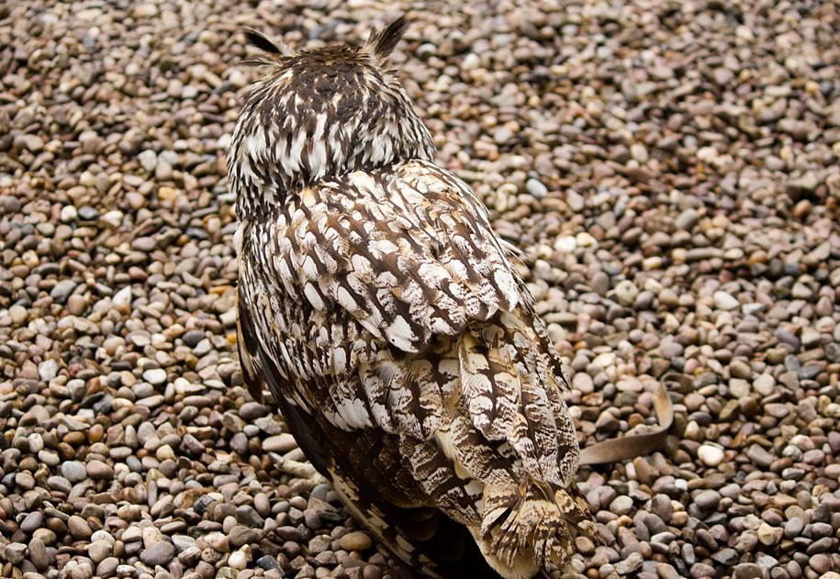
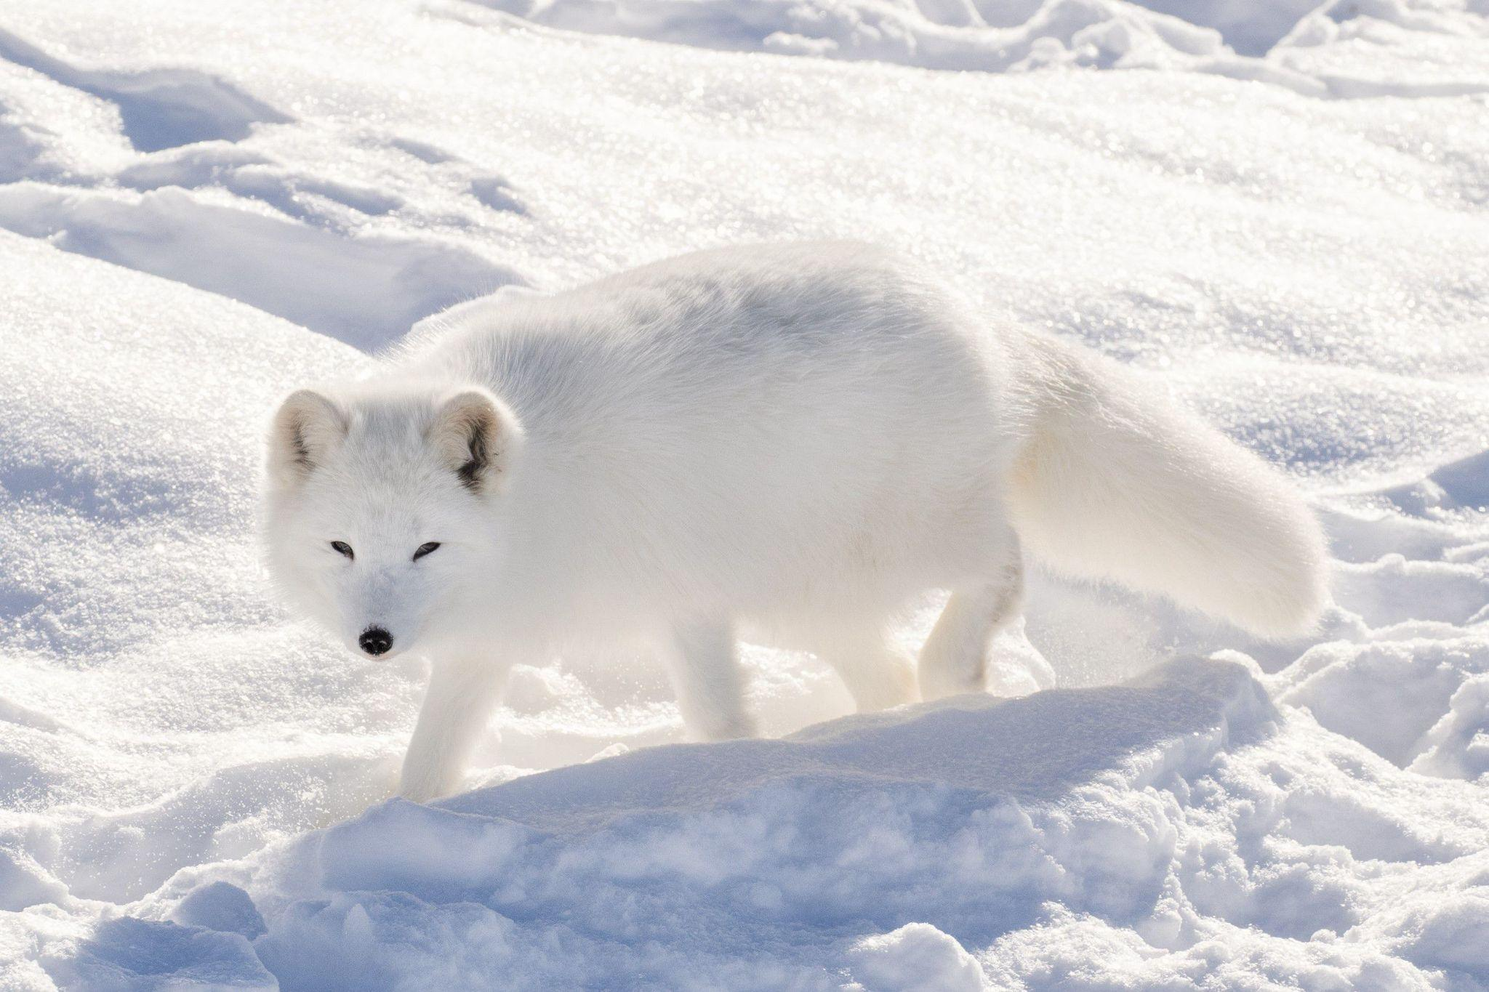
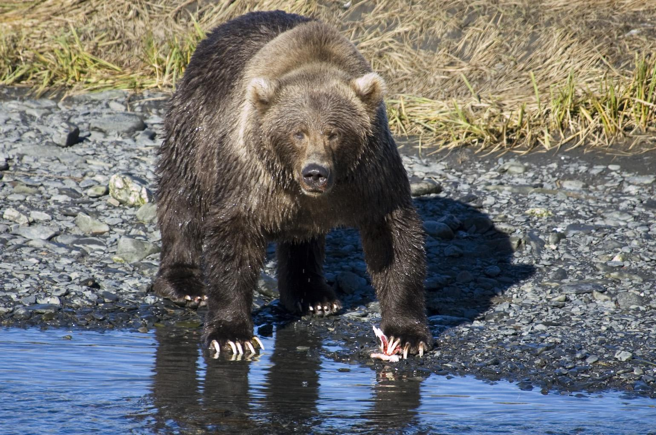
Methods
AlexNet10
MatLab 2019b
Datasets
ClearNet
CamoNet
ExpClearNet
ExpCamoNet
Initial Learning rate (0.001) & drop factor (0.05)
Functions and Formulas

Slide 7
Results
Learning and Generalization Performance
Internal representations in feature spaces
Geometry of object recognition in feature spaces
Distances in feature spaces and the generalization functions

Slide 8
Discussion
Power Law => A(f) ≈ c/f^γ.
A frequency-tuning characteristic adapted to this power law
Low Level Neural Computation
Object recognition as High Level Neural Computation
A “Universal generalization function” can be found by analyzing network
Positive result
A bridge between Gibsonian ecological approach and information processing approaches

