Slide 1
Aspect of African culture
Traditional African medicine practices
Presented By
Wachira Wahome
C025-01-0911/2021
August 2024

Slide 2
Introduction Relevance Of African Medicine Practices
By leveraging indigenous knowledge and natural resources, traditional African medicine offers valuable insights and solutions for sustainable health management.
This tradition typically incorporates African mysticism, indigenous herbalism, and the work of midwives, herbalists, and diviners.
Traditional African medicine practitioners assert, mostly without supporting data, that they can treat a wide range of illnesses, such as cancer, mental health issues, hypertension, cholera, most sexually transmitted infections, epilepsy, asthma, eczema, fever, anxiety, depression, benign prostatic hyperplasia, urinary tract infections

Slide 3
Importance Of This Practice
Crucial role in healthcare systems for centuries.
Integration with modern healthcare and continued relevance.
Accessibility: Compared to contemporary healthcare facilities, traditional African medicine is frequently more accessible to underprivileged and rural communities.
Cultural Relevance: By their strong cultural roots in the customs and beliefs of numerous African cultures, these techniques encourage patient adherence and confidence.

Slide 4
Key Components Of Traditional African Medicine
Practitioners:
Midwives, herbalists, and diviners.
Diagnosis and Treatment:
Spiritual methods for diagnosis.
Herbal cures with symbolic and spiritual value.
Contrasts with Modern Medicine:
Focus on social or spiritual imbalances.
Use of medicinal plants with therapeutic potential.

Slide 5
Medicinal Plants
Cannabis Sativa:
Treats blood poisoning, anthrax, dysentery, tetanus, and more.
Carduus Tenuiflorus:
Used hermetically, believed to absorb illnesses.
Stramonium Datura:
Alleviates pain, swelling, boils, abscesses, and more.
Bidens Pilosa:
Treats infertility, jealousy, evil spirits, and various diseases.

Slide 6
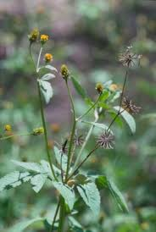

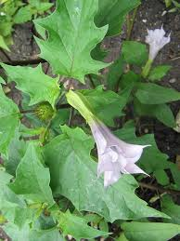
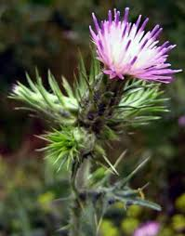
Visual Medicinal Plants

Slide 7
Integration And Future Trends
Modern healthcare integration:
Increased collaboration between traditional and modern practices.
Use of technology to enhance traditional medicine.

Slide 8
Integration And Future Trends
Revival And Regulation:
Revival of traditional medicinal plants in modern health systems.
Importance of regulation for safety and efficacy.
Leveraging indigenous knowledge for sustainable health solutions.

Slide 9
Conclusion & summary
Traditional African medicine has long been integral to African healthcare, leveraging indigenous knowledge and natural resources. Incorporating mysticism, herbalism, and expertise from midwives, herbalists, and diviners, it treats illnesses through spiritual methods and herbal cures with symbolic value. With over 4,000 medicinal plants, like cannabis sativa for various ailments and Bidens Pilosa for diseases and infertility, traditional practices address health issues holistically. Integration with modern healthcare, including AI, machine learning, and telehealth platforms, enhances efficacy and safety, offering personalized health insights and sustainable management solutions. This fusion preserves cultural heritage while providing advanced healthcare, showcasing the continued relevance and innovation in traditional African medicine.

Slide 10
THE END

