Slide 1
Relational Algebra
Ullman & al. @ Stanford
http://infolab.stanford.edu/~ullman/fcdb/aut07/index.html
Basic Operations
Algebra of Bags

Slide 2
What is an “Algebra”
Mathematical system consisting of:
Operands --- variables or values from which new values can be constructed.
Operators --- symbols denoting procedures that construct new values from given values.

Slide 3
What is Relational Algebra?
An algebra whose operands are relations or variables that represent relations.
Operators are designed to do the most common things that we need to do with relations in a database.
The result is an algebra that can be used as a query language for relations.

Slide 4
Core Relational Algebra
Union, intersection, and difference.
Usual set operations, but both operands must have the same relation schema.
Selection: picking certain rows.
Projection: picking certain columns.
Products and joins: compositions of relations.
Renaming of relations and attributes.

Slide 5
Selection
R1 := σ_{C} (R2)
C is a condition (as in “if” statements) that refers to attributes of R2.
R1 is all those tuples of R2 that satisfy C.

Slide 6
Example: Selection
Relation Sells:
bar beer price
Joe’s Bud 2.50
Joe’s Miller 2.75
Sue’s Bud 2.50
Sue’s Miller 3.00
JoeMenu := σ_{bar=“Joe’s”}(Sells):
bar beer price
Joe’s Bud 2.50
Joe’s Miller 2.75

Slide 7
Example: Selection
Joe’s | Joe´s | Joe‘s | Joe's ???
REMARK: Unlike in this presentation, I do not use punctuation in the database!
Instead of Joe’s you find Joes in the database.
REASON: Apostrophe, accents, single quotation marks (opening, closing), backtick, etc. are often confused and can cause problems because of unclear character encoding and character typeset. If you are interested in the details please see:
https://www2.cs.sfu.ca/~ggbaker/reference/characters/
Relation Sells:
bar beer price
Joe’s Bud 2.50
Joe’s Miller 2.75
Sue’s Bud 2.50
Sue’s Miller 3.00
JoeMenu := σ_{bar=“Joe’s”}(Sells):
bar beer price
Joe’s Bud 2.50
Joe’s Miller 2.75

Slide 8
Example: Selection
select * from SELLS where BAR = 'Joe’s'
Relation Sells:
bar beer price
Joe’s Bud 2.50
Joe’s Miller 2.75
Sue’s Bud 2.50
Sue’s Miller 3.00
JoeMenu := σ_{bar=“Joe’s”}(Sells):
bar beer price
Joe’s Bud 2.50
Joe’s Miller 2.75

Slide 9
Example: Selection
Column and table names with small and capital letters and with blanks: double quotation marks
select * from "Sells" where "bar" = 'Joe’s' ;
Relation Sells:
bar beer price
Joe’s Bud 2.50
Joe’s Miller 2.75
Sue’s Bud 2.50
Sue’s Miller 3.00
JoeMenu := σ_{bar=“Joe’s”}(Sells):
bar beer price
Joe’s Bud 2.50
Joe’s Miller 2.75

Slide 10
Example: Selection
Column and table names with small and capital letters and with blanks: double quotation marks
select * from "Sells" where "bar" = 'Joe’s' ;
Relation Sells:
bar beer price
Joe’s Bud 2.50
Joe’s Miller 2.75
Sue’s Bud 2.50
Sue’s Miller 3.00
double quotes for table and column names
single quotes for string constants
JoeMenu := σ_{bar=“Joe’s”}(Sells):
bar beer price
Joe’s Bud 2.50
Joe’s Miller 2.75

Slide 11
Projection
R1 := π_{L} (R2)
L is a list of attributes from the schema of R2.
R1 is constructed by looking at each tuple of R2, extracting the attributes on list L, in the order specified, and creating from those components a tuple for R1.
Eliminate duplicate tuples, if any.

Slide 12
Example: Projection
Relation Sells:
bar beer price
Joe’s Bud 2.50
Joe’s Miller 2.75
Sue’s Bud 2.50
Sue’s Miller 3.00
Prices := π_{beer,price}(Sells):
beer price
Bud 2.50
Miller 2.75
Miller 3.00

Slide 13
Example: Projection
select distinct "beer" , "price" from "Sells" ;
Relation Sells:
bar beer price
Joe’s Bud 2.50
Joe’s Miller 2.75
Sue’s Bud 2.50
Sue’s Miller 3.00
Prices := π_{beer,price}(Sells):
beer price
Bud 2.50
Miller 2.75
Miller 3.00

Slide 14
Extended Projection
Using the same π_{L} operator, we allow the list L to contain arbitrary expressions involving attributes:
Arithmetic on attributes, e.g., A+B->C.
Duplicate occurrences of the same attribute.

Slide 15
Example: Extended Projection
R = ( A B )
1 2
3 4
π_{A+B->C,A,A} (R) = C A1 A2
3 1 1
7 3 3

Slide 16
Example: Extended Projection
select A + B as C , A as A1 , A as A2 from R ;
R = ( A B )
1 2
3 4
π_{A+B->C,A,A} (R) = C A1 A2
3 1 1
7 3 3

Slide 17
Example: Extended Projection
R = ( A B )
1 2
3 4
π_{A+B->C,A,A} (R) = C A1 A2
3 1 1
7 3 3
select "beer" + 3 , "price" + 3 from "Sells" ;

Slide 18
Product
R3 := R1 Χ R2
Pair each tuple t1 of R1 with each tuple t2 of R2.
Concatenation t1t2 is a tuple of R3.
Schema of R3 is the attributes of R1 and then R2, in order.
But beware attribute A of the same name in R1 and R2: use R1.A and R2.A.

Slide 19
Example: R3 := R1 Χ R2
R1( A, B )
1 2
3 4
R2( B, C )
5 6
7 8
9 10
R3( A, R1.B, R2.B, C )
1 2 5 6
1 2 7 8
1 2 9 10
3 4 5 6
3 4 7 8
3 4 9 10

Slide 20
Example: R3 := R1 Χ R2
select R1.* , R2.* from R1 , R2 ;
R1( A, B )
1 2
3 4
R2( B, C )
5 6
7 8
9 10
R3( A, R1.B, R2.B, C )
1 2 5 6
1 2 7 8
1 2 9 10
3 4 5 6
3 4 7 8
3 4 9 10

Slide 21
Theta-Join
R3 := R1 ⋈_{C} R2
Take the product R1 Χ R2.
Then apply σ_{C} to the result.
As for σ, C can be any boolean-valued condition.
Historic versions of this operator allowed only A θ B, where θ is =, <, etc.; hence the name “theta-join.”

Slide 22
Example: Theta Join
Sells( bar, beer, price ) Bars( name, addr )
Joe’s Bud 2.50 Joe’s Maple St.
Joe’s Miller 2.75 Sue’s River Rd.
Sue’s Bud 2.50
Sue’s Coors 3.00
BarInfo := Sells ⋈_{Sells.bar = Bars.name} Bars
BarInfo( bar, beer, price, name, addr )
Joe’s Bud 2.50 Joe’s Maple St.
Joe’s Miller 2.75 Joe’s Maple St.
Sue’s Bud 2.50 Sue’s River Rd.
Sue’s Coors 3.00 Sue’s River Rd.

Slide 23
Example: Theta Join
Sells( bar, beer, price ) Bars( name, addr )
Joe’s Bud 2.50 Joe’s Maple St.
Joe’s Miller 2.75 Sue’s River Rd.
Sue’s Bud 2.50
Sue’s Coors 3.00
BarInfo := Sells ⋈_{Sells.bar = Bars.name} Bars
BarInfo( bar, beer, price, name, addr )
Joe’s Bud 2.50 Joe’s Maple St.
Joe’s Miller 2.75 Joe’s Maple St.
Sue’s Bud 2.50 Sue’s River Rd.
Sue’s Coors 3.00 Sue’s River Rd.
select "Sells".*, "Bars".* from "Sells", "Bars" where "Sells"."bar" = "Bars"."name"

Slide 24
Natural Join
A useful join variant (natural join) connects two relations by:
Equating attributes of the same name, and
Projecting out one copy of each pair of equated attributes.
Denoted R3 := R1 ⋈ R2.

Slide 25
Example: Natural Join
Sells( bar, beer, price ) Bars( bar, addr )
Joe’s Bud 2.50 Joe’s Maple St.
Joe’s Miller 2.75 Sue’s River Rd.
Sue’s Bud 2.50
Sue’s Coors 3.00
BarInfo := Sells ⋈ Bars
Note: Bars.name has become Bars.bar to make the natural
join “work.”
BarInfo( bar, beer, price, addr )
Joe’s Bud 2.50 Maple St.
Joe’s Milller 2.75 Maple St.
Sue’s Bud 2.50 River Rd.
Sue’s Coors 3.00 River Rd.

Slide 26
Example: Natural Join
Sells( bar, beer, price ) Bars( bar, addr )
Joe’s Bud 2.50 Joe’s Maple St.
Joe’s Miller 2.75 Sue’s River Rd.
Sue’s Bud 2.50
Sue’s Coors 3.00
BarInfo := Sells ⋈ Bars
Note: Bars.name has become Bars.bar to make the natural
join “work.”
BarInfo := π_{bar,beer,price,addr}(Sells ⋈_{Sells.bar = Bars.bar} Bars)
BarInfo( bar, beer, price, addr )
Joe’s Bud 2.50 Maple St.
Joe’s Milller 2.75 Maple St.
Sue’s Bud 2.50 River Rd.
Sue’s Coors 3.00 River Rd.
select "bar", "beer", "price", "addr" from "Sells", "Bars" where "Sells"."bar" = "Bars"."bar"

Slide 27
Renaming
The ρ operator gives a new schema to a relation.
R1 := ρ_{R1(A1,…,An)}(R2) makes R1 be a relation with attributes A1,…,An and the same tuples as R2.
Simplified notation: R1(A1,…,An) := R2.

Slide 28
Example: Renaming
Bars( name, addr )
Joe’s Maple St.
Sue’s River Rd.
R(bar, addr) := Bars
R( bar, addr )
Joe’s Maple St.
Sue’s River Rd.

Slide 29
Example: Renaming
Bars( name, addr )
Joe’s Maple St.
Sue’s River Rd.
R(bar, addr) := Bars
R( bar, addr )
Joe’s Maple St.
Sue’s River Rd.
select "name" as "bar" , "addr" from "Bars" ;

Slide 30
Building Complex Expressions
Combine operators with parentheses and precedence rules.
Three notations, just as in arithmetic:
Sequences of assignment statements.
Expressions with several operators.
Expression trees.

Slide 31
Sequences of Assignments
Create temporary relation names.
Renaming can be implied by giving relations a list of attributes.
Example: R3 := R1 ⋈_{C} R2 can be written:
R4 := R1 Χ R2
R3 := σ_{C} (R4)

Slide 32
Expressions in a Single Assignment
Example: the theta-join R3 := R1 ⋈_{C} R2 can be written: R3 := σ_{C} (R1 Χ R2)
Precedence of relational operators:
[σ, π, ρ] (highest).
[Χ, ⋈].
∩.
[∪, —]

Slide 33
Expression Trees
Leaves are operands --- either variables standing for relations or particular, constant relations.
Interior nodes are operators, applied to their child or children.

Slide 34
Example: Tree for a Query
Using the relations Bars(name, addr) and Sells(bar, beer, price), find the names of all the bars that are either on Maple St. or sell Bud for less than $3.

Slide 35
As a Tree:
∪
ρ_{R(name)}
π_{name}
π_{bar}
σ_{addr = “Maple St.”}
σ_{price<3 AND beer=“Bud”}
Bars
Sells

Slide 36
UNION
(select * from "Sells" where "beer" = 'Bud') union (select * from "Sells" where "price" < 3)
select * from "Sells" where "beer" = 'Bud' or "price" < 3
(select * from "Sells" where "beer" = 'Bud') union all (select * from "Sells" where "price" < 3)
select "name" as "bar" from "Bars" union all
select "bar" from "Sells"

Slide 37
Example: Self-Join
Using Sells(bar, beer, price), find the bars that sell two different beers at the same price.
Strategy: by renaming, define a copy of Sells, called S(bar1, beer1, price1). The natural join of Sells and S consists of quadruples (bar, beer, beer1, price) such that the bar sells both beers at this price.

Slide 38
The Tree
π_{bar}
σ_{beer != beer1}
⋈
ρ_{S(bar1, beer1, price1)}
Sells (bar, beer, price)
Sells (bar, beer, price)

Slide 39
The Tree
π_{bar}
σ_{beer != beer1}
⋈_{price = price1}
ρ_{S(bar1, beer1, price1)}
Sells
Sells

Slide 40
The Tree
π_{bar}
σ_{beer != beer1}
⋈_{price = price1}
ρ_{S(bar1, beer1, price1)}
select t1.*, t2.* from "Sells" t1, "Sells" t2 where t1."price" = t2."price" and t1."beer" != t2."beer"
Sells
Sells

Slide 41
The Tree
πbar1,beer1,price1,bar,beer,price
σ_{beer != beer1}
⋈_{price = price1}
ρ_{S(bar1, beer1, price1)}
select t1.”bar” as “bar1”, t1.”beer” as “beer1”, t1.”price” as “price1”, t2.* from "Sells" t1, "Sells" t2 where "price" = "price1" and "beer" != "beer1"
Sells
Sells

Slide 42
Example: Self-Join 2
Using Sells(bar, beer, price), find prices at which two different bars offer beer.
Strategy: by renaming, define a copy of Sells, called S(bar1, beer1, price1). The theta join consists of all beers having the same price. Bars must be different, i.e. bar1 ≠ bar.

Slide 43
The Tree
πbar,beer,price,bar1,beer1,price1
σ_{bar != bar1}
⋈_{price = price1}
ρ_{S(bar1, beer1, price1)}
Sells
Sells

Slide 44
The Tree
πbar,beer,price,bar1,beer1,price1
σ_{bar != bar1}
⋈_{price = price1}
select t1.*, t2.* from "Sells" t1, "Sells" t2 where t1."price" = t2."price" and t1."bar" != t2."bar"
ρ_{S(bar1, beer1, price1)}
Sells
Sells

Slide 45
„group by“ Clause
First group data and then aggregate: sum(), count(), avg() …
Average beer price in the bars:
Average price of beer brands:
select "bar", avg("price") from "Sells"
group by "bar"
select "beer", avg("price") from "Sells"
group by "beer"

Slide 46
Schemas for Results
Union, intersection, and difference: the schemas of the two operands must be the same, so use that schema for the result.
Selection: schema of the result is the same as the schema of the operand.
Projection: list of attributes tells us the schema.

Slide 47
Schemas for Results --- (2)
Product: schema is the attributes of both relations.
Use R.A, etc., to distinguish two attributes named A.
Theta-join: same as product.
Natural join: union of the attributes of the two relations.
Renaming: the operator tells the schema.

Slide 48
Relational Algebra on Bags
A bag (or multiset ) is like a set, but an element may appear more than once.
Example: {1,2,1,3} is a bag.
Example: {1,2,3} is also a bag that happens to be a set.

Slide 49
Why Bags?
SQL, the most important query language for relational databases, is actually a bag language.
Some operations, like projection, are more efficient on bags than sets.

Slide 50
Why Bags?
SQL, the most important query language for relational databases, is actually a bag language.
Some operations, like projection, are more efficient on bags than sets.
select "bar" from "Sells"
yields non-unique tuples or dublicates (bag).
select distinct "bar" from "Sells"
yields unique tuples (set).

Slide 51
Operations on Bags
Selection applies to each tuple, so its effect on bags is like its effect on sets.
Projection also applies to each tuple, but as a bag operator, we do not eliminate duplicates.
Products and joins are done on each pair of tuples, so duplicates in bags have no effect on how we operate.

Slide 52
Example: Bag Selection
R( A, B )
1 2
5 6
1 2
σ_{A+B < 5} (R) = A B
1 2
1 2

Slide 53
Example: Bag Projection
R( A, B )
1 2
5 6
1 2
π_{A} (R) = A
1
5
1

Slide 54
Example: Bag Product
R( A, B ) S( B, C )
1 2 3 4
5 6 7 8
1 2
R Χ S = A R.B S.B C
1 2 3 4
1 2 7 8
5 6 3 4
5 6 7 8
1 2 3 4
1 2 7 8

Slide 55
Example: Bag Theta-Join
R( A, B ) S( B, C )
1 2 3 4
5 6 7 8
1 2
R ⋈ _{R.B<S.B} S = A R.B S.B C
1 2 3 4
1 2 7 8
5 6 7 8
1 2 3 4
1 2 7 8

Slide 56
Bag Union
An element appears in the union of two bags the sum of the number of times it appears in each bag.
Example: {1,2,1} ∪ {1,1,2,3,1} = {1,1,1,1,1,2,2,3}

Slide 57
Bag Intersection
An element appears in the intersection of two bags the minimum of the number of times it appears in either.
Example: {1,2,1,1} ∩ {1,2,1,3} = {1,1,2}.

Slide 58
Bag Difference
An element appears in the difference A – B of bags as many times as it appears in A, minus the number of times it appears in B.
But never less than 0 times.
Example: {1,2,1,1} – {1,2,3} = {1,1}.

Slide 59
Beware: Bag Laws != Set Laws
Some, but not all algebraic laws that hold for sets also hold for bags.
Example: the commutative law for union (R ∪S = S ∪R ) does hold for bags.
Since addition is commutative, adding the number of times x appears in R and S doesn’t depend on the order of R and S.

Slide 60
Example: A Law That Fails
Set union is idempotent, meaning that S ∪S = S.
However, for bags, if x appears n times in S, then it appears 2n times in S ∪S.
Thus S ∪S != S in general.
e.g., {1} ∪ {1} = {1,1} != {1}.

Slide 61
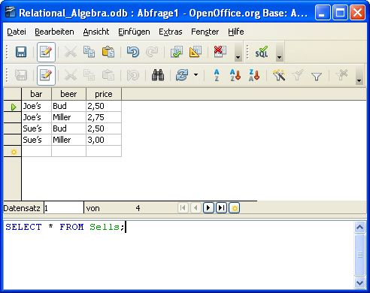
Simple selection

Slide 62
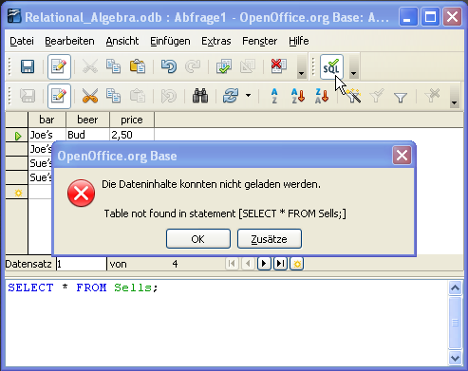
Same selection fails in native SQL mode: table name not recognized.

Slide 63
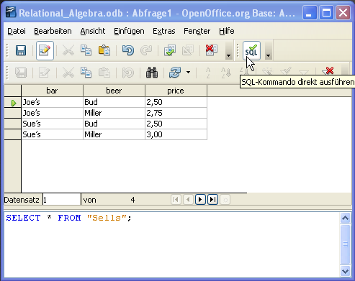
Selection with quotation marks works in native SQL mode.

Slide 64
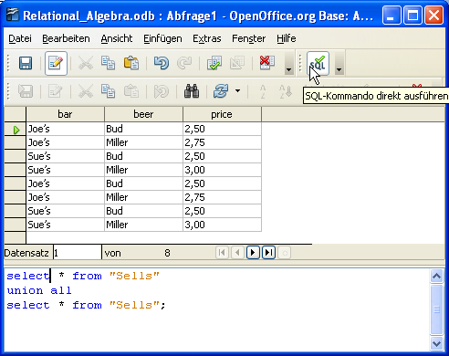
UNION and UNION ALL only work in native SQL mode.

Slide 65
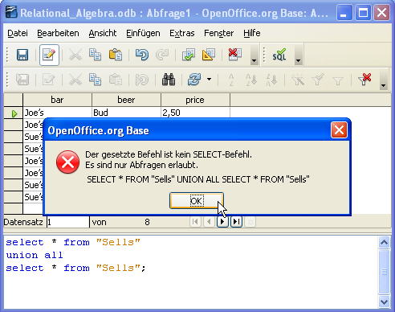
UNION and UNION ALL do not work in design mode.

Slide 66
Native SQL mode vs. design mode
Sie können Ihre Abfrage direkt im SQL-Code formulieren. Dabei ist jedoch zu beachten, dass die spezielle Syntax von Ihrem verwendeten Datenbank-system abhängt.
Wenn Sie den SQL-Code von Hand eingeben, können Sie SQL-spezifische Abfragen anlegen, die nicht von der grafischen Oberfläche im Abfrageentwurf unterstützt werden. Diese Abfragen müssen im Native-SQL-Modus ausgeführt werden.
(OpenOffice Base help)

Slide 67
Native SQL mode vs. design mode
Im Native-SQL-Modus haben Sie die Möglichkeit, SQL-Befehle einzugeben, die nicht von OpenOffice.org interpretiert, sondern direkt an die Datenquelle übergeben werden. Wenn Sie diese Änderungen nicht in der Entwurfsansicht anzeigen, kann nicht mehr in die Entwurfsansicht zurückgeschaltet werden.
Bei einem Native SQL wird der SQL-String direkt an das angeschlossene Datenbank-System weitergegeben, ohne vorher vom OpenOffice.org ausgewertet zu werden. Greifen Sie beispielsweise per ODBC-Schnittstelle auf eine Datenbank zu, dann wird der SQL-String an den ODBC-Treiber übergeben und von diesem verarbeitet.

Slide 68
Some SQL commands
select bar,beer,price,addr from Sells,Bars where bar=name;
select * from Sells, Bars where bar=name;
select Sells.bar, Bars.* from Sells, Bars;
select t1.*, t2.* from Sells t1, Bars t2 where t1.bar=t2.name;
select * from Sells where name like 'Jo%';
select * from Sells where name = 'Joes';
select * from Sells where name = ' Joes'; ↓ blank in const.
select t1.*,t2.* from Sells t1, Sells t2; where t1.price = t2.price and t1.bar != t2.bar;
select beer,bar,price from Sells where price between 2 and 2.6;
select beer,bar,price from Sells where price >= 2 and price <= 2.6; (same as above)

Slide 69
Some SQL commands
DRUNKEN PIRATE BREWERY
SELECT "Salary Type", SUM("Salary Amount") FROM "Employee" GROUP BY "Salary Type";
SELECT "Customer State", count("Customer State") FROM "Customer" group by "Customer State";

Slide 70
Exercises with For Ladies Database

Slide 71
Paste table "Customer"
Open "For_Ladies_Imported.odb" in OpenOffice Base
Open "For_Ladies_Decomposed.ods" in OpenOffice Calc
Select in OOCalc tuples of "Customer" including heading, copy (<Ctrl>-C)
Change to OOBase and paste (<Ctrl>-V): Table name "Customer", all columns, no special column settings, no primary key.

Slide 72
Paste table "Customer"
In OOBase right klick on table "Customer" and select "edit" ("bearbeiten")
Change data type of attribute "Customer_ID" to integer[INTEGER]
Select primary key: Right klick on the row heading (left most column) of row "Customer_ID" and select "primary key" from context menu.
Save table changes.

Slide 73
Paste table "Employee"
Follow the same procedure as with table "Customer".

Slide 74
Paste table "Product"
In OOCalc change numeric format of cells to 'English (USA)' with decimal separator '.'
Copy-Paste to OOBase.
Change attribute types where necessary and select primary key. Use attribute type "float" for floating point numbers and "integer" for integer.

Slide 75
Paste table "Order"
Change date format of cells to ISO: 'JJJJ-MM-TT'
Copy/paste to OOBase.
Change attribute types where necessary and select primary key.

Slide 76
Paste table "Order Detail"
Copy-Paste to OOBase.
Change attribute types where necessary.
Primary key is composed of two attributes (Order_ID, Product_ID): select both lines (holding <Ctrl>-key down), right klick and choose primary key.

Slide 77
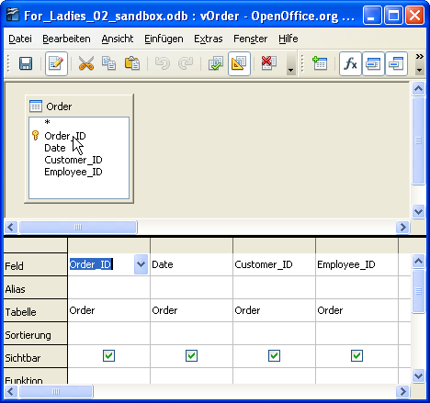
Create view ("Abfrage") vOrder in design mode
vOrder (Order_ID , Date , Customer_ID , Employee_ID)

Slide 78
Insert new "Order"
In table Order (or view vOrder) klick on the last empty line and insert the following tuples (press <enter> after each new line): (9 , , 4 , 4) (10 , , , )
What do you experience? What do you think?

Slide 79
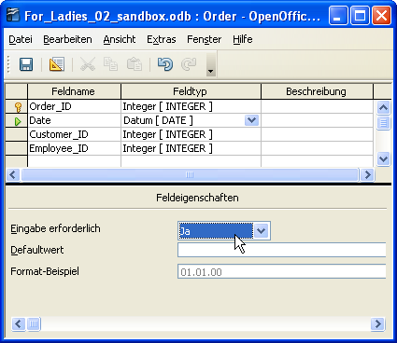
Add constraints to table "Order" for integrity and correctness
HSQLDB, direct SQL: alter table "Order" alter column "Date" set not null

Slide 80
Insert new "Order"
Insert the following tuple: (11 , 1.12.09 , 5 , 5)
What do you experience? What do you think?

Slide 81
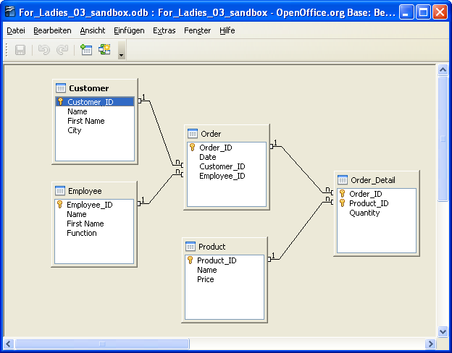
Referential Integrity: Relationships (Beziehungen)

Slide 82
Let's start analysis

Slide 83
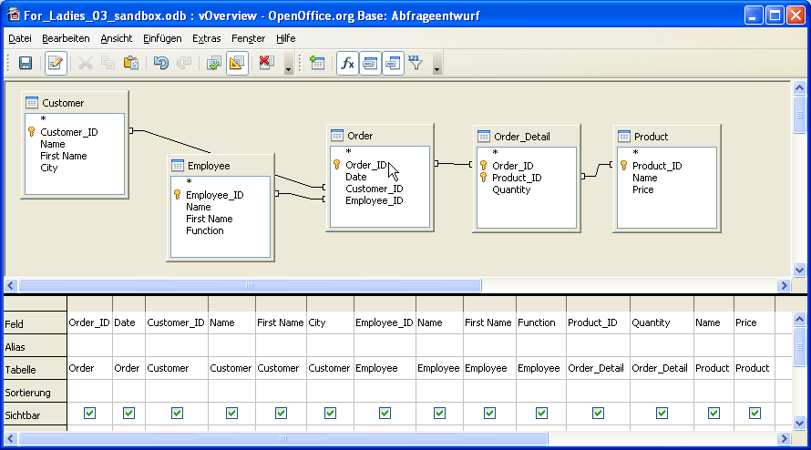
Create view "vOverview" with all tables and distinct columns
Create a "Natural Join", same attributes only once:

Slide 84
vOverview
vOverview looks like initial spreadsheet.
What is the difference?
What have we accomplished?
Check anomalies ...

Slide 85
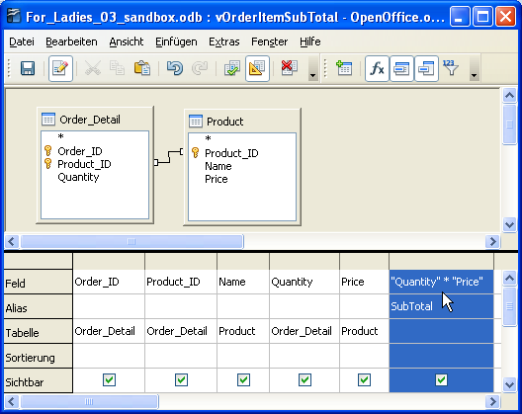
Create view "vOrderItemSubTotal": extended projection
"Quantity" * "Price" as "SubTotal"

Slide 86
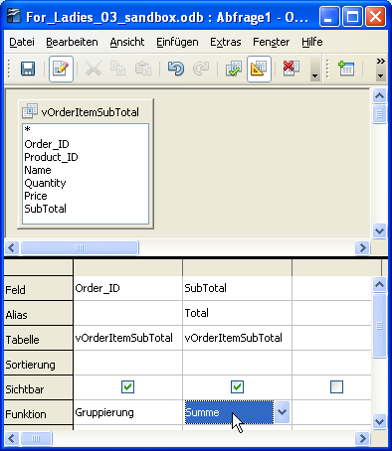
Create view "vOrderTotal": "group by"-clause
select "Order_ID", sum("SubTotal") as "Total" from "vOrderItemSubTotal" group by "Order_ID"

Slide 87
Now we have:
vOverview: like initial spreadsheet start
vOrderItemSubTotal: Price * Quantity
vOrderTotal: Total of each order
Generate a list of orders with customer, employee, and total of each order.

Slide 88
Play with referential integrity
Insert new customer.
Caputure an order (Order ID 111) for this customer.
Fill the order with products.
Look at the data with view "vOverview".
Delete Order 111.
What happened to order details? What happened to the products? Explain!

Slide 89
Let's create a simple DB application: Form ("Formular")
Create view vOrderCustEmp comprising the tables Order, Customer and Employee.
Together we create the form based on vOrderCustEmp with subform vOrderItemTotal

