Slide 1

N26
Master 1 Finance · Gestion de bases de données financières · Arthur Le Maire – Thomas Philippotin

Slide 2
Company Overview
2013
8M+
24
Founded in Berlin
Customers
Markets in Europe
Full banking license issued by the European Central Bank
Evolved from a simple payment app into a full financial super-app
Core values: Simplicity, Transparency and Innovation
Mobile-first model: customers onboarded in minutes, fully online

Slide 3
Why N26?
THE PROBLEM
BAFIN SANCTIONS
Onboards thousands of customers per day
Fraudulent account openings
No physical branch, no face-to-face check
Insufficient KYC verification
Fully automated = attractive for criminals
Delays in reporting suspicious activity
Sanctioned by BaFin multiple times
Weaknesses in AML controls

Slide 4
Why a Hybrid Architecture?
Fraud detection is multi-dimensional — no single database can cover all of it.
Transactions
Relationships
Behaviour
Identity
Financial integrity
& ACID compliance
Networks, mules
& circular flows
Velocity anomalies
& risk scores
KYC documents
& verification
SQL
Graph
Time-Series
Document

Slide 5
The 4-Database Architecture
01
SQL Database
ACID compliance · Financial integrity · Regulatory reporting
The Core
02
Graph Database
Money mule networks · Circular flows · Hidden account links
The Network
03
Time-Series DB
Transaction velocity · Real-time anomaly detection · Risk scores
The Behaviour
04
Document DB
Flexible KYC schema · Identity docs · Duplicate passport detection
The KYC

Slide 6
Synthetic Dataset
30
400+
3
Accounts
Transactions
CSV files
SMURFING PATTERN
DATASET DETAILS
1. SOURCE accounts send large sums (8k–25k€)
accounts.csv — 30 profiles with KYC level
2. HUB accounts receive & fragment the money
transactions.csv — all flows with flags
3. MULE accounts receive many payments < 950€
aml_flags.csv — automated AML alerts
4. Always below the €1,000 detection threshold
Generated in Python · 100% synthetic

Slide 7
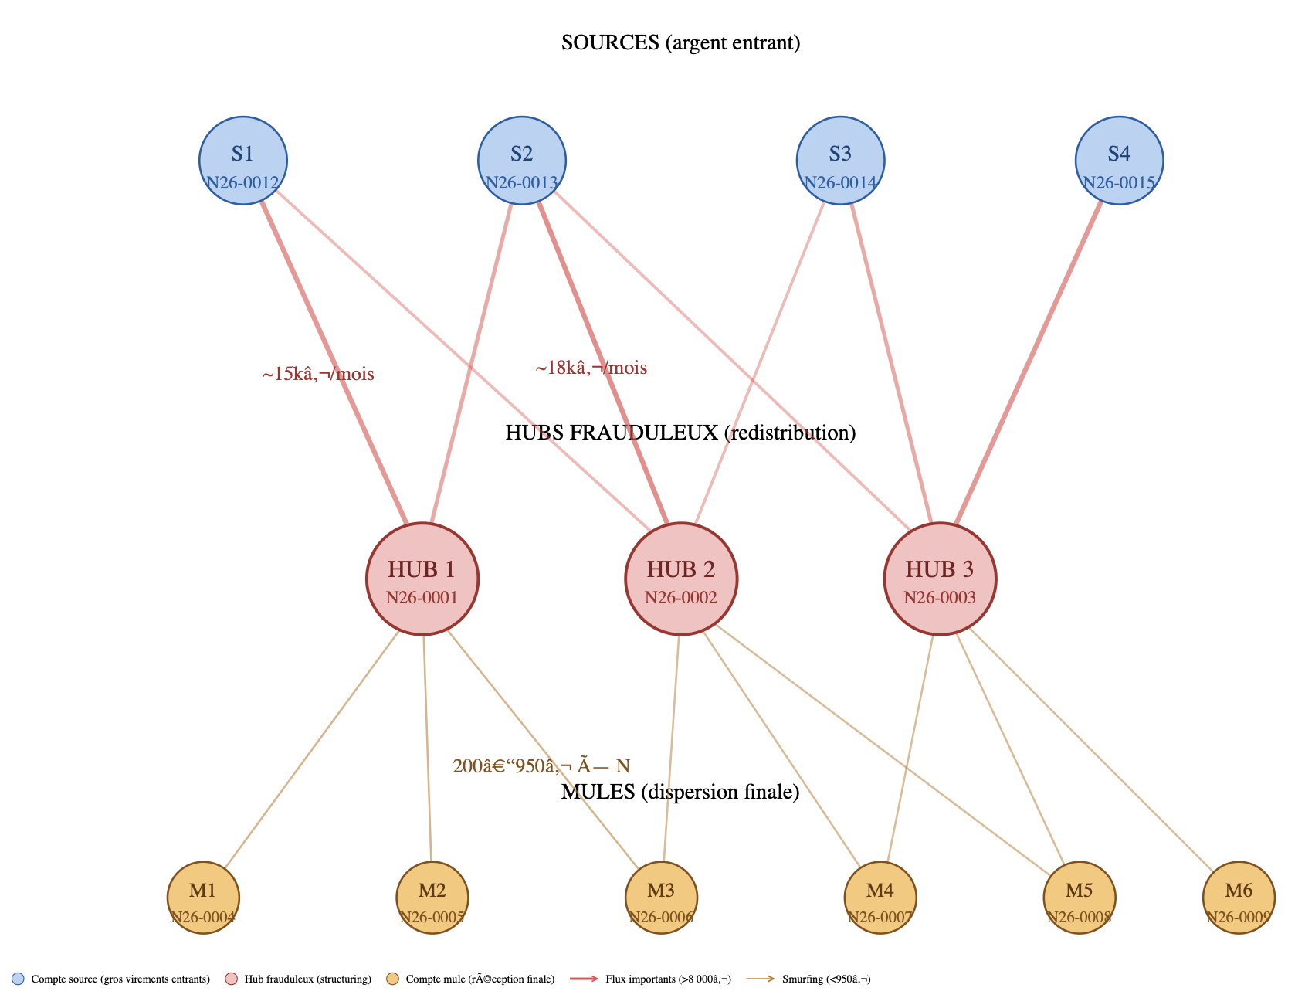
Fraud Network — Graph Visualization

Slide 8
Conclusion
SQL guarantees financial integrity and ACID compliance
Graph DB reveals hidden fraud networks invisible to SQL
Time-Series DB detects velocity anomalies in real time
Document DB addresses the KYC weaknesses sanctioned by BaFin
Long-term vision: automate AML detection — given any account, the system analyzes its transaction graph and flags suspicious patterns automatically.

Slide 9
N26
Thank you for your attention!
Master 1 Finance · Gestion de bases de données financières · Arthur Le Maire – Thomas Philippotin

