Slide 1
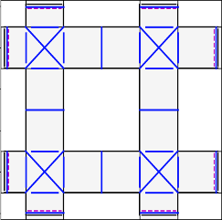
Exit 7
Waypoint 8
Exit 8
Exit 6
Exit 1
Waypoint 3
Waypoint 6
Waypoint 7
Exit 5
Exit 2
Exit 4
Exit 3

