Slide 1

Machine Learning Classification Likelihood that a consumer clicks on an ad
Hellen Wainaina

Slide 2
Agenda
Improving Click Through Rate
Background / Business Problem 3
Executive Summary / Key Takeaways 4
Analysis – Data Set Characteristics 5
Analysis – EDA 6-11
Analysis – Cleaning & Pre-processing 12,13
Analysis – Modelling, Tuning & Evaluation 14
Analysis – Key Results & Recommendation 15
Next Steps & Improvements 16
Appendix 17-19

Slide 3
Business Problem
Situation
Media conglomerate company X has a network of different websites within its network and would like to run a certain ad for company A which is selling product M. The company is willing to pay the media company $25 for each successful click up to a maximum of $40,000 and is looking to create awareness about product M. Company X has 10 websites within its network that have a target audience that would be likely to click on the ad based on data from previous campaigns with companies selling similar products. However, company A is only interested in running on two websites.
Complication
The media conglomerate would like a model saved in a pickle that they can use to test on data from other websites to see which ones are likely to have the highest number of clicks. This would ensure that they run the ads on the top 2 websites where they are likely to drive the most clicks to the site and therefore secure the full amount of $40,000. If the goal is not met by this campaign company X will not secure the full amount and will potentially lose any future business with Company A estimated at a minimum of $300,000 per year.

Slide 4
Executive Summary
The goal was to build a model with an accuracy above 95%, the model presented in this project has an accuracy of 97.25%
Hyperparameter tuning was useful in improving model accuracy
The key features in predicting the likelihood that a person on the site would click on an ad were time spent online and, on the website

Slide 5
Data Set Characteristics and Information
CHARACTERISTICS
The dataset used for this project has 1018 rows and 10 columns.
There were 4 missing values in the target variable column and 7 duplicated values.
FEATURES
Daily Time Spent on Site: The time spent on the site in minutes
Age: Customer age in years
Area Income: Avg. Income of geographical area of consumer
Daily Internet Usage: Avg. time in minutes a day consumer is on the internet
Ad Topic Line: Headline of the advertisement
City: City of consumer
Male: Whether the consumer was male
Country: Country of consumer
Timestamp: Time at which consumer clicked on Ad or closed window
Clicked on Ad: 0 or 1 indicated clicking on Ad (Target Variable)

Slide 6
EXPLORATORY DATA ANALYSIS

Slide 7
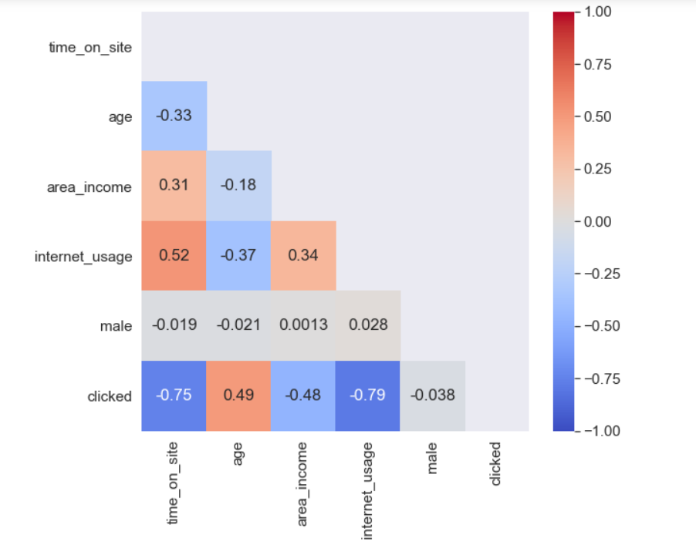
Internet Usage and Time on Site highly correlated with target variable
There is a strong correlation between the target variable and other numerical features except for the gender
Time on site and internet usage have the highest negative correlation with the target variable
Age has a positive correlation with the target variable

Slide 8
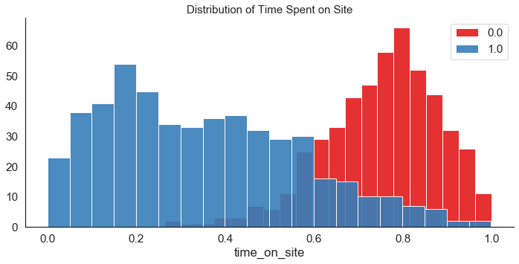
Consumers who spent less time on site more likely to click on the ad
Time on site is likely to be an important feature in our model since there is a good distinction between the people who clicked on the ad and those that did not
The avg time that the consumers spent on this site was 65 mins with the minimum time based on this dataset as 32mins
Notes:
This means that the model would only be fitting for this site since the min for other sites might be different and it might still lead to people clicking on the ad

Slide 9
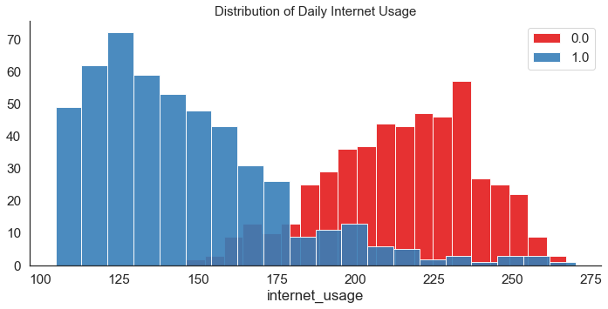
Audiences who spent less time on the internet were more likely to click on the ad
The avg daily internet usage for the consumers on this dataset is ~3hours. The minimum amount of time spent online based on this dataset was ~24mins
Consumers who spent less time on the internet were more likely to click on the ad
There’s a good distinction between consumers who clicked on the ad and those that did not and therefore there’s a high likelihood that internet usage will be an important feature in our model
Notes:
This means that the model would only be fitting for this site since the min for other sites might be different and it might still lead to people clicking on the ad

Slide 10
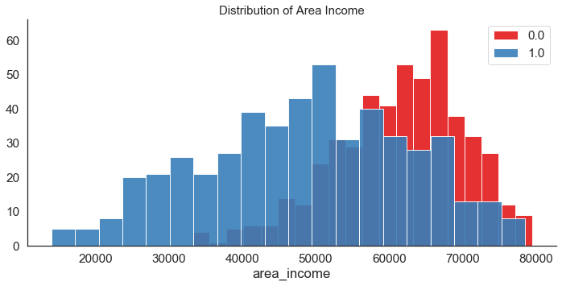
Audiences in high income areas less likely to click on the ad
There's an even distribution for consumers who are likely to click on the ad. The average area income for people in this dataset is ~$55K.
Consumers who were less likely to click on the ad live in higher income areas. This was also reflected in the correlation chart
A likely explanation is that the consumer living in a higher income area does not resonate with the ad
Notes:
This means that the model would only be fitting for this site since the min for other sites might be different and it might still lead to people clicking on the ad

Slide 11
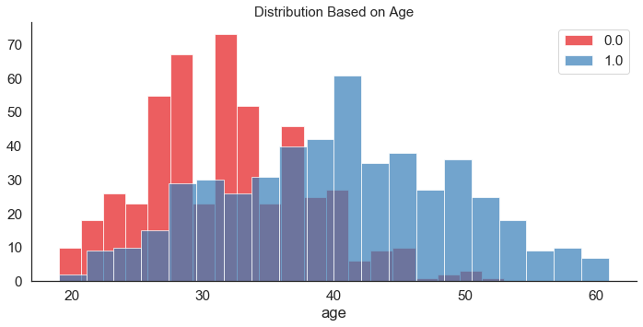
Younger audiences were less likely to click on the ad
There's an even distribution of people who are likely to click on the ad. However, younger consumers were less likely to click on the ad which might be due to the product/service sold by company B
A brand study might be useful in revealing more information
Notes:
This means that the model would only be fitting for this site since the min for other sites might be different and it might still lead to people clicking on the ad

Slide 12
Data Cleansing & Pre-processing
Categorical Features
This dataset contains two categorical features, the target variable ( whether the audience clicked or did not click) and the gender (whether the audience was male or not).
Both are almost even at around 50% each.
Since the number of observations in this dataset that clicked on the ad is about 50%, to preprocess the data we do not carry out resampling
The target column had 4 null value and those were removed from the data set entirely since it would not be accurate to impute those values. However, it would still be helpful to investigate why they were missing in the first place

Slide 13
Data Cleansing & Pre-processing
Numerical Features
This dataset consists of data on time spent on site, internet usage, area income and age
Age and area income had skewed distributions and therefore were log transformed to avoid introducing bias to this model
Other Features
Ad topic line would be best analyzed using a natural language processing model which merits its own project and is not pursued here
Timestamp would also be best analyzed using a time series model
The dataset contains too many countries (237) and too many cities (969) and the assumption is that they will not have a very strong predictive power and are thus eliminated

Slide 14
Modelling, Tuning & Evaluation
Model Selection
Model Evaluation
Since this is a classification problem, a logistic regression model was used
In terms of hyper parameter tuning, the initial range focused on a C value between 0.001 and 1000. The results showed that a value of 1 was closer to the best value of C. The next evaluation was with values between 0.01and 10 and the best value was 3.34 which was the value used in this model
The model was evaluated based on its accuracy and F score
Initially, accuracy was at 95.50%, the model was tuned and that improved accuracy to 97.25%
The initial F score was 95.77%, after hyperparameter tuning this increased to 98.25%
Model Performance Results
The model selected had a final accuracy score of 97.25% and an F Score of 98.25%. In future, this model can be tuned further, and additional data could be added based on availability. This would likely improve performance

Slide 15
Analysis Results & Recommendations
Key Predictors
Internet usage and time on site were the most important predictors of whether the consumer would be more likely to click on the ad. The next important factors were age and income. The gender had an almost negligible effect on predicting the outcome.
Model Performance
The model has an accuracy of 97.25% and an F score of 98.25%
Business Recommendation
Since the different websites have high traffic, it would be very useful to test this model on all their data and select the top 2 websites. Most websites make over 100,000 impressions and therefore with a model with a 97.25% accuracy, we should be able to acquire more than 1600 clicks.

Slide 16
Next Steps & Improvements
This dataset was originally posted on Kaggle, however the dataset used in this project is from DSDJ
Project/Approach Improvements
Lessons learned
Consider testing more models such as gradient boosting and random forest to determine their accuracy score
A time series model would be useful in determining the time the ad was clicked on the most
It would also be helpful to carry out natural language processing to determine whether there was a specific ad topic line that more users resonated towards
Although time spent online is a useful indicator as to whether someone would click on the ad, this is obvious since one would have to be online to click on the ad. More useful indicators would be the education background of the consumer and their interests and affinities

Slide 17
Appendix

Slide 18
Assumptions
The dataset is balanced at 50%.Real world datasets are not likely to be balanced. CTRs are usually very low at about 1-3% of the impressions served and therefore more representative data would be useful
The company is compensated based on the number of clicks; most websites are compensated based on the number of impressions made

