Slide 1
Autoencoder

Slide 2
Outline
Simple autoenocder, deep autoencoder and convolutional autoencoder
Two dimensional code visualization
Generate new image with decoder
Classify image with encoder

Slide 3
Outline
Simple autoenocder, deep autoencoder and convolutional autoencoder
Two dimensional code visualization
Generate new image with decoder
Classify image with encoder

Slide 4
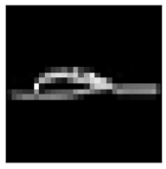
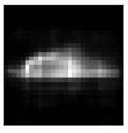
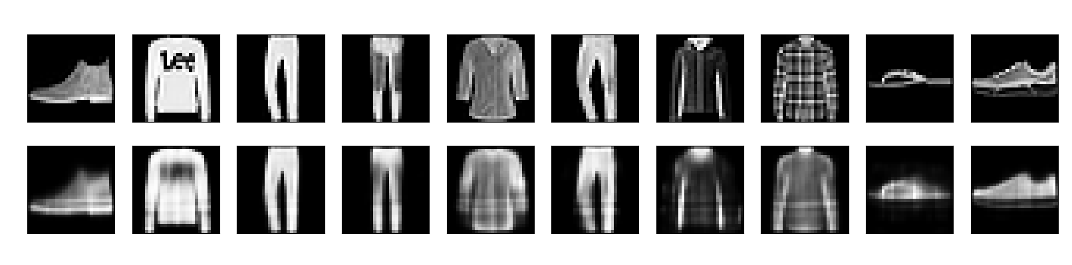
Simple Autoencoder(hw6)
784
784
32
Code

Slide 5
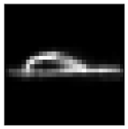
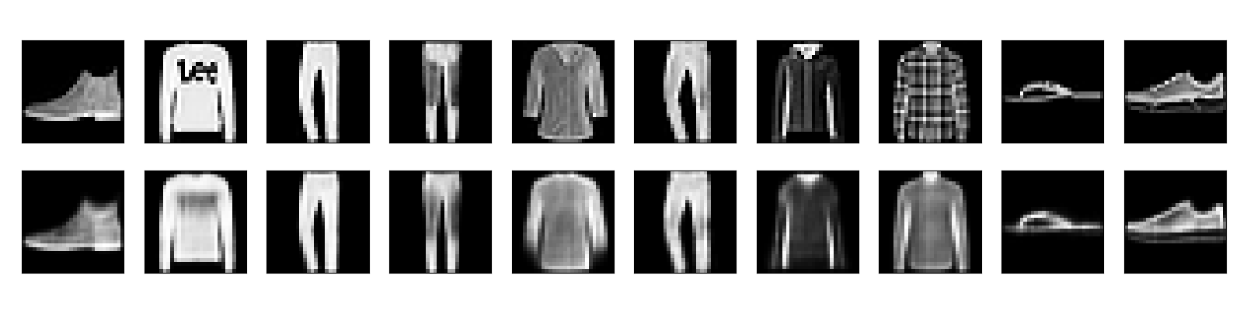
Deep Autoencoder
784
784
128
128
64
64
32
Code

Slide 6
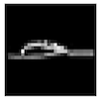
Convolutional Autoencoder
Convolution
Unpooling
Pooling
Deconvoltion
Convolution
Code
Unpooling
Pooling
Deconvoltion
(7,7,8)

Slide 7
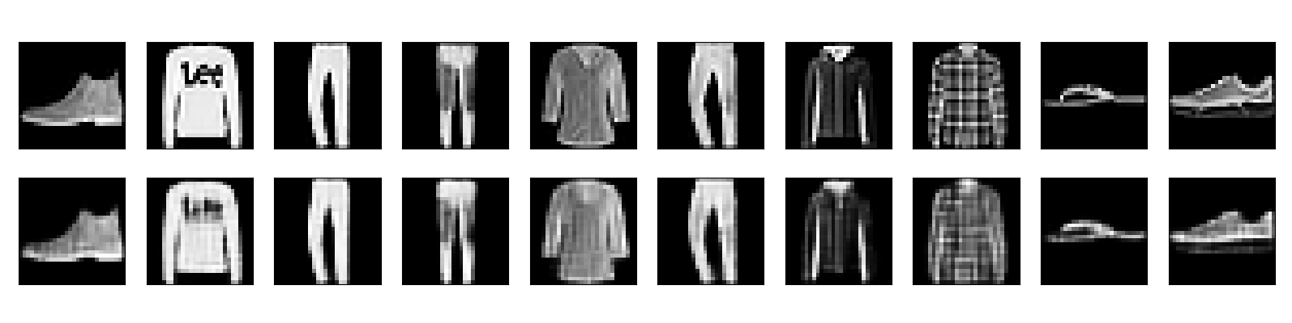
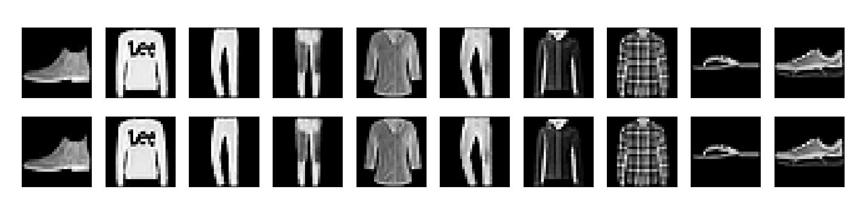
Convolutional Autoencoder(Cont.)

Slide 8
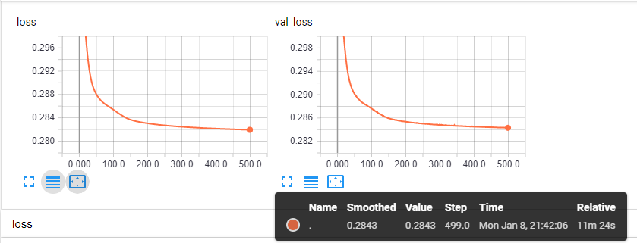
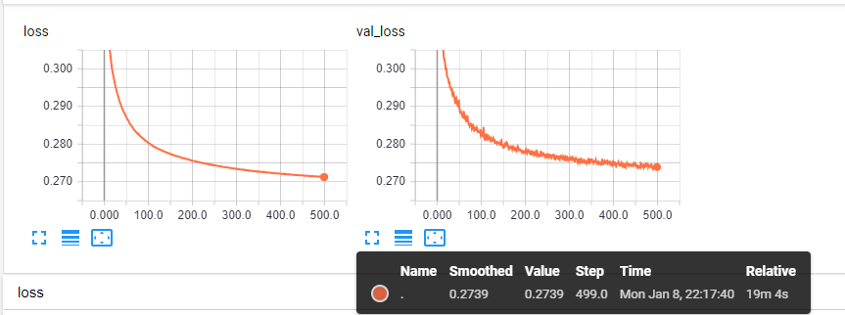
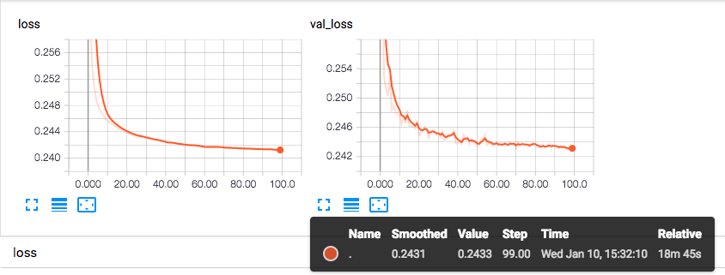
Simple
Val_loss
0.2843
Deep
0.2739
Best
Convolutional
0.2431

Slide 9
Outline
Simple autoenocder, deep autoencoder and convolutional autoencoder
Two dimensional code visualization
Generate new image with decoder
Classify image with encoder

Slide 10
Visualization
784
784
128
128
64
64
2
Code

Slide 11
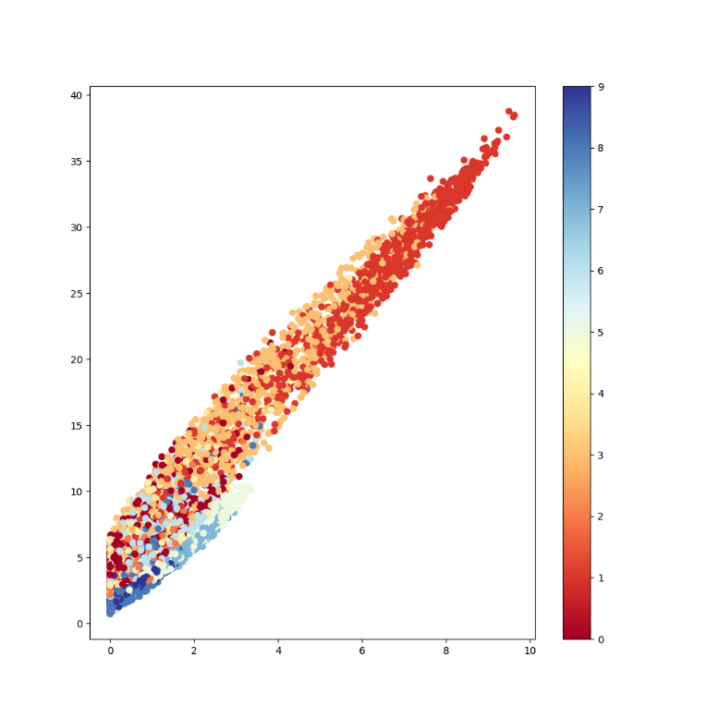
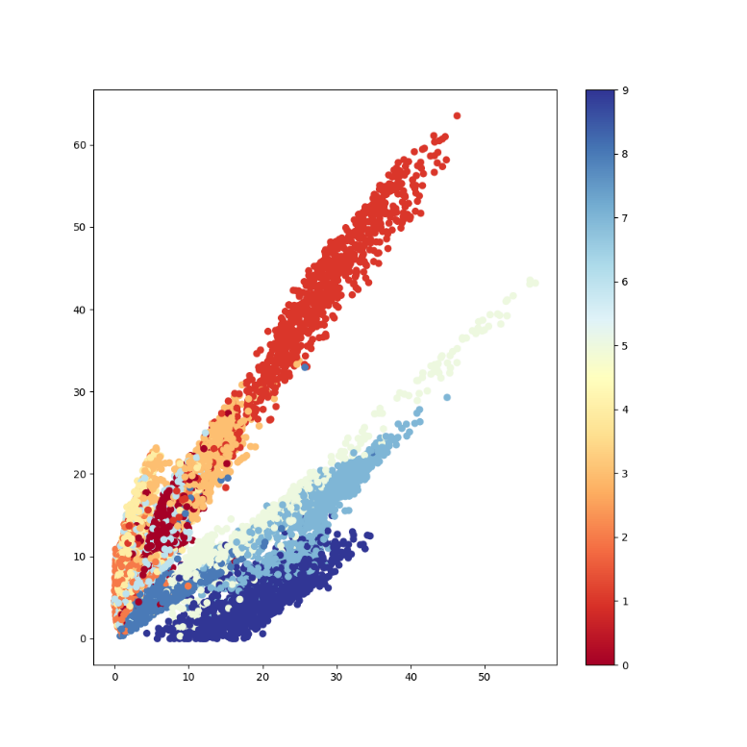
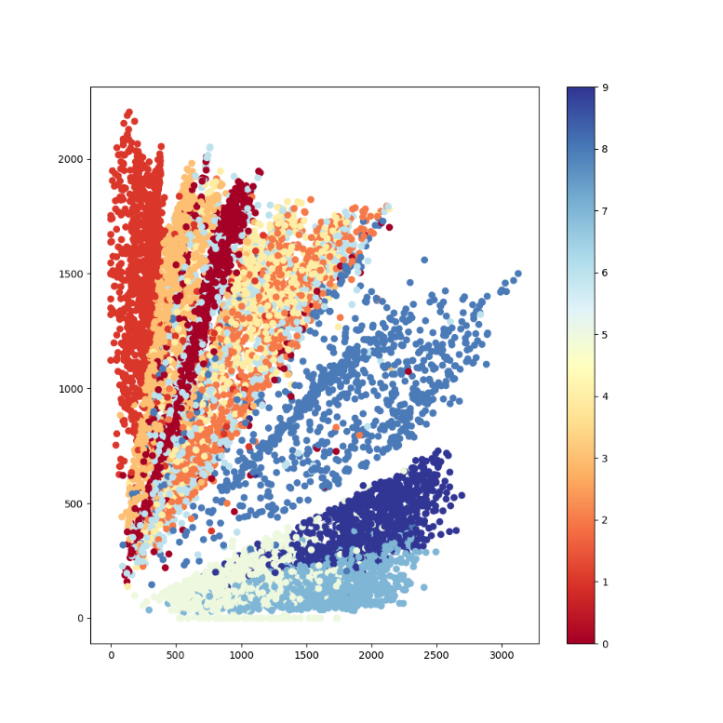
Visualization(Cont.)
1 epoch
10 epoch
100 epoch

Slide 12
Outline
Simple autoenocder, deep autoencoder and convolutional autoencoder
Two dimensional code visualization
Generate new image with decoder
Classify image with encoder

Slide 13
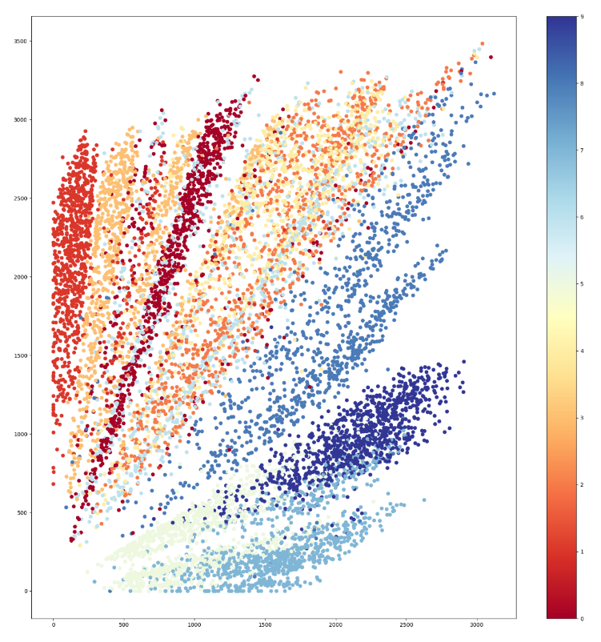

Use decoder to generate new image
Decoder
2
Code
Decoder

Slide 14

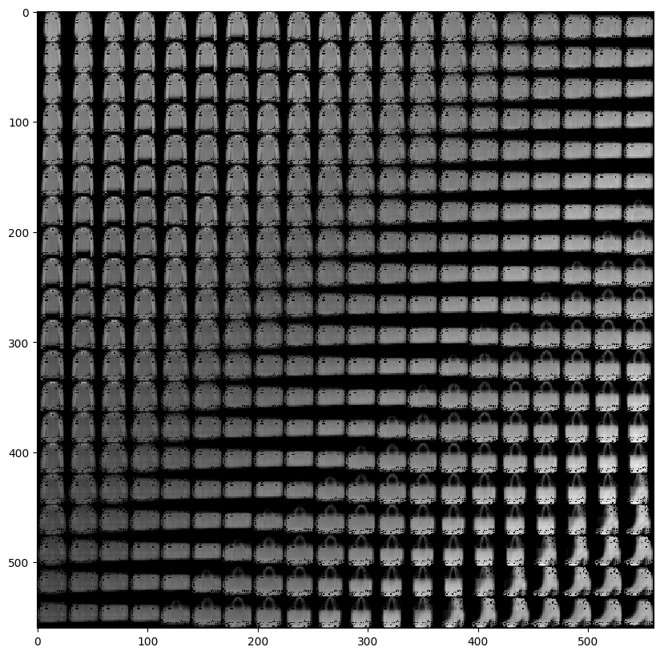
Use decoder to generate new image(Cont.)

Slide 15
Outline
Simple autoenocder, deep autoencoder and convolutional autoencoder
Two dimensional code visualization
Generate new image with decoder
Classify image with encoder

Slide 16
Use encoder to classify image
Encoder
32
Kmean
Label = 5
Code
…….
Label = 5
Label = 4
Label = 3
Label = 9

Slide 17
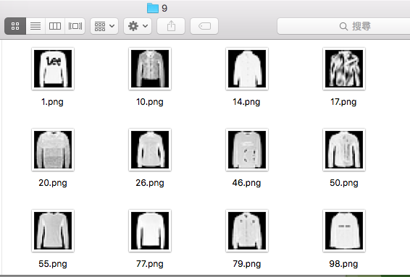
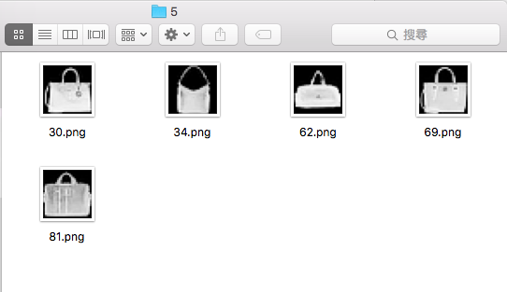
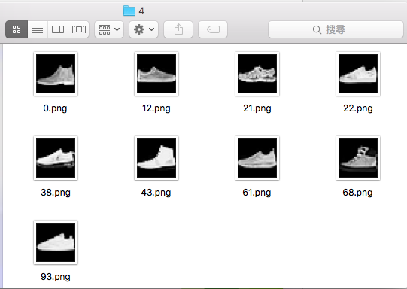
Use encoder to classify image

Slide 18
Reference
ML Lecture 16: Unsupervised Learning - Auto-encoder http://speech.ee.ntu.edu.tw/~tlkagk/courses/ML_2017/Lecture/auto.pdf
Building Autoencoders in Keras https://blog.keras.io/building-autoencoders-in-keras.html
https://github.com/WaitingLin/Autoencoder
Code

