Slide 1
NYC Taxi Fare Prediction
Predicting trip fares with machine learning — and a web app to use it
Wai Yan Tun
Python Programming — Pre Course Project
Notes:
Open: this project predicts the fare of an NYC taxi trip from its details, and wraps the trained model in a small web app. Two halves: train a model on Kaggle, then serve it through an app. Plan to spend ~15 minutes; keep ~1 minute per slide.

Slide 2
The Problem & Goal
Taxi fares depend on how far you go, when you travel, and the rate type. Can a model learn that relationship from past trips and estimate the fare before the ride?
Model
Random Forest regressor
Project goals
Build a model that predicts the base meter fare accurately
Compare models honestly with proper metrics
Deliver a simple web app anyone can use
Evaluation
RMSE · MAE · R²
Web App
Streamlit, runs locally
Notes:
Frame the problem in plain terms: fare is driven mainly by distance, plus time of day and rate type. The goal is three deliverables: a model, an honest evaluation, and a usable app. Stress 'honest' — we will report real numbers, including weaknesses.

Slide 3
The Dataset
Cleaned NYC Yellow Taxi trip records (2025 sample) from Kaggle
Each row is one taxi trip: distance, pickup time, passengers, rate type, and the fare charged
Millions of trips — large enough to train a reliable model
Prediction target
fare_amount
The base time-and-distance meter fare.
Tips, tolls and surcharges are NOT part of the target — they are added on top of the meter fare.
Source: Cleaned NYC Taxi Trip Data 2025 Sample (Kaggle).
Notes:
Describe one row = one trip. The key decision is the target: fare_amount, the pure meter fare. Tell the audience we will see in a moment why we deliberately do NOT predict total_amount.

Slide 4
Avoiding Data Leakage
Some columns are only known AFTER the trip, or are pieces of the total bill. Using them would let the model 'see the answer'. We keep only what is known at the start of a trip.
Used as input ✓
Excluded — would leak ✕
trip_distance (miles)
passenger_count
pickup time → hour, day of week, month
RatecodeID (rate type)
total_amount (includes everything)
tip_amount, tolls_amount
extra, mta_tax, congestion, airport_fee
dropoff time (unknown before the trip)
total_amount = fare + tips + tolls + surcharges. Predicting it would be circular — the answer is baked in.
Notes:
This is the slide that shows understanding. Explain leakage simply: if you train on total_amount you are basically handing the model the fare plus extras. Dropoff time leaks trip duration. Examiners love this point — emphasise it.

Slide 5
Features Used
Feature | What it is
trip_distance | Trip distance in miles (strongest predictor)
passenger_count | Number of passengers
hour | Hour of pickup (0–23), from pickup time
day_of_week | Day of week (0 = Monday … 6 = Sunday)
month | Month of the trip
rate_1 … rate_6 | Rate type, one-hot encoded (1 = Standard, 2 = JFK …)
Why one-hot the rate code? The codes are labels, not a scale — rate 2 is not 'twice' rate 1 — so each becomes its own yes/no column.
Notes:
Walk the table quickly. Highlight that hour/day/month are engineered from the pickup datetime — the same engineering is repeated later in the app. Explain one-hot encoding for the rate code in one sentence.

Slide 6
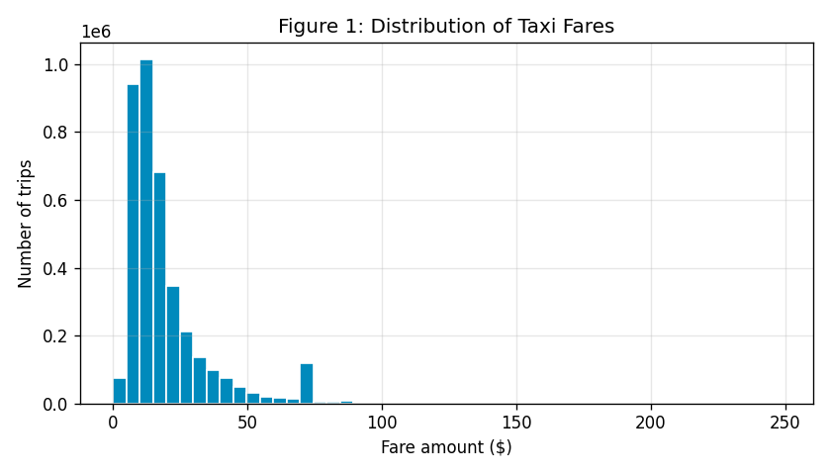
Where Do Fares Fall?
Most trips are cheap
Most fares sit between about $5 and $25
The shape is right-skewed: a long tail of expensive trips
A small spike near $70 — these are the JFK Airport flat-rate trips
Figure 1 — Distribution of taxi fares
Notes:
Point at the tall bars on the left: the typical trip is short and cheap. Mention the right skew, and call out the little bump near $70 — that is the JFK flat rate, which comes back on the next slides.

Slide 7
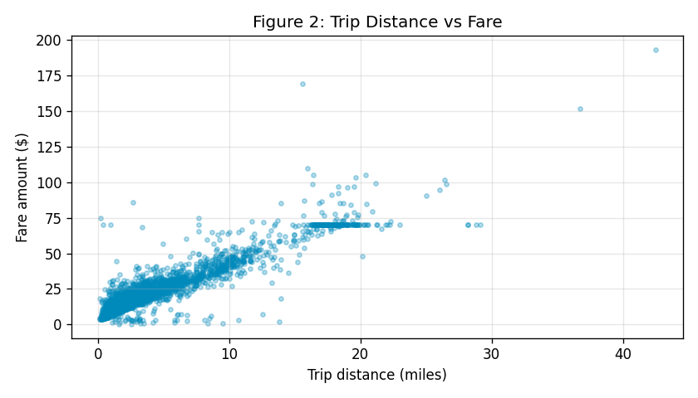
Distance Drives the Fare
The core relationship
Clear upward trend: longer trips cost more
The points form a tight band — distance explains most of the fare
The flat horizontal line near $70 is the JFK flat rate (same price regardless of distance)
Figure 2 — Trip distance vs fare
Notes:
This is the most important EDA chart. The tight diagonal band tells us a model should do well. Explain the flat $70 line: JFK trips charge a fixed fare, so distance does not change them.

Slide 8
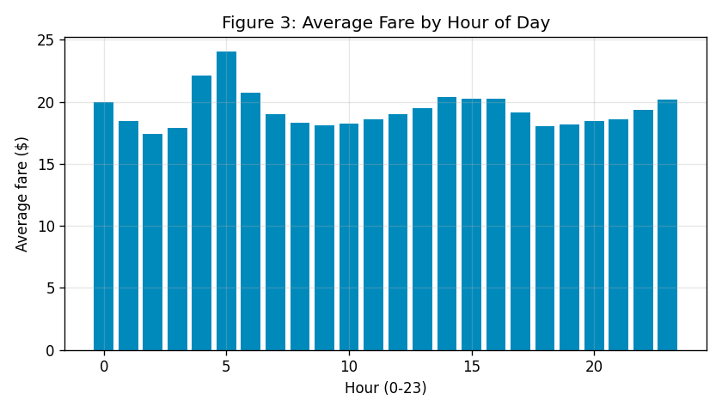
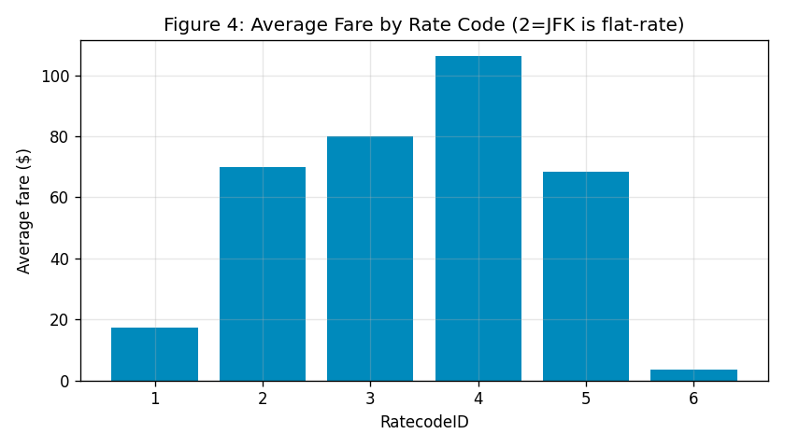
Patterns in Time and Rate Type
Average fare is fairly steady by hour, with a small early-morning bump.
Rate type matters a lot: standard (1) is cheap; airport / out-of-city rates are far higher.
Figure 3 — Average fare by hour • Figure 4 — Average fare by rate code
Notes:
Two quick reads. Left: hour of day barely changes the average fare — note the small spike around 5am. Right: rate type is a big lever — standard trips are ~$17, airport and special rates are $70+. This is why we kept the rate code as a feature.

Slide 9
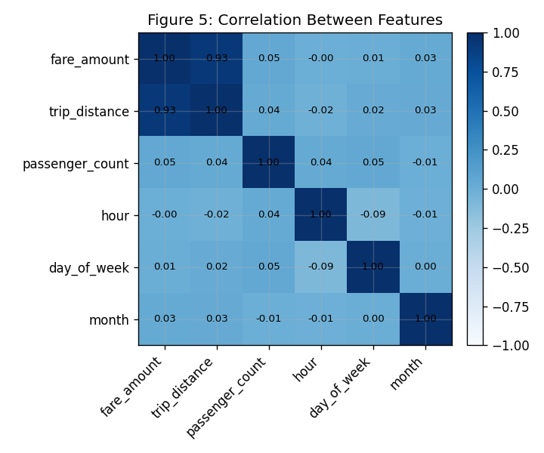
What Correlates with Fare?
Distance is king
trip_distance has a very strong 0.93 correlation with fare
hour, day, month and passenger_count are all near zero
This tells us early that a distance-based model will be strong
Figure 5 — Correlation between features
Notes:
Read the top-left of the matrix: fare vs distance is 0.93 — very strong. Everything else is near zero. This foreshadows the feature-importance result later: distance does almost all the work.

Slide 10
How the Model Was Built
1
Clean data
2
Engineer features
3
Encode rate code
Drop bad fares, distances and rate codes
hour, day, month from pickup time
One-hot into rate_1 … rate_6
4
Split 80 / 20
5
Train two models
6
Evaluate
Train on 80%, test on unseen 20%
Linear Regression and Random Forest
Compare RMSE, MAE and R²
Notes:
Walk the six steps left to right, top to bottom. Emphasise step 4: we test on data the model never saw, so the scores are honest. Random Forest is an average of many decision trees; Linear Regression is the simple baseline.

Slide 11
How the Project Is Built
Library | Used for
pandas | Load and clean the data
scikit-learn | Build models, measure accuracy
matplotlib | Create the charts
joblib | Save and load the model
streamlit | Build the web app
taxi-fare-prediction/
├─ taxi-fare-prediction.ipynb (training)
├─ app.py (web app)
├─ fare_model.pkl (saved model)
└─ README.md
Flow: train in the notebook → save the model → the app loads it.
Notes:
Frame this as a programming slide. Three files: the notebook trains and saves the model, app.py serves it, and the .pkl connects them. Then explain each library and why I chose it. This shows program design, not just ML.

Slide 12
Key Code — Building the Features
# Create time features from pickup time
col = "tpep_pickup_datetime"
df[col] = pd.to_datetime(df[col])
df["hour"] = df[col].dt.hour
df["day_of_week"] = df[col].dt.dayofweek
df["month"] = df[col].dt.month
# One-hot encode the rate type
dummies = pd.get_dummies(
df["RatecodeID"], prefix="rate")
X = pd.concat([X, dummies], axis=1)
Convert the text timestamp into a real datetime
Pull out hour, day of week, and month
get_dummies turns the rate code into rate_1 … rate_6
These columns become the model's inputs
Notes:
Walk through the code line by line. Emphasise that I engineered new columns from a raw timestamp — that is real Python data work. get_dummies is how the rate code becomes six yes/no columns. The yellow line builds the final feature table.

Slide 13
Key Code — Train, Compare, Save
# Train two models
lr = LinearRegression().fit(X_train, y_train)
rf = RandomForestRegressor(
n_estimators=30, max_depth=12,
min_samples_leaf=50, random_state=42
).fit(X_train, y_train)
# Keep whichever has the lower error
best = rf if rf_rmse <= lr_rmse else lr
# Save model AND feature order together
joblib.dump({"model": best,
"features": feature_cols},
"fare_model.pkl")
Train a simple baseline and a Random Forest
Pick the better model automatically by error
Save the model AND its feature list in one file
So the app can rebuild the same columns later
Notes:
Highlight two programming ideas: an if-expression that auto-selects the best model, and the bundle pattern in yellow — saving the model together with its feature list so the app never guesses the columns. This is the link between training and the app.

Slide 14
Real Problems I Solved
Out-of-memory crash
1
The Kaggle kernel kept dying while training. I trained on a sample and used a leaner Random Forest (fewer, shallower trees). The model file dropped from 1.28 GB to 7.2 MB — and accuracy slightly improved.
Library version mismatch
2
The saved model would not load on my laptop because the scikit-learn versions differed. I fixed it by matching the same version (1.6.1) used to train it.
Inputs must match the model
3
The app's columns must line up with training exactly. One line fixed it: reindex(columns=feature_cols, fill_value=0)
Notes:
This is a key slide for a programming class — it shows debugging skill. Tell each story briefly: the memory crash and how I made the forest leaner; the version mismatch; and the column-matching fix with reindex. Real bugs solved earn marks.

Slide 15
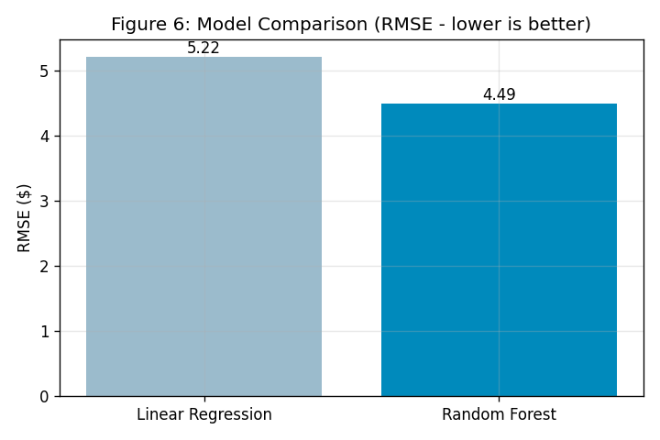
Results: Which Model Won?
Model | RMSE | MAE | R²
Linear Regression | 5.22 | 3.26 | 0.889
Random Forest | 4.49 | 2.63 | 0.918
Lower RMSE and MAE are better; higher R² is better. Random Forest wins on all three.
R²
0.918
of fare variation explained
MAE
$2.63
average error per trip
Notes:
State the verdict: Random Forest wins on every metric. Translate the numbers: R-squared 0.918 means it explains about 92% of fare variation; MAE 2.63 means the typical prediction is within about $2.63. RMSE is higher than MAE because a few long trips have big errors.

Slide 16
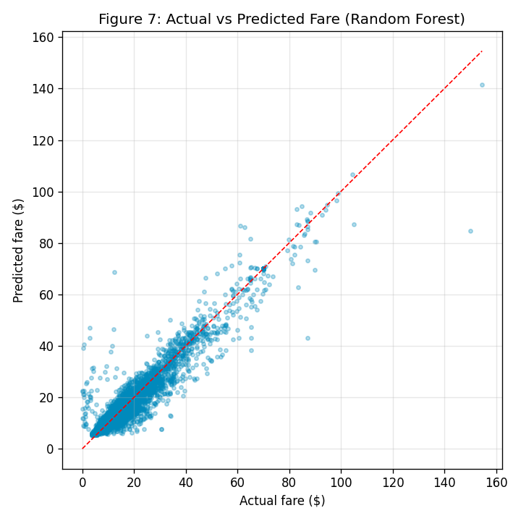
Does It Actually Work?
Predictions hug the line
Each dot is a test trip: actual fare vs predicted fare
Points cluster tightly along the red 'perfect prediction' line
Accuracy is strong for normal fares; a few very long trips are harder
Figure 7 — Actual vs predicted fare (Random Forest)
Notes:
Explain the red dashed line: if a prediction were perfect, the dot would land on it. Most dots are close to the line, which is visual proof the model works. Be honest: the spread grows for expensive trips.

Slide 17
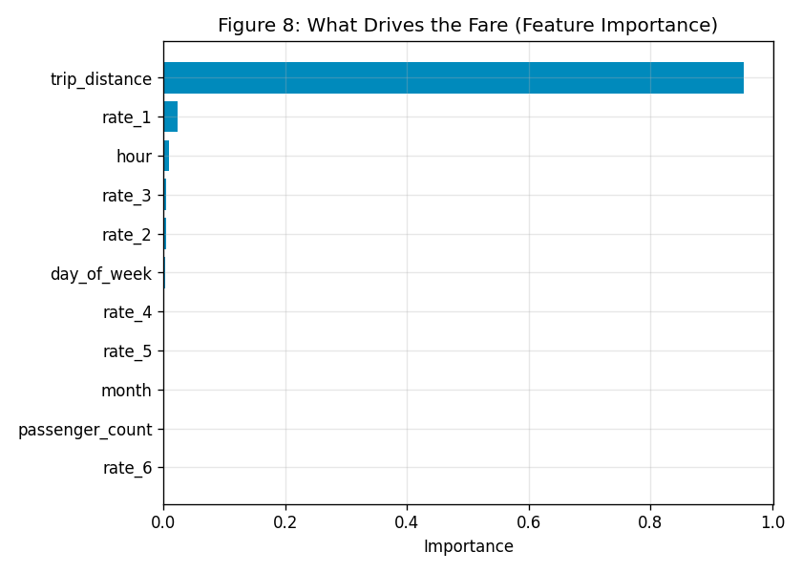
What Drives the Prediction?
One feature dominates
trip_distance accounts for about 95% of the model's decisions
Rate type and hour add small adjustments
Passenger count and month barely matter
Honest takeaway: this is essentially a smart distance-based estimator
Figure 8 — Feature importance (Random Forest)
Notes:
Connect back to the correlation slide: distance dominates, as expected. Be candid — most of the predictive power is distance. That is realistic for taxi fares, and it is fine to say so. The other features fine-tune the estimate.

Slide 18
From Model to Web App
The trained model is saved as a small file (fare_model.pkl, 7.2 MB)
The Streamlit app loads that file — it never needs the raw data
User enters distance, passengers, rate type and pickup time
The app rebuilds the exact same feature columns, then predicts
🚕 NYC Taxi Fare Predictor
Trip distance (miles)
3.5
Passengers
1
Rate type
Standard rate
Pickup
Key idea: the app reuses the same feature engineering as training, so the inputs always line up with the model.
Fri, 6:00 PM
Predict Fare
Estimated fare: $14.20
Mock-up of the Streamlit interface
Notes:
Describe the two-file split: only the 7.2 MB model and app.py are needed locally, not the 500 MB dataset. The single most important line in the app is the reindex step that forces the user input to match the training columns in the same order. The mock on the right shows the layout.

Slide 19
Conclusion & Next Steps
What was achieved
Limitations & future work
End-to-end pipeline: clean → train → evaluate → app
Random Forest beat the baseline (R² 0.918, ±$2.63)
Avoided data leakage by predicting only the meter fare
Working web app that predicts in real time
Predicts base fare only — no tips, tolls or surcharges
Trained on 2025 NYC data; may not fit other cities/years
Fare is heavily distance-driven by design
Next: add pickup/dropoff zones for geography
Next: deploy the app online for public access
Notes:
Summarise confidently but honestly. Lead with the achievement: a complete, working pipeline plus an app. Then own the limitations — base fare only, distance-dominated, single city/year. End on concrete next steps: geographic zone features and online deployment.

Slide 20
Thank you
Questions?
Wai Yan Tun
github.com/Waiyan172
Notes:
Close by restating the one-line story: distance-driven fare model, honestly evaluated, delivered as a working app. Invite questions. Likely questions: why fare_amount not total_amount (leakage); why Random Forest (lower error on all metrics); how the app matches columns (reindex).

