Slide 1
Chapter 9 Objects and Classes

Slide 2

Motivations
After learning the preceding chapters, you are capable of solving many programming problems using selections, loops, methods, and arrays. However, these Java features are not sufficient for developing graphical user interfaces and large scale software systems. Suppose you want to develop a graphical user interface as shown below. How do you program it?

Slide 3
Objectives
To describe objects and classes, and use classes to model objects (§9.2).
To use UML graphical notation to describe classes and objects (§9.2).
To demonstrate how to define classes and create objects (§9.3).
To create objects using constructors (§9.4).
To access objects via object reference variables (§9.5).
To define a reference variable using a reference type (§9.5.1).
To access an object’s data and methods using the object member access operator (.) (§9.5.2).
To define data fields of reference types and assign default values for an object’s data fields (§9.5.3).
To distinguish between object reference variables and primitive data type variables (§9.5.4).
To use the Java library classes Date, Random, and Point2D (§9.6).
To distinguish between instance and static variables and methods (§9.7).
To define private data fields with appropriate get and set methods (§9.8).
To encapsulate data fields to make classes easy to maintain (§9.9).
To develop methods with object arguments and differentiate between primitive-type arguments and object-type arguments (§9.10).
To store and process objects in arrays (§9.11).
To create immutable objects from immutable classes to protect the contents of objects (§9.12).
To determine the scope of variables in the context of a class (§9.13).
To use the keyword this to refer to the calling object itself (§9.14).

Slide 4
OO Programming Concepts
Object-oriented programming (OOP) involves programming using objects. An object represents an entity in the real world that can be distinctly identified. For example, a student, a desk, a circle, a button, and even a loan can all be viewed as objects. An object has a unique identity, state, and behaviors. The state of an object consists of a set of data fields (also known as properties) with their current values. The behavior of an object is defined by a set of methods.

Slide 5

Objects
An object has both a state and behavior. The state defines the object, and the behavior defines what the object does.

Slide 6
Classes
Classes are constructs that define objects of the same type. A Java class uses variables to define data fields and methods to define behaviors. Additionally, a class provides a special type of methods, known as constructors, which are invoked to construct objects from the class.

Slide 7
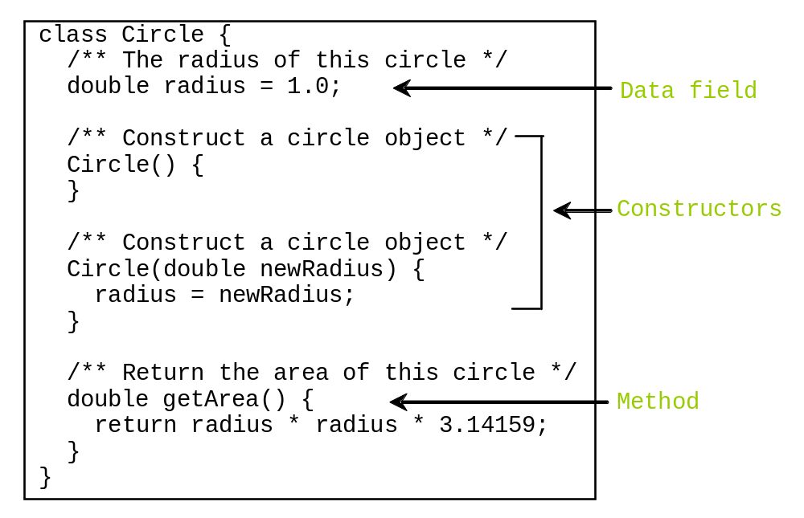
Classes

Slide 8
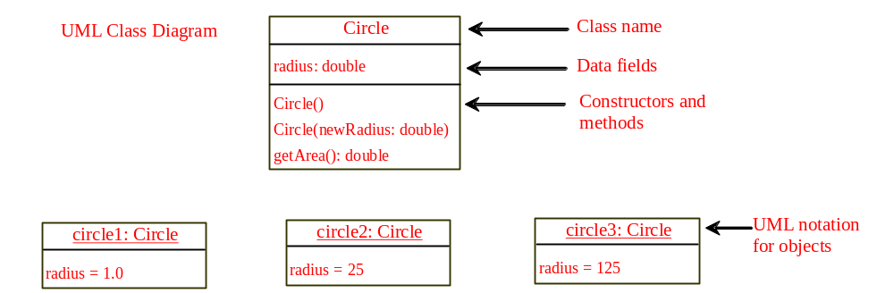
UML Class Diagram

Slide 9

Example: Defining Classes and Creating Objects
Objective: Demonstrate creating objects, accessing data, and using methods.
Note: You can put the two classes into one file, but only one class in the file can be a public class. Furthermore, the public class must have the same name as the file name. Therefore, the file name is TestSimpleCircle.java, since TestSimpleCircle is public.
Animation
TestSimpleCircle
Run

Slide 10
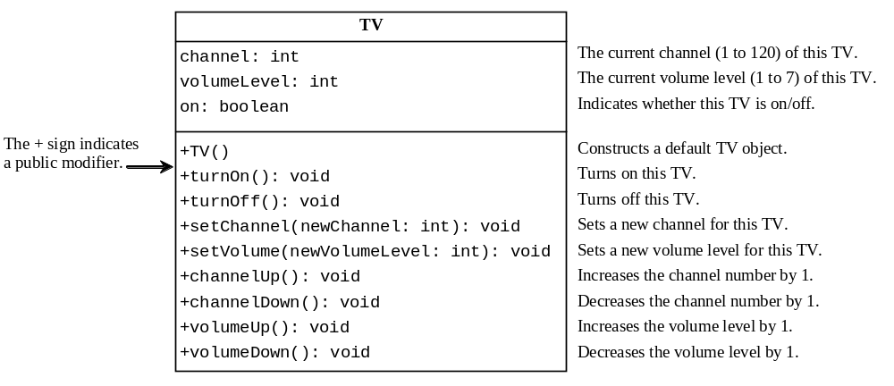
Example: Defining Classes and Creating Objects
TV
TestTV
Run

Slide 11
Constructors
Constructors are a special kind of methods that are invoked to construct objects.
Circle() {
}
Circle(double newRadius) {
radius = newRadius;
}

Slide 12
Constructors, cont.
A constructor with no parameters is referred to as a no-arg constructor.
· Constructors must have the same name as the class itself.
· Constructors do not have a return type—not even void.
· Constructors are invoked using the new operator when an object is created. Constructors play the role of initializing objects.

Slide 13
Creating Objects Using Constructors
new ClassName();
Example:
new Circle();
new Circle(5.0);

Slide 14
Default Constructor
A class may be defined without constructors. In this case, a no-arg constructor with an empty body is implicitly defined in the class. This constructor, called a default constructor, is provided automatically only if no constructors are explicitly defined in the class.

Slide 15
Declaring Object Reference Variables
To reference an object, assign the object to a reference variable.
To declare a reference variable, use the syntax:
ClassName objectRefVar;
Example:
Circle myCircle;

Slide 16
Declaring/Creating Objects in a Single Step
ClassName objectRefVar = new ClassName();
Example:
Circle myCircle = new Circle();
Assign object reference
Create an object

Slide 17
Accessing Object’s Members
Referencing the object’s data:
objectRefVar.data
e.g., myCircle.radius
Invoking the object’s method:
objectRefVar.methodName(arguments)
e.g., myCircle.getArea()

Slide 18
Trace Code
animation
Declare myCircle
Circle myCircle = new Circle(5.0);
Circle yourCircle = new Circle();
yourCircle.radius = 100;
myCircle
no value

Slide 19

Trace Code, cont.
animation
Circle myCircle = new Circle(5.0);
Circle yourCircle = new Circle();
yourCircle.radius = 100;
myCircle
no value
Create a circle

Slide 20
Trace Code, cont.
animation
Circle myCircle = new Circle(5.0);
Circle yourCircle = new Circle();
yourCircle.radius = 100;
myCircle
reference value
Assign object reference to myCircle

Slide 21
Trace Code, cont.
animation
Circle myCircle = new Circle(5.0);
Circle yourCircle = new Circle();
yourCircle.radius = 100;
myCircle
reference value
yourCircle
no value
Declare yourCircle

Slide 22
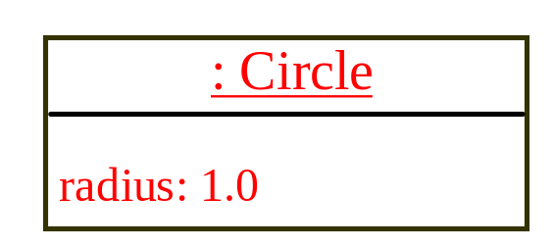
Trace Code, cont.
animation
Circle myCircle = new Circle(5.0);
Circle yourCircle = new Circle();
yourCircle.radius = 100;
myCircle
reference value
yourCircle
no value
Create a new Circle object

Slide 23

Trace Code, cont.
animation
Circle myCircle = new Circle(5.0);
Circle yourCircle = new Circle();
yourCircle.radius = 100;
myCircle
reference value
yourCircle
reference value
Assign object reference to yourCircle

Slide 24

Trace Code, cont.
animation
Circle myCircle = new Circle(5.0);
Circle yourCircle = new Circle();
yourCircle.radius = 100;
myCircle
reference value
yourCircle
reference value
Change radius in yourCircle

Slide 25
Caution
Recall that you use
  Math.methodName(arguments) (e.g., Math.pow(3, 2.5))
to invoke a method in the Math class. Can you invoke getArea() using SimpleCircle.getArea()? The answer is no. All the methods used before this chapter are static methods, which are defined using the static keyword. However, getArea() is non-static. It must be invoked from an object using
  objectRefVar.methodName(arguments) (e.g., myCircle.getArea()).
More explanations will be given in the section on “Static Variables, Constants, and Methods.”

Slide 26
Reference Data Fields
The data fields can be of reference types. For example, the following Student class contains a data field name of the String type.
public class Student {
String name; // name has default value null
int age; // age has default value 0
boolean isScienceMajor; // isScienceMajor has default value false
char gender; // c has default value '\u0000'
}

Slide 27
The null Value
If a data field of a reference type does not reference any object, the data field holds a special literal value, null.

Slide 28
Default Value for a Data Field
The default value of a data field is null for a reference type, 0 for a numeric type, false for a boolean type, and '\u0000' for a char type. However, Java assigns no default value to a local variable inside a method.
public class Test {
public static void main(String[] args) {
Student student = new Student();
System.out.println("name? " + student.name);
System.out.println("age? " + student.age);
System.out.println("isScienceMajor? " + student.isScienceMajor);
System.out.println("gender? " + student.gender);
}
}

Slide 29
Example
Java assigns no default value to a local variable inside a method.
public class Test {
public static void main(String[] args) {
int x; // x has no default value
String y; // y has no default value
System.out.println("x is " + x);
System.out.println("y is " + y);
}
}
Compile error: variable not initialized

Slide 30

Differences between Variables of
Primitive Data Types and Object Types

Slide 31

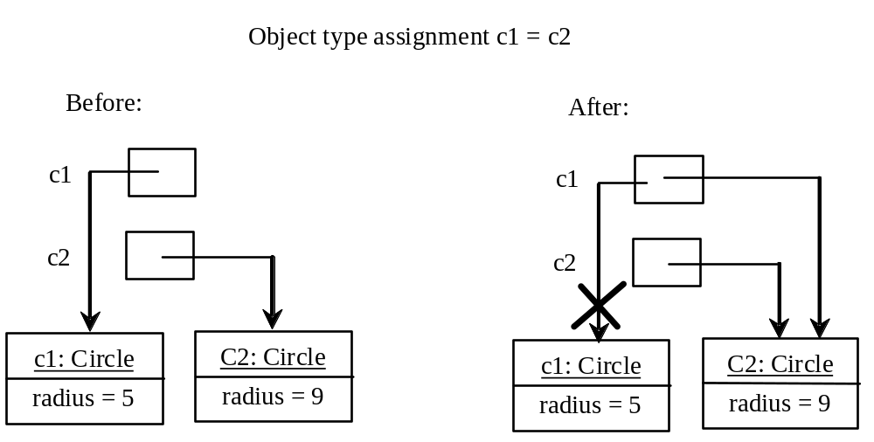
Copying Variables of Primitive Data Types and Object Types

Slide 32
Garbage Collection
As shown in the previous figure, after the assignment statement c1 = c2, c1 points to the same object referenced by c2. The object previously referenced by c1 is no longer referenced. This object is known as garbage. Garbage is automatically collected by JVM.

Slide 33
Garbage Collection, cont
TIP: If you know that an object is no longer needed, you can explicitly assign null to a reference variable for the object. The JVM will automatically collect the space if the object is not referenced by any variable.

Slide 34

The Date Class
Java provides a system-independent encapsulation of date and time in the java.util.Date class. You can use the Date class to create an instance for the current date and time and use its toString method to return the date and time as a string.

Slide 35
The Date Class Example
For example, the following code
  java.util.Date date = new java.util.Date();
  System.out.println(date.toString());
displays a string like Sun Mar 09 13:50:19 EST 2003.

Slide 36

The Random Class
You have used Math.random() to obtain a random double value between 0.0 and 1.0 (excluding 1.0). A more useful random number generator is provided in the java.util.Random class.

Slide 37
The Random Class Example
If two Random objects have the same seed, they will generate identical sequences of numbers. For example, the following code creates two Random objects with the same seed 3.
Random random1 = new Random(3);
System.out.print("From random1: ");
for (int i = 0; i < 10; i++)
System.out.print(random1.nextInt(1000) + " ");
Random random2 = new Random(3);
System.out.print("\nFrom random2: ");
for (int i = 0; i < 10; i++)
System.out.print(random2.nextInt(1000) + " ");
From random1: 734 660 210 581 128 202 549 564 459 961
From random2: 734 660 210 581 128 202 549 564 459 961

Slide 38
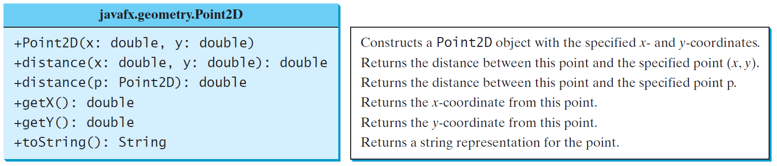
The Point2D Class
Java API has a conveninent Point2D class in the javafx.geometry package for representing a point in a two-dimensional plane.
Point2D
Run

Slide 39
Instance
Variables, and Methods
Instance variables belong to a specific instance.
Instance methods are invoked by an instance of the class.

Slide 40
Static Variables, Constants, and Methods
Static variables are shared by all the instances of the class.
Static methods are not tied to a specific object.
Static constants are final variables shared by all the instances of the class.

Slide 41
Static Variables, Constants, and Methods, cont.
To declare static variables, constants, and methods, use the static modifier.

Slide 42
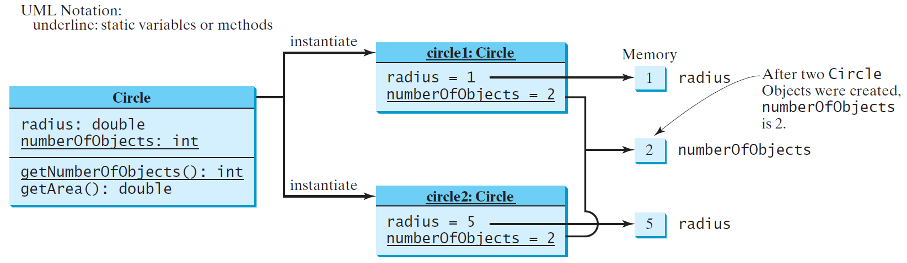
Static Variables, Constants, and Methods, cont.

Slide 43
Example of
Using Instance and Class Variables and Method
Objective: Demonstrate the roles of instance and class variables and their uses. This example adds a class variable numberOfObjects to track the number of Circle objects created.
CircleWithStaticMembers
TestCircleWithStaticMembers
Run

Slide 44
Visibility Modifiers and
Accessor/Mutator Methods
By default, the class, variable, or method can be
accessed by any class in the same package.
public
The class, data, or method is visible to any class in any package.
private
The data or methods can be accessed only by the declaring class.
The get and set methods are used to read and modify private properties.

Slide 45


The private modifier restricts access to within a class, the default modifier restricts access to within a package, and the public modifier enables unrestricted access.

Slide 46
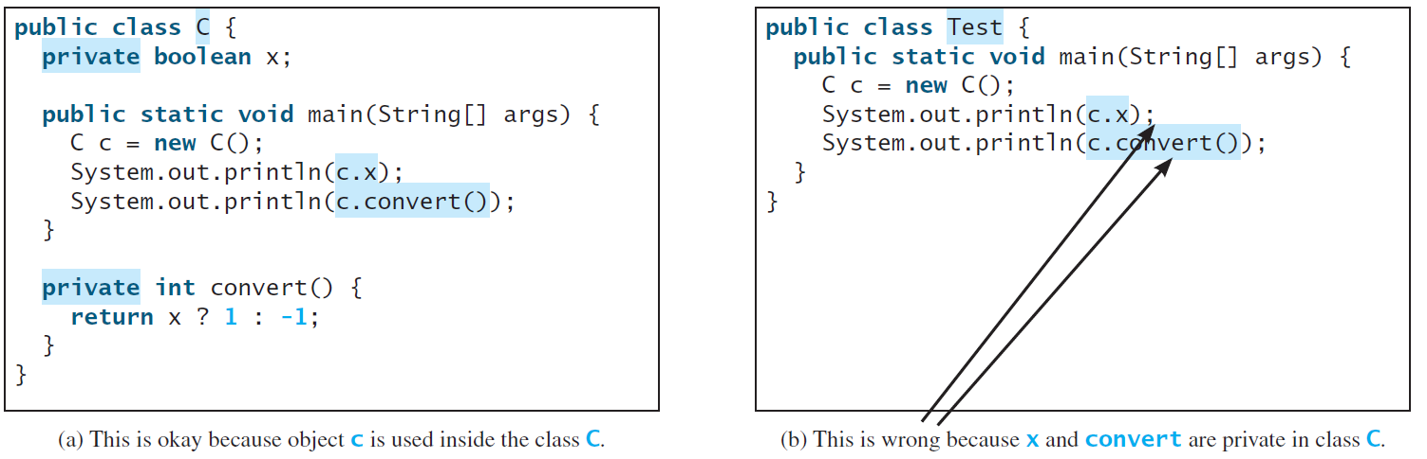
NOTE
An object cannot access its private members, as shown in (b). It is OK, however, if the object is declared in its own class, as shown in (a).

Slide 47
Why Data Fields Should Be private?
To protect data.
To make code easy to maintain.

Slide 48
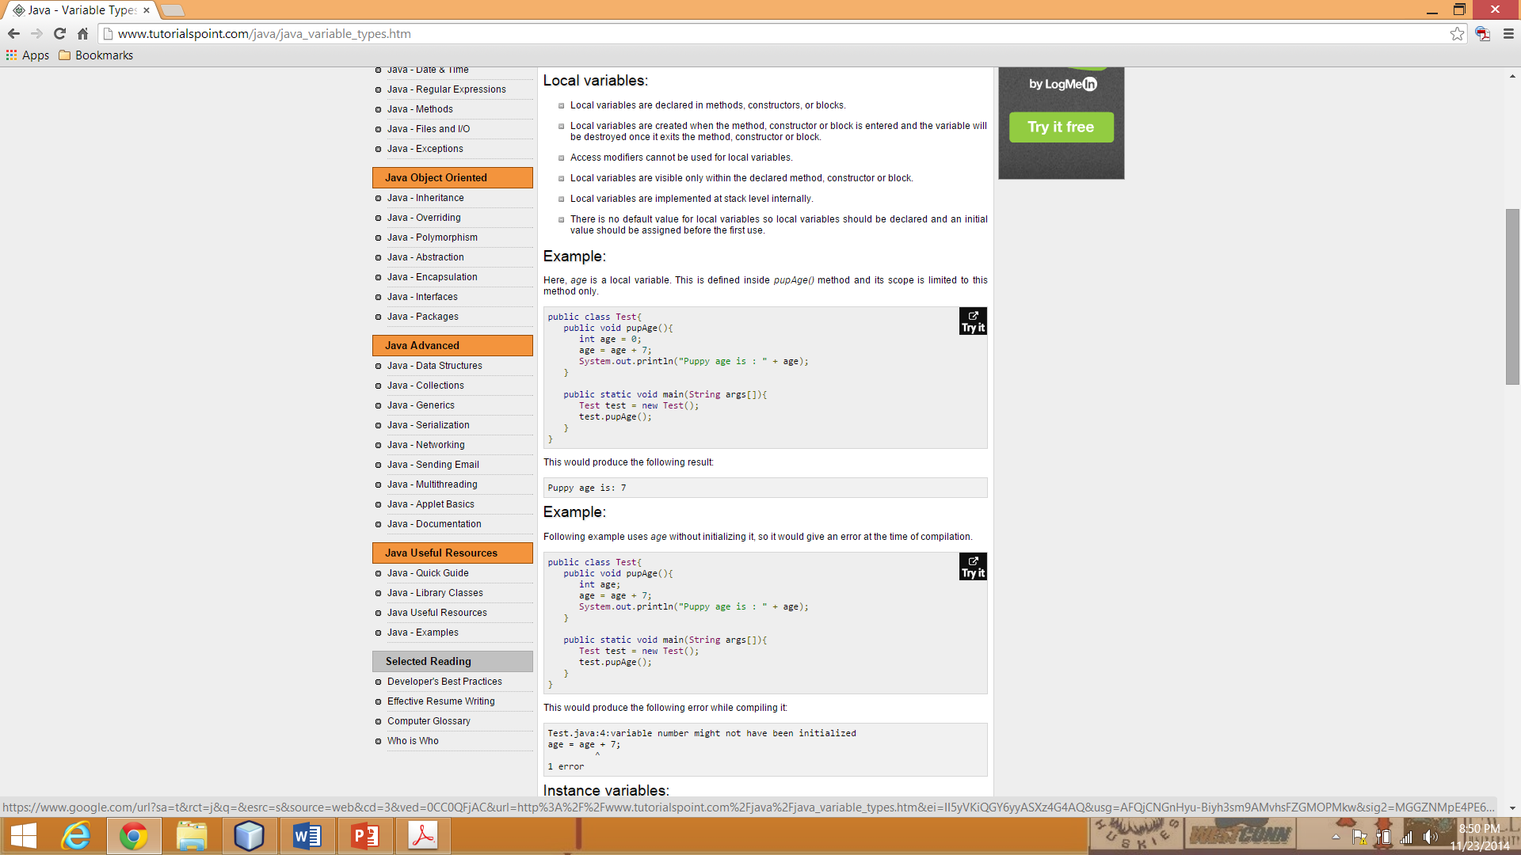
From: http://www.tutorialspoint.com/java/

Slide 49
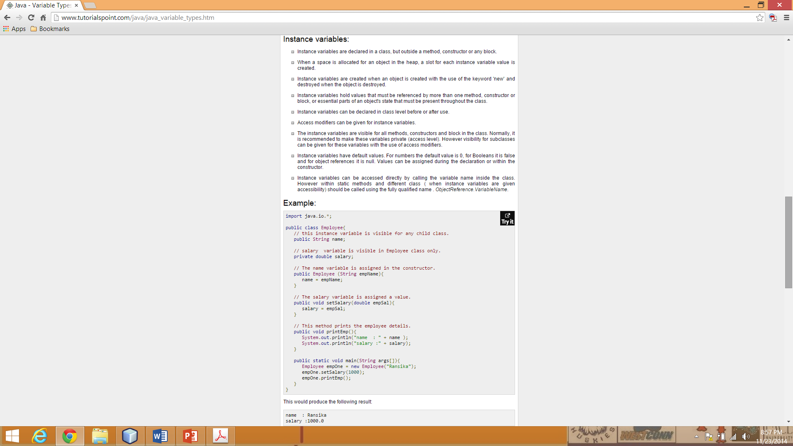
From: http://www.tutorialspoint.com/java/

Slide 50
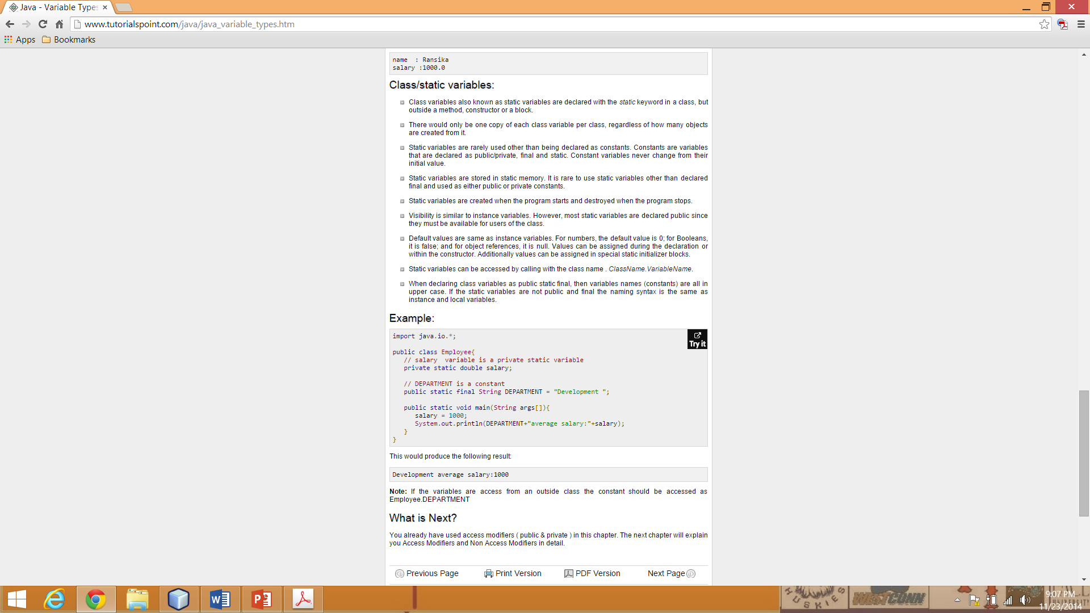
From: http://www.tutorialspoint.com/java/

Slide 51

Example of
Data Field Encapsulation
CircleWithPrivateDataFields
TestCircleWithPrivateDataFields
Run

Slide 52
Passing Objects to Methods
Passing by value for primitive type value (the value is passed to the parameter)
Passing by value for reference type value (the value is the reference to the object)
TestPassObject
Run

Slide 53
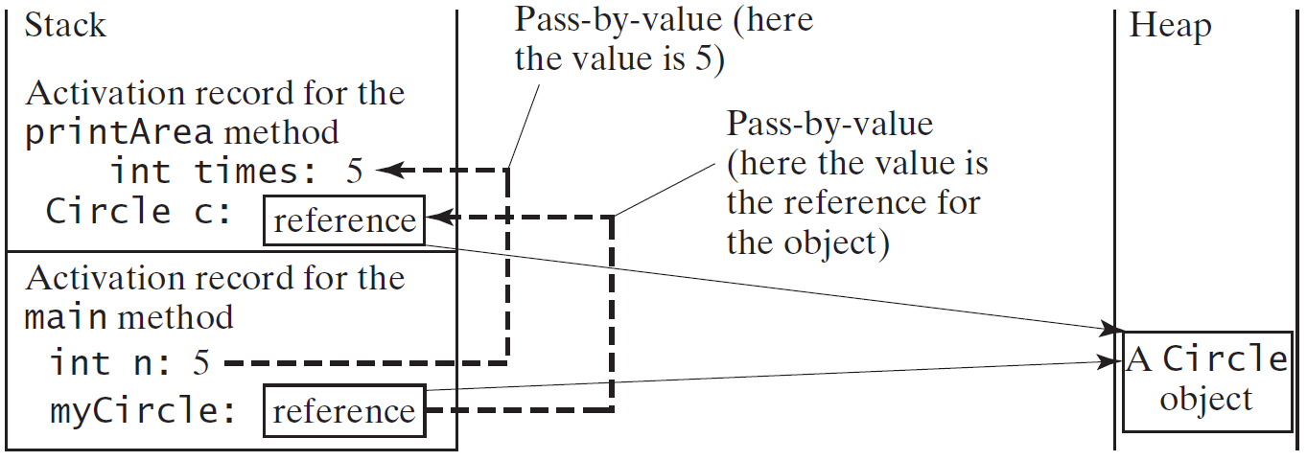
Passing Objects to Methods, cont.

Slide 54
Array of Objects
Circle[] circleArray = new Circle[10];
An array of objects is actually an array of reference variables. So invoking circleArray[1].getArea() involves two levels of referencing as shown in the next figure. circleArray references to the entire array. circleArray[1] references to a Circle object.

Slide 55

Array of Objects, cont.
Circle[] circleArray = new Circle[10];

Slide 56
Array of Objects, cont.
Summarizing the areas of the circles
TotalArea
Run

Slide 57
Immutable Objects and Classes
If the contents of an object cannot be changed once the object is created, the object is called an immutable object and its class is called an immutable class. If you delete the set method in the Circle class in Listing 8.10, the class would be immutable because radius is private and cannot be changed without a set method.
A class with all private data fields and without mutators is not necessarily immutable. For example, the following class Student has all private data fields and no mutators, but it is mutable.

Slide 58
Example
public class BirthDate {
private int year;
private int month;
private int day;
public BirthDate(int newYear,
int newMonth, int newDay) {
year = newYear;
month = newMonth;
day = newDay;
}
public void setYear(int newYear) {
year = newYear;
}
}
public class Student {
private int id;
private BirthDate birthDate;
public Student(int ssn,
int year, int month, int day) {
id = ssn;
birthDate = new BirthDate(year, month, day);
}
public int getId() {
return id;
}
public BirthDate getBirthDate() {
return birthDate;
}
}
public class Test {
public static void main(String[] args) {
Student student = new Student(111223333, 1970, 5, 3);
BirthDate date = student.getBirthDate();
date.setYear(2010); // Now the student birth year is changed!
}
}

Slide 59
What Class is Immutable?
For a class to be immutable, it must mark all data fields private and provide no mutator methods and no accessor methods that would return a reference to a mutable data field object.

Slide 60
Scope of Variables
The scope of instance and static variables is the entire class. They can be declared anywhere inside a class.
The scope of a local variable starts from its declaration and continues to the end of the block that contains the variable. A local variable must be initialized explicitly before it can be used.

Slide 61
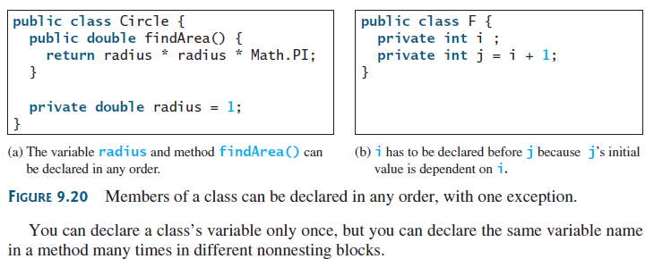
Scope of Variables

Slide 62
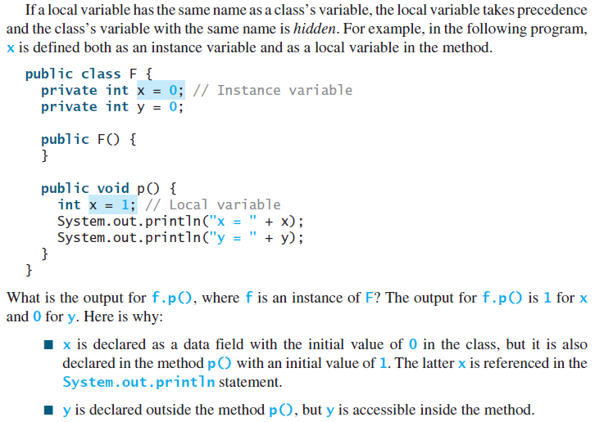
Scope of Variables

Slide 63
The this Keyword
The this keyword is the name of a reference that refers to an object itself. One common use of the this keyword is reference a class’s hidden data fields.
Another common use of the this keyword to enable a constructor to invoke another constructor of the same class.

Slide 64
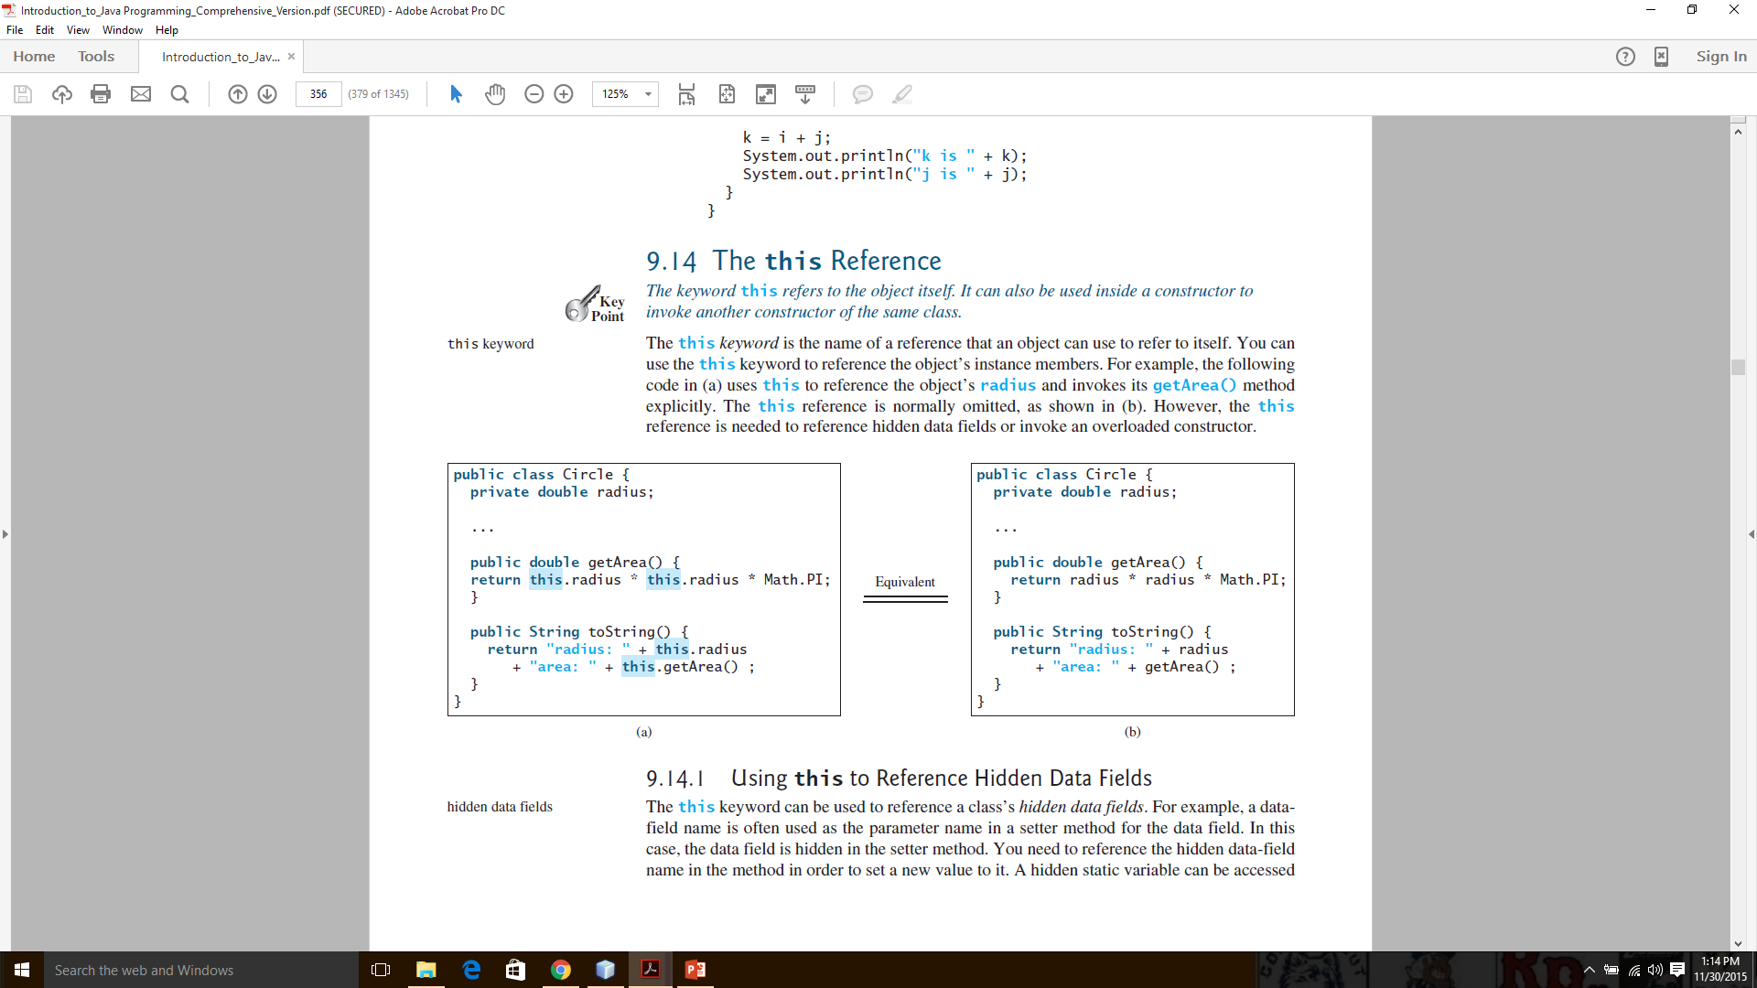
The this Keyword

Slide 65
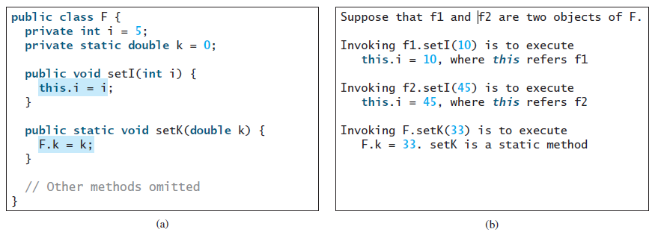
Reference the Hidden Data Fields

Slide 66
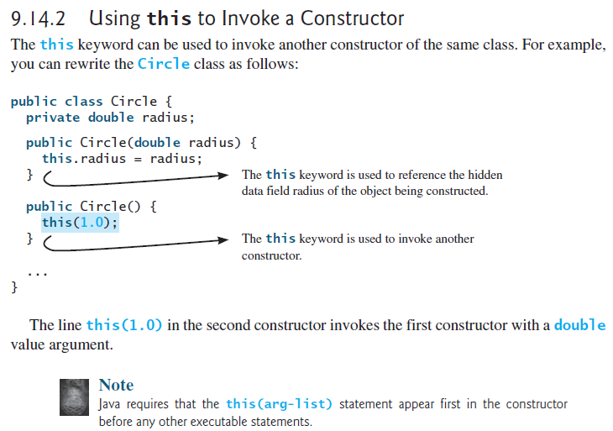

Slide 67
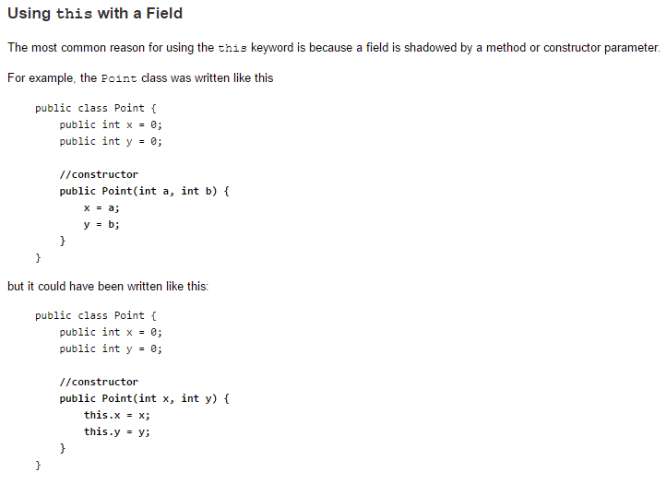
Each argument to the constructor shadows one of the object's fields — inside the constructor x is a local copy of the constructor's first argument. To refer to the Point field x, the constructor must use this.x.

Slide 68
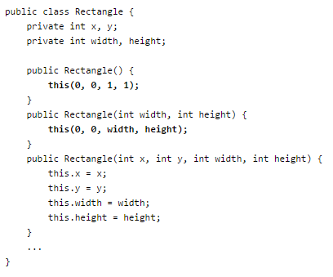
Using this with a Constructor:
From within a constructor, you can also use the this keyword to call another constructor in
the same class.
This class contains a set of constructors. Each constructor initializes some or all of the rectangle's member
variables. The constructors provide a default value for any member variable whose initial value is not provided
by an argument. For example, the no-argument constructor creates a 1x1Rectangle at coordinates 0,0. The
two-argument constructor calls the four-argument constructor, passing in the width and height but always using
the 0,0 coordinates. As before, the compiler determines which constructor to call, based on the number and the
type of arguments. If present, the invocation of another constructor must be the first line in the constructor.

