Slide 1
OUTLINE
Problem Definition.
Methodology
Objectives
Literature Review
Orientation of Work
Requirements of the Proposed system
Flow of Proposed System
Analysis and Simulation Results
Problem Faced during simulation & Solution
Bibliography

Slide 2
PROBLEM DEFINITION
Problem Statement
The classification is performed using a wide range of features, which vary according to the complexity of the model. Features such as Lowenstein distance and a range of other similarity metrics are calculated and fed into the classifier, allowing it to go from a similarity score to a binary classification of “match” or “not a match”. Similarity are used to compare string similarities on product names or product titles in order to try and identify the closest matches.
Problem Area
Machine Learning, Text Similarity and Classification .

Slide 3
Methodology
The proposed system consists of a number of different modules, including Data Cleaning, pre-processing, word embedding, classification, and Evaluation. A feature selection and cleaning strategy will be conducted utilizing data science libraries as part of the data pre-processing step. The suggested model makes use of Levenshtein similarity for text similarity; this helps to extract additional features from the input, which in turn helps to increase the model's accuracy. After that, the features are extracted, and a classification model is applied to determine whether or not the product being offered is a match for the extracted features.
Because of this, a Random Forest Classifier is utilized. This type of algorithm works better when there is a bigger margin separating two classes; furthermore, because our dataset is tiny, training it will not require extra time. Calculating the precision and f1score are the final steps in the model evaluation process.

Slide 4
Objectives
Following are the objectives of the proposed system:
To create a consistent comparison framework so that record linkage models may be compared to one another and evaluated.
To locate an analysis of the most advanced record-linkage models currently being used on product data.
To provide a generic strategy for determining if conventional machine learning methods or deep learning approaches are appropriate for a particular collection of data.
To Classify the Matched and Not Matched products from the Product offers.

Slide 5
LITERATURE REVIEW
Blocking Strategy on Product Similarity:
There are several applications for clustering, from data mining to image retrieval to bio-computing and beyond. The distance metric is an important consideration when grouping data points. The most challenging component of the process is deciding which distance measure to employ for a given dataset.
The selection of a distance measure, which will decide how similar the clusters will be, is an essential stage in any clustering (Vimal, 2018) of these two constituents is determined. This will have an effect on the shape of the clusters because some of the elements may be closer to one another according to one distance and farther away according to another.

Slide 6
ORIENTATION OF WORK
Software and Libraries used in our project are
Python 3.9+
Jupyter Notebook
Sklearn Library
Numpy and Pandas Library
JSON

Slide 7
REQUIREMENTS FOR THE PROPOSED SYSTEM
Dataset: In order to classify products and draw inferences, the suggested system's data set comprises all necessary information.
Data: https://drive.google.com/file/d/1S4SwciKmhw4xIZVQPr6fFSaxf6X4Bw48/view
Data cleaning: Handling missing values and trash values, identifying outliers, and normalizing the data were all components of the data cleaning process.
Data Transformation: By analysing the most popular times of year to buy a home, we were able to zero in on the apartment types with the most demand.
Text Similarity : To determine how 'close' two pieces of text are both in surface closeness [lexical similarity] and meaning [semantic similarity.

Slide 8
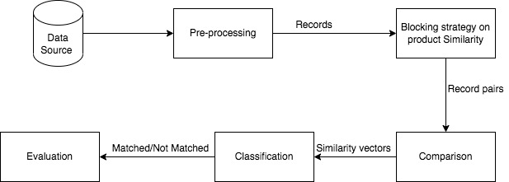
FLOW OF PROPOSED SYSTEM

Slide 9
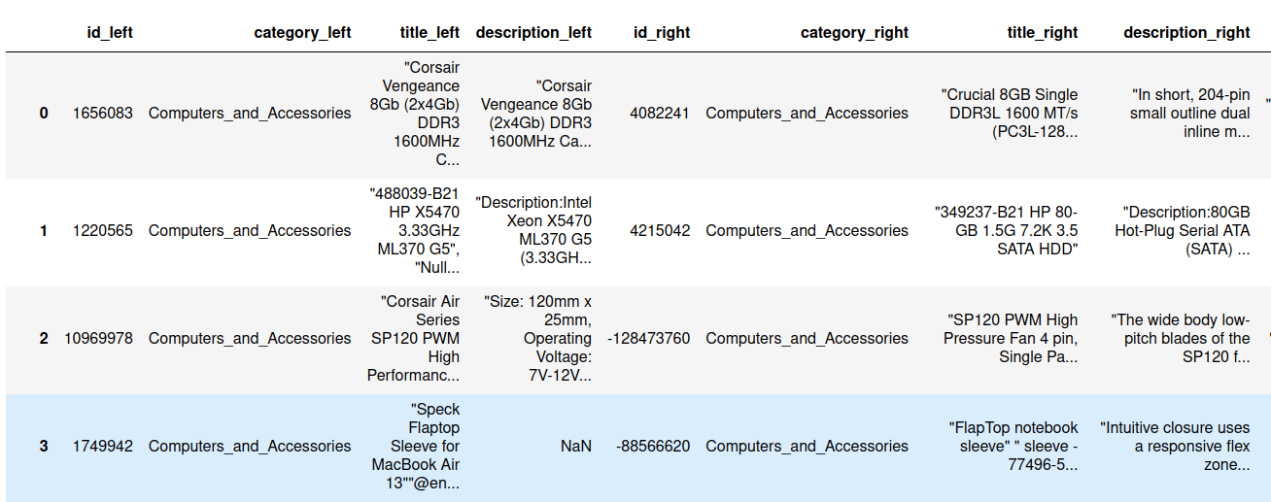
SIMULATION RESULTS & ANALYSIS
Retrieve Data in Data Frame from Json Format

Slide 10
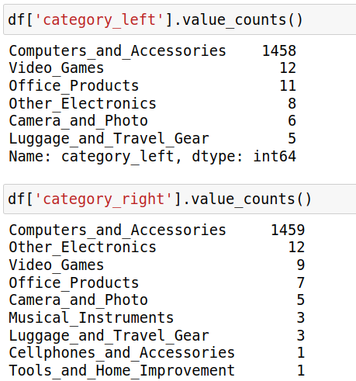
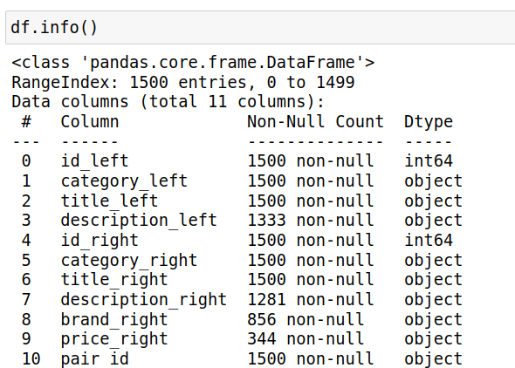
SIMULATION RESULTS & ANALYSIS
Data Analysis using pandas methods : Value Counts() for unique entities and info() to get the Null values count and data type of columns.

Slide 11
Text Similarity Using Levenshtein Distance
Levenshtein distance is very impactful because it does not require two strings to be of equal length for them to be compared.
The Levenshtein distance is usually calculated by preparing a matrix of size (M+1)x(N+1)
where M and N are the lengths of the 2 words and looping through said matrix using 2 for loops, performing some calculations within each iteration.
Thus a large value for Levenshtein distance implies that the two documents were not similar, and a small value for the distance implies that the two documents were similar.

Slide 12
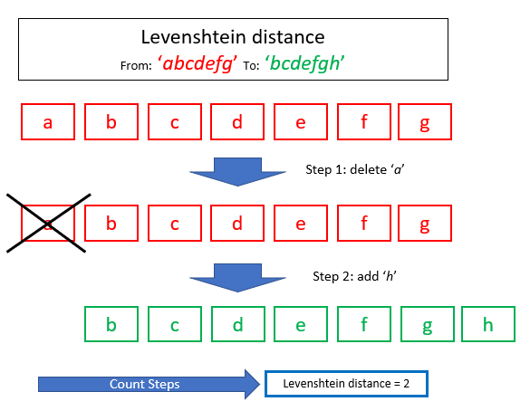
Text Similarity Using Levenshtein Distance

Slide 13
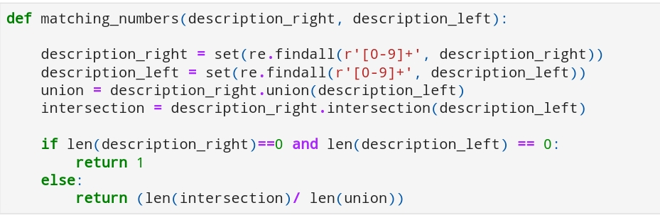
Matching Numbers Using Regular Expression

Slide 14
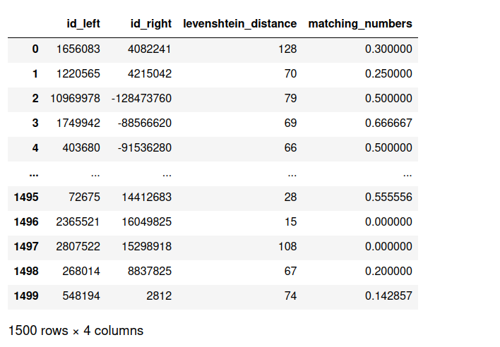
Results
After Applying Levenshtein distance and matching Numbers

Slide 15
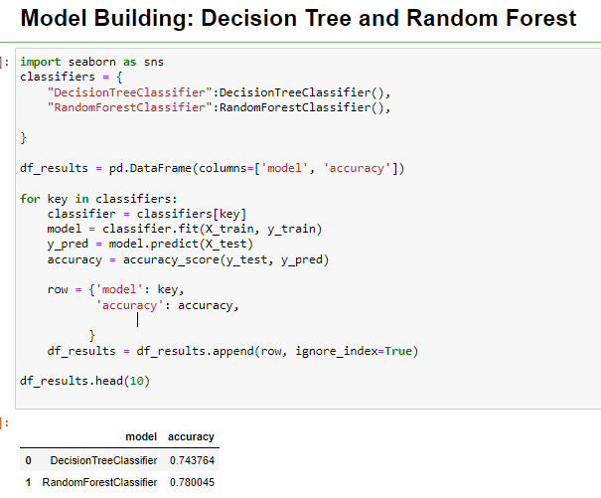
Results

Slide 16
PROBLEM FACED DURING SIMULATION & SOLUTION
While trying to clean the data and pre-process the data, the data types of columns were in form of objects so to convert it into the appropriate data type problem was faced.
The major problem was to select the similarity distance algorithm as there were many algorithms to perform the text similarity.
Also when working with the regular expressions the problem was faced in writing and understanding the meta characters.

Slide 17
REFERENCES
Bernstein, 2015. Dynamic assortment customization with limited inventories.. Manufacturing and Service Operations Management, pp. 538-553.
Bureau, U. C., 2022. QUARTERLY RETAIL E-COMMERCE SALES, washington: US Census Bureau.
Edelman, 2019. Edelman AI Survey., s.l.: Whitepaper.
Ester, 1996. A Density-Based Algorithm for Discovering Clusters in Large Spatial Databases with Noise, 8 Miinchen, Germany: Institute for Computer Science, University of Munic.
Evgeniou, 2001. Support Vector Machines: Theory and Applications. s.l., Machine Learning and Its Applications, Advanced Lectures.
Fujimaki, 2016. Large-scale price optimization via network flow. Advances in Neural Information Processing Systems, Volume 29, pp. 3855-3863.
Gunawan, 2018. The Implementation of Cosine Similarity to Calculate Text Relevance between Two Documents. Journal of Physics Conference Series , Volume 1, p. 978.
Ismail, 2015. Data mining in electronic commerce: Benefits and challenges. International Journal of Communications, Network and System Sciences, pp. 1-16.
Ma, 2015. Using Word2Vec to process big text data. San Jose, CA, Using Word2Vec to process big text data.
Patel, 2018. Study and Analysis of Decision Tree Based Classification Algorithms. INTERNATIONAL JOURNAL OF COMPUTER SCIENCES AND ENGINEERING, 6(10), pp. 74-78.

Slide 18
Thank You

