Slide 1
Verification of AHB Lite Protocol
EE5214 - Fall’23
Semester Project
December 14, 2023
Wajahat Riaz
Zeeshan Khan
Sami Ullah Saqib
Muhammad Ahad

Slide 2
Objectives
The objectives of the semester project are as follows:
Read a specification document and create a verification plan.
Develop different components of a testbench to make it scalable and reusable.
Establishing automated regression environments.
Creating Code and Functional Coverage metrics for effective verification;
Formulating SystemVerilog Assertions for Formal and Simulation Environments;

Slide 3
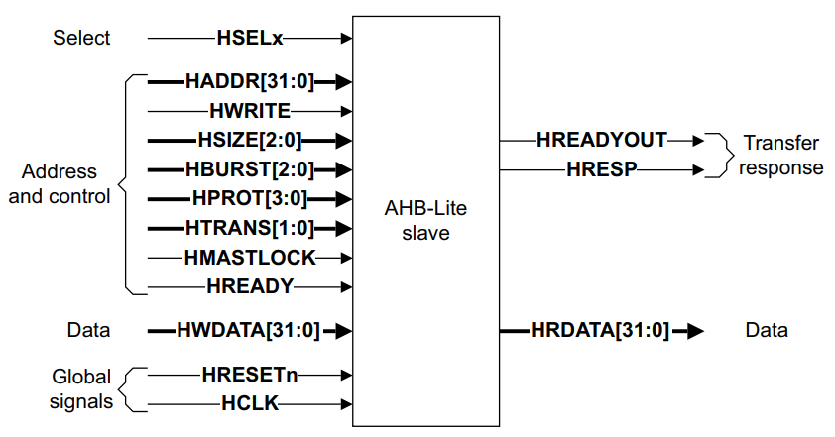
Design Under Test (DUT) - Interface
Brief overview about the design under test:

Slide 4
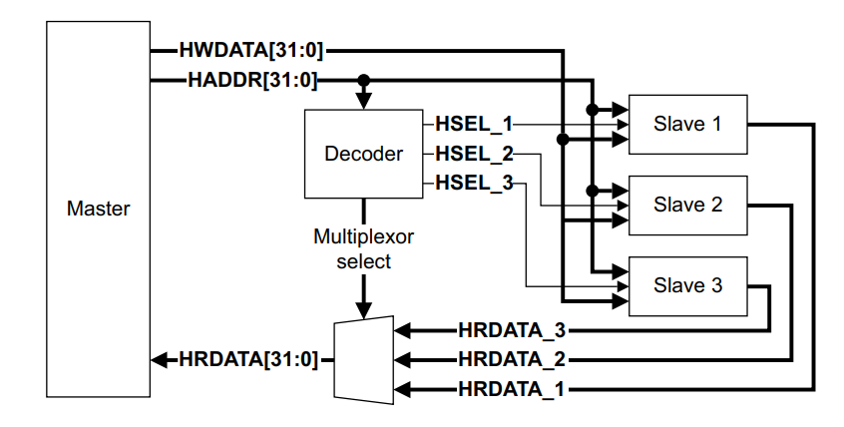
Design Under Test (DUT) - Functionality
Brief overview about the functionality of the design under test:

Slide 5
Testbench Structure - Overview
Brief overview about the testbench:
Interface (BFM)
Top module
Binding construct
Stimulus generation
Response checking
Coverage
Assertion
Regression
Better explanation through a walkthrough of the code

Slide 6
Testbench Structure - Stimulus Generation
Transfer types
Transfers that can be classified into four types:
Master Signal: IDLE HTRANS [1:0] =b00
It means that the Master is in an IDLE transfer when it does not want to perform a data transfer.
Subordinates must always provide a zero wait state OKAY response to IDLE transfers
Master Signal: BUSY HTRANS [1:0] =b01
BUSY transfer type enables Managers to insert idle cycles in the middle of a burst.
It indicates that the Manager is continuing with a burst but the next transfer cannot take place immediately.

Slide 7
Testbench Structure - Stimulus Generation
Transfer type changes from IDLE to NONSEQ
Indicates a single transfer
The address and control signals are unrelated to the previous transfer and are treated as bursts of length one.
Sequential
The remaining transfers in a burst are SEQUENTIAL and the address is related to the previous transfer.
The next address is equal to the address of the previous transfer plus the transfer size.
The transfer size is being signaled by the HSIZE[2:0] signal.
Like for word (4 bytes) its 010

Slide 8
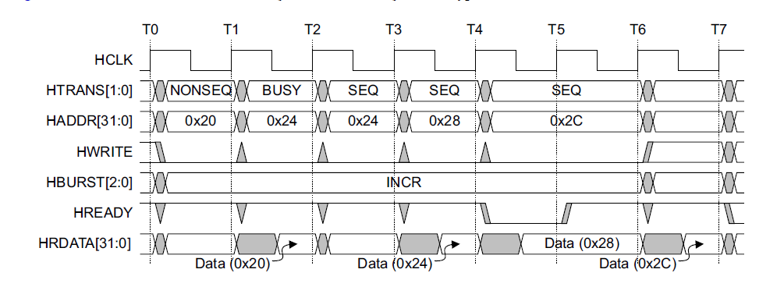
Testbench Structure - Stimulus Generation
An example of transfer Type is shown below.

Slide 9
Testbench Structure - Stimulus Generation
Transfer response based on HRESP and HREADY signals
Slave response: Transfer done
A completed transfer is signalled when HREADY is high and HRESP is low indicating OKAY.
Slave response: Transfer Pending
During the waiting states, the HRESP is low and HREADY is also low which indicates that the transfer is pending.
Slave response: HSEL != 1
Performing a read or write transfer given that slave is not selected during transactions
Locked transfers (Not in DUT)
It indicates to any Slave that the current transfer sequence must be processed before any other transfers are processed.

Slide 10
Burst operation
Support for bursts of 4, 8, and 16 beats, undefined length bursts, and single transfers.
Incrementing and Wrapping Bursts: Incrementing bursts access sequential locations; wrapping bursts wrap at address boundaries.
Address Boundary Calculations: Wrapping occurs when the product of the number of beats in a burst and the size of the transfer crosses an address boundary.
Controlled by HBURST and HSIZE: The number of beats in a burst is controlled by HBURST, and the transfer size is controlled by HSIZE.

Slide 11
Burst operation
Example: A four-beat wrapping burst of word (4-byte) starts at address 0x34 and wraps at 16-byte boundaries, accessing addresses 0x34, 0x38, 0x3c, and 0x30.
HBURST Signal Encoding: HBURST[2:0] signal controls the burst type with various encodings like SINGLE, INCR, WRAP4, etc.
Single Transfers: Masters can perform single transfers using SINGLE burst or undefined length burst with one beat.

Slide 12
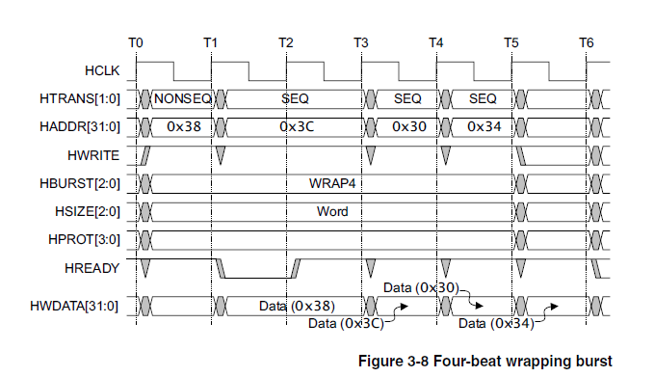
Burst Examples
Four-beat wrapping burst, WRAP4 - 16 byte boundary

Slide 13
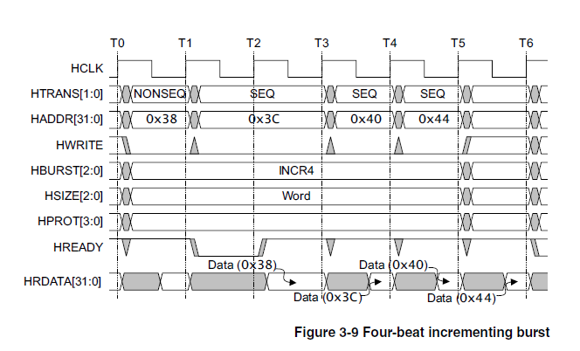
Burst Examples
Four-beat incrementing burst, INCR4

Slide 14
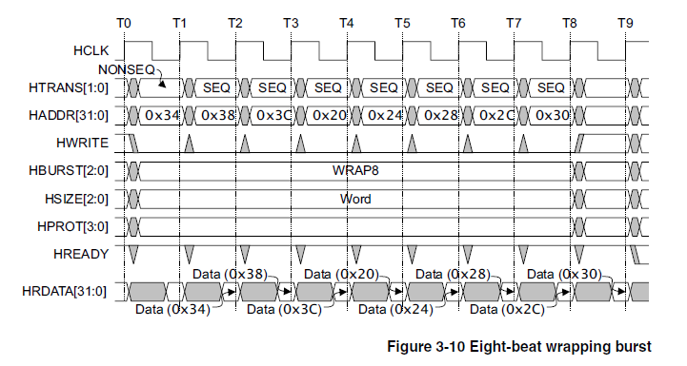
Burst Examples
Eight-beat wrapping burst, WRAP8- 32 byte boundary

Slide 15
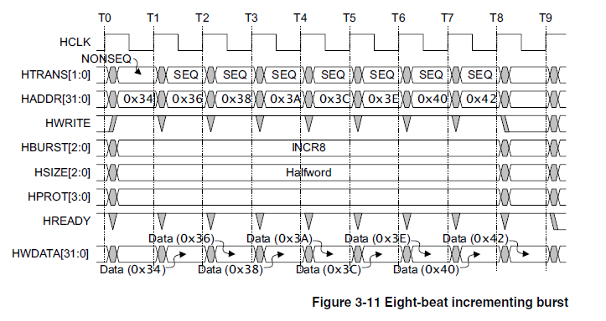
Burst Examples
Eight-beat incrementing burst, INCR8

Slide 16
Test Plan
Brief overview about the test plan and its scalability:
Mention two major categories of test items.
Give a walkthrough about different test items from the link below: LUMS_Semester_Project

Slide 17
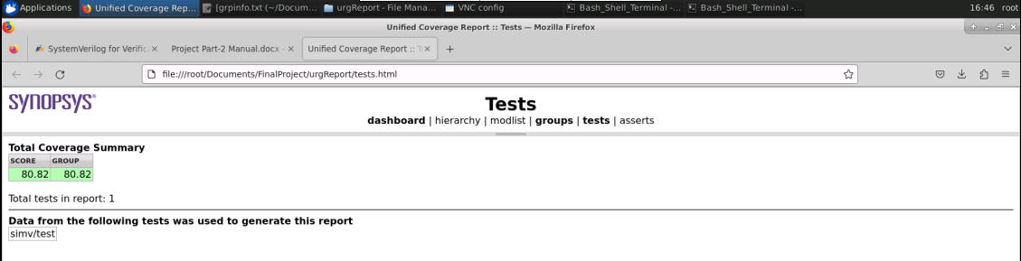
Coverage Result
Running 8 test cases gave the following coverage report:

Slide 18
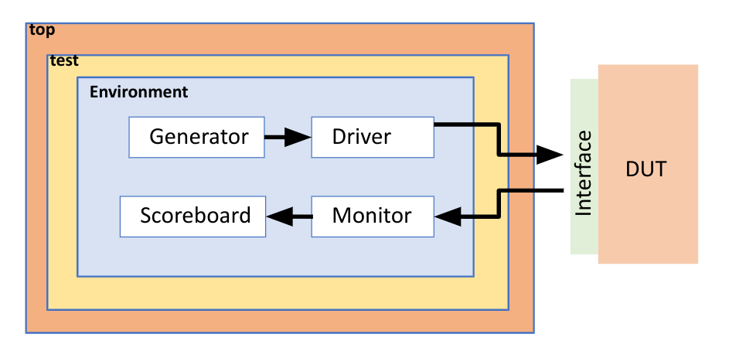
Recommendations
Alternatively, the following things should be considered:
Layered testbenches because OOP can’t be replaced.
The design space is so big, no one can say it’s bug free.

Slide 19
Thank You

