Slide 1
Lending Club Case Study
LUXURY

Slide 2
Team Members
Wajdi Tahmoush
Fadi Anjrou
Lending Club –Case Study

Slide 3

Table of Content
Problem Description
Analysis Approach
Data understanding
Overall Loan Status
Loans situation understanding
Data Cleaning and Manipulation
Data Analysis:
Defaults
Defaults By Interest Rate
Defaults By loan Purpose
Defaults By Borrowers income
Defaults By ratio of amount to income
Defaults By Revolving line Util Rate
Defaults By prior bad record
Defaults By debts to income
Recommendations

Slide 4


THE PROBLEM DESCRIPTION
Company Information
Company Objectives from EDA
This company is the largest online loan marketplace, facilitating personal loans, business loans, and financing of medical procedures.
Borrowers can easily access lower interest rate loans through a fast online interface.
the company wants to understand the driving factors (or driver variables) behind loan default, i.e. the variables which are strong indicators of default.
The company can utilize this knowledge for its portfolio and risk assessment.
The company seeks to find solid basis to accept or reject applications in order to increase business and reduce losses from rejecting low risky applications or accepting high risky ones

Slide 5
Problem Statement & Analysis Approach
Problem Statement
Accepting or rejecting loan applications carries 2 types of financial risks:
1- Rejecting loans for applicants who are likely to repay results in a loss of business to the Club.
2- Approving the loan applicants who are likely to default (not repaying) will result in a financial loss for the Club.
The study aims to analyze applicants’ probability of repaying or defaulting, and provide the Club with a solid basis to accept or reject applications, and decid on the proper interest rates.
Study Methodology The study is based on a lending history dataset provided by the Lending Club. The study analyzes the data set and provide methods for measuring the default probability of applicants based on different criteria. The study is completed in 3 major steps as follows:
1- Analyze the data set and decide on the variables that can serve in the analysis study; remove all useless variables to reduce ambiguity and focus only on useful data.
2- Clean/fix data values in important variables and generate new matrices if needed in preparation for the analysis.
3- Analyze the different variables and their relation to default probability.

Slide 6
Understanding Data Set
Import the Data Set
Import the data set and check the content. Noticed 39,117 rows and111 columns of Data
Import the Data Dictionary
Revise the provided data dictionary to understand content
Segmenting the Data (Loans Status)
Noticed that provided data contains 3 major categories of loans:
Current Loans: These are loans that are still active, and can’t be considered as Defaulted or Not.
Fully Paid: These are closed loans that are fully paid (Good Loans).
Charged Off: These are the Default Loans (bad Loans) that cause losses for the company.
As our analysis aims to predict defaults, Active loans can’t be considered in the study and should be removed.
The data set has a big portion of columns with no data and should be cleaned.

Slide 7
Data Cleansing and Manipulation
Different Steps has been applied on data in preparation for analysis
Remove all Active Loans.
Check for duplicate records; No duplicates found.
Drop all columns with no data; (Columns reduced from 111 to 57 Variable)
Identify relevant and irrelevant variables to the study; Variables related to the current loans or customer behavior like payments, delinquent, etc… are irrelevant to the study. Variables to define the client, or the loan characteristics are those to consider.
With the help of the data dictionary file and the provided variables descriptions and values, we decided on relevant variables created a variables file with Relevant flag.
Dropped all irrelevant variables. (Variables reduced from 57 to 28.
Check for variables not important for the study and drop them like Id, Member Id, etc….
Final Data set has 38577 rows and 21 columns.
Understand the columns and their content: Categorical vs Continuous variables.
Create New columns flagging Good and Bad Loans based on the Loan Status.

Slide 8
Data Analysis
Having all the data cleaned and ready for Analysis
Analyze Default against Categorical Variables
Created a generic function for analyzing Categorical variables and their relation to Good/Bad Loans.
The relation is defined as the percentage of good and bad loans in each Category.
Run the Analysis function against each Categorical variable and visualize the results using Pie, Bar charts.
Analyze Default against Continuous Variables
Created a generic function for analyzing Continuous variables and their relation to Good/Bad Loans.
The relation is defined as the percentage of good and bad loans in each Category.
Run the Analysis function against each Continious variable and visualize the results using line Charts.
Summarize the outcome of each analysis
The analysis results provide the company with guidelines for each variable and its relation to the default probability. All visualizations presented the Bad Loans to provide clear vision of Default Probability.

Slide 9
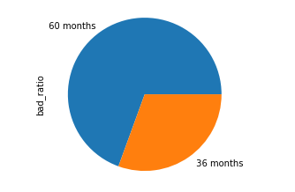
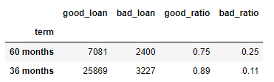
Sample Results – Term Analysis
Term Analysis: Term Analysis shows that 60 months terms loans has much higher probability of default. (25% vs 11% for 36months)
The company strategy should be to promote and focus on short term loans.

Slide 10
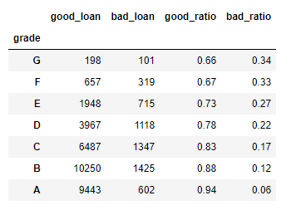
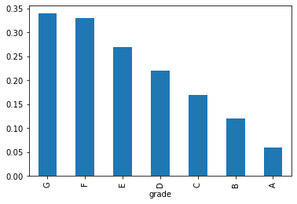
Sample Results – Grade Analysis
Grade Analysis shows that Default probability increases as we go from Graded A-B…G.
The company should focus on loans of grades with less bad ratio.

Slide 11
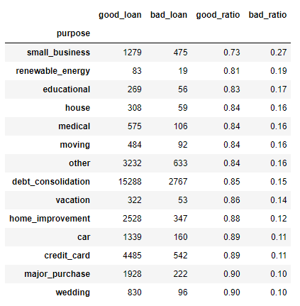
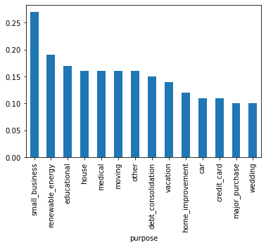
Sample Results – Purpose
Small Business Loans have highest risk of default, while wedding are least risky. Avoid Small Business Loans

Slide 12
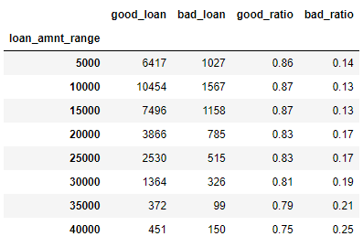
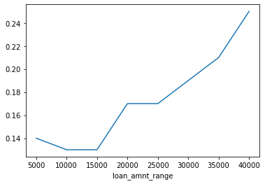
Sample Results – Loan Amount
Loan Amount shows that default risk increases with higher amounts. The company must avoid high value loans.

Slide 13
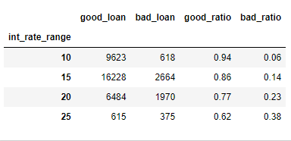
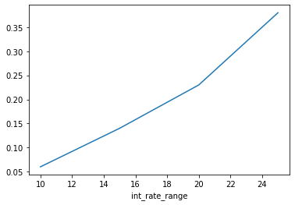
Sample Results – Interest Rate
Loans with Higher Interest rate have higher default probability. The company must work out an equation between interest rate and default probability.
Higher Default probability leads to higher interest rate, and higher interest rate, leads to higher default probability.. Need a good Balance between the 2 indicators.

Slide 14
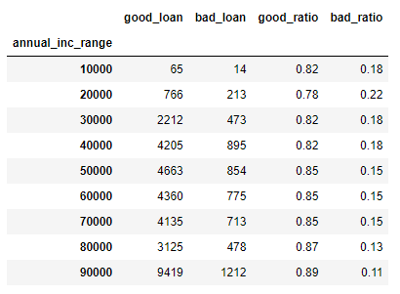
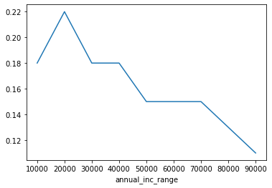
Sample Results – Purpose
Annual income is another predictor; Low annual income is associated with higher Default probability. The company should avoid loans for applicants with very low annual income

Slide 15
Conclusion
We have provided sample results and recommendations from the analysis. For the complete Analysis on all variables, you can run the Python code.
For the Continuous Variables analysis, different bins can be tested when calling the function. We used bins that are logical with the variable, for example 5% for interest rate, 1000 for loans amount, and 10000 for annual income. Other bins can be tested for more analysis.
Some variables were found of no, or very little influence on the default probability like the employment length.
For the full analysis, please run the Python code.

