Slide 1

How does the WEB work ?
The browser sends an HTTP request message to the server, asking it to send a copy of the website to the client.

Slide 2

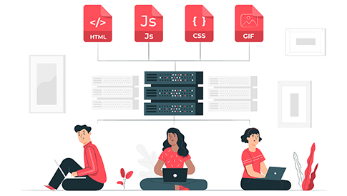

To be a WEB developer you have To :
Pick THE SKILLS YOU NEED TO WORK IN WEB DEVELOPMENT
(HTML – css – JavaScript)
START LEARNING WEB DEVELOPMENT AND PUT YOUR SKILLS IN PRACTICE
FIND THE RIGHT WEB DEVELOPER JOB FOR YOU

Slide 3
my reasons to choose learning web development
To make my own applications
To have more money

