Slide 1
URDU DICTIONARY
University Of Karachi
Department Of Computer Science
Group Members:
Wajeeha Parker : B15101151
Ayesha Ali : B15101022
Taimoor Al Qureshi : B15101146
Junaid Siddiqui : B15101077
Course Supervisor: Sir Usman Amjad

Slide 2
INTRODUCTION
It is a Roman to Urdu dictionary that takes Roman word as input and gives meaning in Urdu.

Slide 3
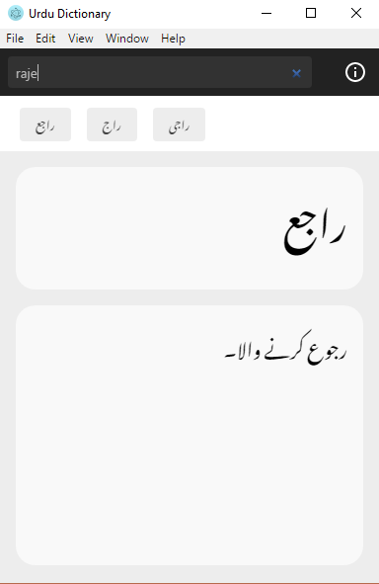
SAMPLE INPUT AND OUTPUT

Slide 4
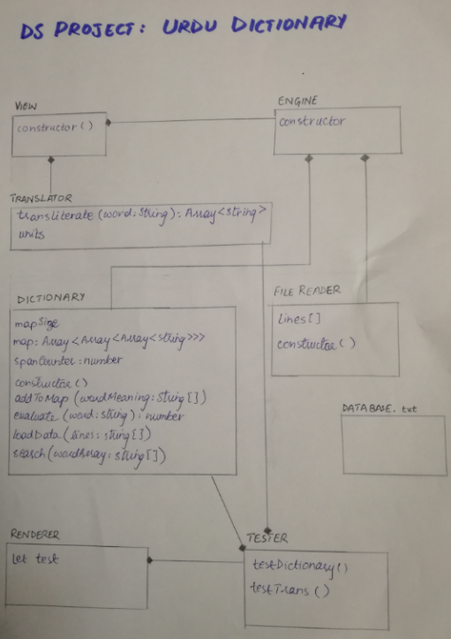
MODULE Diagrams

Slide 5
CLASSES, ATRIBUTES AND FUNCTIONS
RENDERER:
It is the main class that calls view and electron app.
VIEW:
It is placing the input and output on GUI.
It is using the classes of engine and translator.
Search function in class Dictionary is being called for searching the input word.
ENGINE:
It is calling the constructors of classes File Reader and Dictionary.
It receives data from file and loads it in the hashtable through loaddata() function of Dictionary.

Slide 6
TRANSLATOR:
This class translated Roman words to Urdu.
It returns the array containing all possible translations of the word input.
FILE READER:
It reads data from Database file.
It separates each line and save it in an array of String type.
DICTIONARY:
It initializes the hashmap.
It has a loaddata function that loads data in the map by evaluating the hashcode of the word input.
It has search function that is used to search the meaning of the input word. It also provides suggestions of the similar words.

Slide 7
Mathematics, logic , data structure
Hashing using separate chaining for efficient searching.
Combination algorithm similar to tree for generating word combinations.

