Slide 1
PRINTER
By : Wajiha M.Ismail

Slide 2
PRINTER
The world’s first computer printer was invented in 19th century by Charles Babbage.
A printer is a peripheral device which makes a representation of an electronic document on physical media.
It is hardware device which is responsible for taking computer data and generating a hardcopy of that data.

Slide 3
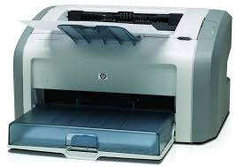
It is commonly used to print text, image and photos.
Some printers can print documents stored in memory cards or from digital cameras and scanners.
CATEGORIES OF PRINTER
Printer are divided in two categories:
Impact printer.
Non-Impact printer.

Slide 4
IMPACT PRINTER:
Impact printer produces text and images when tiny wire pins on print head strike the ink ribbon by physically contacting the paper .
Daisy wheel printer.
Dot-matrix printer.

Slide 5
DOT MATRIX PRINTER
Dot matrix printer were 1st introduced by Centronics in 1970. The term dot matrix refers to the process of placing dots to form an image.
However, unlike a typewriter or daisy wheel printer, letters are drawn out of a dot matrix, and thus, varied fonts and arbitrary graphics can be produced.
It speed is usually 30 to 1000 characters per second (cps).

Slide 6
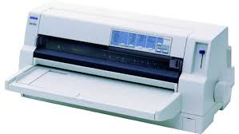
This is the cheapest and the most noisy printer and has a low print quality.

Slide 7
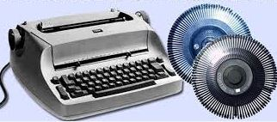
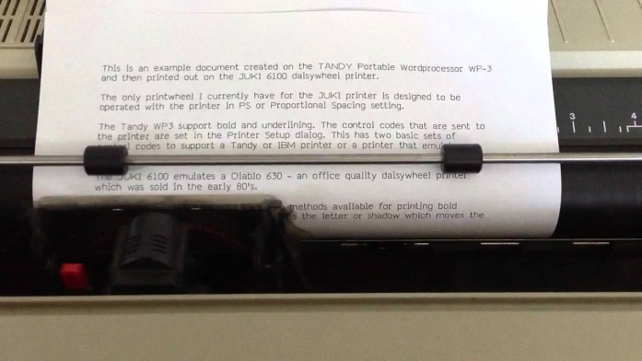
DAISY WHEEL PRINTER
A daisy wheel printer basically an impact printer, it consisting of a wheel and attached extensions on which molded metal characters are mounted. A daisy wheel printer produces letter quality print and it can’t produce graphics output.

Slide 8
NON-IMPACT PRINTER:
Non-impact printer produces text and graphics on paper without striking the paper.
Ink-jet printer.
Laser printer.

Slide 9
INK-JET PRINTER
Ink-jet technology was developed in 1960s, but first commercialized by IBM in 1976.
Ink jet printer is a type of non impact printer. It creates output on paper by spraying tiny drops of liquid ink.
Ink jet printer has print head that can spray very fine drops of ink. It consist of print cartridge filled with liquid ink and has small nozzles.

Slide 10
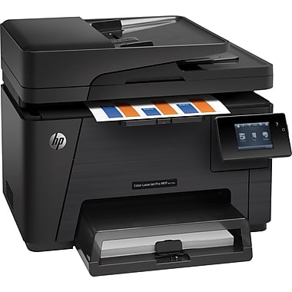
LASER PRINTER
Laser printer are non impact printers which can print text and images in high speed and high quality resolution ranging from 600 to 1200 dpi.
A laser beam projects an image of the page to be printed onto an electrically charged rotating drum coated with selenium.
Laser printer produces very high-quality print and are capable of printing an almost unlimited variety of fonts.

Slide 11
IMPACT PRINTER V/S NON-IMPACT PRINTER
Impact printers function by applying force, where non-impact printers does not do so.
Non-impact printers prints without touching the paper, where impact printer does not do so.
Non-impact printers are faster and produce high quality output than impact printer.
Non-impact printers produce almost no noise during printing where impact printer produce loud noise while printing.
Non-impact printers print more pages per minutes.

Slide 12
FACTORS EFFECTING PRINT QUALITY
DPI is the measurement of printer resolution indicating how many dots can be placed by the printer in one square inch. The higher the dpi,the sharper the image.
Each type of printers has its own capabilities of printing. Some type of printers produce high quality print while other produce low quality.
The printing mode may also effect the quality. For example : the draft mode increases the print rate but quality is reduced.

Slide 13
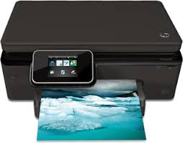
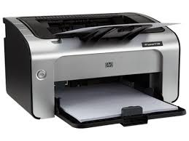
The quality and amount of toner also effects print quality.

Slide 14
Thank you…

