Slide 1

Wajiha M. Ismail
Muneeba Sohail
Tooba Azher

Slide 2

FREEDOM
The power or right to act, speak, or think as one wants without hindrance or restraint.
The condition or right of being able or allowed to do, say, think etc. whatever you want to, without being controlled or limited or restricted.

Slide 3
TYPES OF FREEDOM
Self Freedom
Collective Freedom
Internal Freedom
External Freedom

Slide 4

SELF FREEDOM
Self freedom refers to your ability to do something on your own or for yourself.
Example: write a story, buy a cake, run your business etc.
In the sense of learning how to escape the ever-present danger of enslavement by our own passion and ignorance.

Slide 5
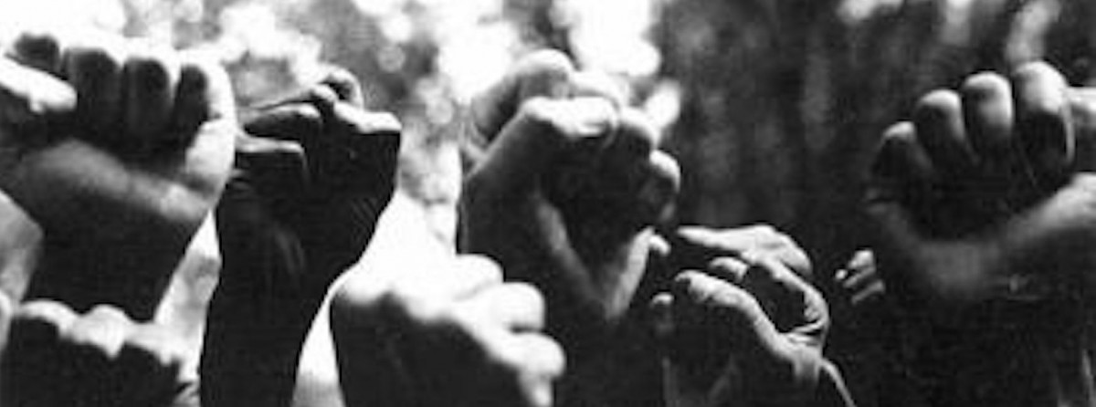
COLLECTIVE FREEDOM
Collective freedom is refers to the group of people.
Example: Association, peaceful meeting, and collective labours.

Slide 6


INTERNAL FREEDOM
This is the most basic type of freedom.
It is the greatest personal informality and secretiveness.
It is the hidden core of our being and unknowable by others.

Slide 7

EXTERNAL FREEDOM
This is refers to the normal and common freedoms expected in daily life, in the most countries, throughout history.
It implies immunity from undue interference by authority, especially by government.

Slide 8
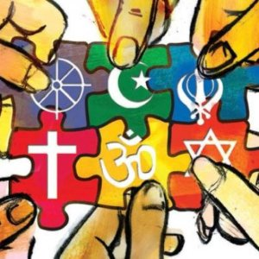
RELIGIOUS FREEDOM
Religious freedom is very important.
Many countries don’t allow religious freedom.
We have to be thankful to Almighty Allah that we have religious freedom.

Slide 9

CHILDREN FREEDOM
Children should be given freedom to make their own decision in life.
Parent should support their children in all decisions of their lives.

Slide 10

WOMEN AND FREEDOM
Like men, women have been created free and desire to live.
Humans have need of their fellow creatures
The freedom of women is also such. Islam respects the freedom of women.

Slide 11

FREEDOM IN WORK
Islam regards women as one of the two pillars of the society.
Islam regards work as an obligation and a superior form of worship and warns its supporters to avoid idleness, vanity, and retirement from work.

Slide 12

FREEDOM IN MARRIAGE
Like men, women are completely free in marriage and choosing their spouse.
No one has the right to force a woman to marry or to choose a specific husband for her, even one’s father, mother, sibling, or grandparents.

Slide 13

FREEDOM IN SEEKING KNOWLEDGE
Unmarried women may freely endeavor to acquire knowledge.
a married woman must observe the rights of her spouse and children and must confer with her husband on this issue in order to reach a consensus.

Slide 14



