Slide 1
HeatSafe Pakistan
HeatSafe Pakistan Team | Climate & Health / AI

Slide 2
Problem Statement
THE PROBLEM
1
Who is affected?
Karachi faces dangerous heat and changing weather. Residents lack one simple place to view current conditions, explore long-term trends and understand heat-related risks.
Karachi residents, outdoor workers, students and local planners
2
Why does it matter?
Heat exposure affects health and work; raw climate data is difficult to interpret.
3
Our goal
Combine trusted weather sources, ML risk estimates and evidence-based guidance in one dashboard.

Slide 3
Dataset Declaration
Dataset name | Karachi hourly weather + air quality
Source / link | Open-Meteo; NASA POWER; OpenAQ APIs
Size | 41,616 raw hourly weather records per source
Time period | Jan 2022 – Sep 2026 (weather)
Format & license | CSV / DuckDB; source licenses vary
Key features / target | Temp, humidity, dew point, wind; proxy risk 0–3
41.6K
Rows / records
Hourly
Columns / features
CSV + DB
Dataset size

Slide 4
Pipeline Used
1
2
3
4
5
Data Collection
Data Cleaning
Analysis / EDA
Modeling
Dashboard / App
Open-Meteo, NASA POWER, OpenAQ
Timestamp alignment, missingness, QA flags
Hourly/monthly trends; source comparisons
Gradient boosting; 4 proxy risk levels
Streamlit + Plotly + Gemini/RAG
Weather APIs → validated data → trends, proxy heat-risk estimates and safety guidance

Slide 5
Pipeline Details & Tools
Stage | Tools / Libraries | What we did
Collection | Python, requests | Fetched historical weather and PM2.5 API data
Preprocessing | Pandas, DuckDB | Aligned hourly timestamps; built processed dataset
Analysis / EDA | Pandas, Plotly | Explored trends and flagged 66 disagreements
Modeling | scikit-learn | HistGradientBoosting; F1 0.852 (proxy labels)
Dashboard / App | Streamlit, Gemini | Live weather, forecast, charts and RAG guidance

Slide 6
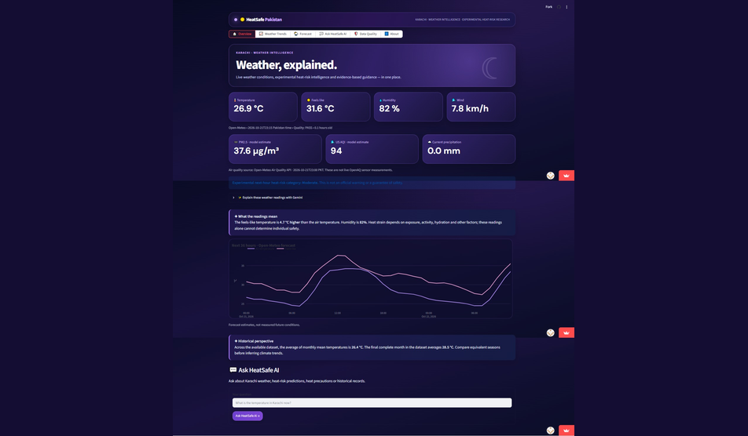
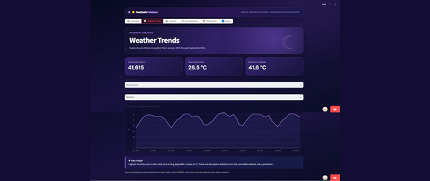
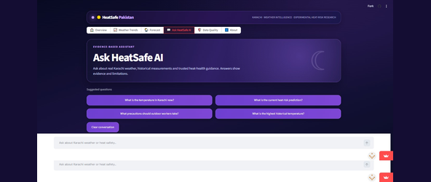
Dashboard / App Views
OVERVIEW
WEATHER TRENDS
Paste screenshot here
Paste screenshot here
ASK HEATSAFE AI
Paste screenshot here
Repo: github.com/WajihaAd/HeatSafe-Pakistan

Slide 7
Conclusion
Key finding 1
IMPACT
1
41,615 usable hourly rows shown in dashboard (2022–2026).
Residents can interpret local weather, trends and heat precautions in one place.
2
Key finding 2
66 cross-source temperature disagreements flagged for review.
FUTURE WORK
Extend to 2020–21; validate alerts; publish Prefect results; expand verified RAG corpus.
3
Key finding 3
ML proxy risk classifier achieved F1 0.852 on evaluation.

Slide 8
Team & Credits
HEATSAFE PAKISTAN TEAM
AB
AB
AB
Team member 1
Team member 2
Team member 3
Wajiha Adnan DT-23001
Sarisa Parvez DT-23026
Iqra DT-23048
Mentor / contact: add verified details | github.com/WajihaAd
Thank you!

