Slide 1
Statistical & Machine Learning Approaches for Marketing
Group-4 Presentation

Slide 2



TEAM
Wajih
Arfaoui
Aazad
Ghoslya
Harikrishnan
Gopalakrishnan

Slide 3
BUSINESS PROBLEM
A Portuguese financial institution uses telemarketing to predict the success of a campaign. In particular, the objective is to determine whether a client will subscribe to a term deposit in order to help the marketing team target potential clients.

Slide 4
PIPELINE
Data
Processing
Modeling
Experimental
setup
Debugging
Feature
Importance
Interpretability

Slide 5
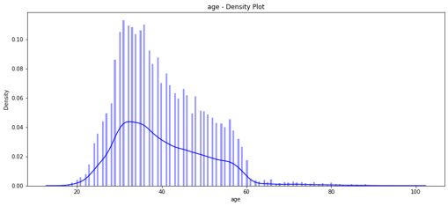
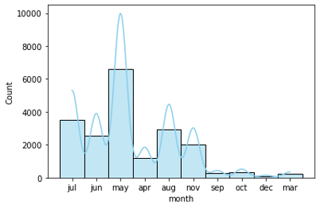
Engagement of Customers for different Months.
DATA EXPLORATION
Density Plot for Age of Customers.

Slide 6
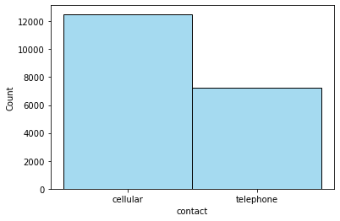
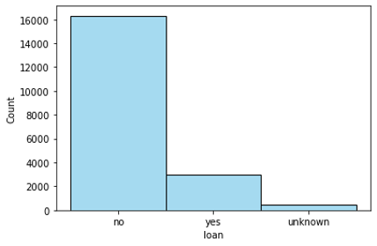
Loan Status and Count
Comparison between the Contact Type

Slide 7
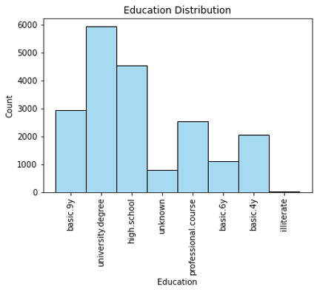
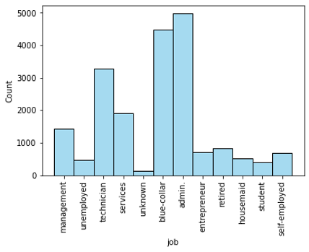
Qualification of Customers
Employment Type and Count

Slide 8
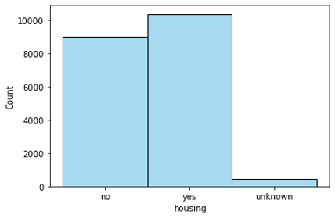
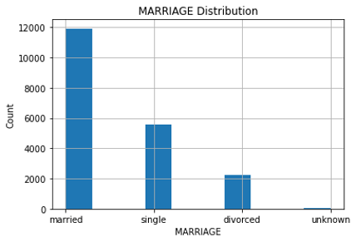
Housing Details
Customers Status

Slide 9
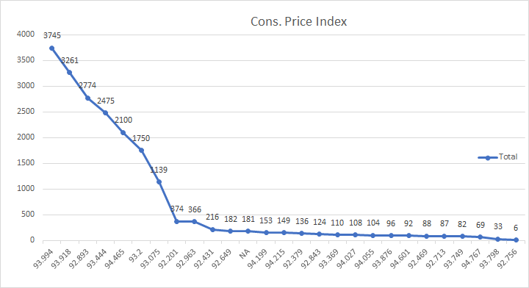
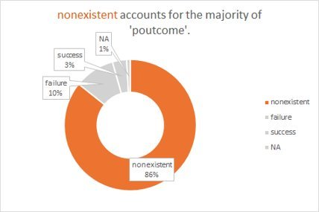
Poutcome & Accounts
Cons. Price

Slide 10
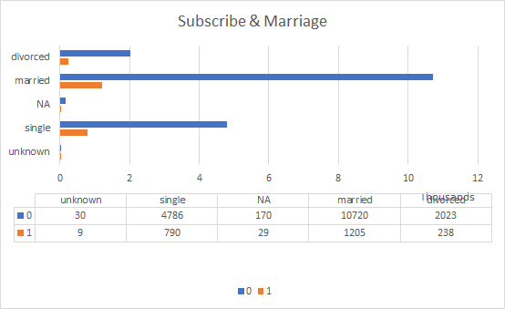
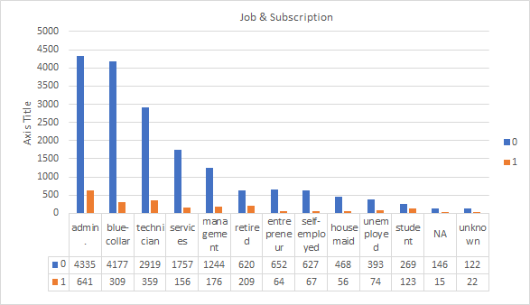
Subscription & Employment Type
Subscription & Marriage

Slide 11
DATA PREPARATION
Creating a List of column names to manage variables
Treating Missing Values
Checking for Outliers
Encoding the categorical variables

Slide 12
FEATURE ENGINEERING
Correlation test for numerical variables to detect the important variables.
Filtering low-variance variables
Re-Mapping Categorical variables
Incidence (of Target variable) replacement
Value Transformation
Value Representation
Discretizing (or Binning) Numerical Variables
Weight-of-Evidence Conversion
Adding Polynomial terms for Numerical Variables
Scaling the numerical variables and dropping the duplicated variables

Slide 13
FEATURE SELECTION
Generalized Fisher Score method is used for Feature selection.
Top 20 variables are selected based on the Fisher score for Data modeling.

Slide 14
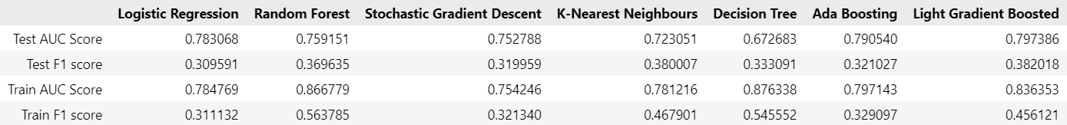
RAW MODEL BENCHMARKING Imbalanced data

Slide 15
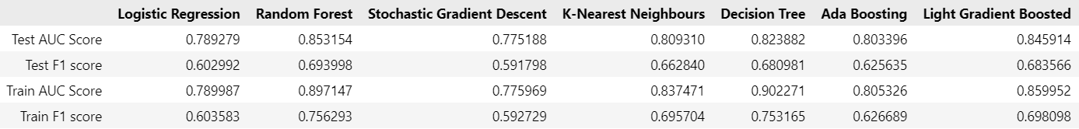
RAW MODEL BENCHMARKING Balanced data

Slide 16
HYPERPARAMETER TUNING

Slide 17
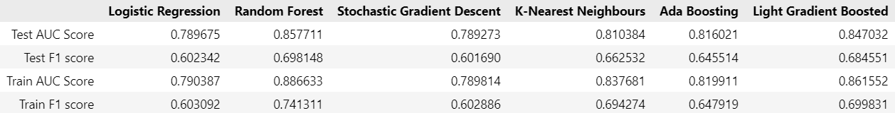
MODELS EVALUATION

Slide 18
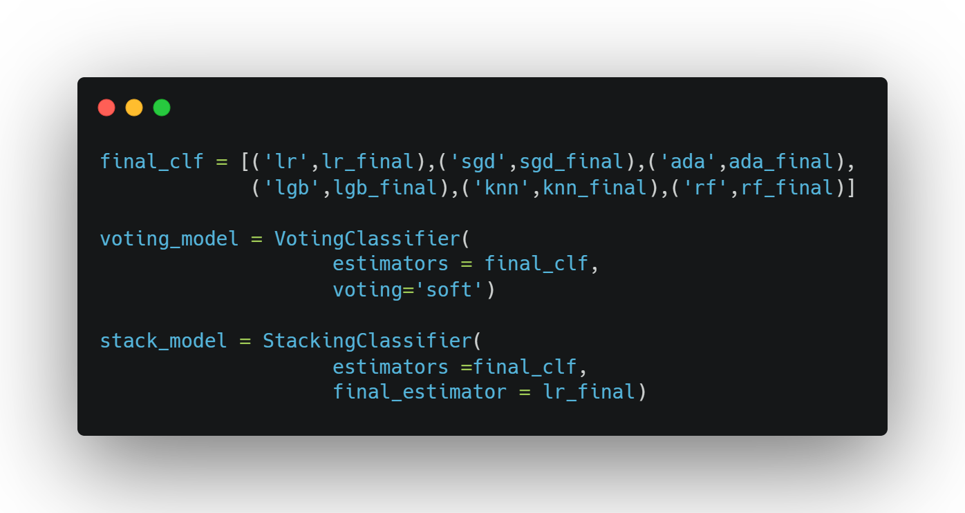
STACKING & VOTING CLASSIFIERS

Slide 19
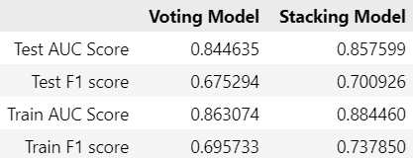
STACKING & VOTING EVALUATION

Slide 20


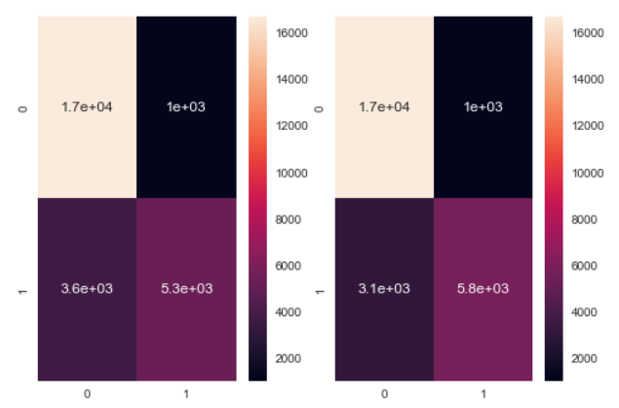
STACKING & VOTING EVALUATION

Slide 21
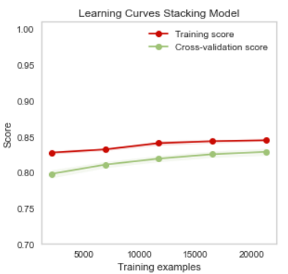
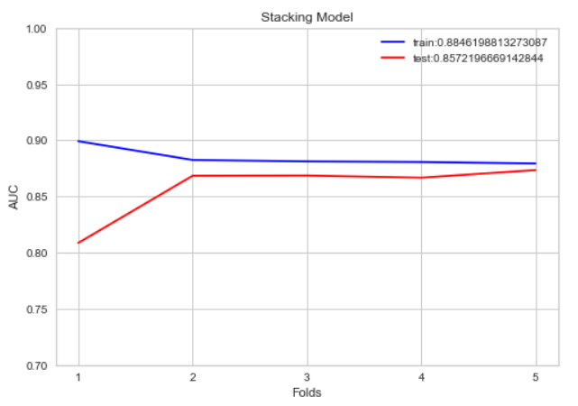
DEBUGGING

Slide 22
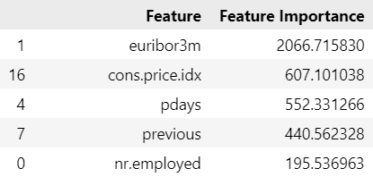
FEATURE IMPORTANCE
Social and economic context attributes
Campaign related attributes

Slide 23
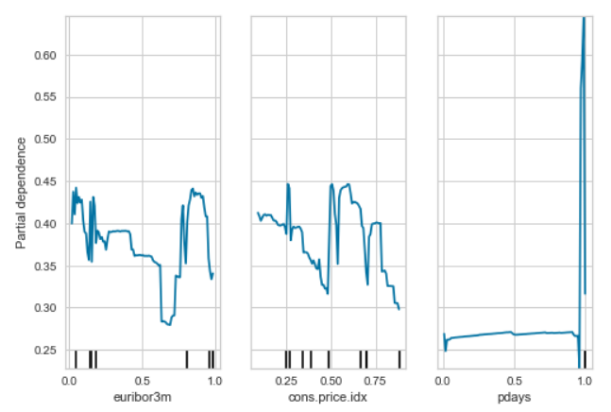
MODEL INTERPRETATION

Slide 24
REFERENCES
https://scikit-learn.org/
https://towardsdatascience.com/ensemble-learning-stacking-blending-voting-b37737c4f483
https://medium.com/@chaudhurysrijani/tuning-of-adaboost-with-computational-complexity-8727d01a9d20
https://www.analyticsvidhya.com/blog/2021/08/ensemble-stacking-for-machine-learning-and-deep-learning/?fbclid=IwAR23Z7CngObadE1NmGh72upRyNVvVIPT11xU01Bg-9wuGr7cPv6ULBgeXoA
https://medium.com/@nesrine.ammar/how-learning-curve-function-from-scikit-learn-works-692d7d566d17
https://towardsdatascience.com/ensemble-methods-comparing-scikit-learns-voting-classifier-to-the-stacking-classifier-f5ab1ed1a29d
https://towardsdatascience.com/custom-implementation-of-feature-importance-for-your-voting-classifier-model-859b573ce0e0
https://www.analyticsvidhya.com/blog/2020/10/how-to-use-stacking-to-choose-the-best-possible-algorithm/
https://python.hotexamples.com/examples/lightgbm/LGBMClassifier/fit/python-lgbmclassifier-fit-method-examples.html

Slide 25
Thank you

