Slide 1
System Design Document
Cs6310-A6 Group10

Slide 2
System Architecture
HTML/CSS/React
(View)
FrontEnd
JavaScript
(Model/Controller)
JSON
Java/Spring Boot
(RESTful/Business Logic/Data Access)
BackEnd
Data
(Scenario files: csv/Json)

Slide 3
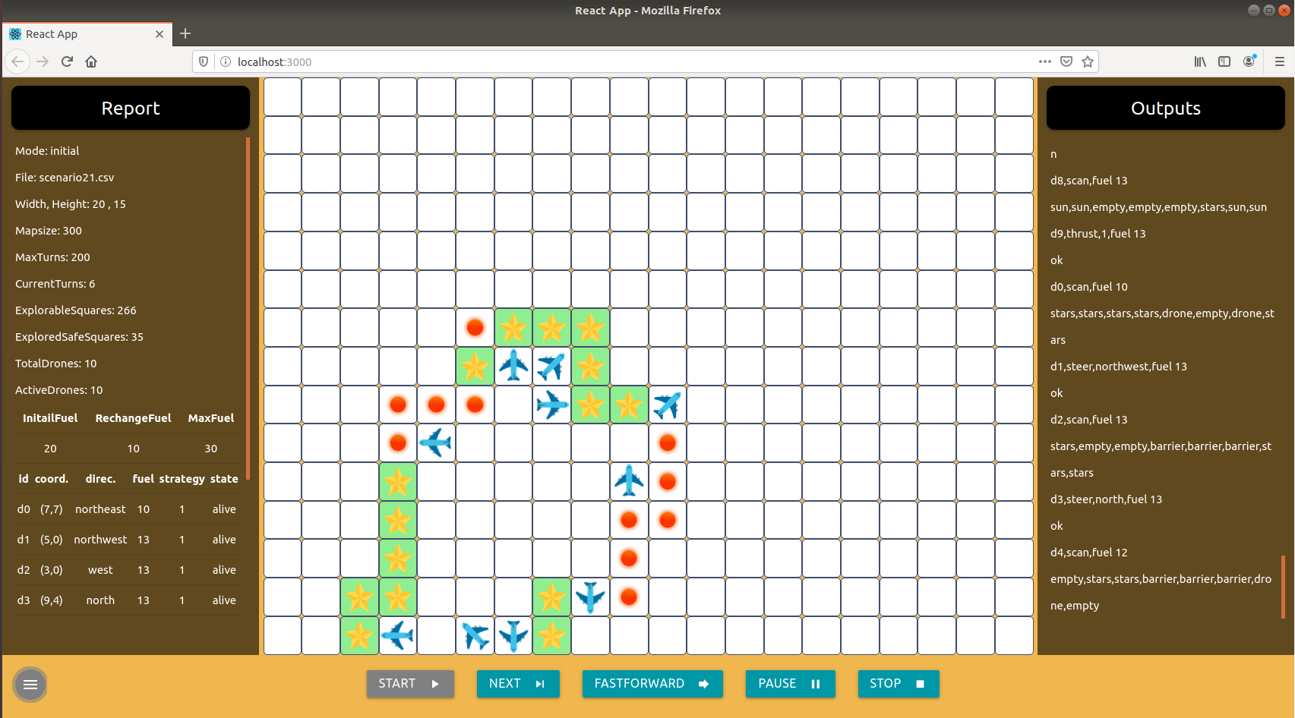
Development
/locathost:3000
React
(HTML, JS, CSS)
/web
npm start
Node Server
Proxy
Update
/locathost:8080
API
@RestController
@GetMapping
@RequestParam
RESTful Server

Slide 4
Define RESTful API
1. /starSearch/?filename=filename&mode=mode 2. /files?filename=fileName 3. /getStrat 4. /nextAction 5. /nextActionByUser/?action=action&param=param 6. /stop
Client
Web
Service
GET:
1. {“width”,“height”, “maxTurns”, “turns”, “fuels”, “explorableSquares”, “squares”, “safeSquares”, “totalDrones”, “drones”, “outputs”} 2. {“filesToInitial”, “filesToResume”} 3. “strat” (strategy) {“turns”, “squares”, “safeSquares”, “drones”, “outputs”} 5. {“turns”, “squares”, “safeSquares”, “drones”, “outputs”} 6. {“finalReport”}
RESPONSE :

Slide 5

Step-by-step Set up
Download virtual machine
Team_10.ova: https://drive.google.com/open?id=16u1_TMGzOWvij-xwguOu52lv8VLBoa11
(Md5sum: c11ffe3f4b0105c262471c521257c008 Password: group10)
Download and unzip source_code.zip from our group submission and store it in VM
Open terminal and go to /source_code
Run the command below to build and run file in the current directory: gradle run
Build and run successfully if you see the information below

Slide 6
Two Ways to Start GUI
Once backend build and run successfully, there are two ways to start GUI:
- Production Mode
Open the browser (Firefox), enter http://127.0.0.1:8080
- Development mode (OR you can start it with development mode)
Open Visual Studio Code, Click File -> Add folder to Workspace and select the folder source_code
Click Terminal -> New Terminal, cd web to go to the folder /web
To Install the dependencies in the local folder node_modules, run the command (once): npm install
To run server file and app in the development mode, use the command: npm start
The browser(Firefox) will open automatically with an address http://127.0.0.1:3000

Slide 7
Fuel & Energy Impacts
“Recharge” action is implemented as part of new functionality, which refuels the drones. Initial fuel, recharge fuel and max fuel are read from each scenario files. Drones will automatically take recharge action if their fuels are less than 3. Drones will carry a number of units of fuel but not exceeding the maximum number of fuels in the beginning. Each action costs a different unit of fuel, for example, Pass and Recharge cost 0 fuel, Steer and Scan cost 1 fuel, and thrust costs 1,2,3 fuel based on the steps the drones actually thrust.
 | Initial fuel | Recharge fuel | Max Fuel | Cost Fuel
 |  |  |  | Pass | Recharge | Steer | Scan | Thrust
Drone | Read from scenario files | Read from scenario files | Read from scenario files | 0 | 0 | 1 | 1 | thrust costs 1,2,3 fuel based on the steps

Slide 8
Fuel Test
To regenerate star_search.jar (already generated under source_code ), run the command under source_code :
gradle shadowjar
To save output to a scenario_results file, run the command:
java -cp star_search.jar simulator.Main scenario<N>.csv > scenario<N>_results.csv
Test one file as following (only test scenario files 2) :
java -jar fuel_test.jar 2 2
Test mulitple files as following (only test scenario files 3 to 5) :
java -jar fuel_test.jar 3 5
Or you can test all scenario files and save it to report.txt, run the command:
./test.sh > report.log

Slide 9
References
Building a RESTful Web Service: https://spring.io/guides/gs/rest-service/
Visual Studio Code: https://code.visualstudio.com/
Create a New React App: https://reactjs.org/docs/create-a-new-react-app.html
Gradle User Manual: https://docs.gradle.org/current/userguide/userguide.html
Materialize: https://materializecss.com/

