Slide 1
System Design Document
Cs6310-A6 Group10

Slide 2
System Architecture
HTML/CSS/React
(View)
FrontEnd
JavaScript
(Model/Controller)
JSON
Java/Spring Boot
(RESTful/Business Logic/Data Access)
BackEnd
Data
(Scenario files: csv/Json)

Slide 3
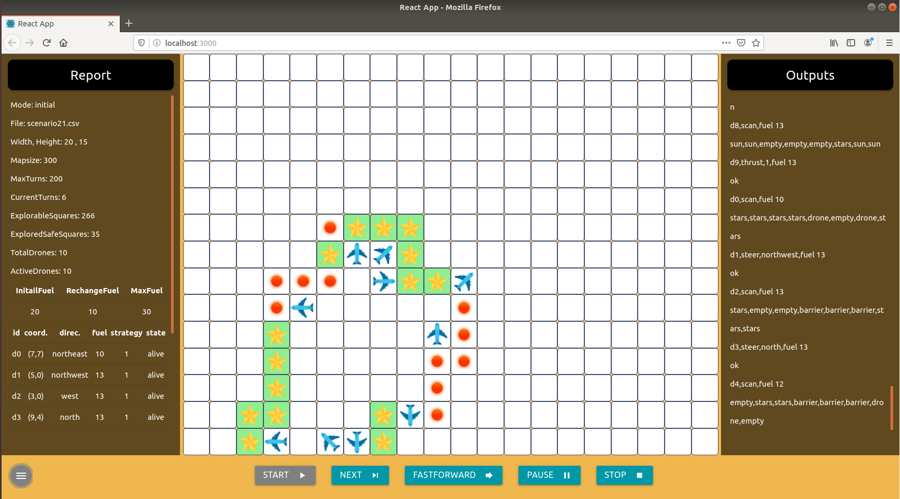
Development
/locathost:3000
React
(HTML, JS, CSS)
/web
npm start
Node Server
Proxy
Update
/locathost:8080
API
@RestController
@GetMapping
@RequestParam
RESTful Server

Slide 4
Define RESTful API
1. /starSearch/?filename=filename&mode=mode 2. /files?filename=fileName 3. /getStrat 4. /nextAction 5. /nextActionByUser/?action=action&param=param 6. /stop
Client
Web
Service
GET:
1. {“width”,“height”, “maxTurns”, “turns”, “fuels”, “explorableSquares”, “squares”, “safeSquares”, “totalDrones”, “drones”, “outputs”} 2. {“filesToInitial”, “filesToResume”} 3. “strat” (strategy) {“turns”, “squares”, “safeSquares”, “drones”, “outputs”} 5. {“turns”, “squares”, “safeSquares”, “drones”, “outputs”} 6. {“finalReport”}
RESPONSE :

Slide 5

Step-by-step Set up
Download virtual machine
Team_10.ova: https://drive.google.com/open?id=16u1_TMGzOWvij-xwguOu52lv8VLBoa11
(Md5sum: c11ffe3f4b0105c262471c521257c008 Password: group10)
Download and unzip source_code.zip from our group submission and store it in VM
Open terminal and go to /source_code
Run the command below to build and run file in the current directory: gradle run
Build and run successfully if you see the information below

Slide 6
Two Ways to Start GUI
Once backend build and run successfully, there are two ways to start GUI:
- Production Mode
Open the browser (Firefox), enter http://127.0.0.1:8080
- Development mode (OR you can start it with development mode)
Open Visual Studio Code, Click File -> Add folder to Workspace and select the folder source_code
Click Terminal -> New Terminal, cd web to go to the folder /web
To Install the dependencies in the local folder node_modules, run the command (once): npm install
To run server file and app in the development mode, use the command: npm start
The browser(Firefox) will open automatically with an address http://127.0.0.1:3000

Slide 7
References
Building a RESTful Web Service: https://spring.io/guides/gs/rest-service/
Visual Studio Code: https://code.visualstudio.com/
Create a New React App: https://reactjs.org/docs/create-a-new-react-app.html
Gradle User Manual: https://docs.gradle.org/current/userguide/userguide.html
Materialize: https://materializecss.com/

