Slide 1


HPPS PROJECT
Tutor: Matteo Ferroni
Professors: Donatella Sciuto, Marco D. Santambrogio
AndroBenchmark: high performance computation on android devices
Fabio1.gritti@mail.polimi.it
Sebastiano.mariani@mail.polimi.it
Fabio Gritti & Sebastiano Mariani – Hpps project

Slide 2


Situation now
Wide diffusion of mobile devices
Devices more complex and heterogeneous
Expectations about app’s performance are increasing
How can I obtain high performance from my app?
Fabio Gritti & Sebastiano Mariani – Hpps project
<numero>

Slide 3
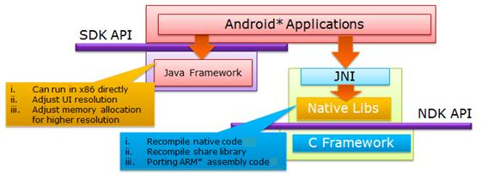
High performance on Android
How can I speed up my app?
Before Android 3.0 → SDK || NDK
After Android 3.0 → SDK || NDK || RenderScript
Fabio Gritti & Sebastiano Mariani – Hpps project
<numero>

Slide 4





Who is better?
NDK || RenderScript?
Portability
Performance
Power consumption
Our project
What is NDK? What is RenderScript?
Fabio Gritti & Sebastiano Mariani – Hpps project
<numero>

Slide 5

The Technology: NDK and RS
NDK
Exploits Java Native Interface ( JNI )
C/C++ toolchain with gcc compiler
App_complexity++
Portability--
RenderScript
Heterogeneous parallel computation
C99 kernels + toolchain with Clang compiler and LLVM
App_complexity--
( thanks to Reflected Layer )
Portability++
Fabio Gritti & Sebastiano Mariani – Hpps project
<numero>

Slide 6
The APP: androBENCHMARK
Analysis of performance
( execution's time in ms )
                +
Analysis of resistence
( # of executions on same data to lose 1% of battery )
<numero>
Fabio Gritti & Sebastiano Mariani – Hpps project
<numero>

Slide 7
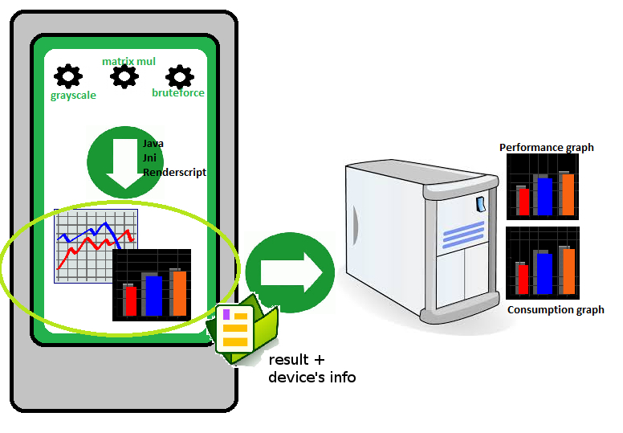


The APP: androBENCHMARK
Fabio Gritti & Sebastiano Mariani – Hpps project
<numero>

Slide 8
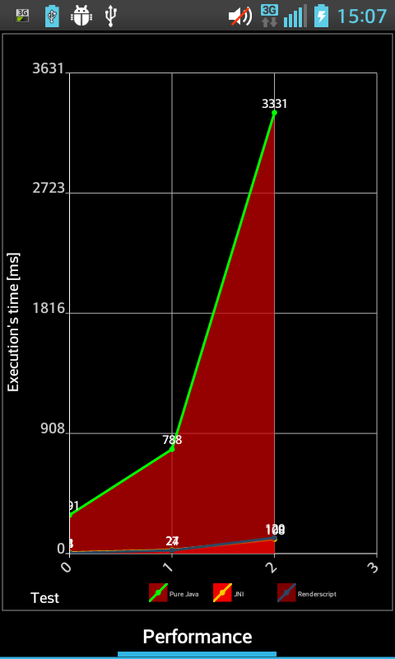
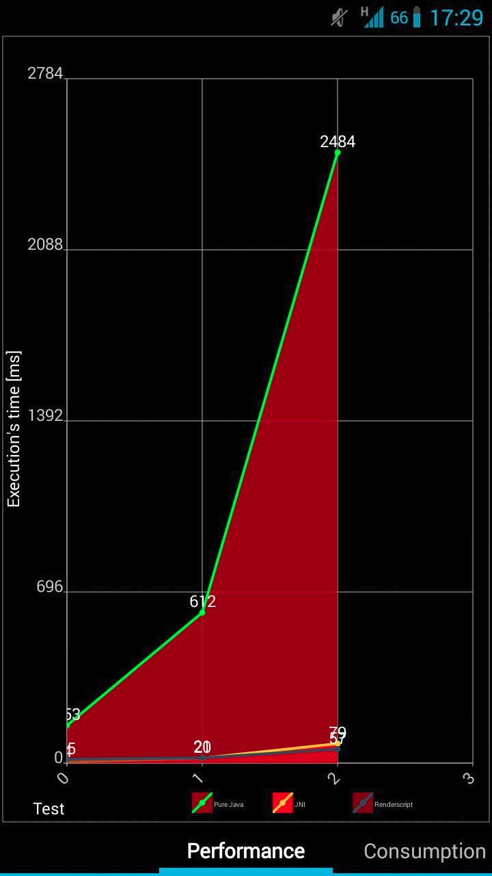
Discussion of local result ( Grayscale Performance )
LG L5
Galaxy SIII
IN THE TEST
N°2
JNI 26x
faster than Java
RenderScript 33x
faster than Java
RenderScript 1,3x
faster than JNI
IN THE TEST
N°2
JNI 31,4x
faster than Java
RenderScript 43,6x
faster than Java
RenderScript 1,4x
faster than JNI
391
Fabio Gritti & Sebastiano Mariani – Hpps project
<numero>

Slide 9
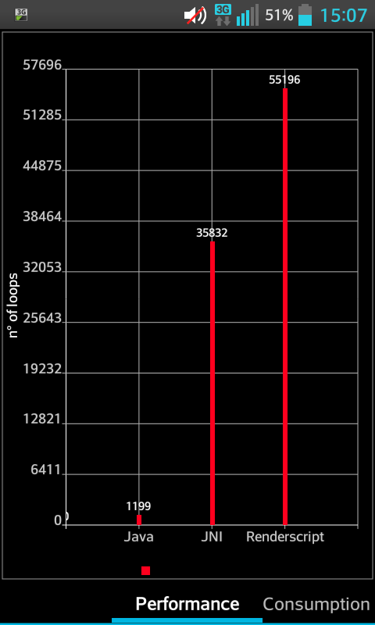
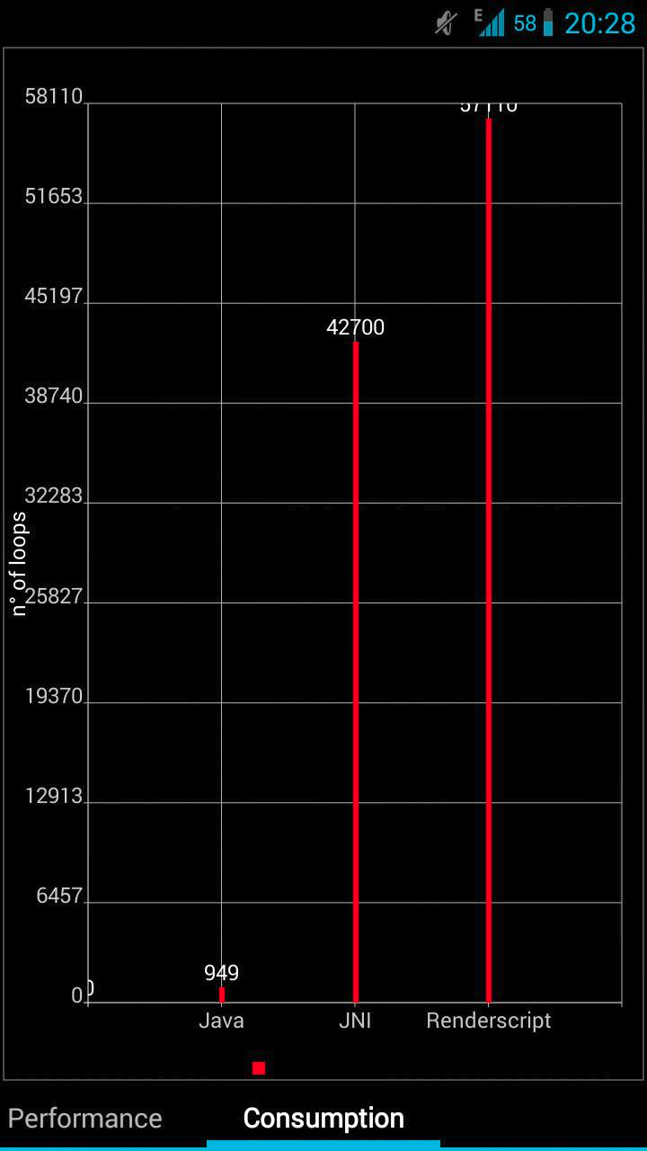
Discussion of local result (Grayscale loops untill lose of 1% battery )
LG L5
Galaxy SIII
LOOP
COMPARISON
RenderScript 1,5x
JNI loops
RenderScript 46x
Java loops
JNI 29,9x Java loops
LOOP
COMPARISON
RenderScript 1,3x
JNI loops
RenderScript 60x
Java loops
JNI 45x Java loops
57110
Fabio Gritti & Sebastiano Mariani – Hpps project
<numero>

Slide 10
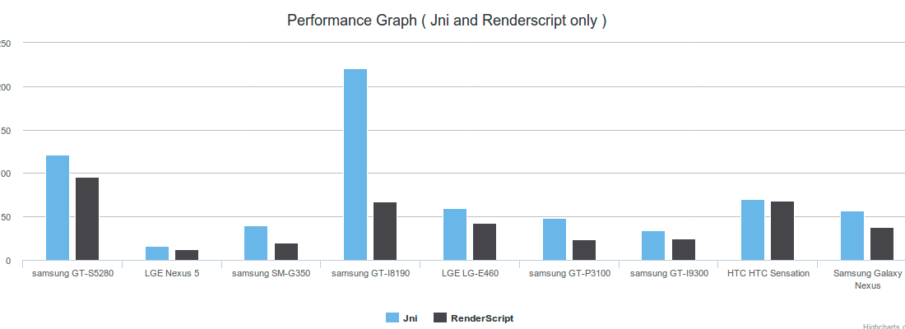
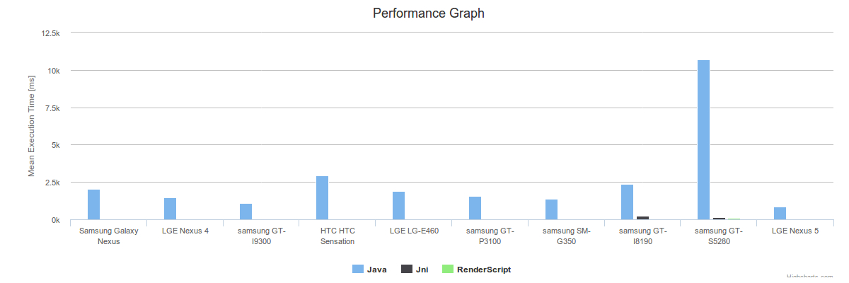
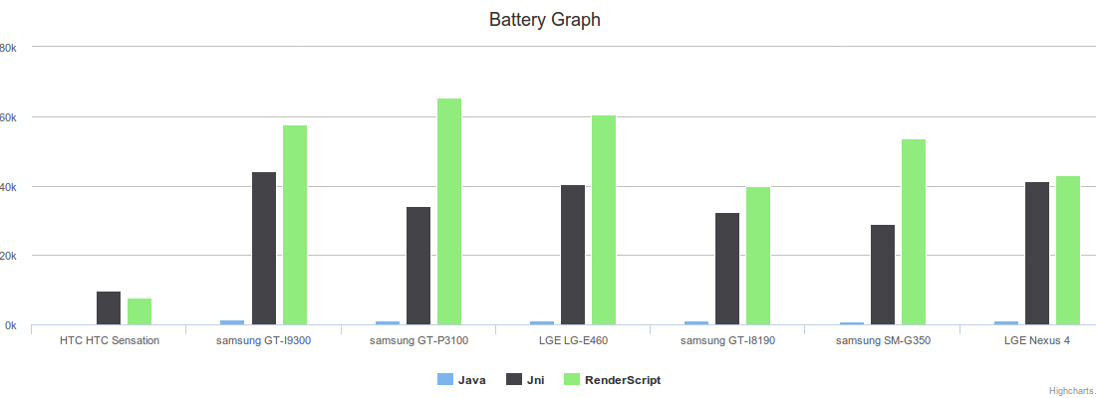
Discussion of global result (Grayscale)
Text...
Fabio Gritti & Sebastiano Mariani – Hpps project
<numero>

Slide 11
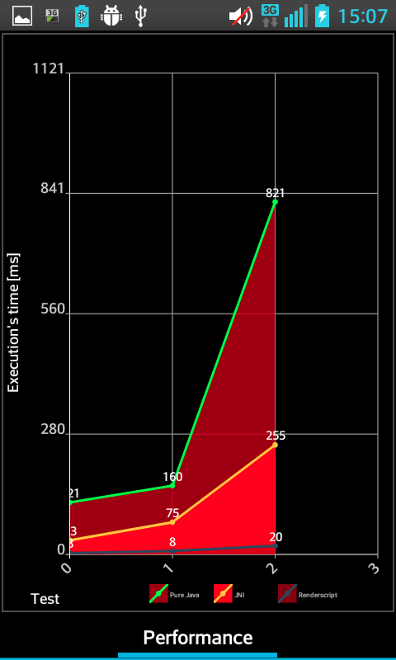
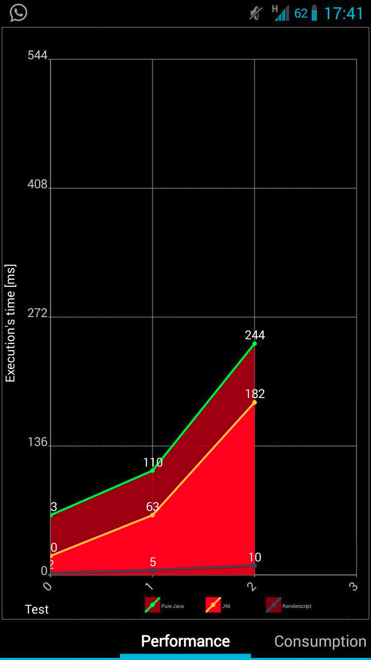
Discussion of local result ( Matrix Mult Performance )
LG L5
Galaxy SIII
IN THE TEST
N°2
JNI 3,2x faster than Java
RenderScript 41x
faster than Java
RenderScript 12,75x
faster than JNI
IN THE TEST
N°2
JNI 1,3x faster than Java
RenderScript 24,4x
faster than Java
RenderScript 18,2x
faster than JNI
Fabio Gritti & Sebastiano Mariani – Hpps project
<numero>

Slide 12
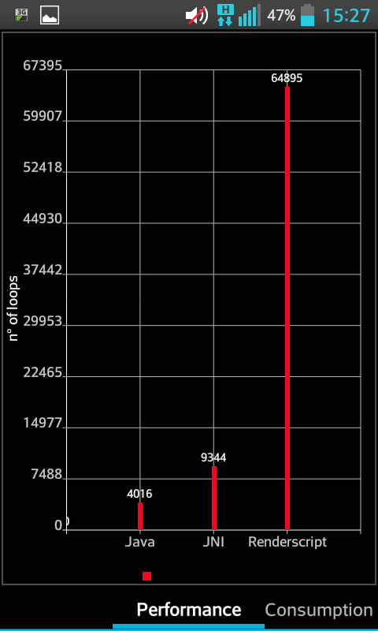
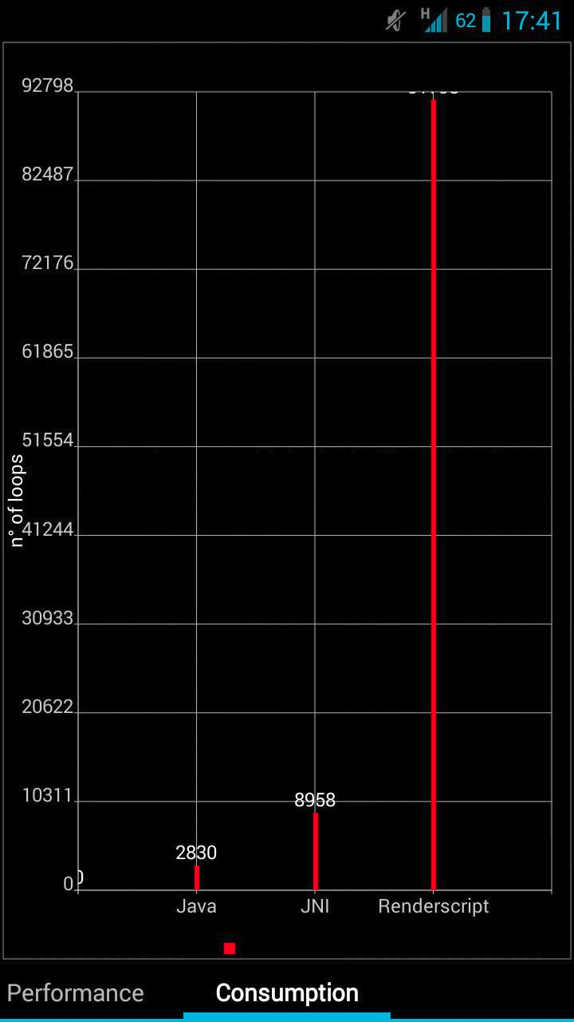
Discussion of local result (Matrix mult loops untill lose of 1% battery )
LG L5
Galaxy SIII
LOOP
COMPARISON
RenderScript 6,94x
JNI loops
RenderScript
16,2x Java loops
JNI 2,3x Java loops
LOOP
COMPARISON
RenderScript 10,2x
JNI loops
RenderScript
32,4x Java loops
JNI 3,2x Java loops
91729
Fabio Gritti & Sebastiano Mariani – Hpps project
<numero>

Slide 13
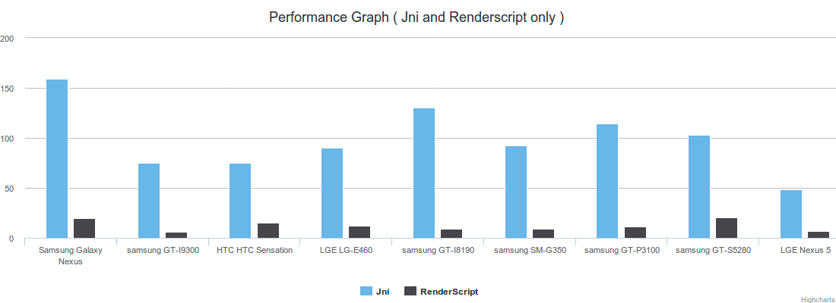
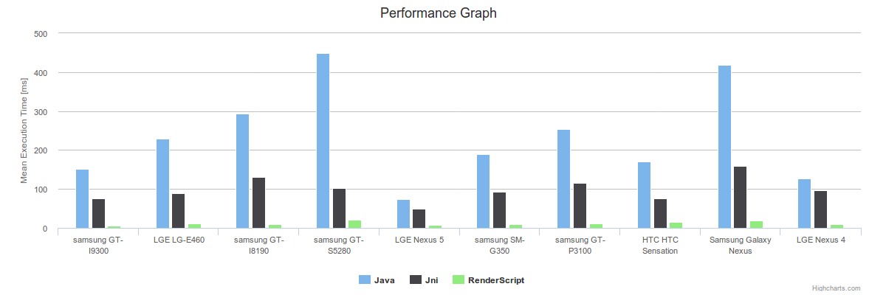
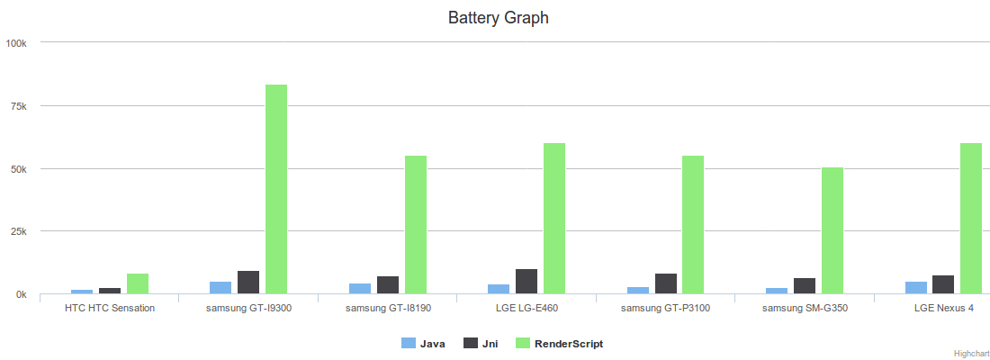
Discussion of global result (Matrix mult)
Text...
Fabio Gritti & Sebastiano Mariani – Hpps project
<numero>

Slide 14
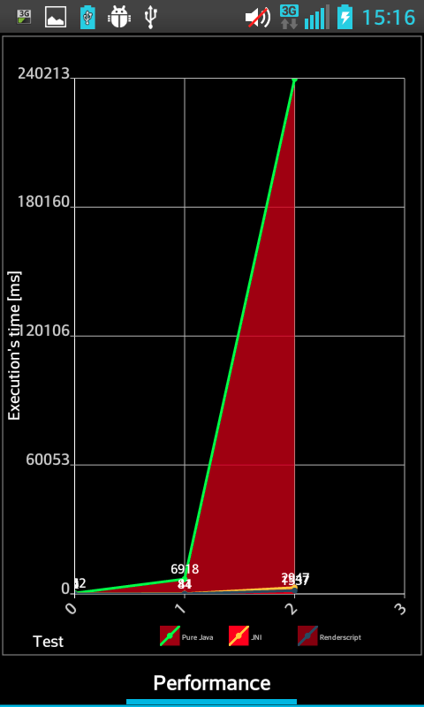
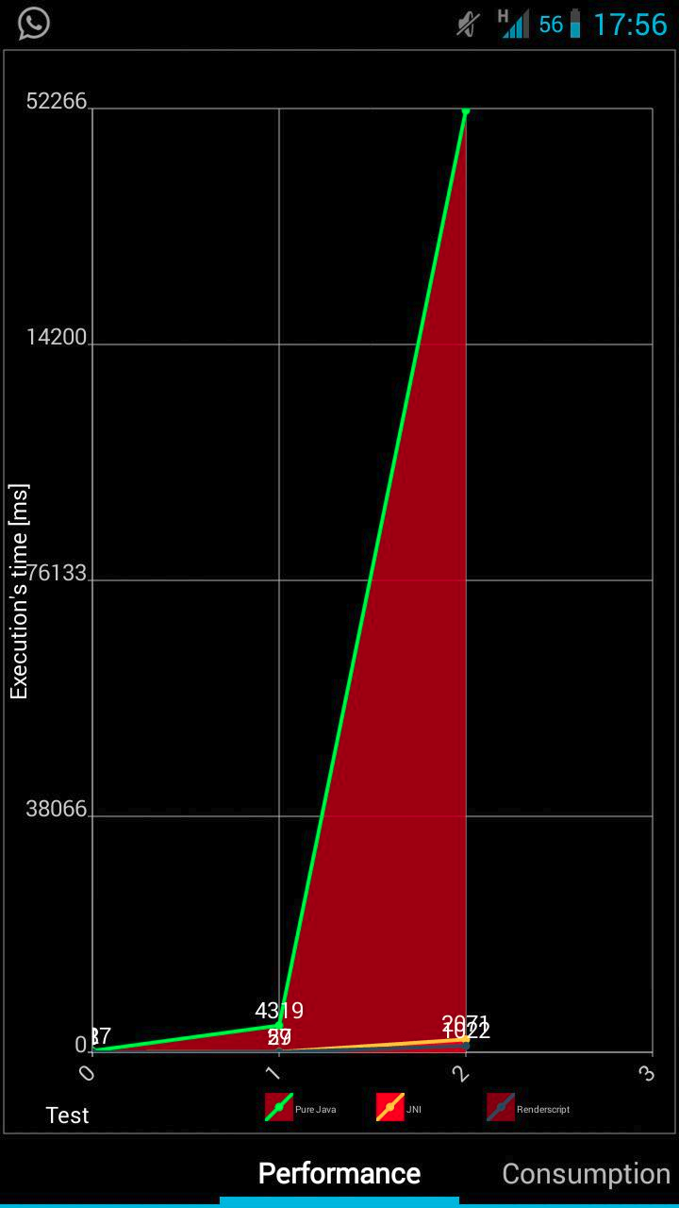
Discussion of local result (Bruteforce Performance )
LG L5
Galaxy SIII
IN THE TEST
N°2
JNI 81,5x
faster than Java
RenderScript 154,3x
faster than Java!
RenderScript 1,6x
faster than JNI
IN THE TEST
N°2
JNI 25,2x
faster than Java
RenderScript 51,1x
faster than Java!
RenderScript 2x
faster than JNI
240213
52266
Fabio Gritti & Sebastiano Mariani – Hpps project
<numero>

Slide 15
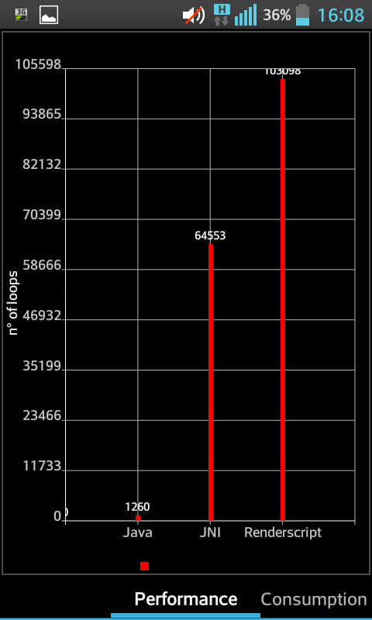
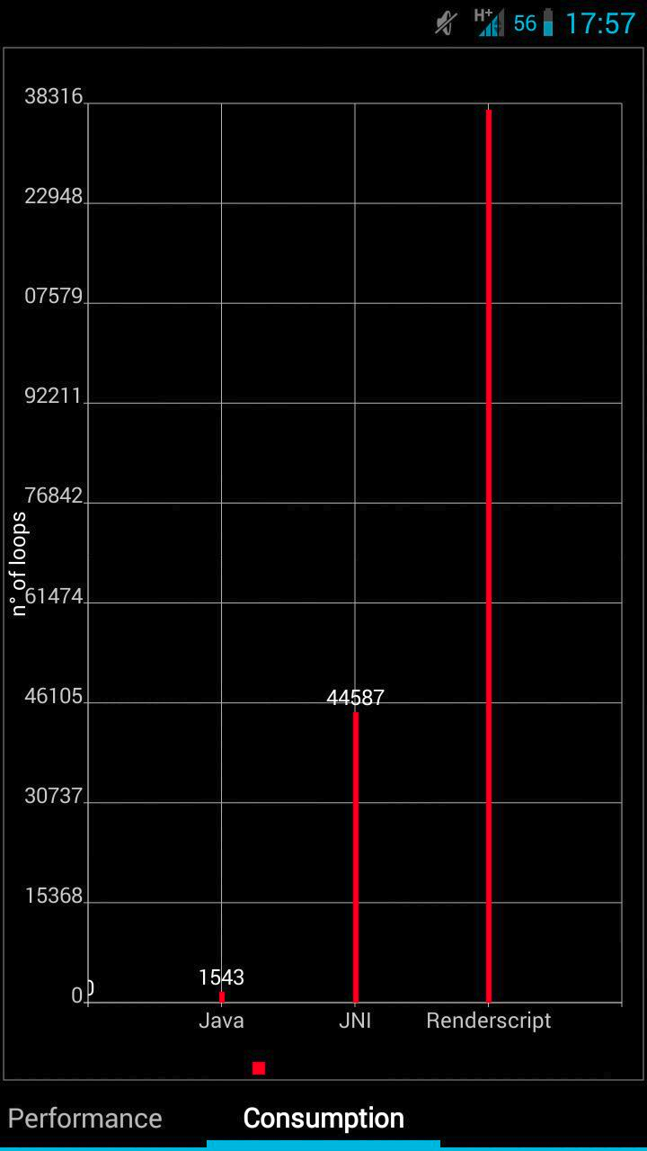
Discussion of local result (Bruteforce loops untill lose of 1% battery )
LG L5
Galaxy SIII
LOOP
COMPARISON
RenderScript 1,6x
JNI loops
RenderScript
81,8x Java loops
JNI 51,2x Java loops
LOOP
COMPARISON
RenderScript 3x
JNI loops
RenderScript
89,6x Java loops
JNI 28,9x Java loops
103098
1
138200
1
1
Fabio Gritti & Sebastiano Mariani – Hpps project
<numero>

Slide 16
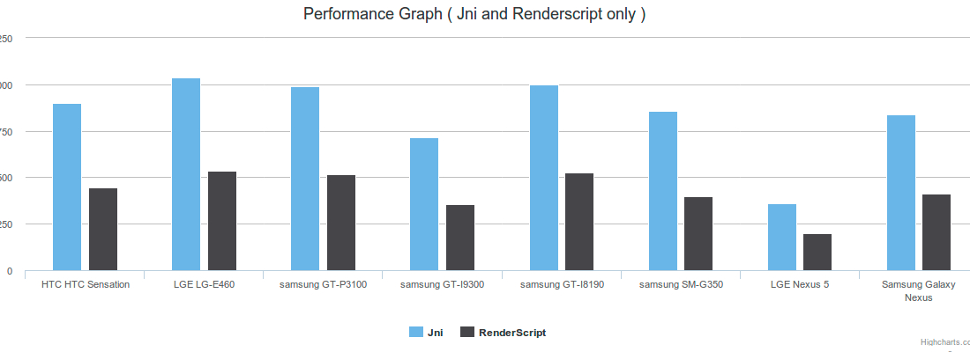
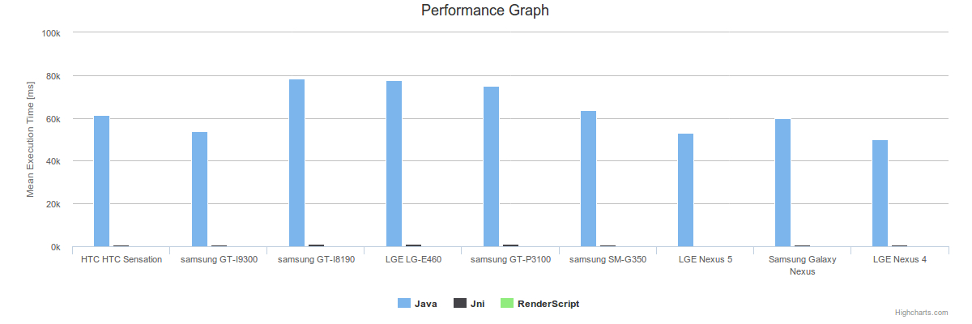
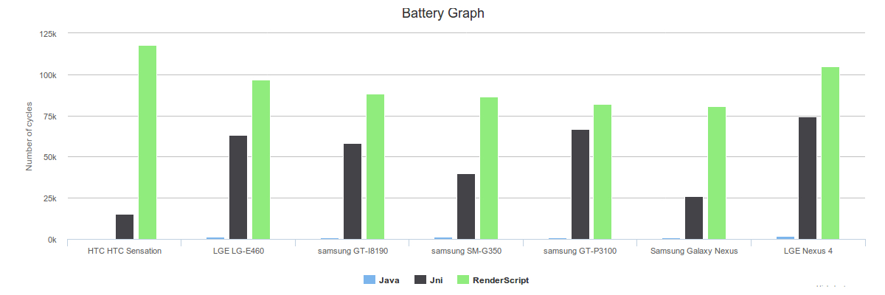
Discussion of global result (Bruteforce)
Text...
Fabio Gritti & Sebastiano Mariani – Hpps project
<numero>

Slide 17


Conclusion
In a future where the devices will be more complex and heterogeneous RenderScript can boost the performance of your app at no cost!
Renderscript has a great power in speed up particoular tasks respect to Java
According to global results obtained RenderScript tends to lose its benefit more slower than jni
RenderScript seems that is able to mantain its performance on old devices and new one ( with not so significantly difference in execution's time )
RenderScript provide us a larger number of loops with a restricted battery's budget
Fabio Gritti & Sebastiano Mariani – Hpps project
<numero>

Slide 18

EOF
QUESTIONS?
Fabio Gritti & Sebastiano Mariani – Hpps project
<numero>

Slide 19
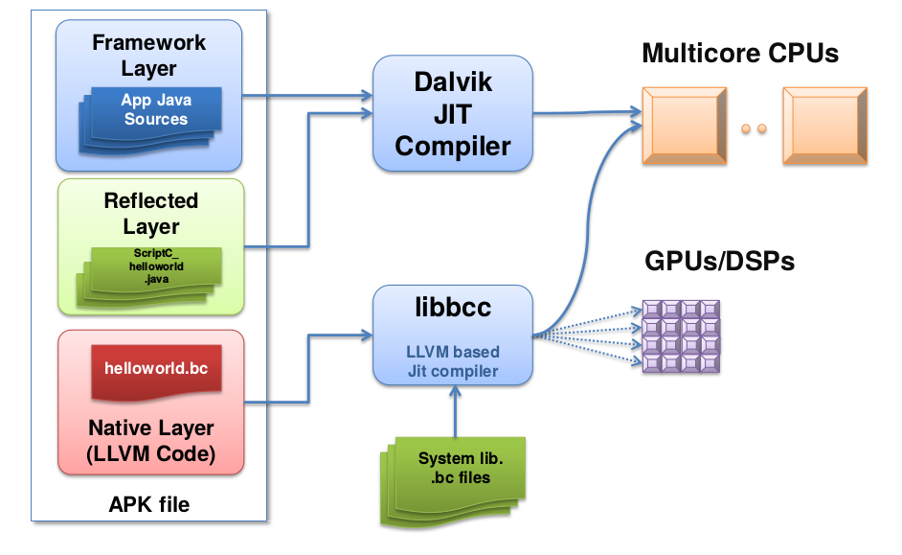
EXTRA : How RS works?
High-performance compute kernels written in a C99-derived language
+
A Java API used for managing the lifetime of RenderScript resources and controlling kernel execution
Fabio Gritti & Sebastiano Mariani – Hpps project
<numero>

