Slide 1
experiment
Lecture 1

Slide 2
Training Process

Slide 3




Supervised Learning
$$dataset=\{\left(x_{1},y_{1}\right),…(x_{n},y_{n})\}$$
model
$$x$$
$$\hat{y}$$
$$y$$

Slide 4

Supervised Learning - weight
model
$$x$$
$$\hat{y}$$
$$y$$
$$weight$$

Slide 5


Supervised Learning - testing
model
$$new$$
$$predict$$
$$weight$$

Slide 6
Tensorflow

Slide 7
tf.Session()
# Initializing the variables
init = tf.global_variables_initializer()
with tf.Session() as sess:
# start our mission
sess.run(init)
…
…

Slide 8
sess.run()
training
sess.run(optimizer, feed_dict={x: batch_x, y: batch_y})
Testing
loss = sess.run(cost, feed_dict={x: batch_x, y: batch_y})
our input

Slide 9
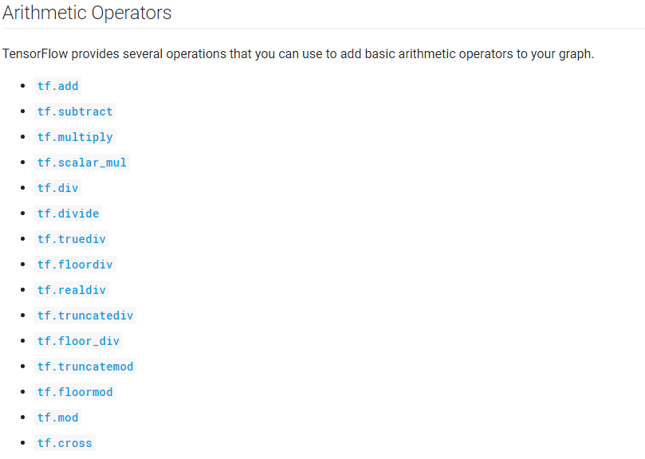
tensor
x = tf.placeholder("float", [None, input_size])
y = tf.placeholder("float", [None, input_size])

Slide 10
Model define - weight
# Define weights
Weight = {
'A' : tf.Variable(tf.random_normal([input_size, hidden])),
'A_bias': tf.Variable(tf.random_normal([hidden])),
'B' : tf.Variable(tf.random_normal([hidden, input_size])),
'B_bias': tf.Variable(tf.random_normal([input_size]))
}

Slide 11
Model define - operation
# our model
temp = tf.matmul(x, Weight['A']) + Weight['A_bias']
output = tf.matmul(temp, Weight['B']) + Weight['B_bias']
=>
temp = x*A + A_bias
output = temp*B + B_bias

Slide 12
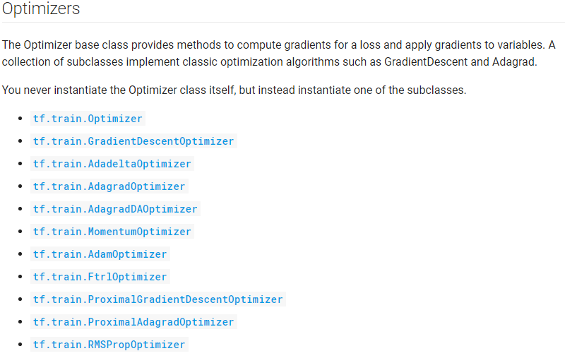
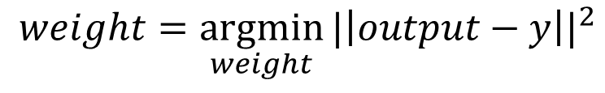
loss and optimizer
$$weight=\underset{weight}{argmin}{{|\left|output−y\right||}^{2}}$$
# Define loss and optimizer
cost = tf.reduce_mean(tf.square(output-y))
optimizer = tf.train.AdamOptimizer(learning_rate).minimize(cost)

Slide 13


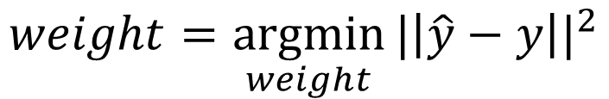

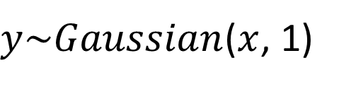
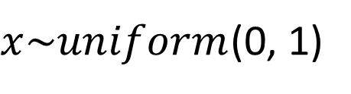

example
$x\sim uniform$(0, 1)
$$weight=\underset{weight}{argmin}{{|\left|\hat{y}−y\right||}^{2}}$$
$y\sim Gaussian$($x$, 1)
model
$$x$$
$$\hat{y}$$
$$y$$
$$weight$$

Slide 14
import tensorflow as tf
from numpy import random
save_route = 'save_program/save_net.ckpt'
# training parameters
display_step = 1
training_iters = 200000
learning_rate = 0.001
# model parameters
batch_size = 5
input_size = 10
hidden = 15
# Define weights
Weight = {
'A' : tf.Variable(tf.random_normal([input_size, hidden])),
'A_bias': tf.Variable(tf.random_normal([hidden])),
'B' : tf.Variable(tf.random_normal([hidden, input_size])),
'B_bias': tf.Variable(tf.random_normal([input_size]))
}
# model inputs
x = tf.placeholder("float", [None, input_size])
y = tf.placeholder("float", [None, input_size])
# our model
temp = tf.matmul(x, Weight['A']) + Weight['A_bias']
output = tf.matmul(temp, Weight['B']) + Weight['B_bias']
# Define loss and optimizer
cost = tf.reduce_mean(tf.square(output-y))
optimizer = tf.train.AdamOptimizer(learning_rate).minimize(cost)
# Initializing the variables
init = tf.global_variables_initializer()
# save
saver = tf.train.Saver()
# Launch the graph
with tf.Session() as sess:
sess.run(init)
# Training
step = 0
while step * batch_size < training_iters:
batch_x = random.random(size=(batch_size,input_size))
batch_y = random.random(size=(batch_size,input_size))
# produce y
for i in range(0, batch_size, 1):
for j in range(0, input_size, 1):
batch_y[i,j] = random.normal(batch_x[i,j], 1)
sess.run(optimizer, feed_dict={x: batch_x, y: batch_y})
# display
if step*batch_size % display_step == 0:
loss = sess.run(cost, feed_dict={x: batch_x, y: batch_y})
print("Iter " + str(step) + "-batch, loss= " + "{:.6f}".format(loss))
step += 1
print("Optimization Finished!")
save_path = saver.save(sess, save_route)

Slide 15
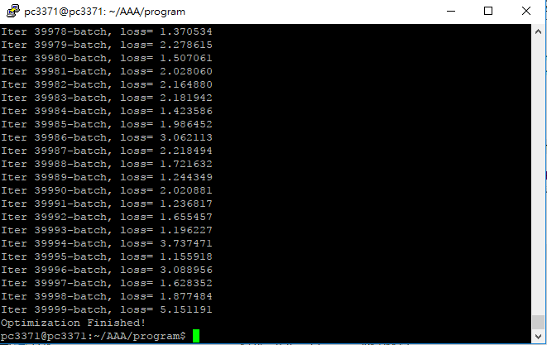
Experiment result

Slide 16
Testing
import tensorflow as tf
from numpy import random
save_route = 'save_program/save_net.ckpt'
# model parameters
batch_size = 5
input_size = 10
hidden = 15
# Define weights
Weight = {
'A' : tf.Variable(tf.random_normal([input_size, hidden])),
'A_bias': tf.Variable(tf.random_normal([hidden])),
'B' : tf.Variable(tf.random_normal([hidden, input_size])),
'B_bias': tf.Variable(tf.random_normal([input_size]))
}
# model inputs
x = tf.placeholder("float", [None, input_size])
y = tf.placeholder("float", [None, input_size])
# our model
temp = tf.matmul(x, Weight['A']) + Weight['A_bias']
output = tf.matmul(temp, Weight['B']) + Weight['B_bias']
# Define loss and optimizer
cost = tf.reduce_mean(tf.square(output-y))
# Initializing the variables
init = tf.global_variables_initializer()
# save
saver = tf.train.Saver()
# Launch the graph
with tf.Session() as sess:
saver.restore(sess, save_route)
print("Testing!")
batch_x = random.random(size=(batch_size,input_size))
batch_y = random.random(size=(batch_size,input_size))
# produce y
for i in range(0, batch_size, 1):
for j in range(0, input_size, 1):
batch_y[i,j] = random.normal(batch_x[i,j], 1)
loss, output = sess.run([cost, output], feed_dict={x: batch_x, y: batch_y})
print("loss: " + str(loss))
print("output: " + str(output))

