Slide 1
Employee Training Management Software

Slide 2
Abstract
The project aims to develop a Comprehensive Training Management System for a GMP compliant manufacturing organization with over 2000 employees. The system's primary goal is to streamline and automate training process, ensuring compliance with industry regulations and keeping the workforce updated with the latest skills.

Slide 3
Literature Survey

Slide 4
Objectives
Efficient Training Administration
Centralized Training
Performance Tracking and Reporting
Automated Alerts and Notifications
Enhanced User Experience

Slide 5
Existing Methods- Drawbacks
Cost
Complexity
Scalability
Integration Challenges
Resource Intensive
User Interface

Slide 6
Proposed Method
Web App

Slide 7
Modules
The proposed method includes the following modules:
User Management Module
Training Program Management Module
Employee Training Records Module
Alerts and Notifications Module
Support and Helpdesk Module

Slide 8


Architecture Diagram
Register
Login
View
Feedback
Update
Name
User Interface
Employee Id
Phone Number
(Optional)
DataBase
Email
Admin
Training
Complition
Department
Create
View
Update
Delete
Notify
Approve/DisApprove

Slide 9
Hardware & Software Detail
Apache
Visual Studio
HTML, CSS, JavaScript, C#, .NET, SQL
i3 5th gen 8GB RAM

Slide 10
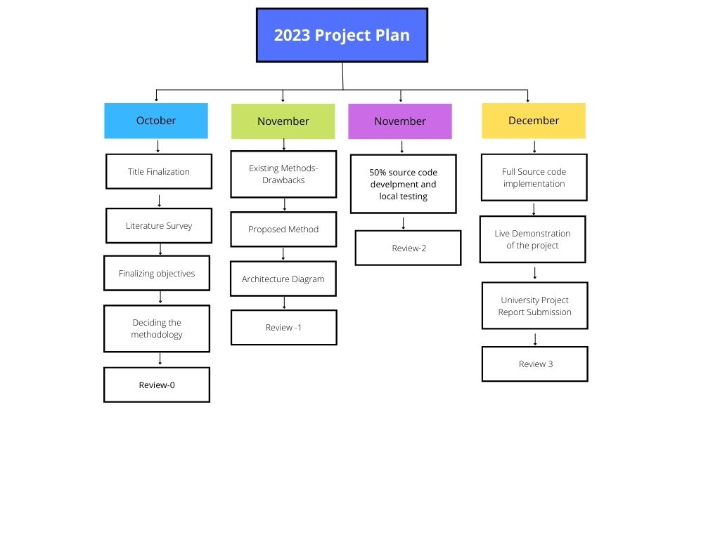
Timeline

Slide 11
References
[1]. Ms Kavitha AC, Madurai Kamaraj University, “Electronic - Human Resource Development (e - HRD) Software for Workforce Training Management – A Case Study of CVRDE”
[2]. Janet H. Marler, State University of New York at Albany, Xiaoya Liang,
Fudan University in Shanghai, China, James Hamilton Dulebohn, Michigan State University, “Training and Effective Employee Information Technology Us”

Slide 12
Thank You

