Slide 1
MATLAB
Programming Assignment One

Slide 2
Write your programs in a file.
The file name is yourStudentID_YourName.m.
For example, if you name is Peter and ID is 12345678, then the file name must be 12345678_Peter.
Output the results that are required only.
Do not output all the results.
You must not input the elements explicitly one by one.

Slide 3
For each problem, display the problem number before showing the results.
disp(‘Problem 1.1’) % show Problem 1.1

Slide 4
At the top of the file, write down your name, ID, email address, department, and date.
%%%%%%%%%%%%%%%%%%%%%%%%%%%
% Assignment Number: …
% Student Name: …
% Student ID: …
% Email address: …
% Department: Computer Science, NCTU
% Date: ….
%%%%%%%%%%%%%%%%%%%%%%%%%%%%

Slide 5
Example
Create the following matrix.
n = 10;
z =
1 2 3 4 5 6 … 10 % contains n elements
Use at most two instructions. You can change n to get a new row vector.
=================================================================
If you type
n = 10; % instruction 1. You must write this instruction.
z = [1 2 3 4 5 6 7 8 9 10] % instruction 2
Your score is zero.
=================================================================
You may type:
n = 10; % do not output n
z = [1:n ] or z = [1:1:n]

Slide 6
Problem Set 1

Slide 7
Problem 1.1
Create the following matrix.
% the elements are from –n to n, with increments of 2.
n = 8;
P =
-8 -6 -4 -2 0 2 4 6 8
Use at most two instructions, (including instruction: n = 8; )
You can change n to get a new row vector.

Slide 8
Problem 1.2
Create the following matrix.
z =
-0.0370 0.2500 -1.0000 1.0000 1.0000 4.0000 27.0000
-0.0370 0.2500 -1.0000 1.0000 1.0000 4.0000 27.0000
-0.0370 0.2500 -1.0000 1.0000 1.0000 4.0000 27.0000
-0.0370 0.2500 -1.0000 1.0000 1.0000 4.0000 27.0000
-0.0370 0.2500 -1.0000 1.0000 1.0000 4.0000 27.0000
-0.0370 0.2500 -1.0000 1.0000 1.0000 4.0000 27.0000
-0.0370 0.2500 -1.0000 1.0000 1.0000 4.0000 27.0000
Use at most 3 instructions.
Hint: use meshgrid

Slide 9
Problem 1.3
Create the following matrix.
n = 10;
X = [1 -1 1 -1 1 -1 … ] % contains n elements
Use at most 4 instructions, (including instruction: n = 10; )
You can change n to get a new row vector.

Slide 10
Problem 1.4
Create the following matrix.
n = 10;
X = [1 2 1 2 1 2 … ] % contains n elements
Use at most 2 instructions (including instruction: n = 10; )
You can change n to get a new row vector.
You must not use mod.

Slide 11
Problem 1.5
Create the following matrix.
n = 10;
X = [1 2 3 1 2 3 … ] % contains n elements
Use at most 2 instructions (including instruction: n = 10; )
You can change n to get a new row vector.
You can use mod operator.
https://www.mathworks.com/help/matlab/ref/mod.html

Slide 12
Problem Set 2

Slide 13
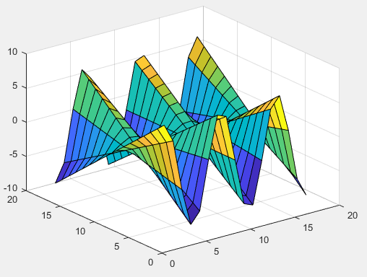
Problem Set 2 Problem 2.1
Plot a graph
z = y sin(x)
x in [-8, 8]
y in [-8, 8]
Use: shading faceted
You can use a smaller step size to get a smoother surface.
Type: help shading
Try different shading methods: flat, interp, faceted

Slide 14
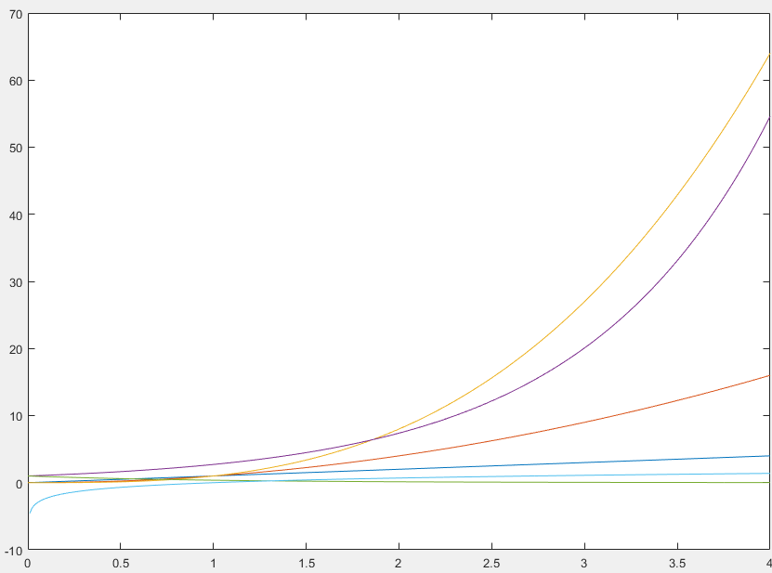
Problem Set 2 Problem 2.2
Plot the following functions in the same figure.
y = x;
y = x²;
y = x³;
y = e^{x}
y = e^{-x}
y = log x
x in [0, 4]. Step size 0.01.
You can use clf to clear all figures.
Do you know how to label the curves?
e is the natural log base.

Slide 15
Problem Set 2 Problem 2.3
Plot the composite function z(x, y(x)) with solid line segments and ‘o’.
y = sin(x) – x;
z = sin(y²) – e^{x}/x;
x is inside [-10, 10].
e is the natural log base.
x’s step size is 0.5 when plot in ‘o’ style. Could we use step size 0.001?
x’s step size is 0.001 when plot in line segments

Slide 16
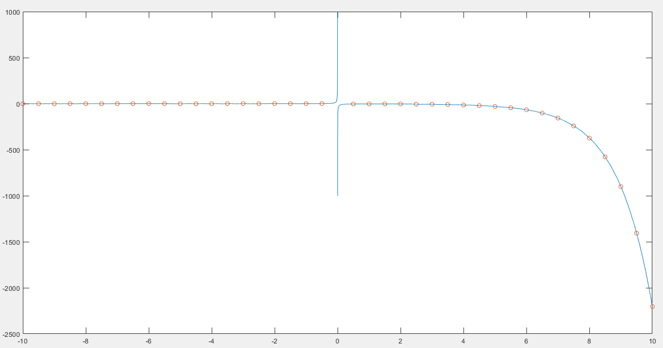
y = sin(x) – x; z = sin(y²) – e^{x}/x;

Slide 17
Problem Set 2 Problem 2.4
Plot the following surface.
z = (x + y) / (x² + y² + 1)
x is inside [-10, 10].
y is inside [-10, 10].
Step size is 0.5.
Use meshc, and shading faceted.
Try to use a step size: 0.01. Check the result again.
Use clf to clear the figure.

Slide 18
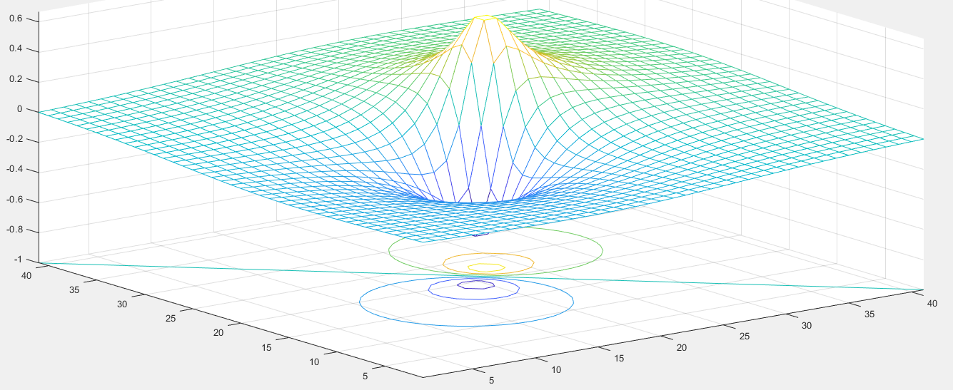
z = (x + y) / (x² + y² + 1)

Slide 19
Problem Set 2 Problem 2.5
Plot the following functions.
y = 0.5 + (x sin x) / ( x² e ^{sin x} + 1);
y = cos²x + sin²x
x is inside [-10, 10].
x’s step size is 0.05;
You can use size(x, 2) to get the number of columns of x.

Slide 20
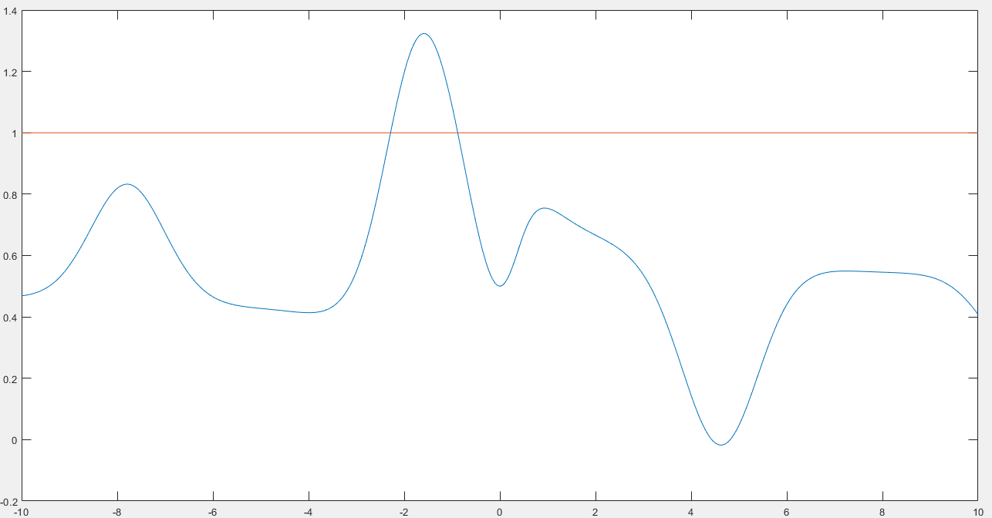
y = 0.5 + (x sin x) / ( x² e ^{sin x} + 1); y = cos²x + sin²x

Slide 21
M file format
%%%%%%%%%%%%%%%%%%%%%%%%%%%
% Assignment Number: …
% Student Name: …
% Student ID: …
% Email address: …
% Department: … + university
% Date: ….
%%%%%%%%%%%%%%%%%%%%%%%%%%%%
%
disp(‘Problem 1.1’); clf; clear; clc;
…
Disp(‘Problem 1.2’); clf; clear; clc;
…

Slide 22
End
Enjoy MATLAB Programming.

