Slide 1
Supplemental
Sai-Keung Wong
National Chiao Tung Unviersity, Hsinchu, Taiwan

Slide 2
Algebraic expression
In mathematics, an algebraic expression is an expression built up from integer constants, variables, and the algebraic operations (addition, subtraction, multiplication, division and exponentiation by an exponent that is a rational number).
https://en.wikipedia.org/wiki/Algebraic_expression

Slide 3
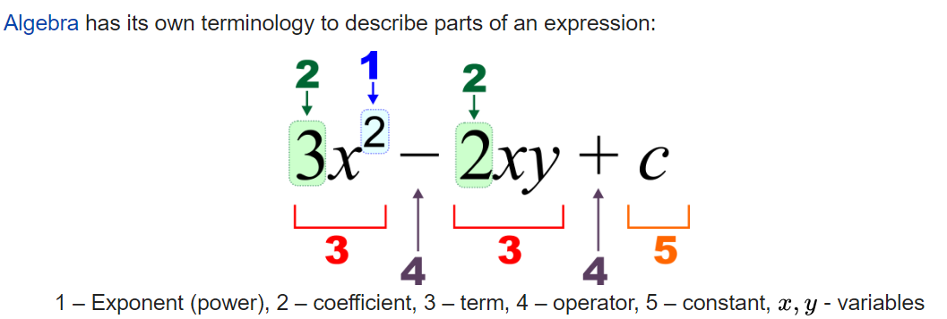
Terminology
https://en.wikipedia.org/wiki/Algebraic_expression

