Slide 1
ISE tutorial
柏宏

Slide 2
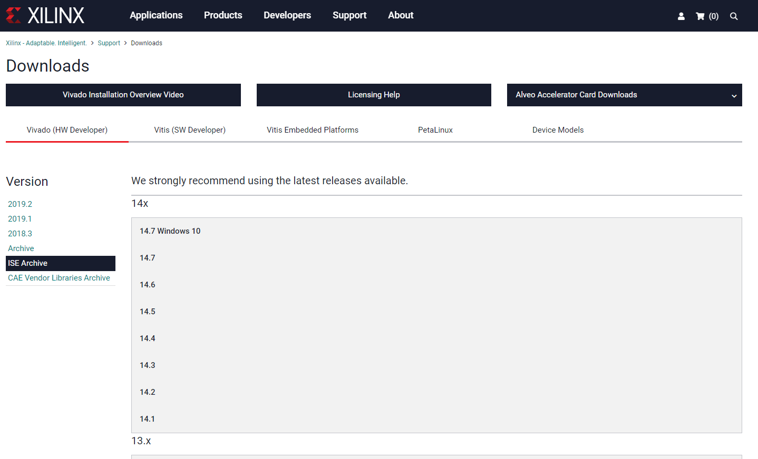
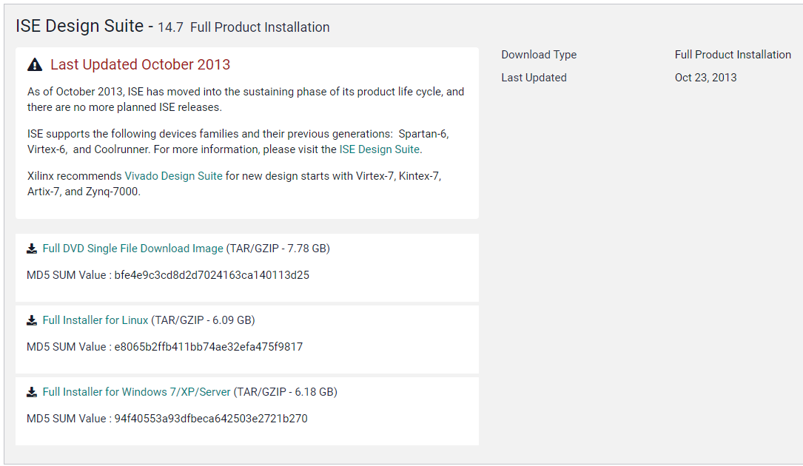
Download
website: https://www.xilinx.com/support/download/index.html/content/xilinx/en/downloadNav/vivado-design-tools/archive-ise.html
14.7 win10 version: base on VM
If you are lazy, you can choose these
Download
-> Win 10 has bugs need to fix

Slide 3
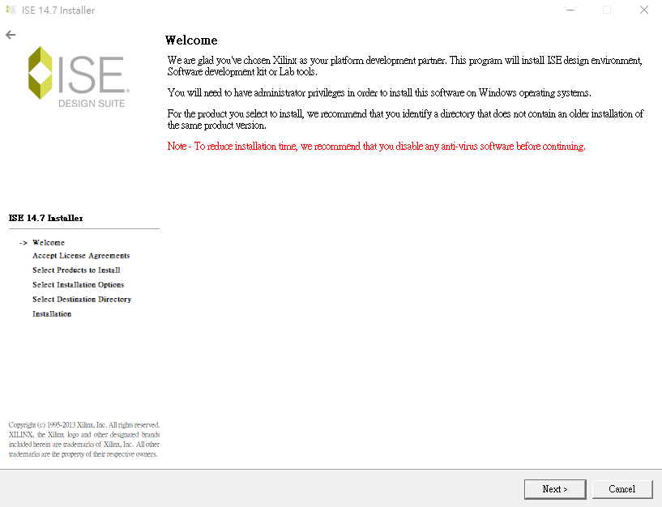
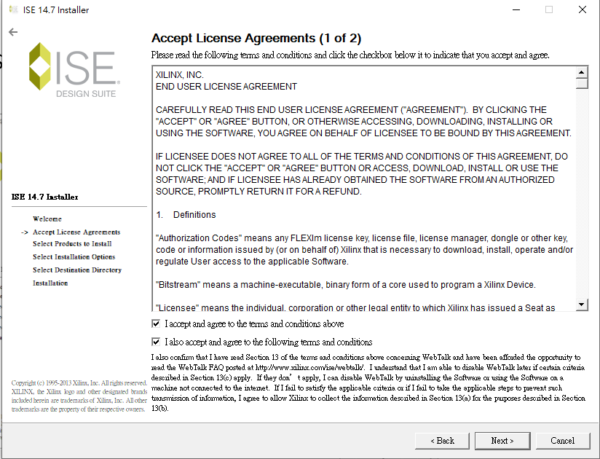
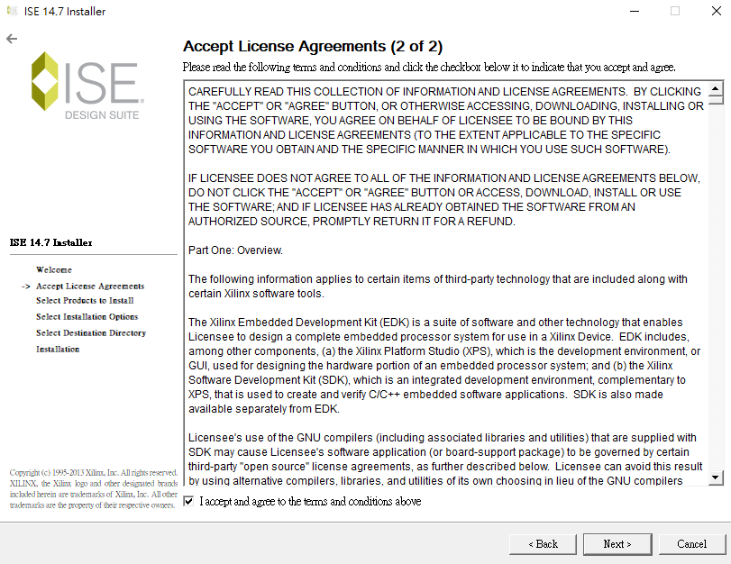
Install ISE 14.7

Slide 4
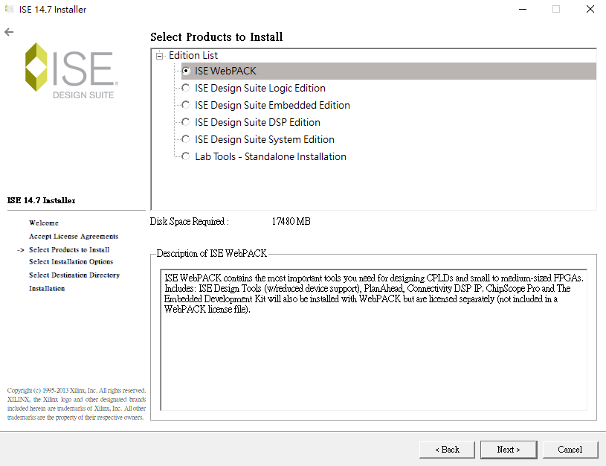
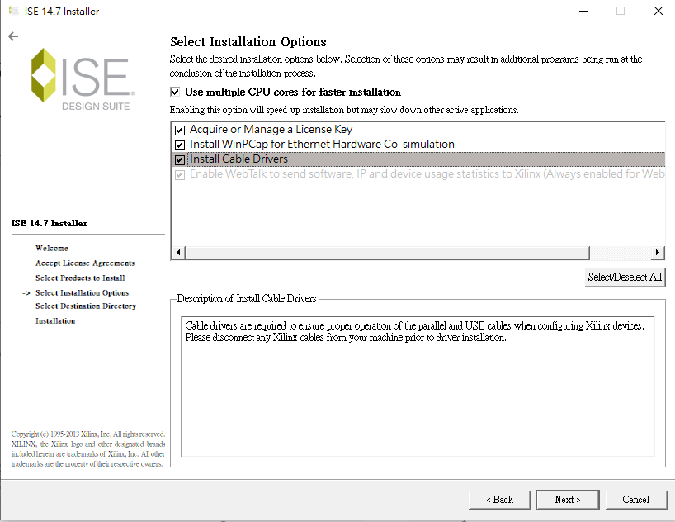
Install ISE 14.7
Choose ISE WebPack (free) Edition

Slide 5
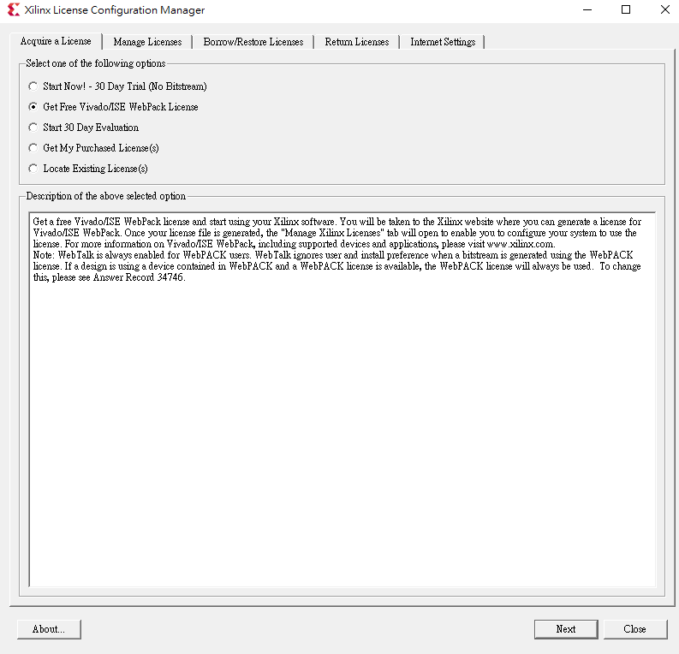
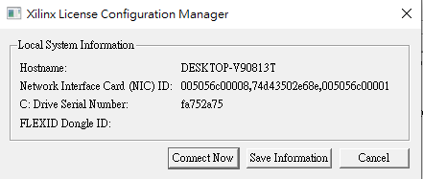
Get Free license
Choose ‘Get Free ISE WebPack License’ and ‘click Connect Now’

Slide 6
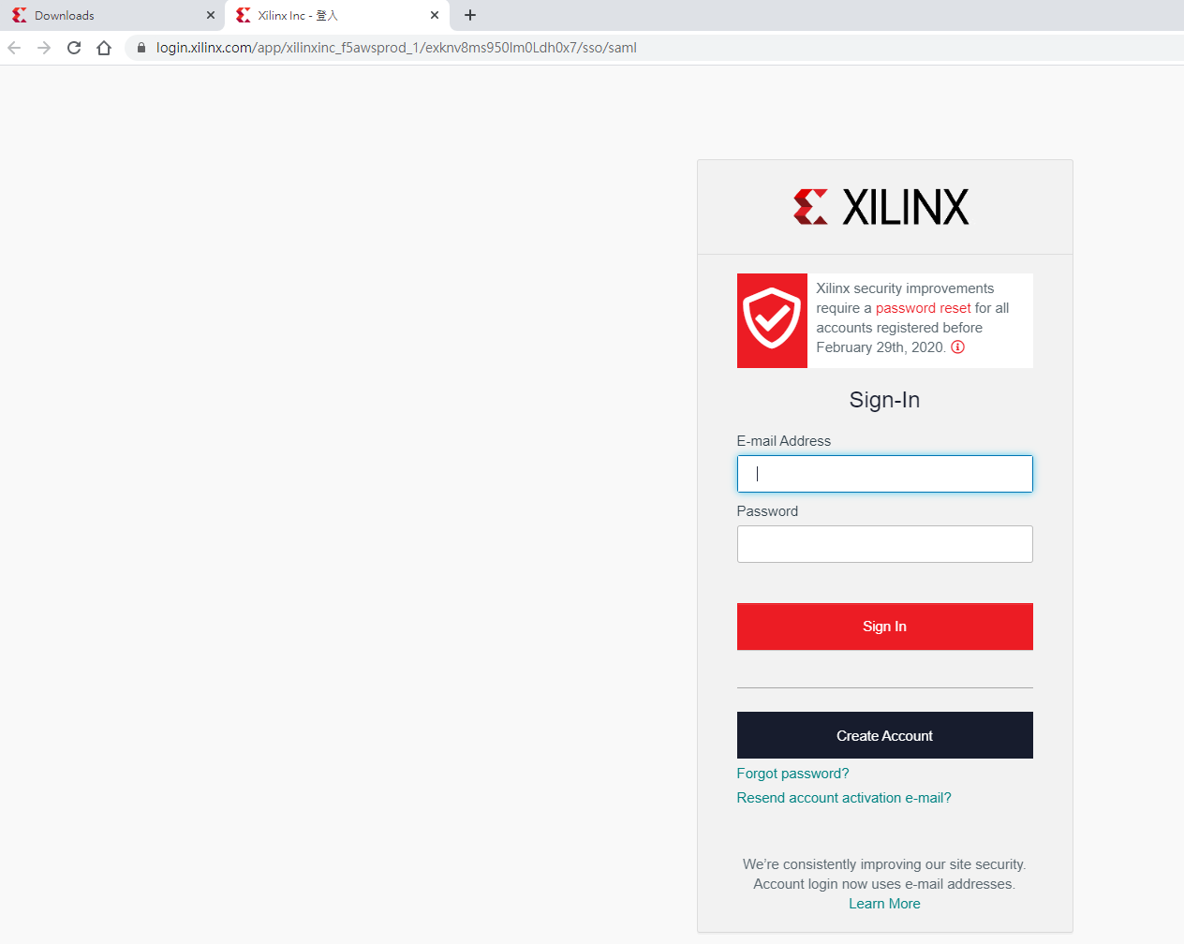
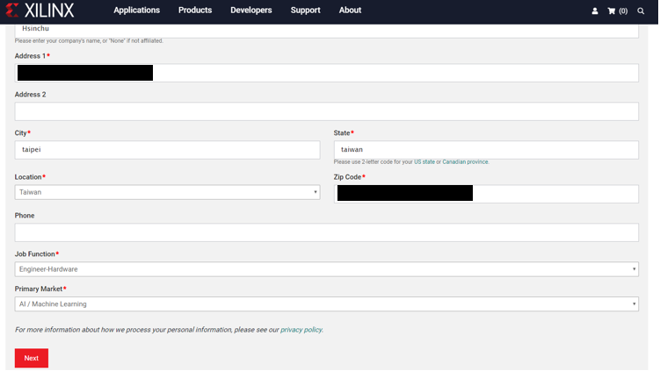
Get Free license
Sign in & fill out verification form

Slide 7
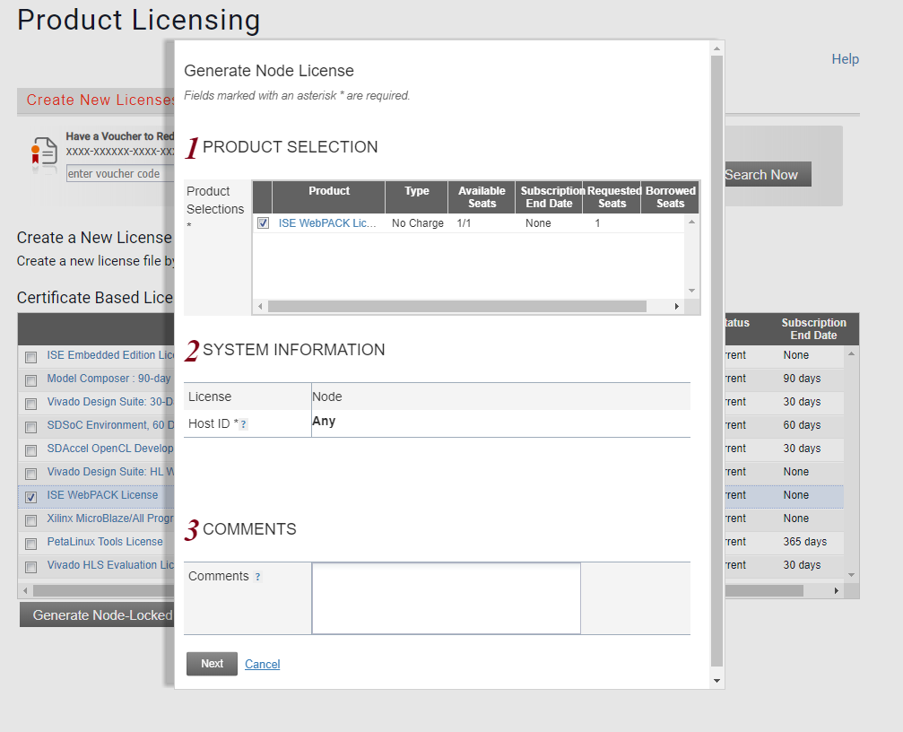
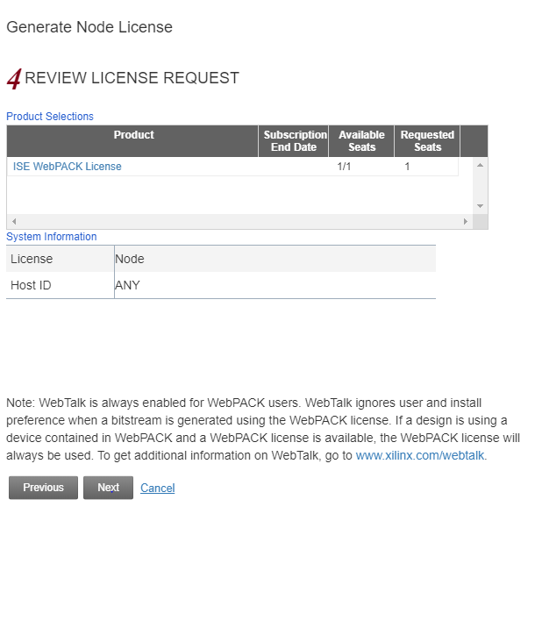
Get Free license
1
4
2
3
License will send to your mail

Slide 8
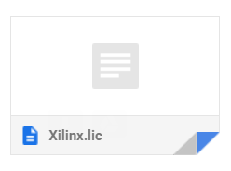
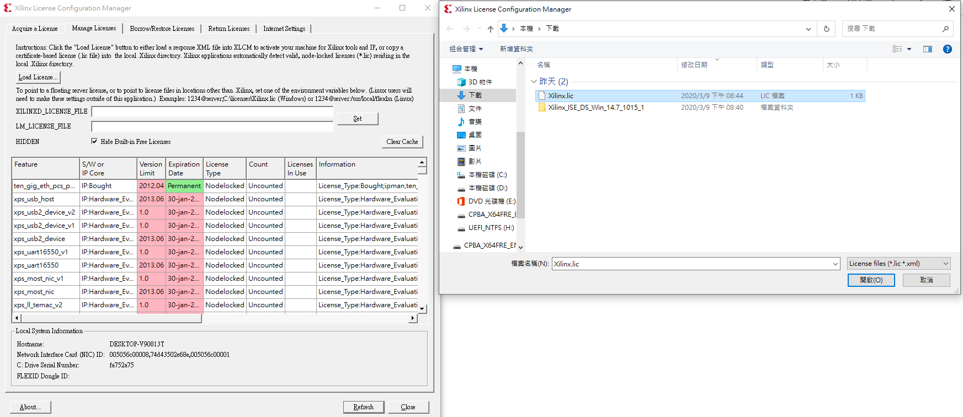
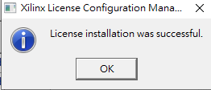
Activate License
Download file from mail
1
2
3
5. Close Xilinx License Configuration Manager
4

Slide 9
WAIT! Fix bug if using win10
Bug : Crash of ISE
Solution:
In path: C:\Xilinx\14.7\ISE_DS\ISE\lib\nt64
Rename file ‘libPortability.dll’ as ‘libPortability_original.dll’
Rename file ‘libPortabilityNOSH.dll’ as ‘libPortability.dll’

Slide 10
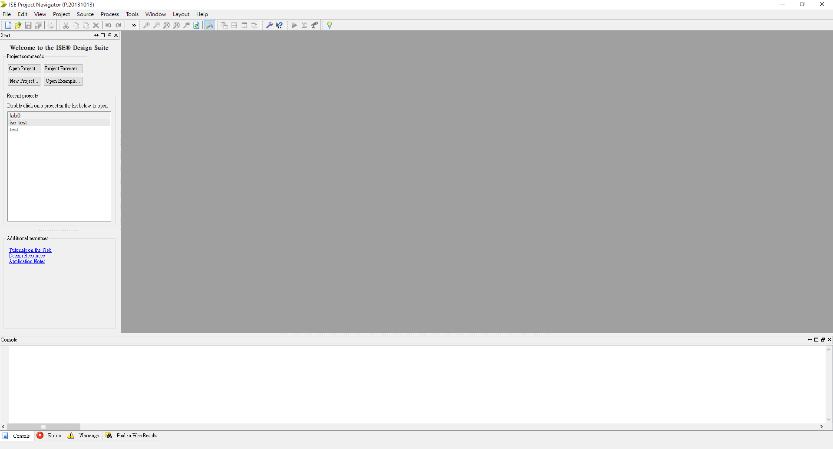
Create new project
Select New Project... or File -> New Project…

Slide 11
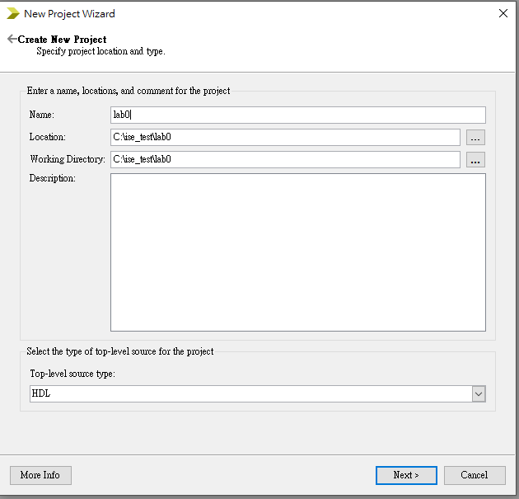
Create new project
Select Next

Slide 12
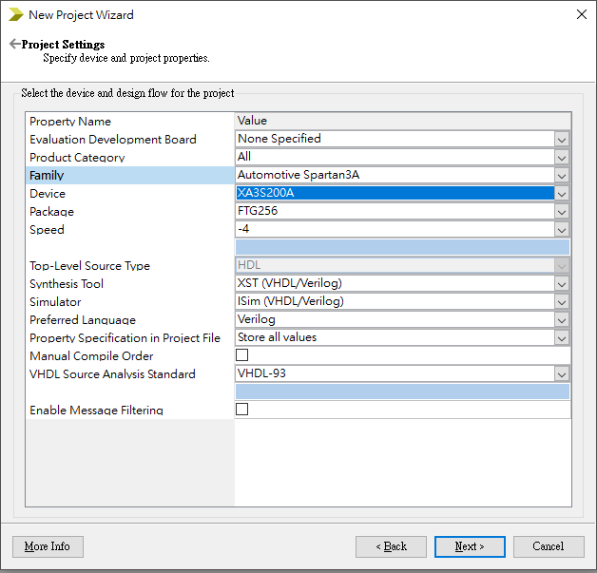
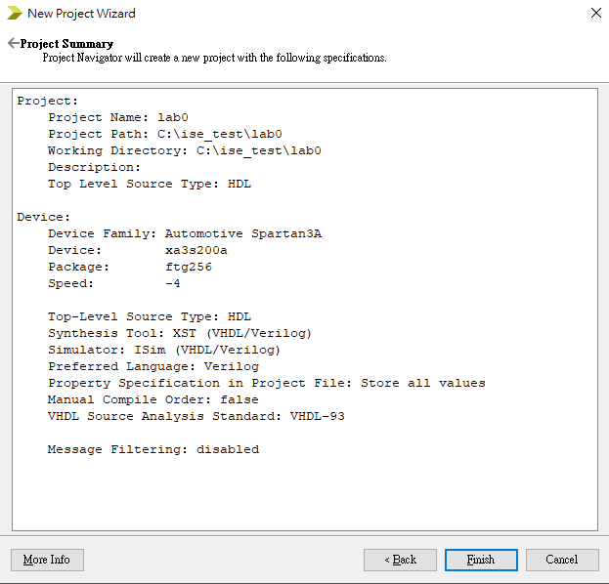
Create new project
Select Device & Specify Project property
Project summary page

Slide 13
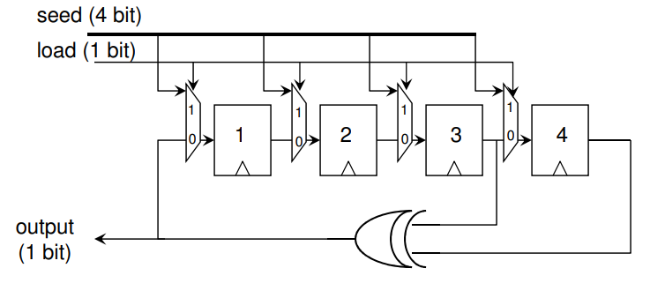
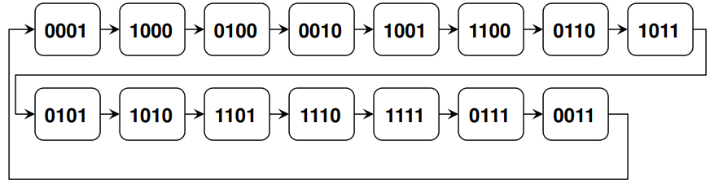
Linear Feedback Shift Register
XOR + D-Flip flop + MUX
Ref.: Lecture 6: A Random Number Generator in Verilog

Slide 14
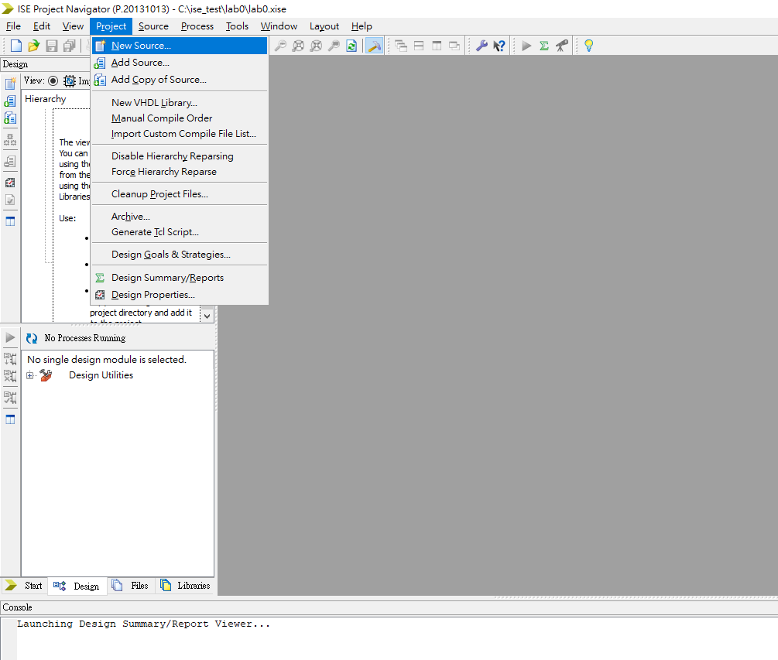
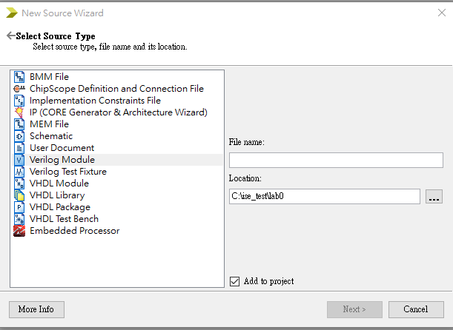
Create Verilog Module File
Choose Verilog module and assign file name as mux_2to1

Slide 15
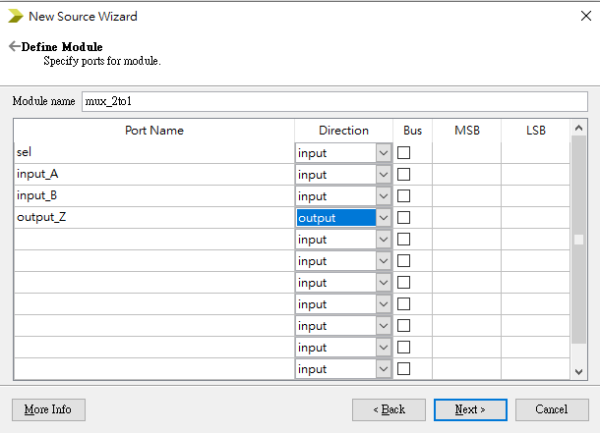
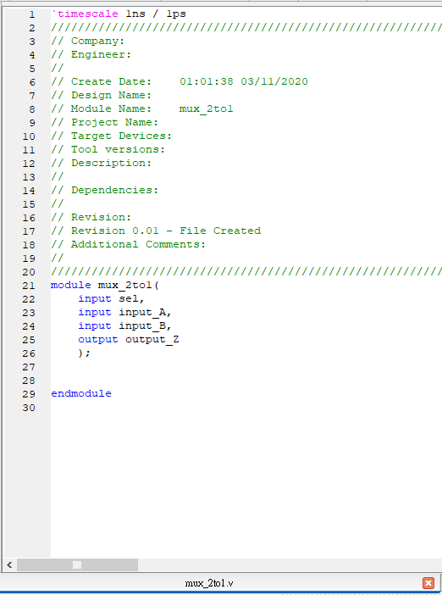
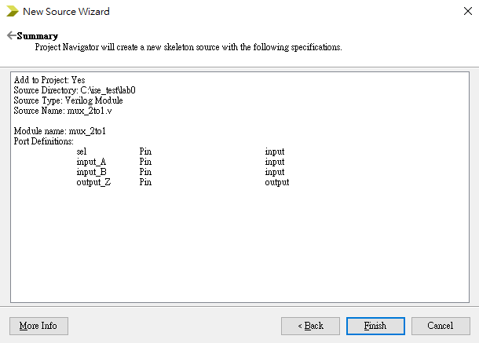
Create 2 to 1 Mux

Slide 16
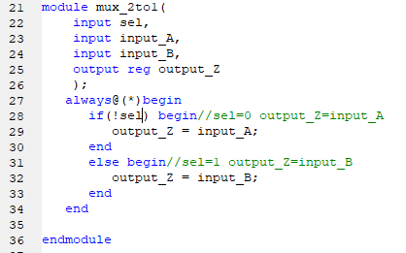
Modify file mux_2to1.v
Modify and save
module mux_2to1(
input sel,
input input_A,
input input_B,
output reg output_Z
);
always@(*)begin
if(!sel) begin//sel=0 output_Z=input_A
output_Z = input_A;
end
else begin//sel=1 output_Z=input_B
output_Z = input_B;
end
end
endmodule

Slide 17

Add Files to Project
Select Project -> Add Source
Select Add Source icon on left-side menu bar
Push right mouse button to select Add Source

Slide 18
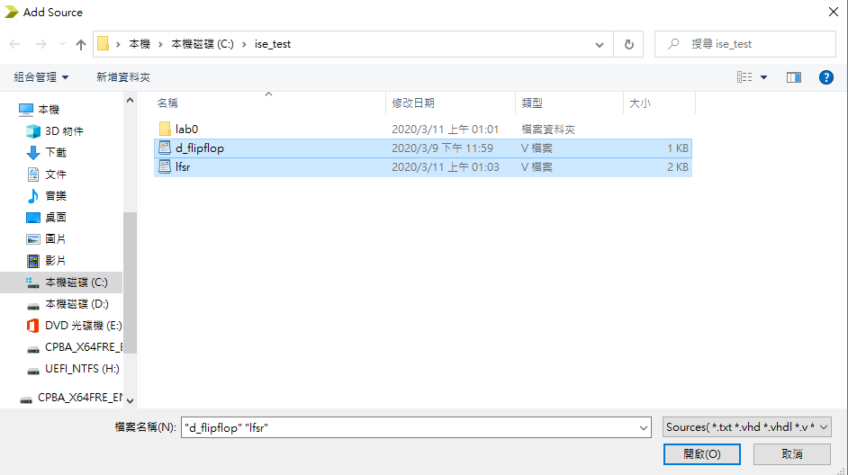
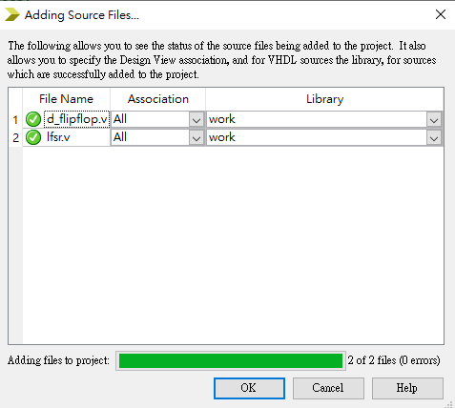
Add Files to Project
Select Project -> Add Source
Select Add Source icon on left-side menu bar
Push right mouse button to select Add Source
Those files are provided by TA

Slide 19
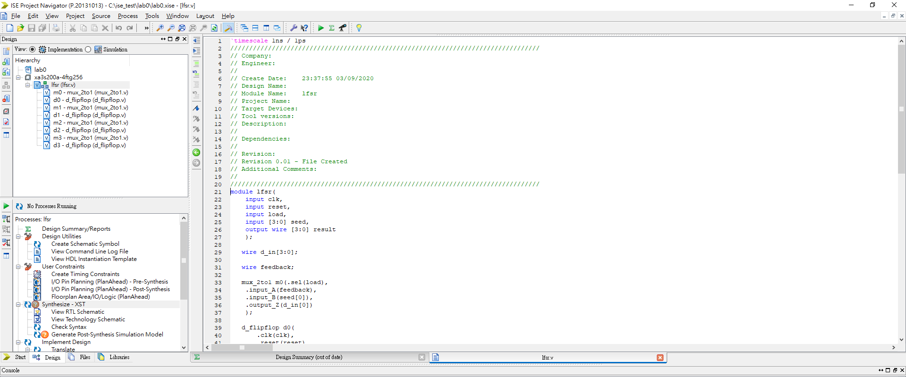
After add file

Slide 20
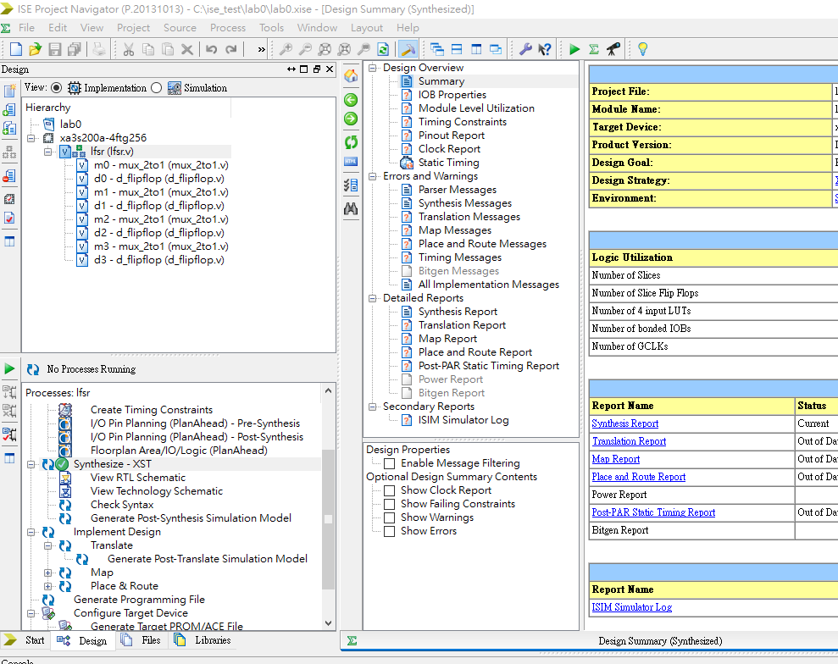
Compile Program
Compile program

Slide 21
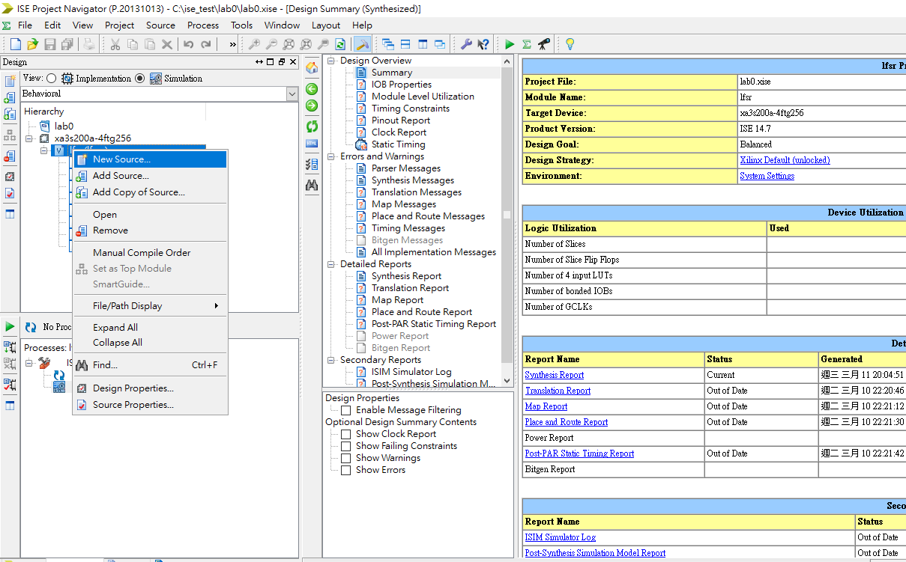
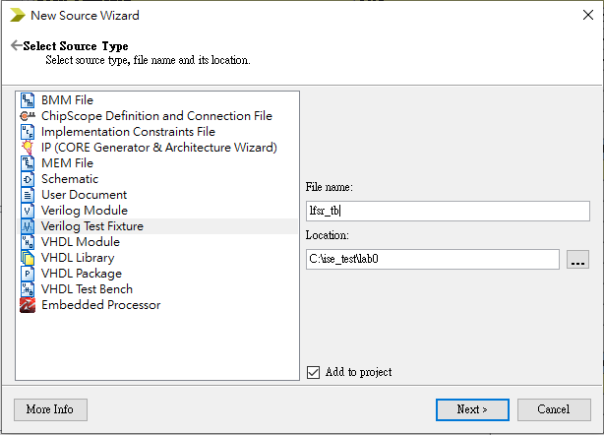
Create test bench source
Add new source -> Verilog Text Fixture (testbench file)

Slide 22
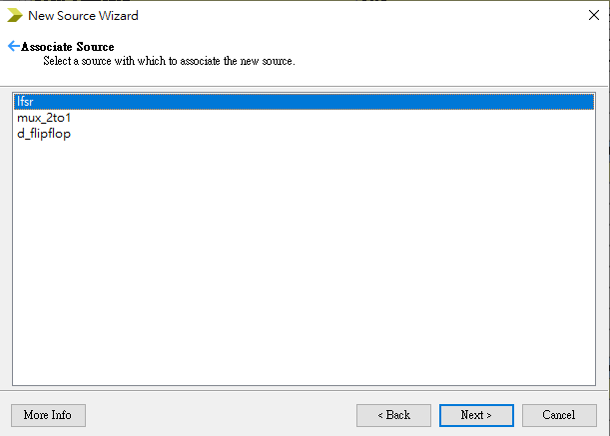
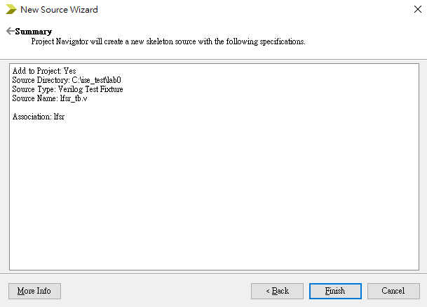
Select source you want to test
Now we want to test lfsr, so choose it

Slide 23
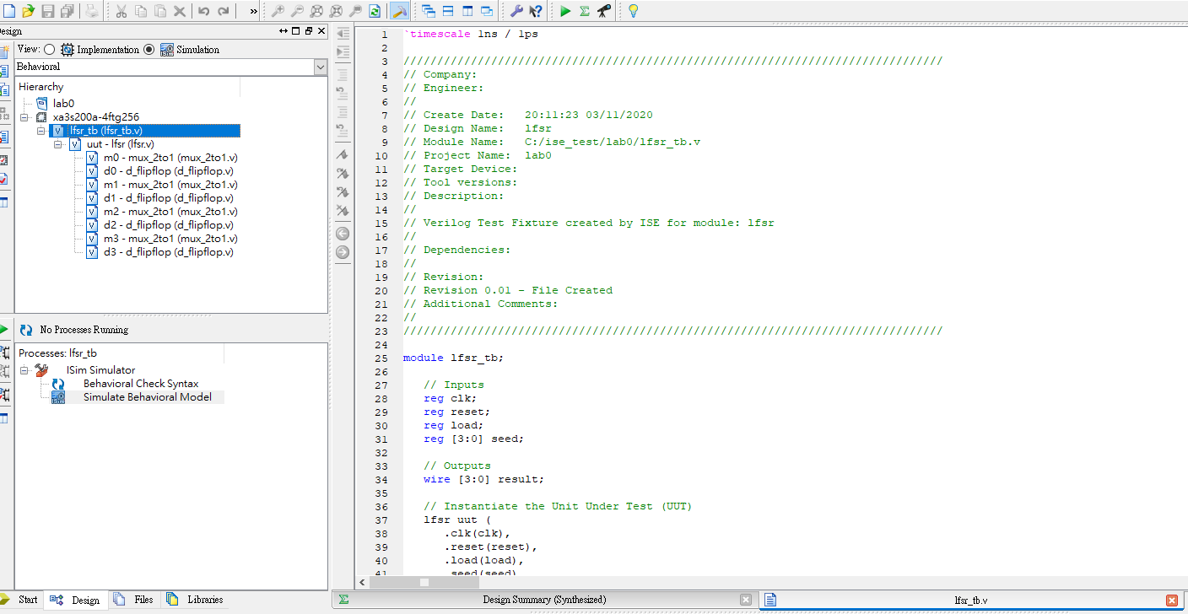
After create test bench
Choose simulation
Double click lfsr_tb

Slide 24
Modify test bench
Copy and paste the code
`timescale 1ns / 1ps
module lfsr_tb;
// Inputs
reg clk;
reg reset;
reg load;
reg [3:0] seed;
// Outputs
wire [3:0] result;
// Instantiate the Unit Under Test (UUT)
lfsr uut (
.clk(clk),
.reset(reset),
.load(load),
.seed(seed),
.result(result)
);
initial begin
reset = 0;
#10 reset = 1; // reset pulse
#10 reset = 0;
end
initial clk = 0;
always #50 clk = !clk; // generate clock
initial begin
load = 0;
seed = 0;
#100 seed = 4'b0001;
load = 1;
#100 load = 0;
end
initial #2000 $finish;
initial $monitor($realtime,"ns %h %h %h\n",load,seed,result);
endmodule

Slide 25
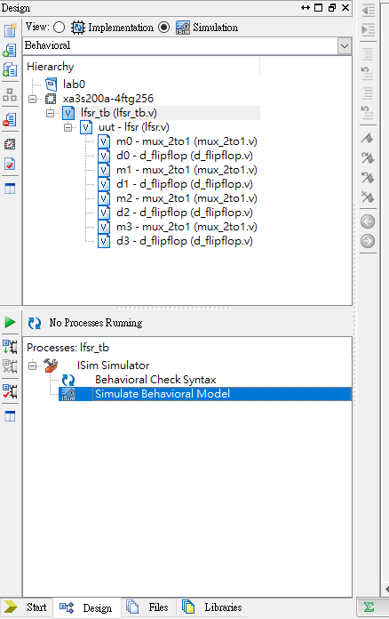
Check syntax and Simulate
Behavioral Check syntax
check syntax of test bench
Simulate Behavior Model
generate wave

Slide 26
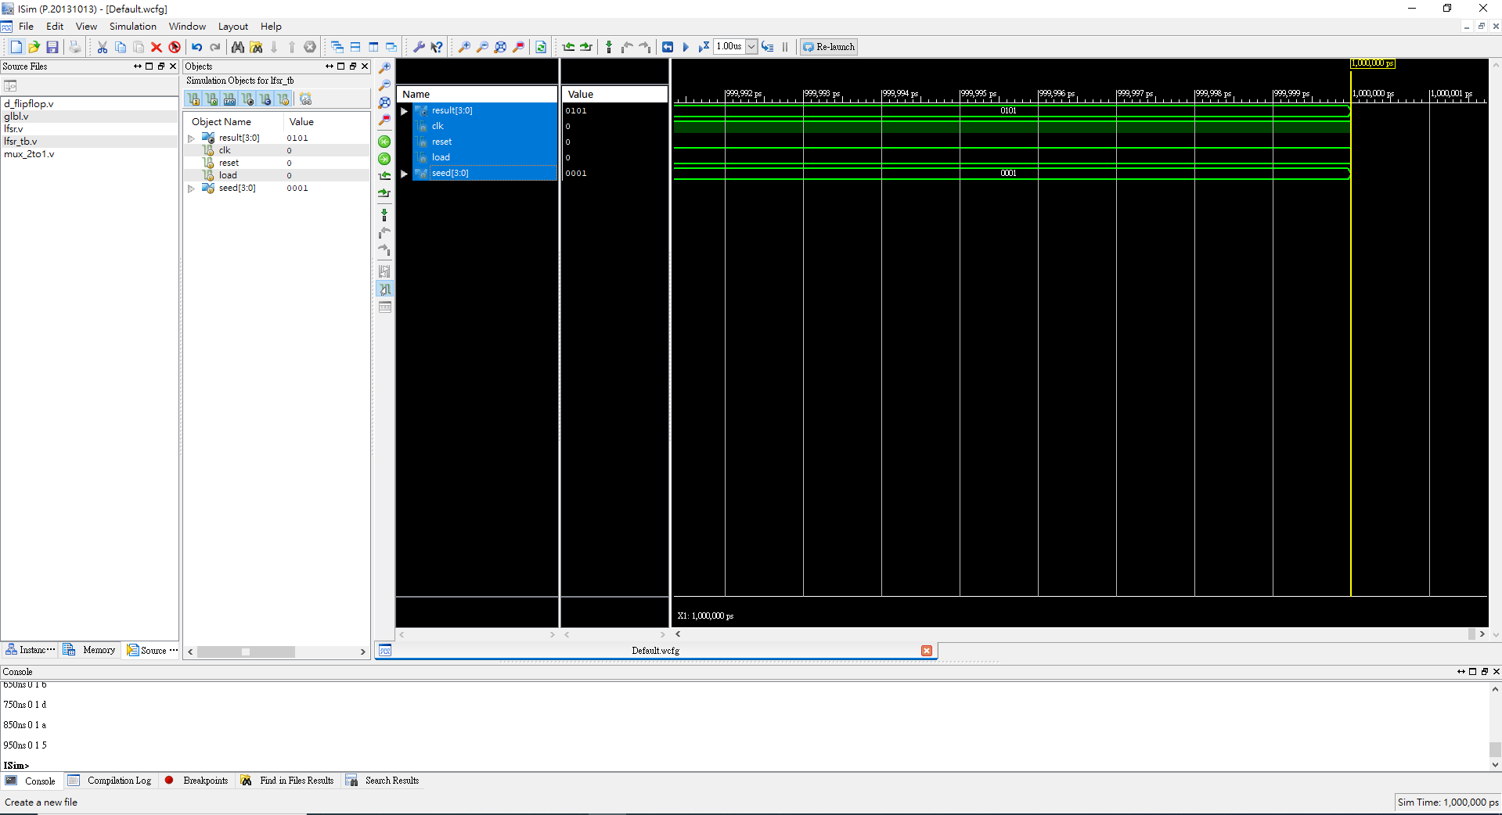
ISIM
After double click Simulate Behavior Mode -> get the wave
Click to run all

Slide 27
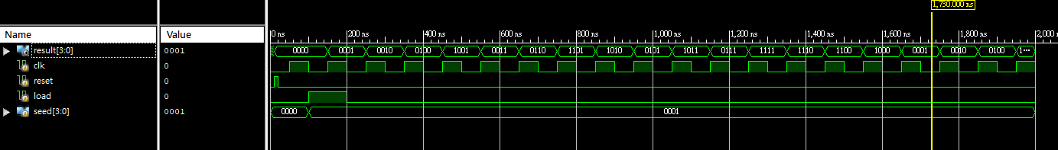
Lab0 part 1
Please change radix of result to Unsigned Decimal
Take screenshot of wave to the report
這個作業很簡單,請把result換成10進制無號數,並截圖放到report.

