Slide 1
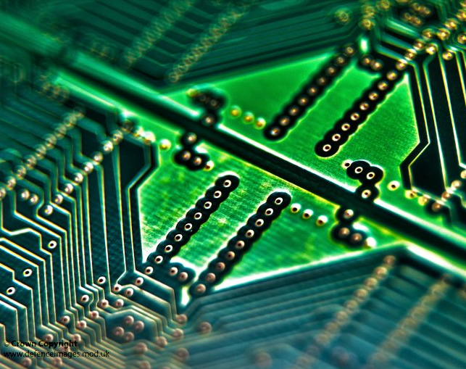
Elon Musk Chip
Section 4
Walaa AbdElhady AbdElMohsen
Habiba Mostafa Ahmed
      Aya Ahmed Abd ElAziz
      Menna Salah Mohamed
      Bedour Farghal Shawki

Slide 2
Project Charter :
1-Official project name
2-Project sponsor and its contact information
3-Project manager and its contact information
6-Key deliverables of the project
5-Business case for the project
4-Purpose of the project
7-Project resources, budget
8-Time
9-High-level risks

Slide 3
NAME OF THE PROJECT : Elon Musk Chip
PROJECT SPONCER : Neuralink Company
- Contact: elonmusk@gmail.com.
PROJECT MANAGER : Walaa AbdElhady AbdElMohsen
- Contact: walaa@gmail.com.
PROJECT TEAM :
      Habiba Mostafa Ahmed
      Aya Ahmed Abd ElAziz
      Menna Salah Mohamed
      Bedour Farghal Shawki
Purpose of the Project :
Making a chip to solve important spine and brain problems with a seamlessly implanted device.
Business case for the project :
This chip can read all of the brain's activities, as well as the chemicals, making it able to plan and predict a person's functions.
The area in which the slide is implanted allows treating some hearing and vision problems as well as some psychological problems, and it is possible in the future to treat many diseases related to nerves.
Chip development could allow for telepathy and mental programming.
In the future, scientists seek to develop it to make it able to cancel the feeling of pain, and the feeling of sadness, as it will control and store memories and dreams.
Through this chip, you can communicate with smartphones, computers, etc., and provide it with information

Slide 4
PROJECT RESOURCES:
Using a robot implant the slide inside the human body.
Some materials for the manufacture of the chip, such as silicon, copper, and chips that contain complex electronic circuits.
Using the services of the civil registry to provide all information about the person to whom the chip will be implanted.
Some transistors and resistors for industry.
The use of a protection system to ensure the privacy of the chip and to ensure that it is not hacked.
Using the World Health Organization to monitor the extent of the health repercussions that the slide may cause to humans.
PROJECT DEIVERABLE:
The technology will initially have a medical focus, such as helping people deal with brain and spinal cord injuries or birth defects. The technology could, for example, help paraplegics who have lost the ability to move or feel because of spinal cord injuries, and early human uses of the technology will aim to help conditions such as paraplegia or quadriplegia.
COMMUNICATION PLAN:
An offline meeting every week.
An online meeting every three days.
TIME:
It will be finished in 11 months.

Slide 5
RISKS:
Hackers hack these chips, thereby controlling and controlling their owners. A person may turn into a walking “robot”, and he may commit crimes and several serious matters that threaten his safety and existence. Hence, increasing control is imposed on it. It may facilitate espionage operations and penetration of the human mind, and control of its thoughts and members, and thus may re-create a group of electronically programmed humans.

Slide 6
Project Scope:
Description
Acceptance Criteria
Exclusions
Deliverables
Constraints
Assumptions

Slide 7
1-Product Scope Description:
The chip is a small and thin piece that is placed in the human body, specifically in the back of the head. This chip is placed by a robot that is programmed to perform this function, or by a specialized surgeon to perform this type of dangerous operations.
2-Product Acceptance Criteria:
The chip must be as small and thin as possible so as not to cause damage and be easy to control, it must also have a large storage capacity so that it can store the largest amount of data and information, that the project is implemented within the specified time
3-Project Exclusions:
1- The use of a brain chip for children is not suitable to avoid some risks
2- The brain chip is used according to the specific goals only, as its main goal is to provide advanced technology that helps the person in many important and difficult tasks
4-Project Deliverables:
1-This chip can read all of the brain's activities, as well as the chemicals, making it able to plan and predict a person's functions.
2-The area in which the slide is implanted allows treating some hearing and vision problems as well as some psychological problems, and it is possible in the future to treat many diseases related to nerves.

Slide 8
5-Project Constraints:
1- Time The project must be completed within one year
2-The cost, as the specified cost is $109.
3-Scope of the project, as the project must be implemented for several purposes, including controlling brain and neurosis cells, relieving pain and depression, as well as obtaining a large amount of information by linking the brain to the computer directly.
6-Project Assumptions:
The Elon musk chip will make me won't use a lot of things such as a telephone or internet.
built link between the brain and computer by it.
It will use the Elon musk chip in medicine to do electrical sessions

Slide 9
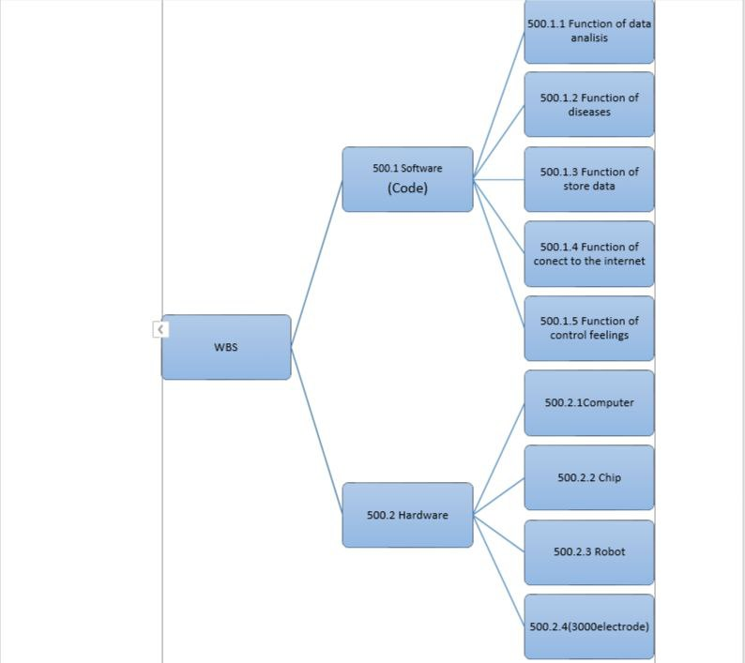
WBS:

Slide 10
WBS Dictionary:
500.2 Hardware
Work package ID:500.2.1
Work package Name: computer
Description : Devices that we will enter the chip information into
Person : team of electrification engineers
Start Date:1/1/2022
End Date:31/1/2022
Work package ID:500.2.2
Work package Name: chip
Description : store the information and treat some diseases
Person : team of electrification engineers
Start Date:1/2/2022
End Date:31/3/2022

Slide 11
Work package ID:500.2.3
Work package Name: robot
Description : put the Elon in human's body
Person : team of electrification engineers
Start Date:1/4/2022
End Date:30/4/2022
Work package ID:500.2.4
Work package Name: 3000electrode
Description : Connecting the human brain with the chip and the computer
Person : team of electrification engineers
Software:500.1
Work package Name : Function of data analysis
Description : collects, analyzes and stores data
Person : Data Analysts
Start Date: 1/5/2022
End date:31/5/2022
Work package ID:500.1.2
Work package Name : Function of diseases
Description : Anticipating and treating abnormalities in a specific part of the body

Slide 12
Person : Software engineers
Start Date:1/6/2022
End date: 31/7/2022
Work package ID:500.1.3
Work package Name : Function of store data
Description : stores data
Person : Data supervisor
Start Date: 1/8/2022
End date: 31/8/2022
Work package ID:500.1.4
Work package Name : Function of connect the internet
Description : connect chip to the Internet
Person : Software engineers
Work package ID:500.1.5
Work package Name : Function of control feelings
Description : Control feelings of sadness, pain and forgetting dreams
Person : software engineers.
Start Date:1/9/2022
End Date: 31/10/2022
Start Date:1/11/2022
End Date : 30/11/2022

Slide 13
Responsibilities Matrix
 | Project Manager | Tester | electrification engineer | Designer | Programmer
Create the chip | A |  | C
Design the chip | R |  | P | C
Test the chip | P | C | P |  | P
Chip Coding | A | P |  |  | C
Push the chip to the workstations | A
A | Approve
P | Participate
C | Create
R | Review

Slide 14
Network
4 | B | 1
1 | Design Hardware | 1
5 | 3 | 2
8 | C | 4
1 | Build and test Hardware | 1
9 | 4 | 5
1 | A | 0
0 | Define Requirements | 0
1 | 1 | 0
11 | F | 9
0 | Integrate System | 0
11 | 2 | 9
5 | D | 1
0 | Code Software | 0
5 | 4 | 1
9 | E | 5
0 | Test Software | 0
9 | 4 | 5

Slide 15
Resource Constrained
ID RES DUR ES LF SL 0 1 2 3 4 5 6 7 8 9 10 11
A | 2P | 1 | 0 | 1 | 0 | 2
B | 2P | 3 | 1 | 5 | 1 |  | 2 | 2 | 2
D | 1P | 4 | 1 | 5 | 0 |  | 1 | 1 | 1 | 1
C | 1P | 4 | 4 | 9 | 1 |  |  |  |  | 1 | 1 | 1 | 1
E | 2P | 4 | 5 | 9 | 0 |  |  |  |  |  | 2 | 2 | 2 | 2
F | 1P | 2 | 9 | 11 | 0 |  |  |  |  |  |  |  |  |  | 1 | 1
Total resources load | 2P | 3P | 3P | 3P | 1P | 3P | 3P | 3P | 3P | 1P | 1P
Resources Available | 3P | 3P | 3P | 3P | 3P | 3P | 3P | 3P | 3P | 3P | 3P

Slide 16
Budget Baseline
ID
A | 5
B | 6 | 4 | 5
C | 10 | 10 | 8 | 5
D | 5 | 5 | 5 | 10
E | 2 | 3 | 2 | 4
F | 10 | 10
ID | Budget | 1 | 2 | 3 | 4 | 5 | 6 | 7 | 8 | 9 | 10 | 11
A | 5 | 5
B | 15 |  | 6 | 4 | 5
C | 33 |  |  |  |  | 10 | 10 | 8 | 5
D | 25 |  | 5 | 5 | 5 | 10
E | 11 |  |  |  |  |  | 2 | 3 | 2 | 4
F | 20 |  |  |  |  |  |  |  |  |  | 10 | 10
Total | 109$ | 5 | 11 | 9 | 10 | 20 | 12 | 11 | 7 | 4 | 10 | 10
Commutative |  | 5 | 16 | 25 | 35 | 55 | 67 | 78 | 85 | 89 | 99 | 109

Slide 17
Risks Management and Monitoring
1-Experts believe that this technological development reveals challenges and risks facing humans in the future, most notably the fears of penetration and control of humans through electronic chips.
2-A person may turn into a "robot", and he may commit crimes and things that threaten his safety and existence.
3-This may also lead to the imposition of increased control over it, facilitating espionage operations and penetrating the human mind, controlling its thoughts and members, and programming it electronically.

Slide 18
We can deal with these Risks by:
1-We can control some of these risks by first testing the slide on animals and monitoring the situation for a period of time.
2-The chip should be programmed and equipped in a controlled manner, and all safety measures should be taken to prevent its penetration and control by other people

