Slide 1
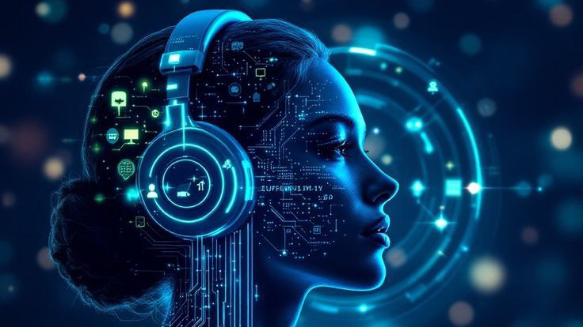
DeFakeIt
Identifying synthetic voices in a world of increasingly realistic audio manipulation.

Slide 2

Team Members
01
Walaa Hassan
02
Walaa Abdelkader
03
Hager Osama
04
Yasmin Maher
05
Avronia Isaac
06
Farah Mohammed
07
Maryam Wael
Supervised By
Dr / Mervat Mikhaeil

Slide 3


Agenda
01
Introduction
07
Software Model
02
Related Work
08
Design Specifications
03
Dataset Overview
09
Application Design
04
EDA
10
Frontend
05
Preprocessing
11
Admin Website
06
Modeling
12
Backend
13
Future Work

Slide 4
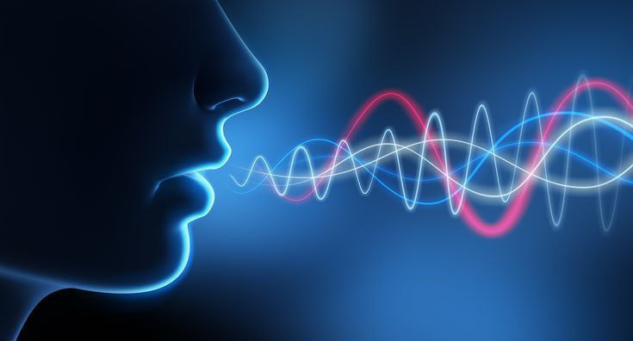
Introduction

Slide 5

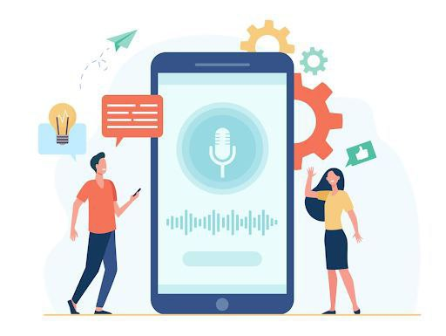
Safeguarding Truth in the Digital Age
In an era where artificial intelligence can replicate human voices with alarming accuracy, deepfake audio poses a growing threat to trust and authenticity in digital communication. From fraud and misinformation to ethical concerns, the rise of synthetic audio demands robust detection solutions.

Slide 6

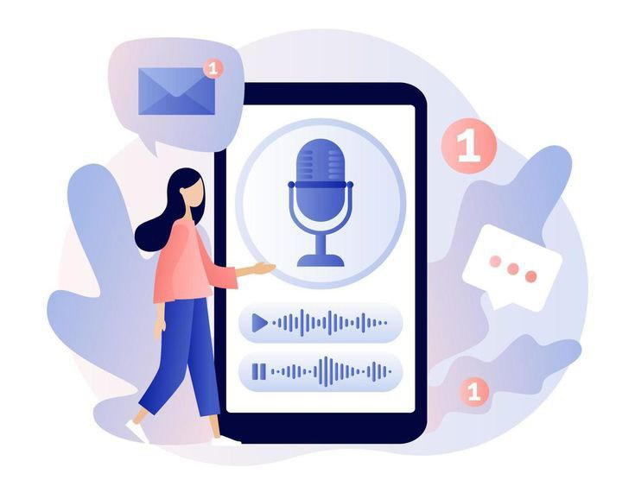
The Growing Risks of AI Misuse
“In an interview with local TV stations, DeStefano said the first thing she heard was her daughter's voice, distraught and sobbing. When the alarmed mother asked what happened, the voice said she had "messed up," and continued crying.
DeStefano said a man came on the line, saying, "I have got your daughter" and threatened harm to her daughter if she called the police. All the while, she said she heard her daughter in the background, crying and asking for help.”
Source: www.moneylife.in April ,2023

Slide 7

Related Work

Slide 8
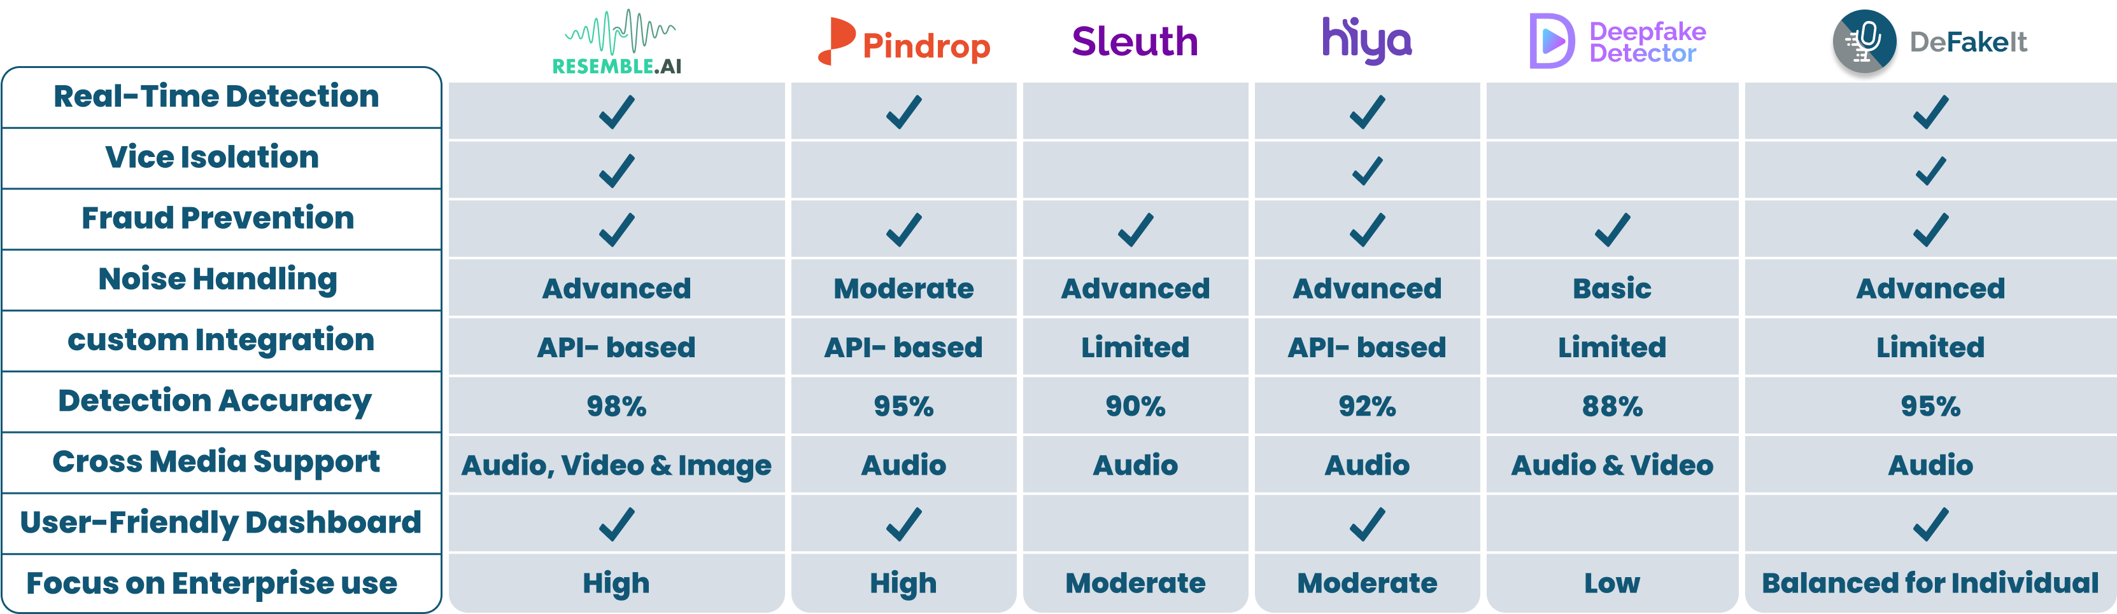
Competitor Feature Comparison

Slide 9
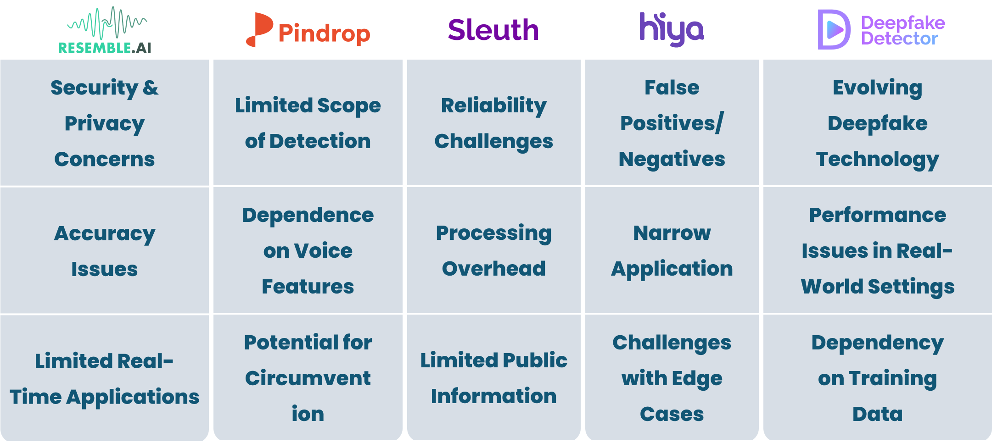
Competitors' Weaknesses

Slide 10
What Makes Our App Unique?
01
Real-Time Detection with High Accuracy

Slide 11
What Makes Our App Unique?
01
01
02
Real-Time Detection with High Accuracy
Real-Time Detection with High Accuracy
Fraud Prevention

Slide 12
What Makes Our App Unique?
01
02
03
Real-Time Detection with High Accuracy
Real-Time Detection with High Accuracy
Fraud Prevention
User-Friendly Design

Slide 13
What Makes Our App Unique?
01
02
03
04
Real-Time Detection with High Accuracy
Real-Time Detection with High Accuracy
Fraud Prevention
User-Friendly Design
Broad Accessibility

Slide 14
What Makes Our App Unique?
01
02
03
04
05
Real-Time Detection with High Accuracy
Real-Time Detection with High Accuracy
Fraud Prevention
User-Friendly Design
Broad Accessibility
Noise Handling &
Voice Isolation

Slide 15
Dataset Overview

Slide 16

Unveiling Our Dataset
Dataset Name:
Fake-or-Real (FoR)
Total Samples:
~195,000 audio clips
Classes:
Real audio (human speech)
Fake audio (synthesized speech using TTS systems like DeepVoice, Wavenet, etc.)
Goal:
Classify if an audio clip is real or fake

Slide 17
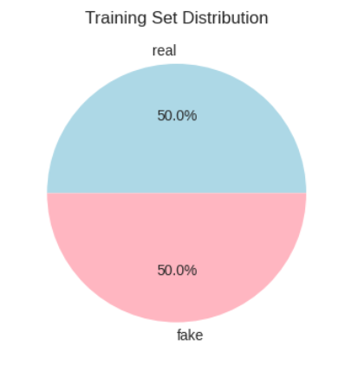
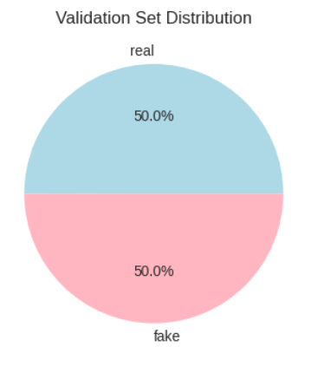
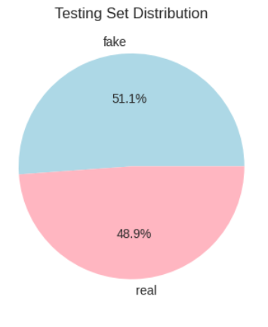
Dataset Overview
Fake Audio: 26.9K
Real Audio: 26.9k
Fake Audio: 5398
Real Audio: 5400
Fake Audio: 2370
Real Audio: 2264

Slide 18
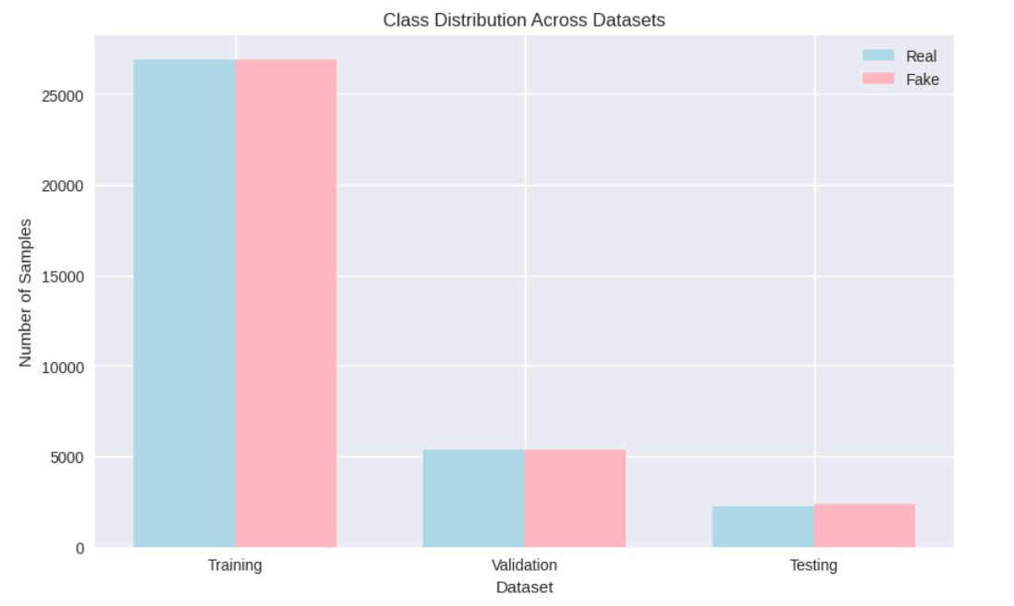
Why This Dataset?
Specifically designed for deep fake audio detection.
Contains a balanced mix of real and fake (AI-generated) audio.

Slide 19

Exploratory Data Analysis

Slide 20

Objective
Explore audio feature distributions to identify patterns differentiating fake and real audio.
Guide feature selection for deepfake detection models.

Slide 21
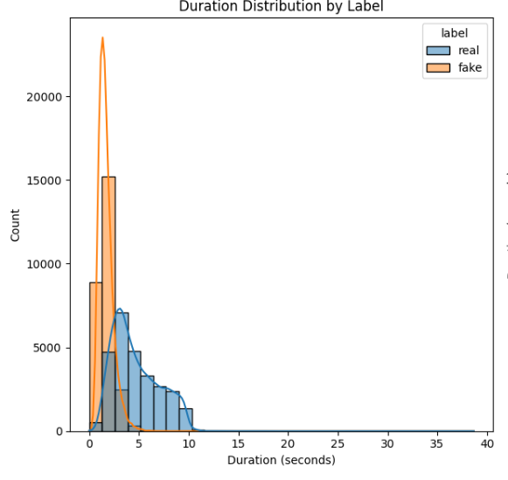
Duration Analysis
Real audio :
Longer average duration.
Wide range with many outliers.
More variability due to natural speaking patterns.
Fake audio :
  Generally shorter.
  Tight duration range with fewer outliers.
  Fake audios are often more uniform in length.

Slide 22
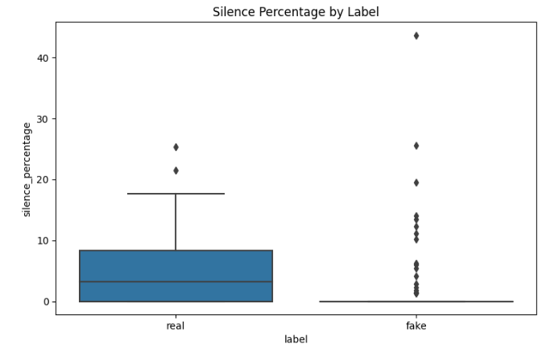

Silence Analysis
Real audio:
Higher and more varied silence percentages.
Reflects natural pauses in human speech (thinking, breathing, hesitations).
Fake audio:
Silence percentage is mostly zero or near zero.
Indicates that synthetic audio lacks natural pauses, likely due to TTS models generating speech without breaks.

Slide 23
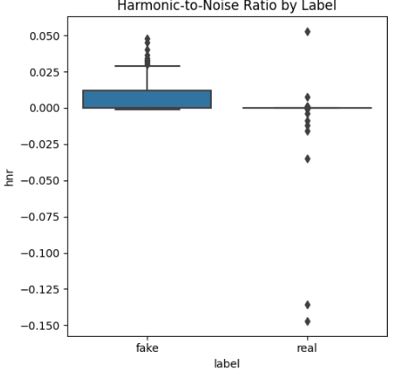

Harmonic-to-Noise Ratio (HNR)
Real audio shows more extreme variation in HNR, with both positive and negative outliers.
Fake audios exhibit a narrower, more uniform HNR distribution.

Slide 24
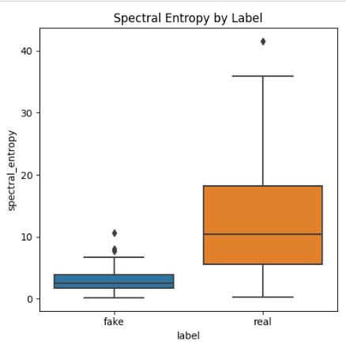
Spectral Entropy
Real audio has higher variance and range in spectral entropy.
Fake audio shows lower, tightly clustered values.
Indicates real audio’s complexity and unpredictability.

Slide 25
What is MFCC?(Mel-Frequency Cepstral Coefficients)
MFCC represents the spectral characteristics of audio signals
Based on human auditory perception using the mel scale
Converts audio signals into a compact feature representation

Slide 26
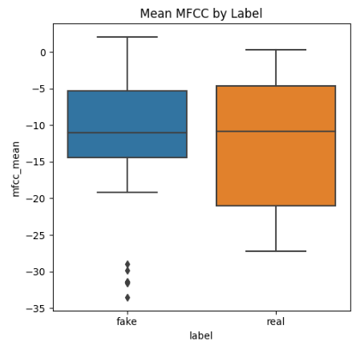
Statistical comparison of real vs fake audio
Distribution Patterns:
Real Audio: MFCC values range from approximately -27 to +2
Fake Audio: MFCC values range from approximately -19 to +3
Both distributions: Show negative skewness, indicating most coefficients have negative values

Slide 27
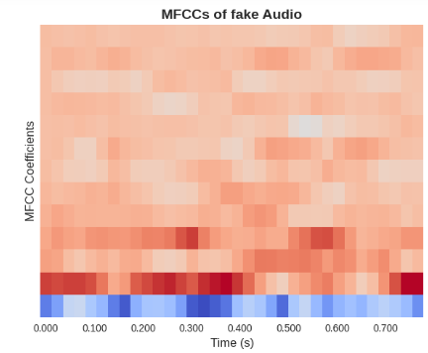

MFCC analysis outcomes
MFCC features show statistically significant differences between real and fake audio
The distinct distributions validate MFCC as an effective feature for deepfake detection

Slide 28

Data Preprocessing

Slide 29
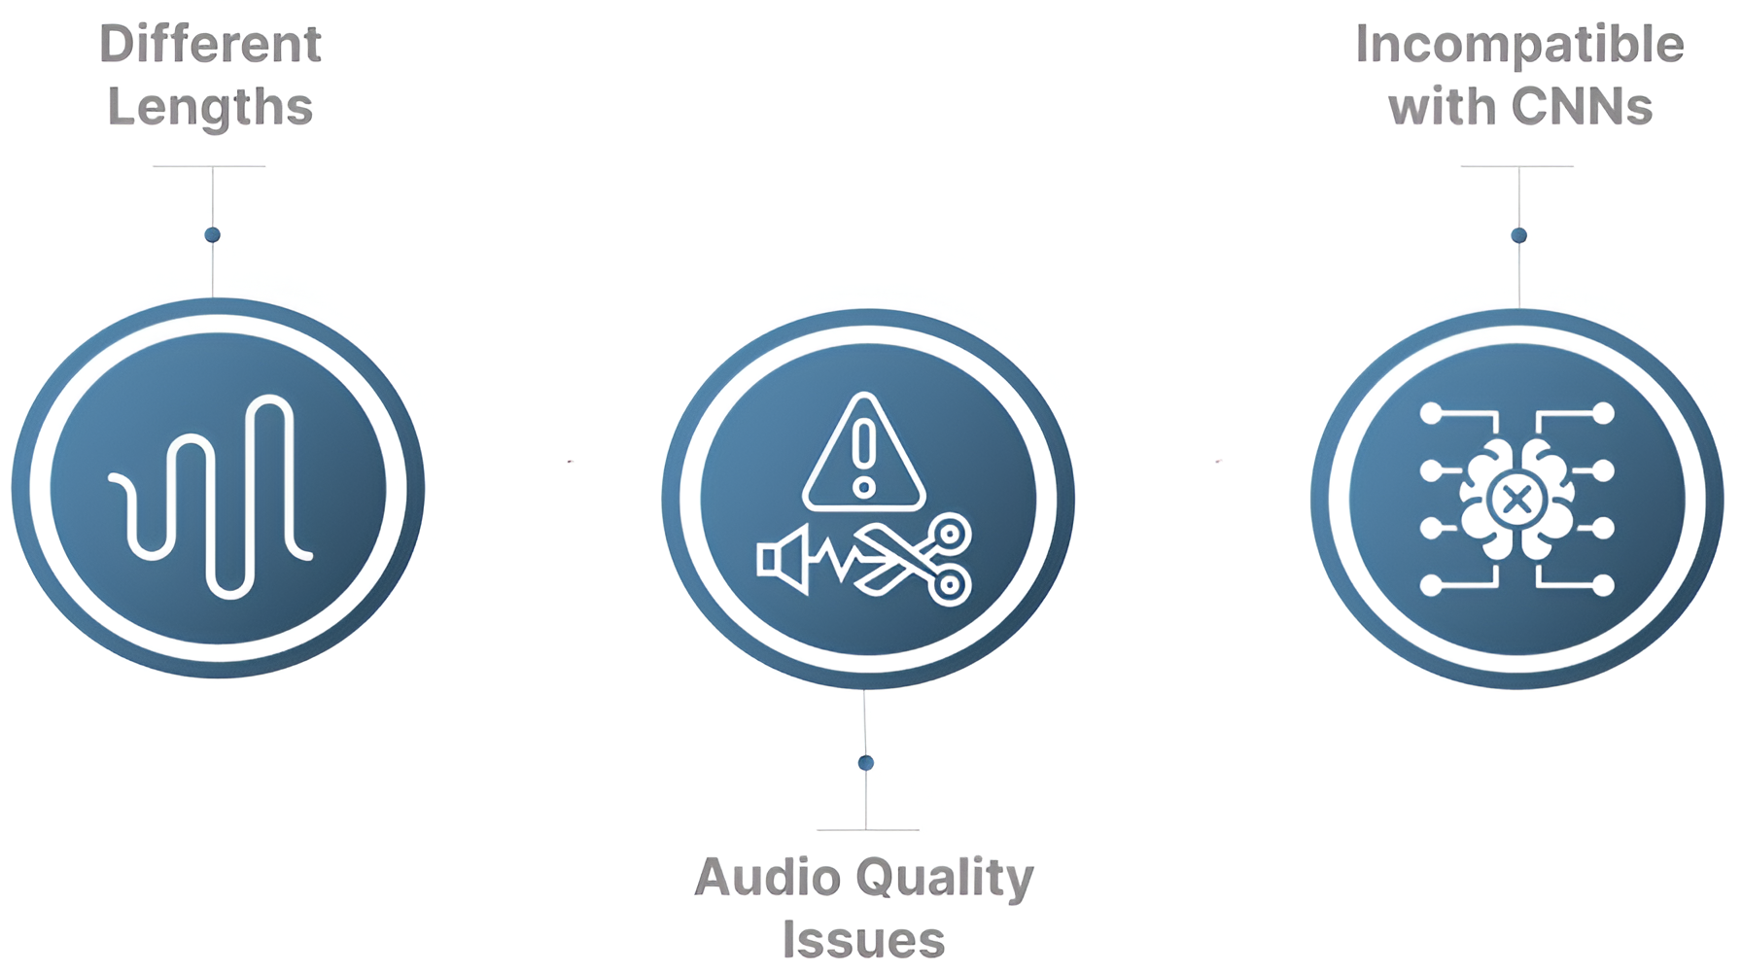
Why Not Use Row Audio Directly

Slide 30
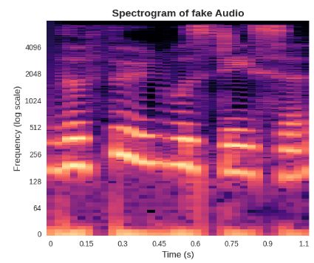

Why We Chose MFCC over Spectrogram
Spectrogram
MFCC
Looks clearer to humans
Performs better for models

Slide 31
Audio Preprocessing Pipeline
Extract MFCC
Convert to Image
Extract 40 MFCC coefficients.
Represents timbre & speech features.
Convert grayscale MFCC → RGB (3 channels).
Load & Normalize
Normalize shape
Handle Errors
Load audio at 16 kHz.
Limit to 12 seconds.
Discard files shorter than 0.1s.
Resize to 128×128 for CNN input.
Pad or truncate MFCCs.
Skip corrupted, silent, or short files.
Ensure clean and reliable dataset.

Slide 32

Modeling

Slide 33
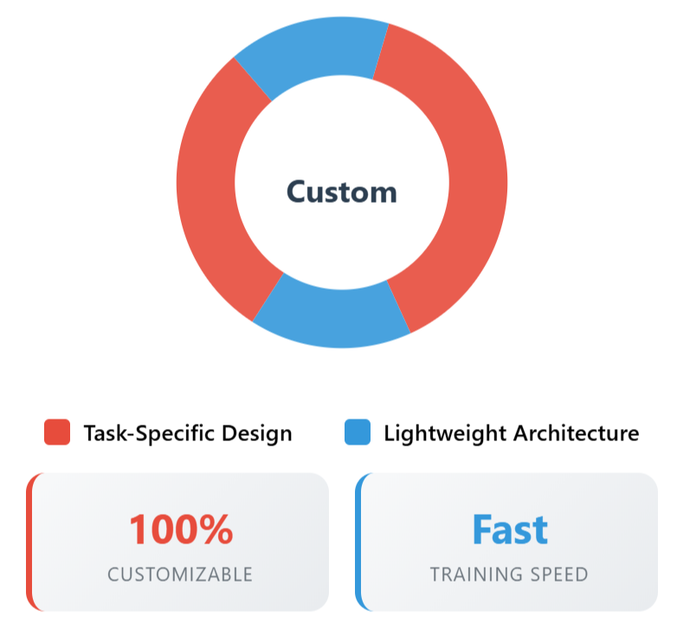

Custom CNN - Our Baseline Model
Architecture:
Multiple convolutional layers to extract features
Pooling layers to reduce data size
Why Chosen:
Simple and flexible, designed specifically for our task
Good for understanding MFCC patterns

Slide 34
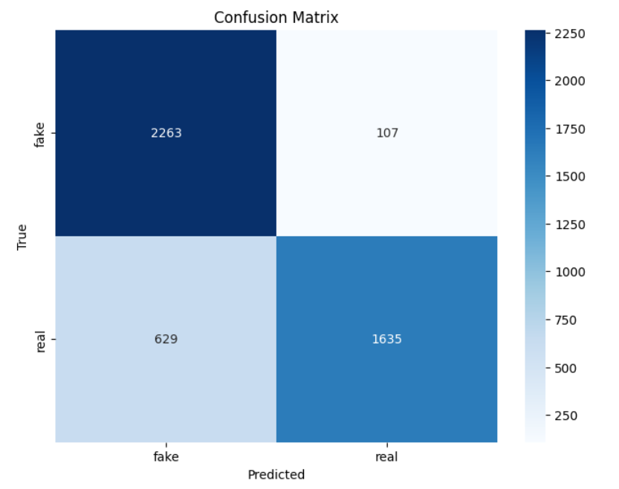
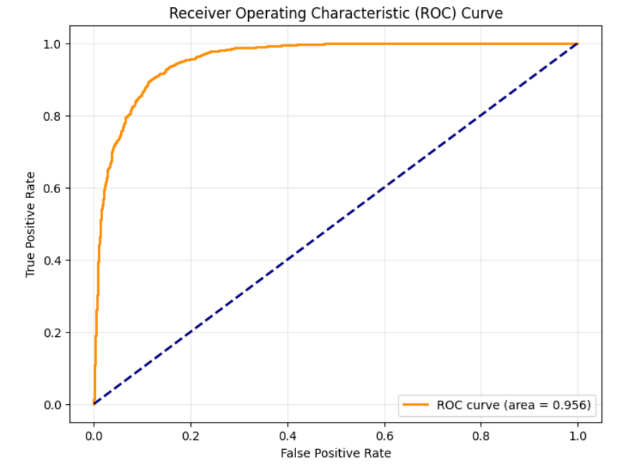
Custom CNN Model Evaluation
Accuracy: 84%
  Roc-AUC Score: 95%

Slide 35
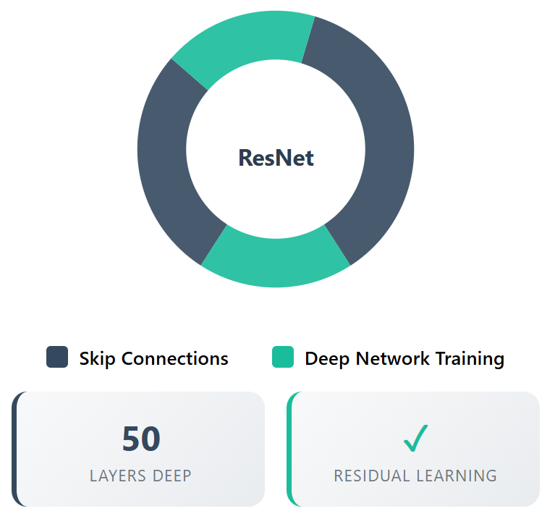
ResNet50 - Deep Residual Learning
Architecture:
50 layers with residual connections
Avoids vanishing gradient problem
Pre-trained on ImageNet, fine-tuned for our task
Why Chosen:
Handles complex tasks with deep networks
Effective for extracting detailed features from MFCCs

Slide 36
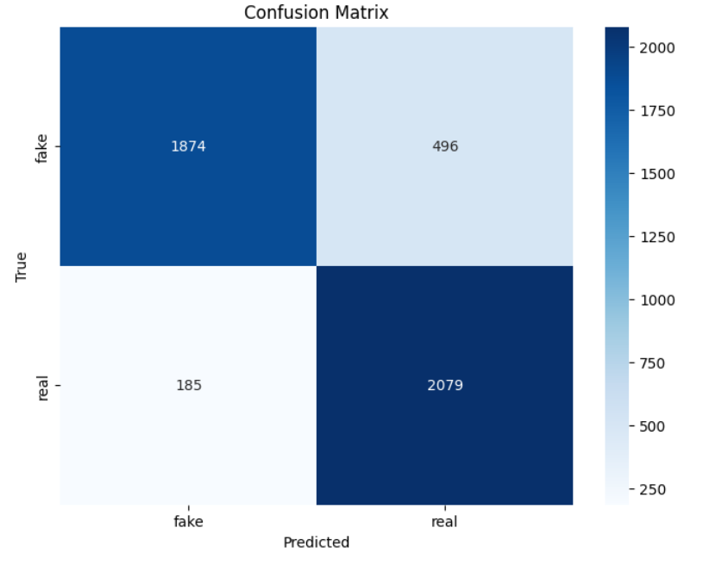

ResNet50 Model Evaluation
  Accuracy: 85%
  AUC Score: 93%

Slide 37
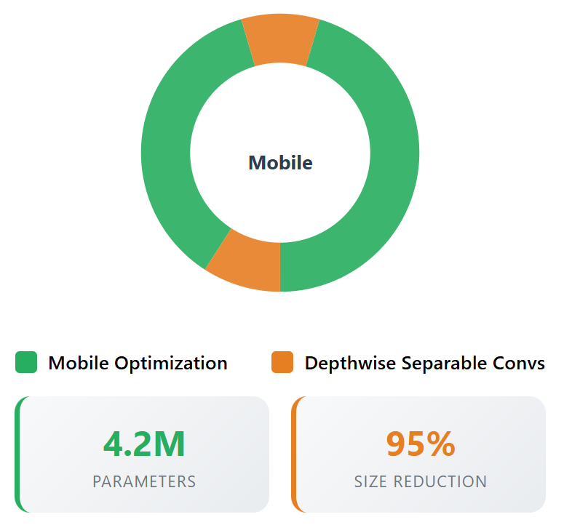
MobileNet - Lightweight and Efficient
Architecture:
Uses Depthwise Separable Convolution
Lightweight design for faster processing
Pre-trained on ImageNet, fine-tuned for our task
Why Chosen:
Ideal for resource-constrained devices (e.g., mobile)
Balances speed and accuracy

Slide 38
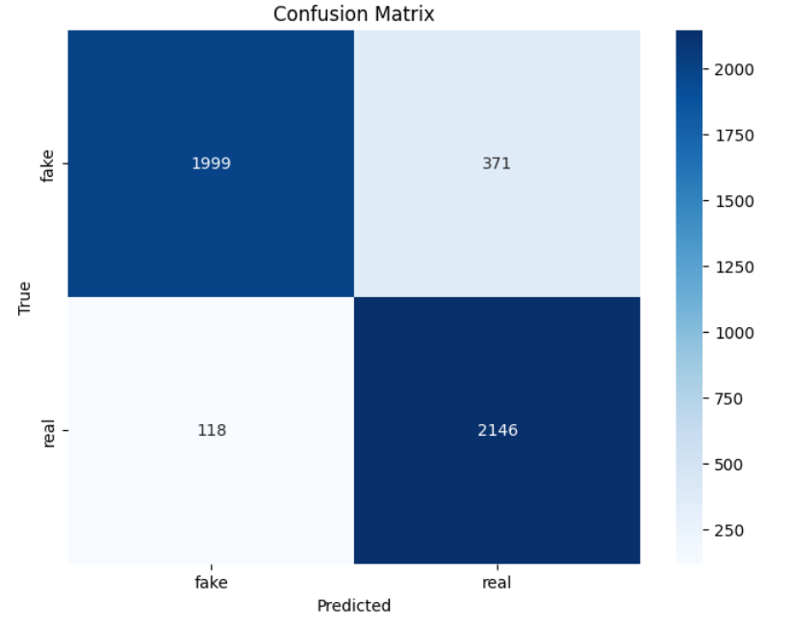
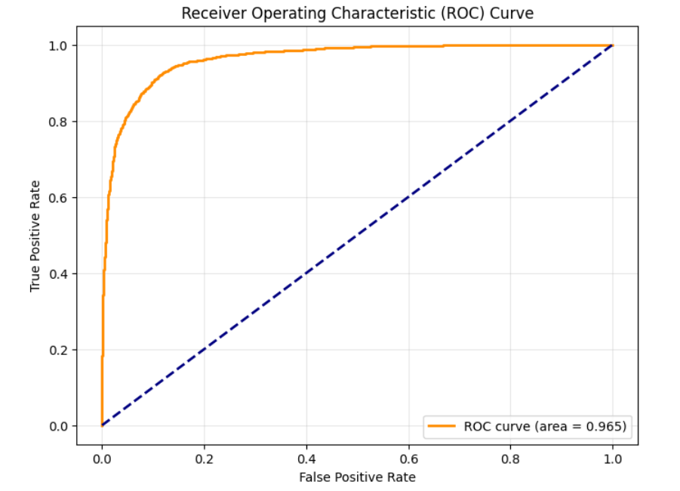
MobileNet Model Evaluation
Accuracy: 89%
AUC Score: 96%

Slide 39
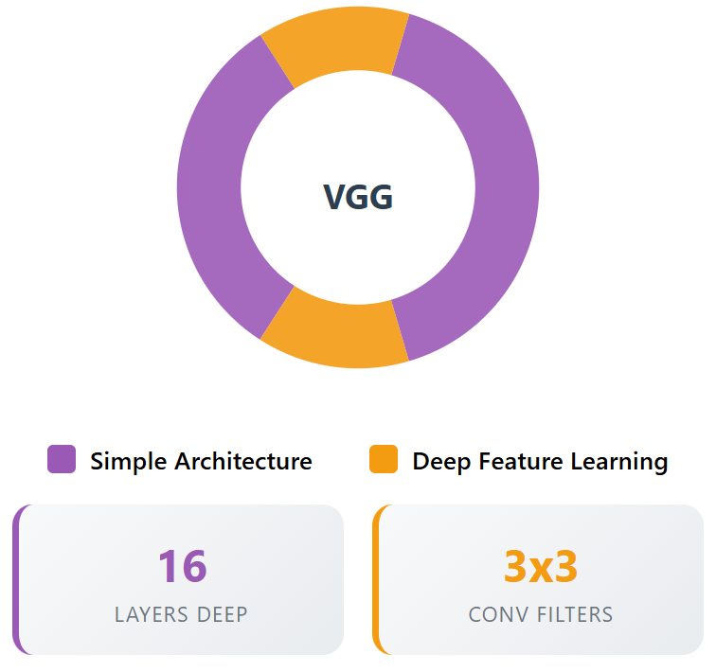
VGG16 - Deep and Detailed Feature Extraction
Architecture:
Stacked 3x3 convolutional layers
Deep network for precise feature extraction
Pre-trained on ImageNet, fine-tuned for audio
Why Chosen:
Excellent for detailed pattern recognition in MFCCs
Proven performance in similar tasks

Slide 40
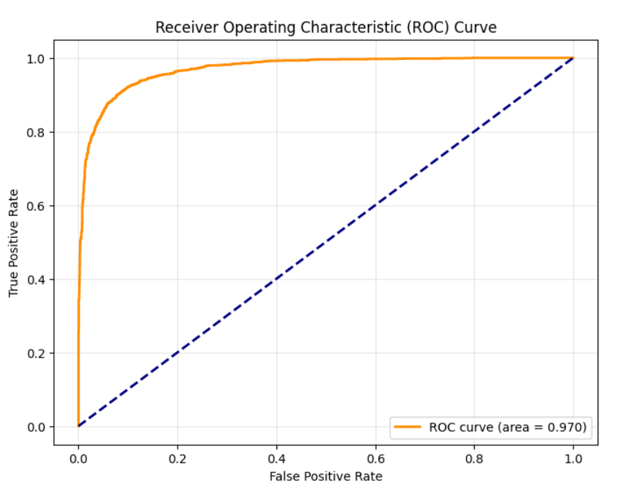
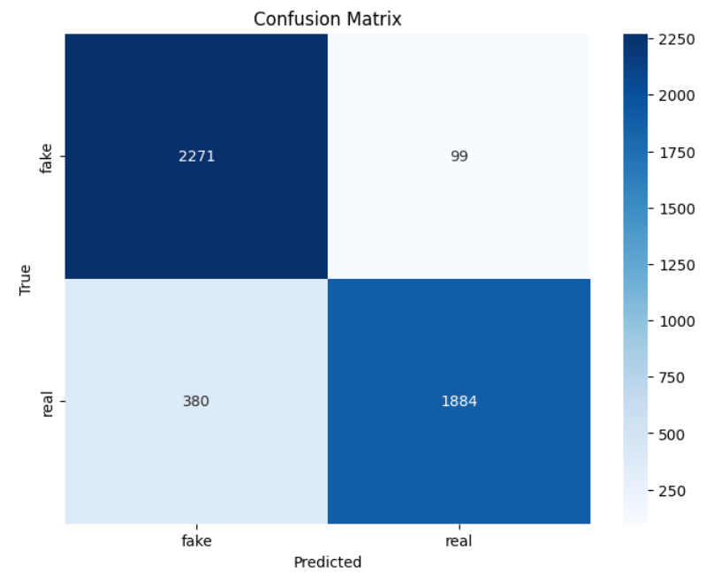
VGG16 Model Evaluation
Accuracy: 90%
  AUC Score: 97%

Slide 41
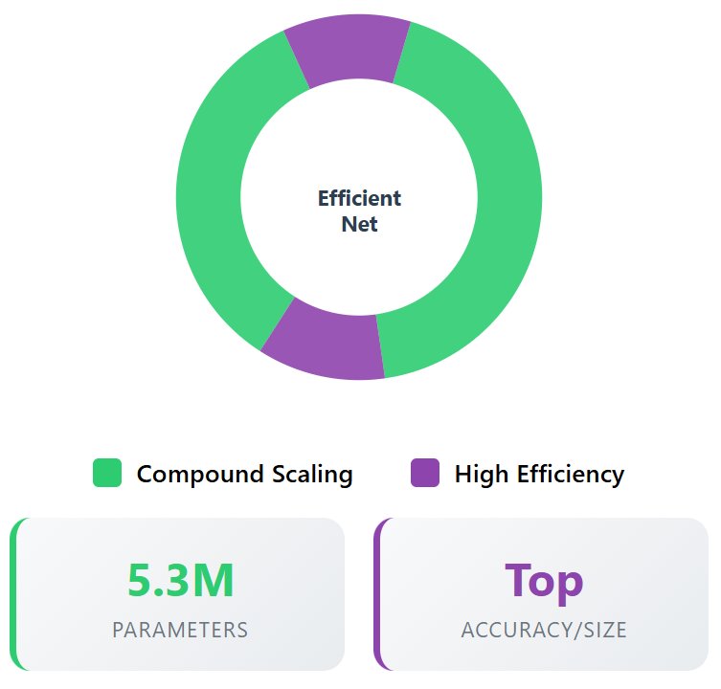
EfficientNetB0 - High Performance, High Efficiency
Architecture:
Compound scaling for balanced depth, width, and resolution
Pre-trained on ImageNet, fine-tuned for audio
Why Chosen:
Combines high accuracy with efficient resource use
Modern architecture for complex tasks

Slide 42
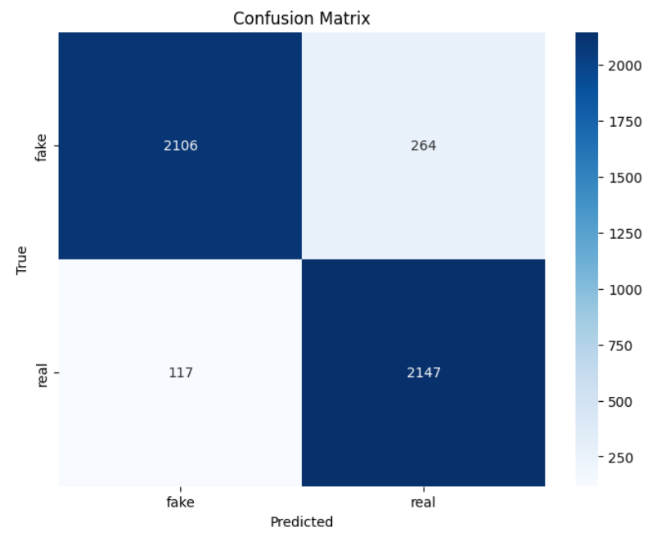
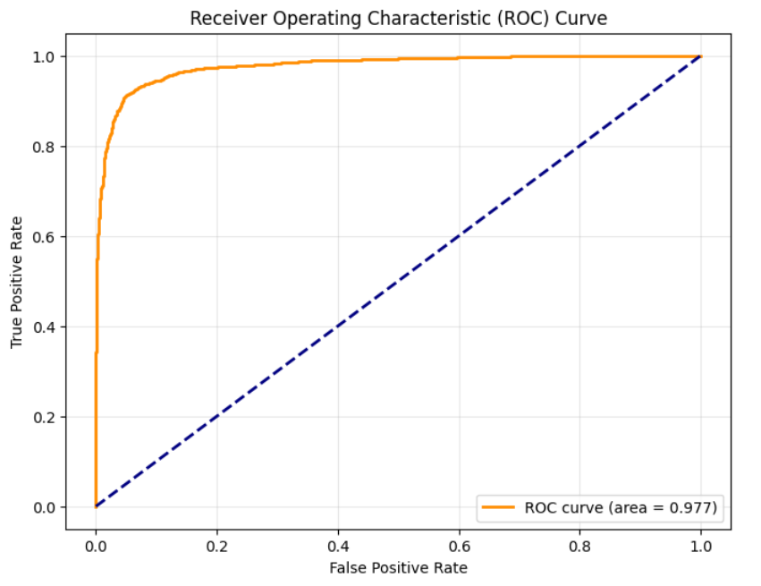
EfficientNetB0 Model Evaluation
Accuracy: 92%
AUC Score: 97%

Slide 43
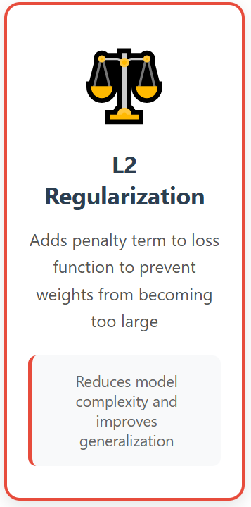
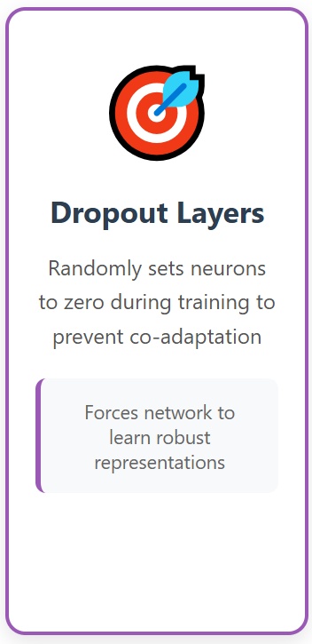
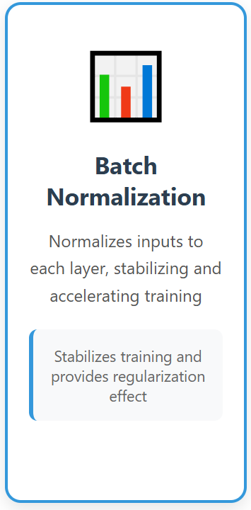
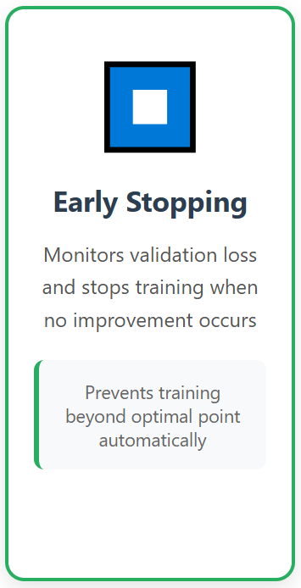
Optimization Techniques :Preventing Overfitting in Deep Learning Models

Slide 44
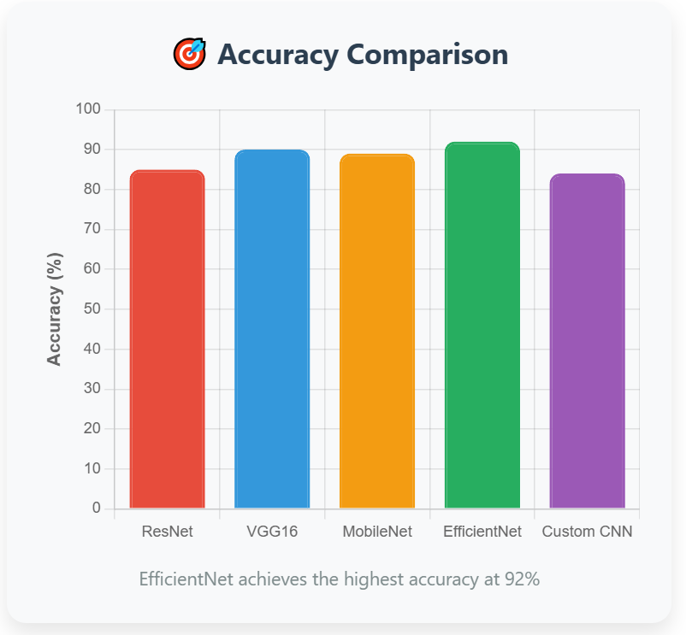
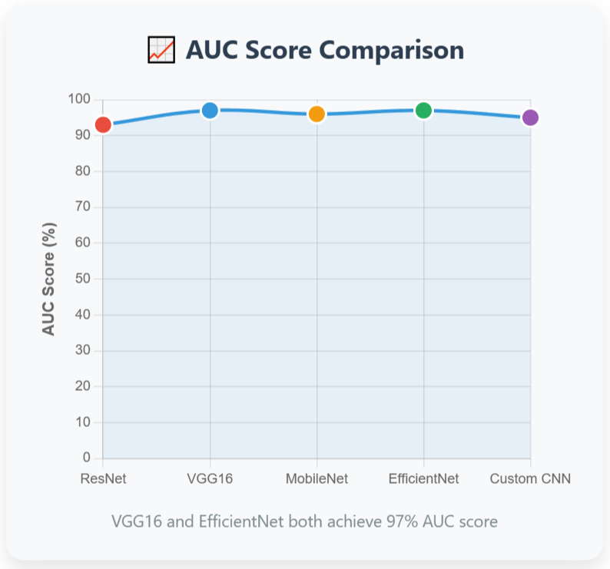
Models Comparison

Slide 45
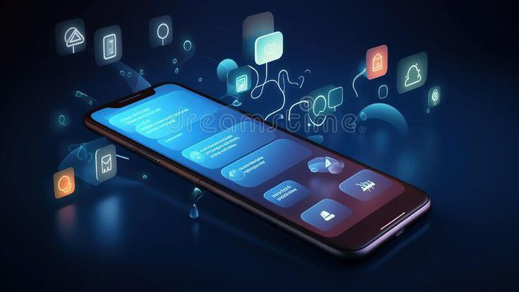
Software Model

Slide 46

Agile software model comparison
Model | Iterative | ML/Data Friendly | Flexibility | Quality Focus | Overhead
Scrum | Sprint | Medium | Good | Moderate | Moderate
Kanban | Continuous | High | Excellent | Optional | Low
XP | Iterations | Low | Rigid | Strong | High
Lean | Flexible | High | Excellent | Good | Low
FDD | Features | Not ideal | Rigid | Medium | Medium
SAFe | Scaled | Low | Rigid | Strong | Very High

Slide 47
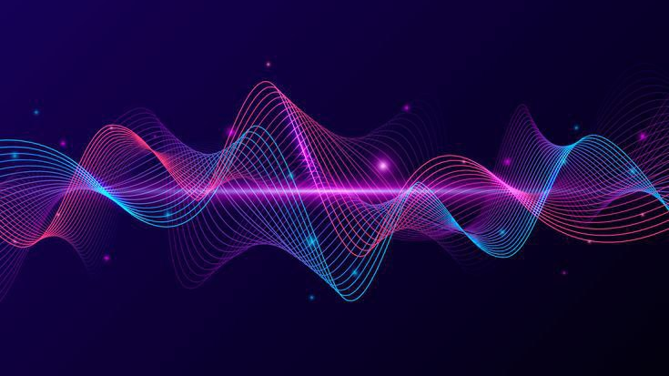
Design Specifications

Slide 48
Business Requirements
Purpose:
Detect and analyze audio authenticity.
Enhance security and reliability.
Combat misinformation and fraud.
Ensure trustworthiness of audio content.
Goals:

Slide 49
System Features - Functional Requirements
1. User Account and Authentication
Register using email or social media.
Password reset functionality.
2. Audio File Input
Supports formats: MP3, WAV, FLAC.
Record audio directly or upload from storage.
Validates file size and type.
3. Audio Analysis and Results
Detects markers of synthetic or manipulated audio.
Results:
Categorized as “Genuine” or “Fake”.
Includes confidence score and explanatory notes.

Slide 50
System Features - Functional Requirements (Con.)
4. User Interaction and Feedback
Save and share results.
5. Multilingual Support
Analyzes audio in English, Arabic, and Spanish.
6. User History and Data
Maintains history of all audio checks.
Provide feedback to improve the system.
Accessible via user accounts.

Slide 51
System Features - Non-Functional Requirements
Performance
Processes audio in max 60 seconds.
Supports files up to 50 MB.
Usability
easy-to-use interface.
Responsive design for mobile and tablets
Security
Ensures privacy by not storing uploaded files.
Implements strong authentication mechanisms.

Slide 52
System Features - Non-Functional Requirements (Con.)
Reliability
High accuracy in detecting fake audio.
Compatibility
Android (min.sdk 23 target sdk 35 = 6.0 to the latest supported version ) and iOS (min. version 13.0).
Scalability
Supports from 10 to 100 simultaneous users.
95% uptime guarantee.

Slide 53

Application Design

Slide 54
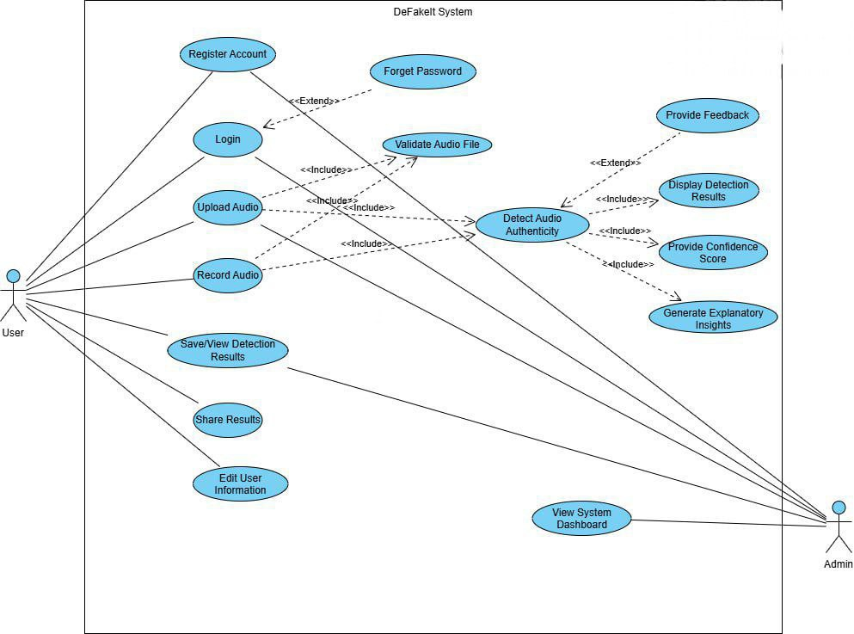
Use Case Diagram

Slide 55

Frontend Development

Slide 56
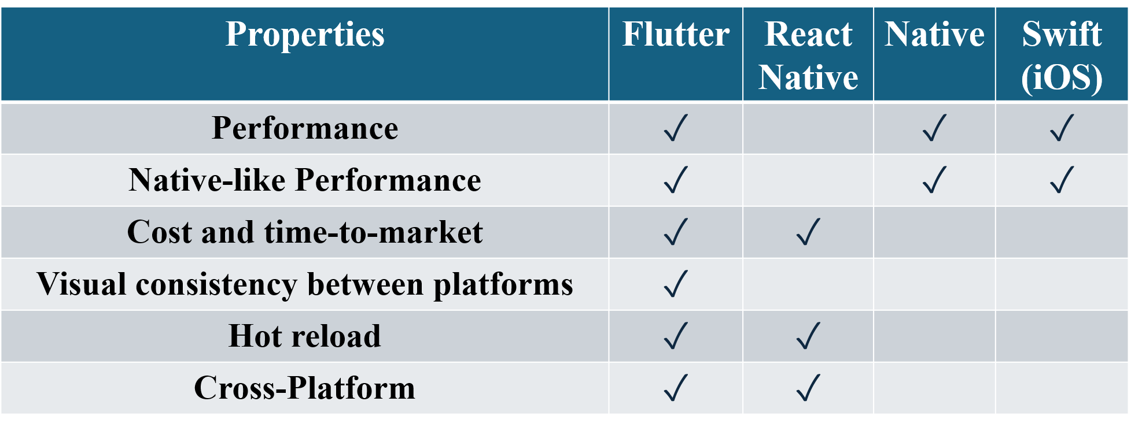
Mobile Frameworks Comparison:

Slide 57
Why Flutter?
Cross-Platform Development.
Native-Like Performance.
Rapid Development (Hot Reload).
Rich UI Capabilities.
Strong Developer Tools.

Slide 58
Framework Limitations:
Flutter:
Larger app size
Limited platform-specific features
Swift:
iOS only
Steep learning curve
React Native:
Performance limitations
Complex UI customization
Kotlin (Android):
Android only
Higher development cost

Slide 59
App Architecture Highlights:
BLoC:
Efficient state management
HTTP:
API communication
Shared Preferences:
Local data storage
Navigation:
Easy screen transitions
Custom Themes:
App styling customization

Slide 60

Admin Website

Slide 61

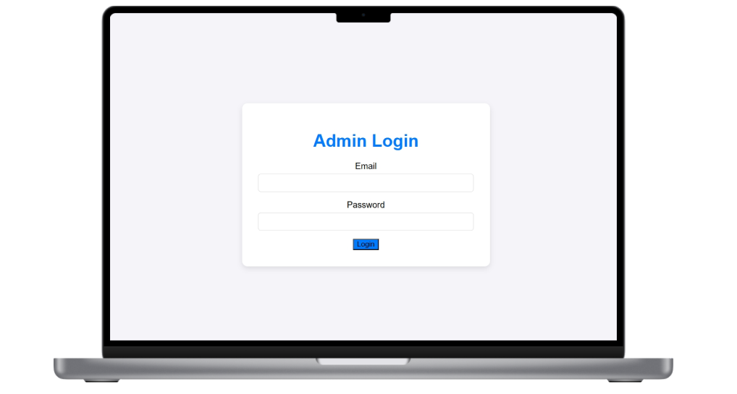
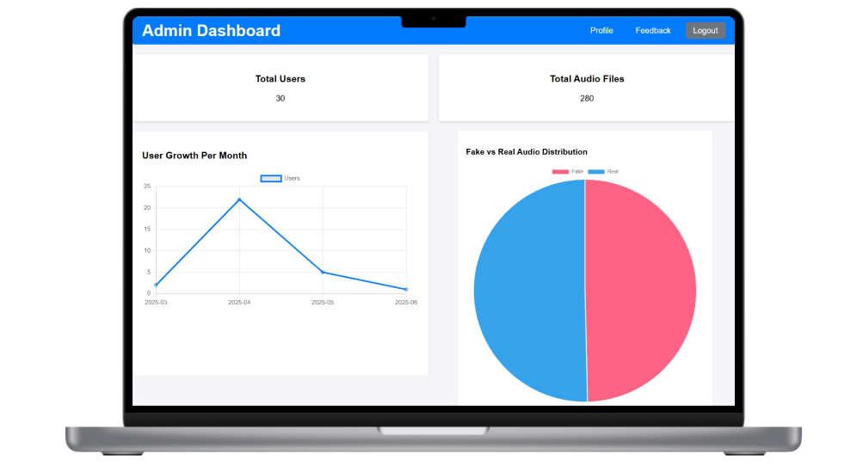
Admin Web Pages

Slide 62
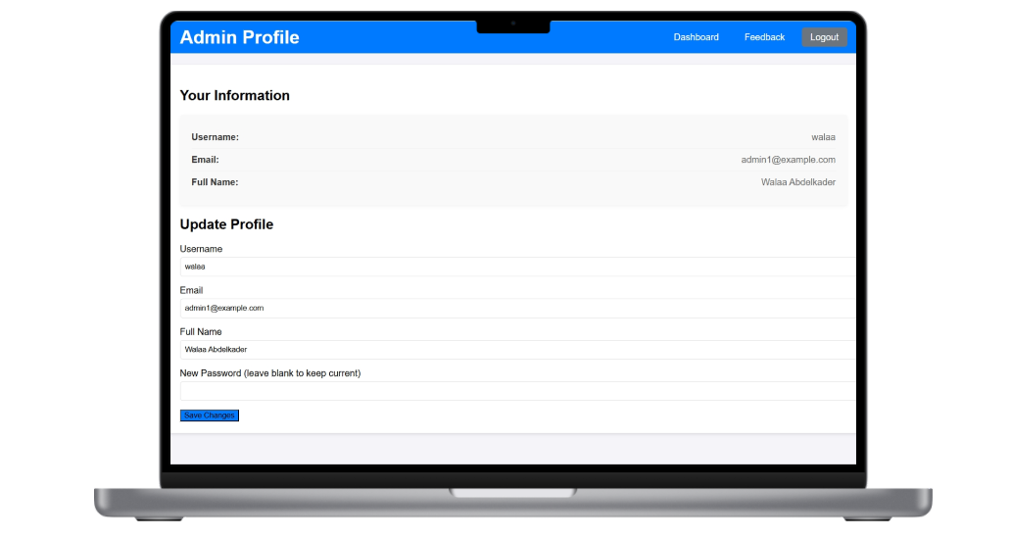
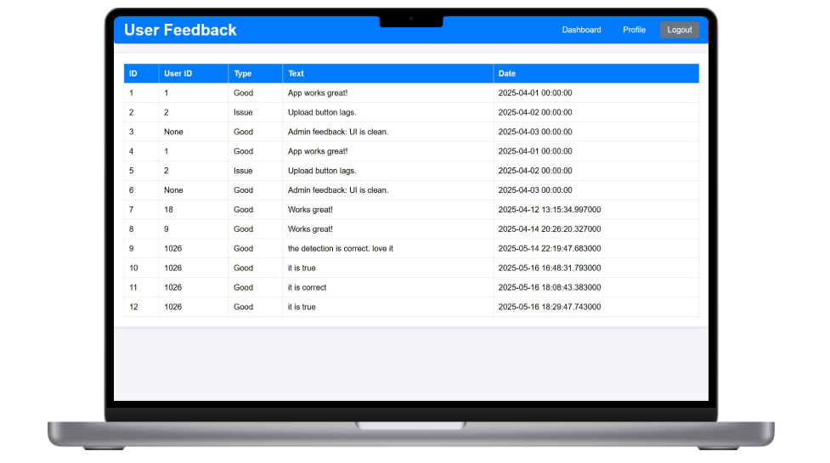
Admin Web Pages

Slide 63
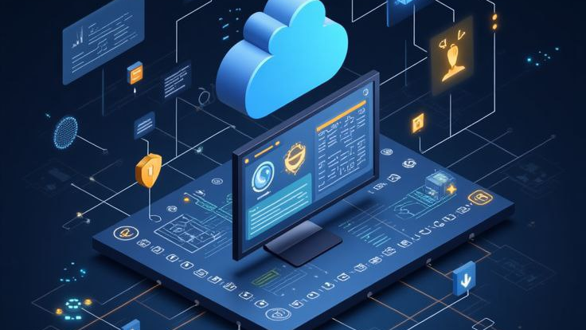
Backend Development

Slide 64

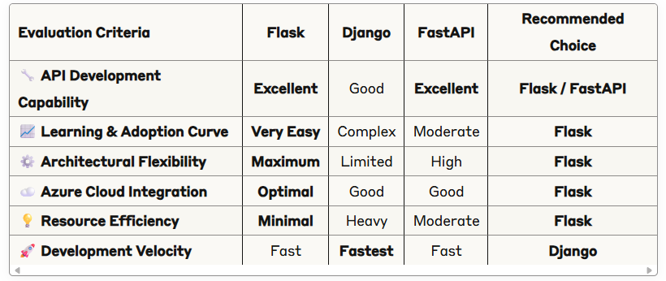

Backend Framework Tools

Slide 65
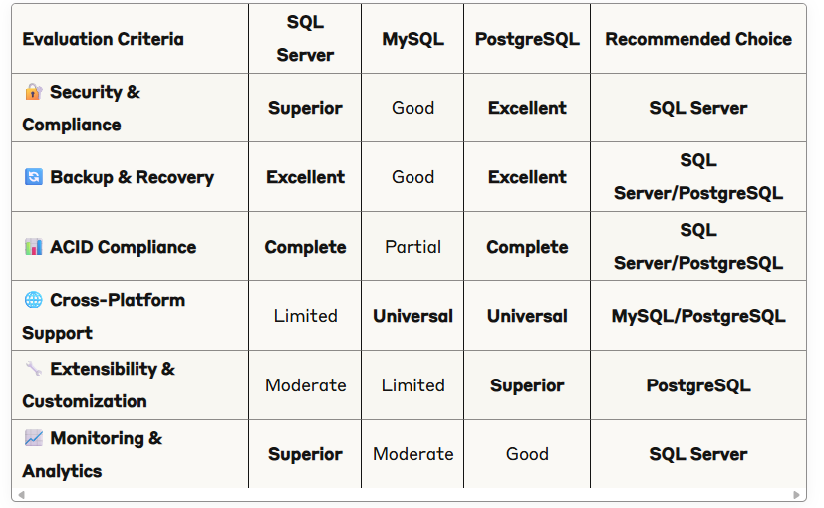
Database Engine Comparison

Slide 66

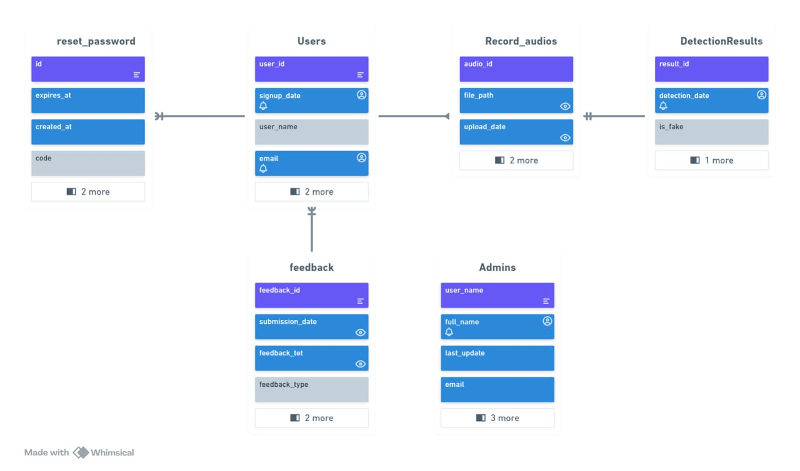
Database Schema

Slide 67

32

Slide 68


Slide 69



The end of this journey

Slide 70


Slide 71

Future Work

Slide 72

1. Detect Phone Calls: Integrate the system with telecommunication channels to analyze and detect deepfake audio in real-time during phone calls.
2. Enhanced Admin Web Page: Develop and enhance the admin web interface for better user experience and control and improve the admin dashboard with advanced analytics.

Slide 73

Prototype

Slide 74


