Slide 1
MOVIE ANALYSIS
BY OMARA WALDEA

Slide 2
SUMMARY
I looked at the highest-grossing films to see what makes them so popular. Based on the following criteria—a superhero film released in April or May, or an animated musical released in June or November—my study will assist you in creating the finest possible film, provided that it has a suitable budget and the ideal director or composer.

Slide 3
Outline
● Business Problem
● Data
● Methods
● Results
● Conclusions

Slide 4
BUSINESS PROBLEM
The CEO will need to be able to use our findings as practical guidance when determining the kinds of movies that should be produced.
We think that investigating these facets of the film industry will be most beneficial to the process of making decisions.
Seasonality and Profit: This will facilitate the efficient distribution of resources.
Diversity in Filmmaking: This aids in measuring the industry's growing and diversified market.
Studios & Production Budgets: When analyzing the costs and benefits of building a particular kind of studio, this information is essential.

Slide 5
DATA
zippedData are movie datasets from:
• Box Office Mojo (https://www.boxofficemojo.com/)
• IMDB (https://www.imdb.com/)
• Rotten Tomatoes (https://www.rottentomatoes.com/)
• TheMovieDB (https://www.themoviedb.org/)
• The Numbers (https://www.the-numbers.com/)

Slide 6
METHODS
Numerous linked pieces of information were imported from The Numbers, Rotten Tomatoes, IMDB, TMDB, and The Box Office Mojo into the datasets.
I reasoned that we already had enough data and didn't need to scrape any more data from the websites given the scope of the data that was already available.
• To gain insight into earnings, genres, movie language, and release months, I added new columns and combined existing ones in the dataset.
• I looked over the dataset to check historical studio data to help figure out how many films each studio made and how much it cost.

Slide 7
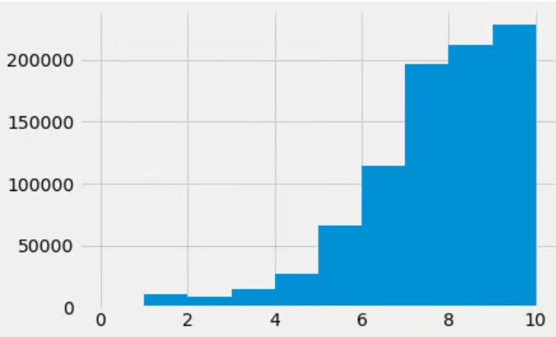
RESULTS
RATINGS HISTOGRAM

Slide 8
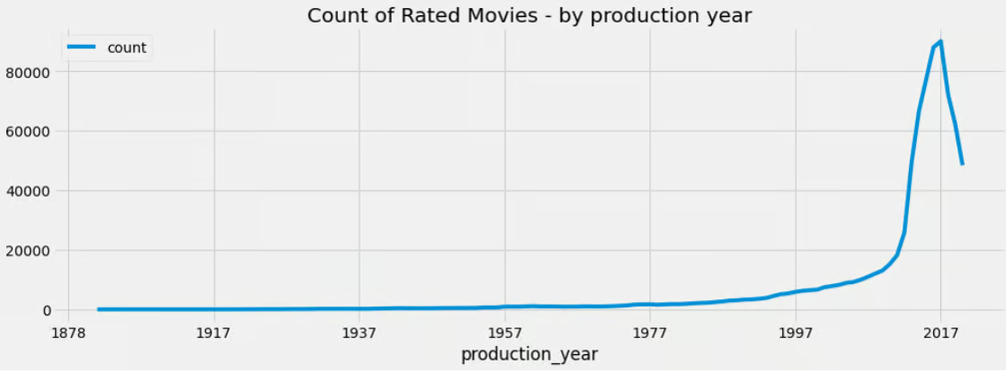
Count of Rated Movies – By Year of Production

Slide 9
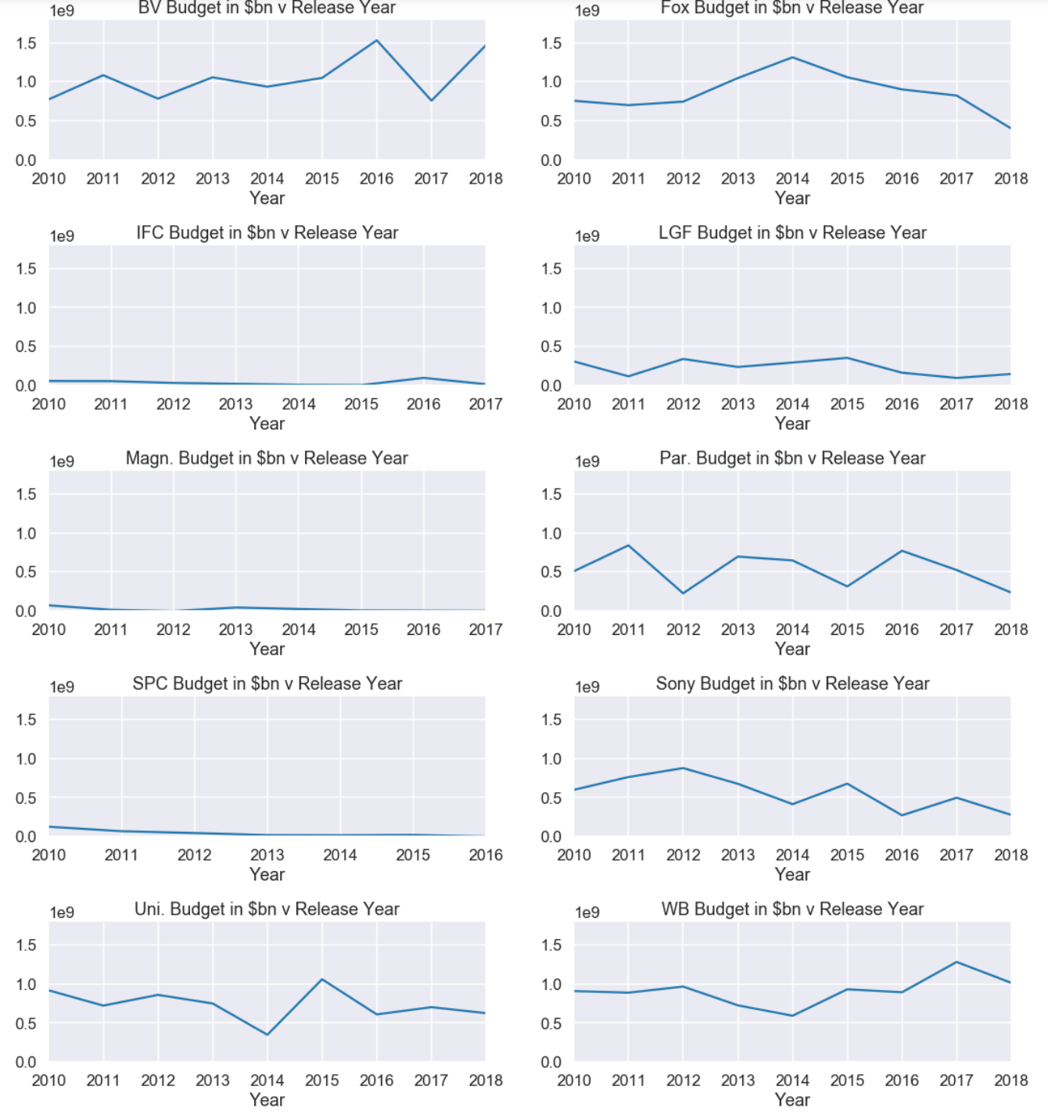
STUDIO BUDGETS

Slide 10
FUTURE WORK
What is the perfect runtime for a well-known film?
What are the top ten movie studios' profit margins?

Slide 11
CONCLUSION
We may summarize our conclusions from the analysis above and suggest the following actions:
We advise getting into the film business via an acquisition/distribution model since it allows for the production of more successful films at a lesser cost than what big film studios do when they make their own films.
If the firm decides to proceed with a foreign language film production or distribution, we suggest going with the Drama or Comedy genre, even if there is a broad variety of popular genre in foreign language films.
It is advisable to schedule your movie releases for late summer or early fall. Not to be overlooked is the fact that June has seen both enormous gains and losses.

