Slide 1
Aprendizaje con dificultad ajustada: Algebra lineal y gráficas
Gonzalez Robles Aldair
Maestría en Ciencias Computacionales
Introducción a la Inteligencia Artificial

Slide 2
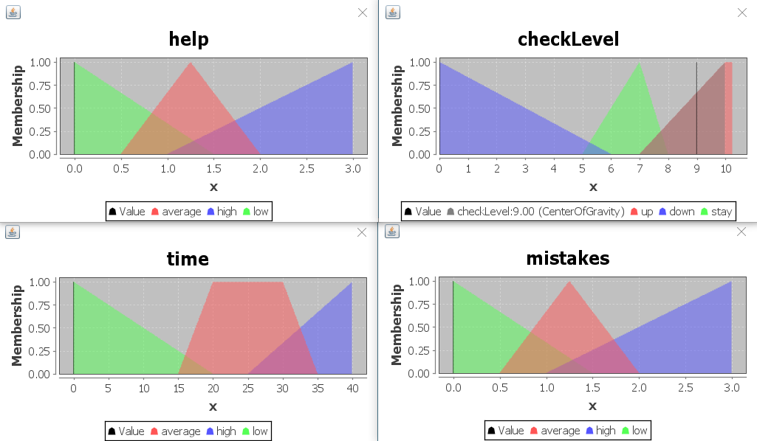
Diagramas Fuzzy Logic
0<= X<6 : Down
6<= X <7.5: Stay
X >= 8: Up

Slide 3
Rules:
RULE 1 : IF time is low AND help is low AND mistakes is low THEN checkLevel is up;
RULE 2 : IF time is high AND help is low AND mistakes is low THEN checkLevel is stay;
RULE 3 : IF time is high AND help is average AND mistakes is low THEN checkLevel is stay;
RULE 4 : IF time is high AND help is average AND mistakes is average THEN checkLevel is down;
RULE 5 : IF help is high THEN checkLevel is down;
RULE 6 : IF mistakes is high THEN checkLevel is down;
RULE 7 : IF mistakes is average THEN checkLevel is stay;
RULE 8 : IF time is average AND help is low AND mistakes is low THEN checkLevel is up;
RULE 9 : IF time is average OR help is average THEN checkLevel is stay;
RULE 10 : IF help is average AND mistakes is average THEN checkLevel is down;

Slide 4
Rules:
RULE 1 : IF time is low AND help is low AND mistakes is low THEN checkLevel is up;
RULE 8 : IF time is average AND help is low AND mistakes is low THEN checkLevel is up;
RULE 2 : IF time is high AND help is low AND mistakes is low THEN checkLevel is stay;
RULE 3 : IF time is high AND help is average AND mistakes is low THEN checkLevel is stay;
RULE 7 : IF mistakes is average THEN checkLevel is stay;
RULE 9 : IF time is average OR help is average THEN checkLevel is stay;

Slide 5
Rules:
RULE 4 : IF time is high AND help is average AND mistakes is average THEN checkLevel is down;
RULE 5 : IF help is high THEN checkLevel is down;
RULE 6 : IF mistakes is high THEN checkLevel is down;
RULE 10 : IF help is average AND mistakes is average THEN checkLevel is down;

Slide 6
Datos.
Usuario: Ficheros.
Datos.txt
Curso: Ficheros
Fácil.txt
Normal.txt
Dificil.txt

Slide 7
Diagrama de clases
Diagrama

