Slide 1
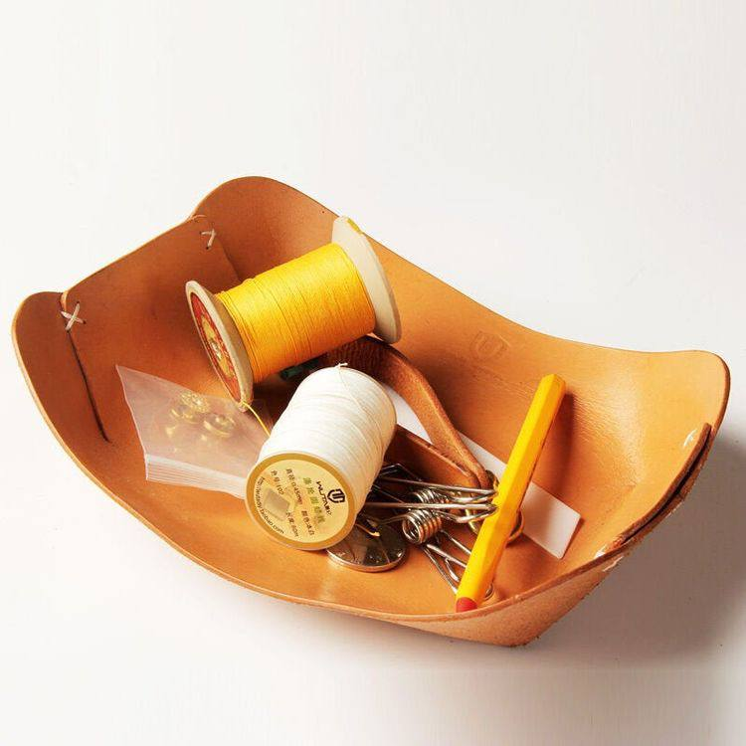
HandMade Application
In this form, we will show the change of the Hand Made applicationوWe will review the methods of profit and development that accrue to the user and also to the developer who displays his products.

Slide 2
HandMade App
profit methods?
The profit from the application is made through advertisements, as the application addresses many categories, including the category that buys products and the category that wants to search for sources to learn and the other who wants to get places to buy their products.
Profit Method
Future plan: the application is developing, so that there is a part on which to explain the production of these products in detail, instead of YouTube links, and we can join it with many submerged industries
Evolution in the application
It must also be mentioned the general recycling process of tools, as well as the use of simple tools to make distinctive things, an idea that expands with investment, as well as development and intellectual creativity, whether it is the methods of handicraft or the re-manufacturing of simple things.
Handmade manufacturers may look for customers to sell their products, and on the other hand, customers are looking for those products to buy.
Recycling and handicrafts

Slide 3
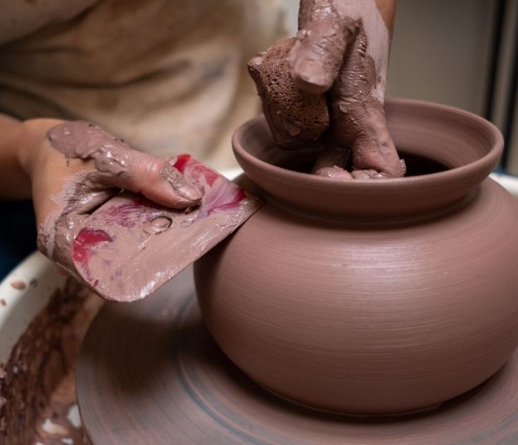
HandMade
✬ Why did we think of a hand-made application?
- Handmade industries are among the most handcrafted industries, and of the highest quality. Hence, they have become necessary and at the same time unavailable, especially in major cities.
Handmade manufacturers may look for customers to sell their products, and on the other hand, customers are looking for those products to buy.
On the other hand, there are many people who are very interested in learning these industries and have not found any reliable sources to learn them.
Finally, there are those who already have the craft, but find it very difficult to know the places that sell these products.
And through the three problems, the idea of ​​a hand-made application came to us

Slide 4
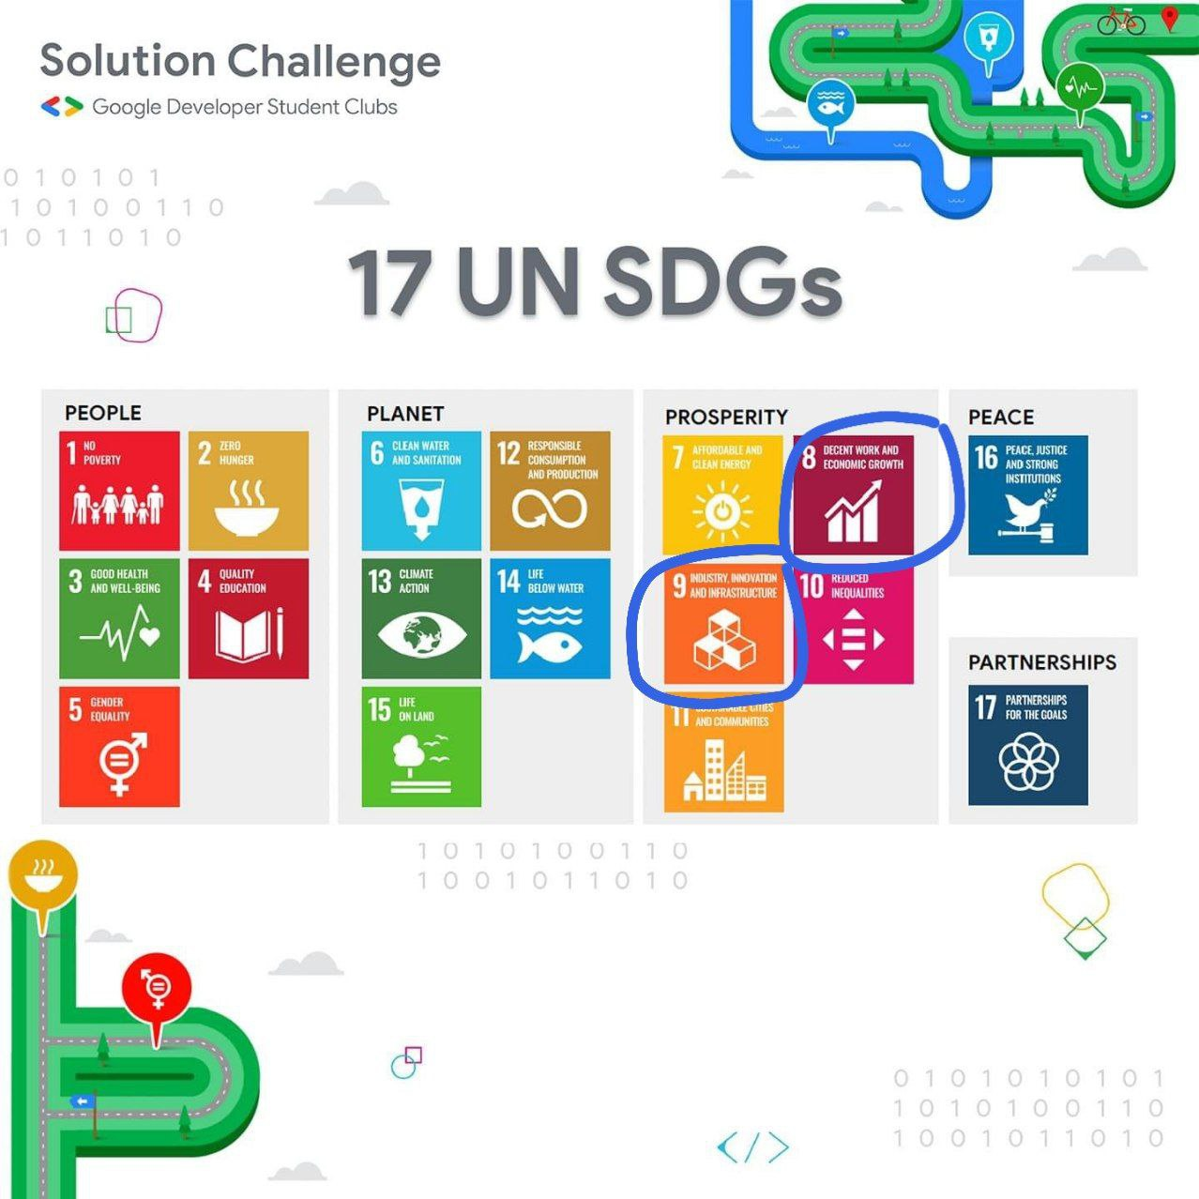
8-Decent Work and Economic Growth
We find a solution for development and the promotion of continuous economic growth, and we see the productive workers and we see work for them that develops them and puts them in the right place so that the production process can take place in a fruitful manner.
9-Inustry Innovation and Interface
How to create an infrastructure and care about manufacturing, and how to develop the process of innovation and creativity

Slide 5
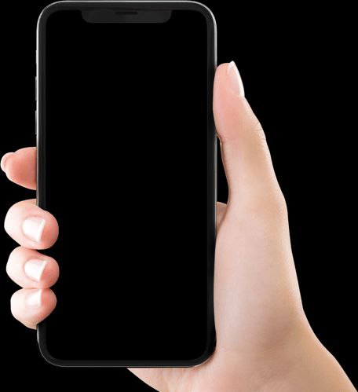

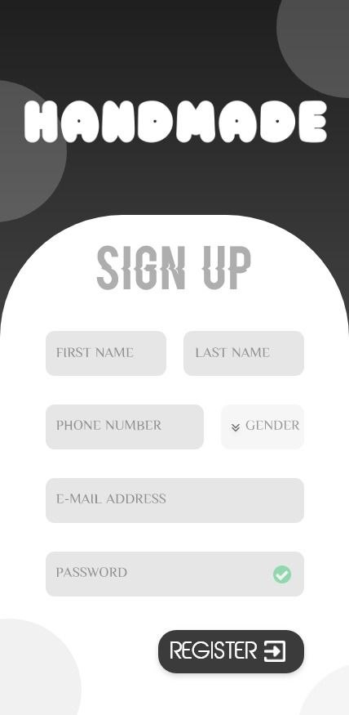
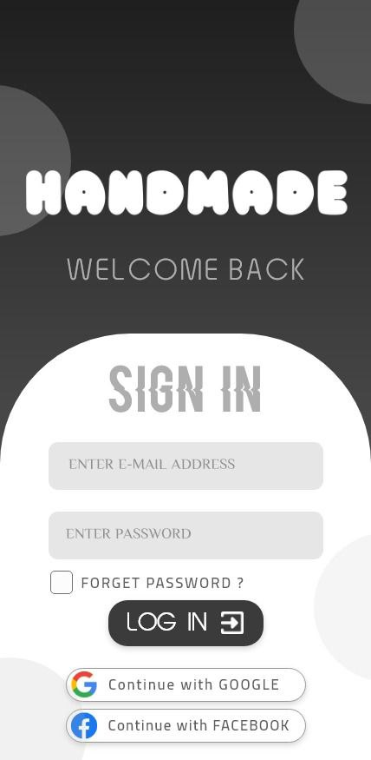
Project Ui & UX

Slide 6
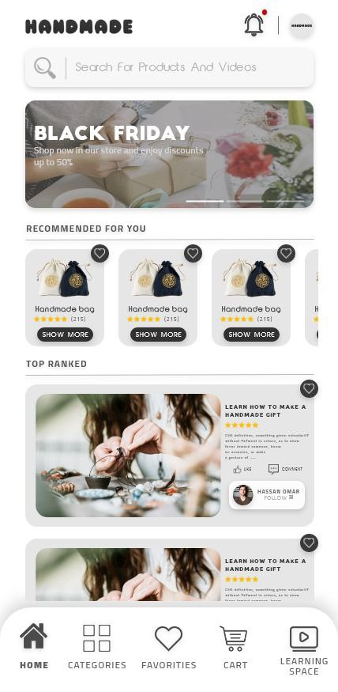
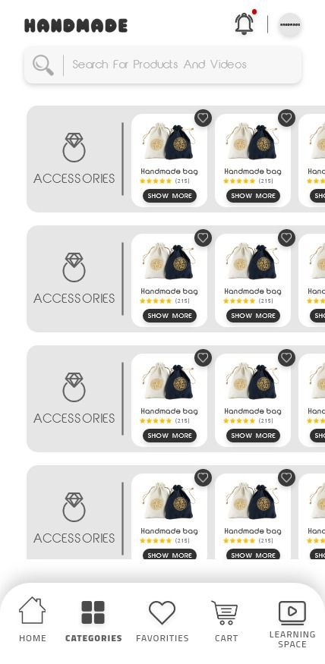
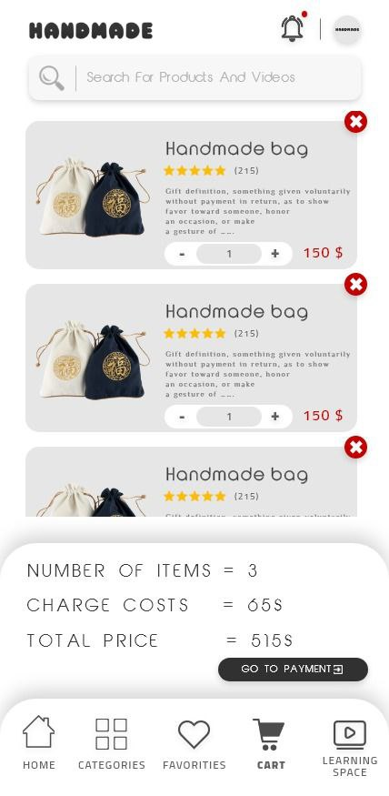
Project Ui & UX

Slide 7

Mobile Application
UI Of Mobile App , Manage The State Management By Flutter
BackEnd and Build Api By NodeJs & Laravel
This Application Is Streamlined and smooth and high quality of Performance
This Application Is Contain Validation And Testing To Save Security and Admin’s Controll Data
Project Technology

Slide 8
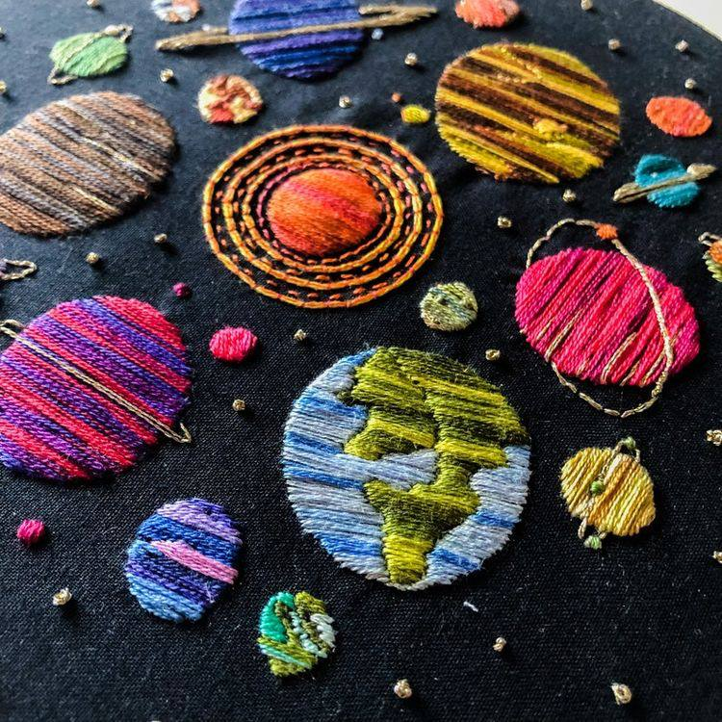
THANK YOU
At the end of the general picture of the project, we would like the project to be fully supported because it supports a different point of view and supports two sides of the problems, namely the increase in innovation and creativity, as well as support for investment and small projects

