Slide 1

Data Science Project
Main Research-Question:
To what extent do weather conditions and public holidays influence electricity consumption and generation in Germany?
Marcel Kawski
Waleed Mahmood
Leon Krückmeyer

Slide 2
Data Science Project
Research Goal
Main Research-Question:
To what extent do weather conditions and public holidays influence electricity consumption and generation in Germany?
Marcel Kawski
Waleed Mahmood
Leon Krückmeyer
Electricity is essential for households, business, and the economy
Demand and generation do not stay constant. They change over time
Weather strongly affects renewable generation, espacially wind and solar power
Holidays may influence electricity demand by changing daily routines and economic activity
We analyze Germay (2022 – 2025), looking at consumption and generation
Electricity is essential for households, business, and the economy
Demand and generation do not stay constant. They change over time
Weather strongly affects renewable generation, espacially wind and solar power
Holidays may influence electricity demand by changing daily routines and economic activity
We analyze Germay (2022 – 2025), looking at consumption and generation

Slide 3



Data Science Project
Data Sources
Research Goal
SMARD
Electricity consumption and electricity generation data for Germany and TSO regions
Open-Meteo
Daily weather data such as wind speed, maximum temperature and precipitation
OpenHolidays
School holiday data for all German federal states, transformed into daily holiday observations
Electricity is essential for households, business, and the economy
Demand and generation do not stay constant. They change over time
Weather strongly affects renewable generation, espacially wind and solar power
Holidays may influence electricity demand by changing daily routines and economic activity
We analyze Germay (2022 – 2025), looking at consumption and generation
Main Research-Question:
To what extent do weather conditions and public holidays influence electricity consumption and generation in Germany?

Slide 4
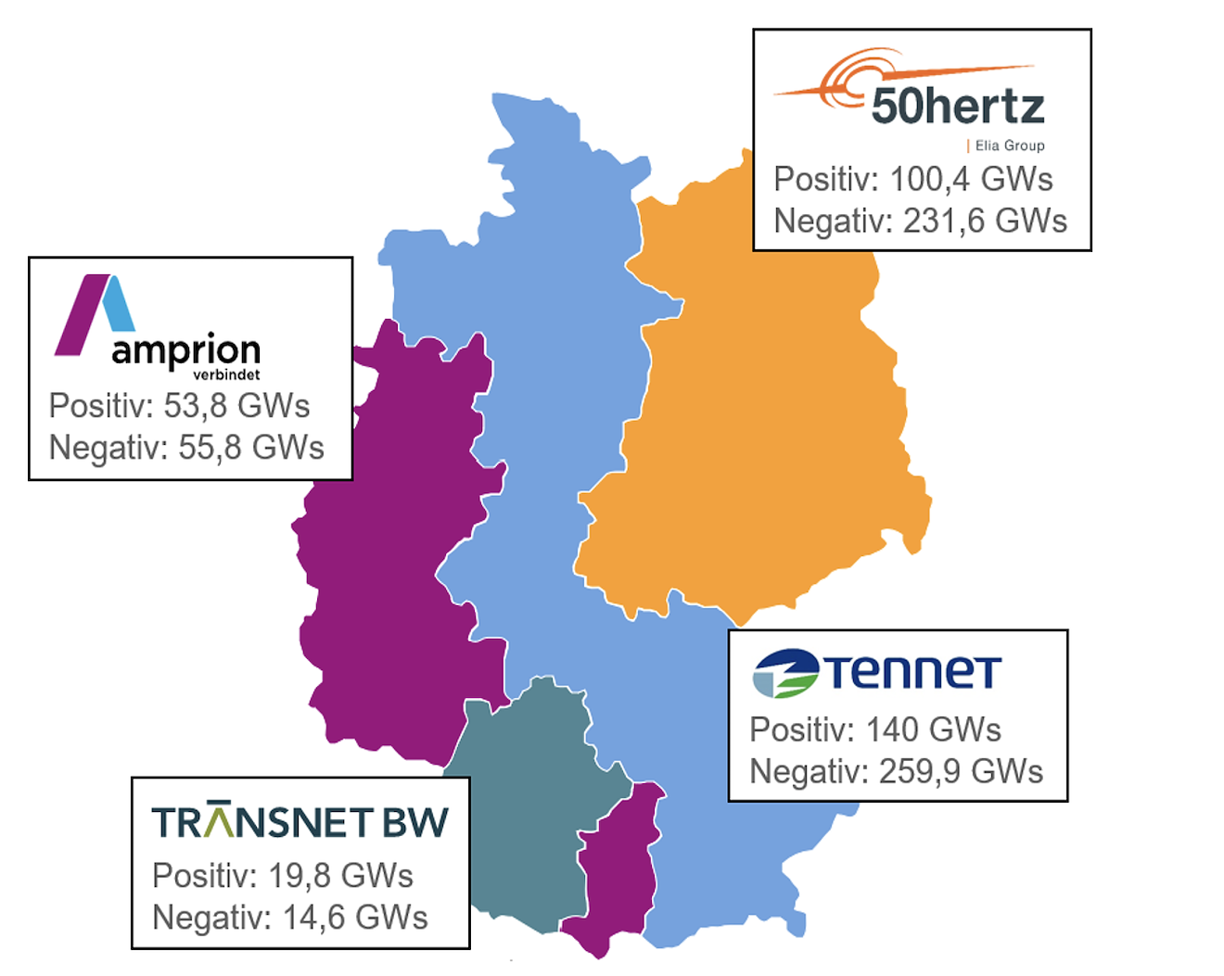
Data Science Project
Electricity is essential for households, business, and the economy
Demand and generation do not stay constant. They change over time
Weather strongly affects renewable generation, espacially wind and solar power
Holidays may influence electricity demand by changing daily routines and economic activity
We analyze Germay (2022 – 2025), looking at consumption and generation
Research Goal
Method
Data Sources
Electricity is essential for households, business, and the economy
Demand and generation do not stay constant. They change over time
Weather strongly affects renewable generation, espacially wind and solar power
Holidays may influence electricity demand by changing daily routines and economic activity
We analyze Germay (2022 – 2025), looking at consumption and generation
SMARD
Electricity consumption and electricity generation data for Germany and TSO regions
Open-Meteo
Daily weather data such as wind speed, maximum temperature and precipitation
OpenHolidays
School holiday data for all German federal states, transformed into daily holiday observations
All datasets were converted to daily level and merged by date
For electricity consumption, we compared three day type:
Regular Days, Sundays and Holidays
For electricity generation, we examined correlations between weather variables and renewable generation, especially:
wind speed – wind generation
Temperature / seasonal conditions – solar generation
We also conducted a regional comparison across TSO zones:
50Hertz, Amprion, TenneT and TransnetBW
All datasets were converted to daily level and merged by date
For electricity consumption, we compared three day type:
Regular Days, Sundays and Holidays
For electricity generation, we examined correlations between weather variables and renewable generation, especially:
wind speed – wind generation
Temperature / seasonal conditions – solar generation
We also conducted a regional comparison across TSO zones:
50Hertz, Amprion, TenneT and TransnetBW

Slide 5
Data Science Project
Electricity is essential for households, business, and the economy
Demand and generation do not stay constant. They change over time
Weather strongly affects renewable generation, espacially wind and solar power
Holidays may influence electricity demand by changing daily routines and economic activity
We analyze Germay (2022 – 2025), looking at consumption and generation
Data Sources
Research Goal
TSO Zones
Method
All datasets were converted to daily level and merged by date
For electricity consumption, we compared three day type:
Regular Days, Sundays and Holidays
For electricity generation, we examined correlations between weather variables and renewable generation, especially:
wind speed – wind generation
Temperature / seasonal conditions – solar generation
We also conducted a regional comparison across TSO zones:
50Hertz, Amprion, TenneT and TransnetBW
SMARD
Electricity consumption and electricity generation data for Germany and TSO regions
Open-Meteo
Daily weather data such as wind speed, maximum temperature and precipitation
OpenHolidays
School holiday data for all German federal states, transformed into daily holiday observations

Slide 6
Data Sources
Research Goal
Method
TSO Zones
All datasets were converted to daily level and merged by date
For electricity consumption, we compared three day type:
Regular Days, Sundays and Holidays
For electricity generation, we examined correlations between weather variables and renewable generation, especially:
wind speed – wind generation
Temperature / seasonal conditions – solar generation
We also conducted a regional comparison across TSO zones:
50Hertz, Amprion, TenneT and TransnetBW
To what extent do holiday periods influence daily electricity consumption in germany?
Lowest consumption on holiday-period days
Higher average consumption on regular working days
Sundays are lower too, but holiday periods show the strongest reduction
Suggest that routines and economic activity affect demand
Electricity consumption lowest on holiday-period days
Regular working days show higher average consumption
Sundays are also lower than regular days, but in our data the strongest reduction appears during holiday periods
This suggests that changes in routines, mobility and economic activity influence electricity demand

Slide 7
Data Sources
Research Goal
Method
TSO Zones
Main Finding 1: Holidays and Consumption
Main Finding 1: Holidays and Consumption
To what extent do holiday periods influence daily electricity consumption in germany?
All datasets were converted to daily level and merged by date
For electricity consumption, we compared three day type:
Regular Days, Sundays and Holidays
For electricity generation, we examined correlations between weather variables and renewable generation, especially:
wind speed – wind generation
Temperature / seasonal conditions – solar generation
We also conducted a regional comparison across TSO zones:
50Hertz, Amprion, TenneT and TransnetBW
Lowest consumption on holiday-period days
Higher average consumption on regular working days
Sundays are lower too, but holiday periods show the strongest reduction
Suggest that routines and economic activity affect demand

Slide 8
Main Finding 1: Holidays and Consumption
Data Sources
Research Goal
Main Finding 2: Weather
And Generation
Method
TSO Zones
Main Finding 1: Holidays and Consumption
How strongly do weather conditions explain renewable electricity generation in Germany?
Website
All datasets were converted to daily level and merged by date
For electricity consumption, we compared three day type:
Regular Days, Sundays and Holidays
For electricity generation, we examined correlations between weather variables and renewable generation, especially:
wind speed – wind generation
Temperature / seasonal conditions – solar generation
We also conducted a regional comparison across TSO zones:
50Hertz, Amprion, TenneT and TransnetBW
To what extent do holiday periods influence daily electricity consumption in germany?
Electricity consumption lowest on holiday-period days
Regular working days show higher average consumption
Sundays are also lower than regular days, but in our data the strongest reduction appears during holiday periods
This suggests that changes in routines, mobility and economic activity influence electricity demand
Weather has a clear influence on renewable electricity genarations
Higher wind speed = higher wind power generation
Higher temperatures / sunnier conditions = higher solar generation
Weather effects are stronger for generation than consumption
Clearest relationships appear for wind and solar power
This shows that renewable generation depends strongly on natural conditions

Slide 9
Main Finding 1: Holidays and Consumption
Website
Data Sources
Research Goal
Method
Website
TSO Zones
Main Finding 1: Holidays and Consumption
Main Finding 2: Weather
And Generation
How strongly do weather conditions explain renewable electricity generation in Germany?
All datasets were converted to daily level and merged by date
For electricity consumption, we compared three day type:
Regular Days, Sundays and Holidays
For electricity generation, we examined correlations between weather variables and renewable generation, especially:
wind speed – wind generation
Temperature / seasonal conditions – solar generation
We also conducted a regional comparison across TSO zones:
50Hertz, Amprion, TenneT and TransnetBW
To what extent do holiday periods influence daily electricity consumption in germany?
Weather has a clear influence on renewable electricity genarations
Higher wind speed = higher wind power generation
Higher temperatures / sunnier conditions = higher solar generation
Weather effects are stronger for generation than consumption
Clearest relationships appear for wind and solar power
This shows that renewable generation depends strongly on natural conditions
Electricity consumption lowest on holiday-period days
Regular working days show higher average consumption
Sundays are also lower than regular days, but in our data the strongest reduction appears during holiday periods
This suggests that changes in routines, mobility and economic activity influence electricity demand

Slide 10
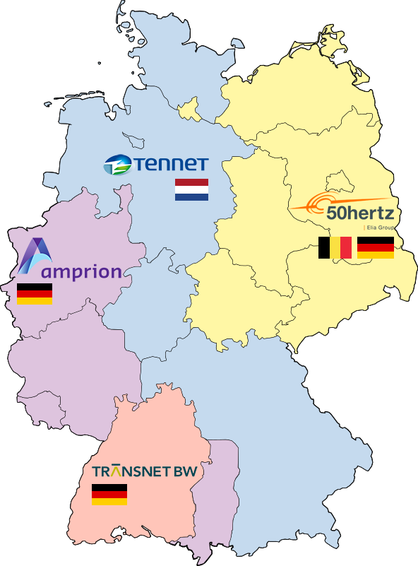
Main Finding 1: Holidays and Consumption
Data Sources
Research Goal
Method
Main Finding 2: Weather
And Generation
Main Finding 3: Regional Differences across
TSO Zones
TSO Zones
Website
Main Finding 1: Holidays and Consumption
How strongly do weather conditions explain renewable electricity generation in Germany?
How do these effects differ across German TSO zones?
Website
All datasets were converted to daily level and merged by date
For electricity consumption, we compared three day type:
Regular Days, Sundays and Holidays
For electricity generation, we examined correlations between weather variables and renewable generation, especially:
wind speed – wind generation
Temperature / seasonal conditions – solar generation
We also conducted a regional comparison across TSO zones:
50Hertz, Amprion, TenneT and TransnetBW
To what extent do holiday periods influence daily electricity consumption in germany?
Electricity consumption lowest on holiday-period days
Regular working days show higher average consumption
Sundays are also lower than regular days, but in our data the strongest reduction appears during holiday periods
This suggests that changes in routines, mobility and economic activity influence electricity demand
Weather has a clear influence on renewable electricity genarations
Higher wind speed = higher wind power generation
Higher temperatures / sunnier conditions = higher solar generation
Weather effects are stronger for generation than consumption
Clearest relationships appear for wind and solar power
This shows that renewable generation depends strongly on natural conditions
Clear differences accros the four TSO zones
Amprion and Tennet have higher average consumption
Regional pattern reflect industry, population and generation mix
Weather effects exist in all zones but with different intensities

Slide 11
Main Finding 1: Holidays and Consumption
Data Sources
Research Goal
Method
Website
TSO Zones
Main Finding 1: Holidays and Consumption
Main Finding 3: Regional Differences across
TSO Zones
How do these effects differ across German TSO zones?
All datasets were converted to daily level and merged by date
For electricity consumption, we compared three day type:
Regular Days, Sundays and Holidays
For electricity generation, we examined correlations between weather variables and renewable generation, especially:
wind speed – wind generation
Temperature / seasonal conditions – solar generation
We also conducted a regional comparison across TSO zones:
50Hertz, Amprion, TenneT and TransnetBW
Website
To what extent do holiday periods influence daily electricity consumption in germany?
Clear differences accros the four TSO zones
Amprion and Tennet have higher average consumption
Regional pattern reflect industry, population and generation mix
Weather effects exist in all zones but with different intensities
Electricity consumption lowest on holiday-period days
Regular working days show higher average consumption
Sundays are also lower than regular days, but in our data the strongest reduction appears during holiday periods
This suggests that changes in routines, mobility and economic activity influence electricity demand

Slide 12

Main Finding 1: Holidays and Consumption
Data Sources
Main Finding 3: Regional Differences across
TSO Zones
Research Goal
Major problems during the project
Method
Main Finding 2: Weather
And Generation
Website
TSO Zones
Main Finding 1: Holidays and Consumption
How strongly do weather conditions explain renewable electricity generation in Germany?
How do these effects differ across German TSO zones?
Website
Data inconsistencies between sources
Unexpectedly high consumption values during data validation
429 rate limit during API data collection (to many requests)
Challenges in embedding an interactive graph in HTML
All datasets were converted to daily level and merged by date
For electricity consumption, we compared three day type:
Regular Days, Sundays and Holidays
For electricity generation, we examined correlations between weather variables and renewable generation, especially:
wind speed – wind generation
Temperature / seasonal conditions – solar generation
We also conducted a regional comparison across TSO zones:
50Hertz, Amprion, TenneT and TransnetBW
To what extent do holiday periods influence daily electricity consumption in germany?
Electricity consumption lowest on holiday-period days
Regular working days show higher average consumption
Sundays are also lower than regular days, but in our data the strongest reduction appears during holiday periods
This suggests that changes in routines, mobility and economic activity influence electricity demand
Clear differences accros the four TSO zones
Amprion and Tennet have higher average consumption
Regional pattern reflect industry, population and generation mix
Weather effects exist in all zones but with different intensities
Weather has a clear influence on renewable electricity genarations
Higher wind speed = higher wind power generation
Higher temperatures / sunnier conditions = higher solar generation
Weather effects are stronger for generation than consumption
Clearest relationships appear for wind and solar power
This shows that renewable generation depends strongly on natural conditions

Slide 13
Main Finding 1: Holidays and Consumption
Data Sources
Research Goal
Method
Main Finding 2: Weather
And Generation
Website
TSO Zones
Main Finding 1: Holidays and Consumption
Major problems during the project
How strongly do weather conditions explain renewable electricity generation in Germany?
Website
All datasets were converted to daily level and merged by date
For electricity consumption, we compared three day type:
Regular Days, Sundays and Holidays
For electricity generation, we examined correlations between weather variables and renewable generation, especially:
wind speed – wind generation
Temperature / seasonal conditions – solar generation
We also conducted a regional comparison across TSO zones:
50Hertz, Amprion, TenneT and TransnetBW
Data inconsistencies between sources
Unexpectedly high consumption values during data validation
429 rate limit during API data collection (to many requests)
Challenges in embedding an interactive graph in HTML
To what extent do holiday periods influence daily electricity consumption in germany?
Electricity consumption lowest on holiday-period days
Regular working days show higher average consumption
Sundays are also lower than regular days, but in our data the strongest reduction appears during holiday periods
This suggests that changes in routines, mobility and economic activity influence electricity demand
Weather has a clear influence on renewable electricity genarations
Higher wind speed = higher wind power generation
Higher temperatures / sunnier conditions = higher solar generation
Weather effects are stronger for generation than consumption
Clearest relationships appear for wind and solar power
This shows that renewable generation depends strongly on natural conditions

Slide 14
Main Finding 1: Holidays and Consumption
Major problems during the project
Data Sources
Research Goal
Method
Main Finding 2: Weather
And Generation
Website
TSO Zones
END
Main Finding 1: Holidays and Consumption
How strongly do weather conditions explain renewable electricity generation in Germany?
Website
Questions?
All datasets were converted to daily level and merged by date
For electricity consumption, we compared three day type:
Regular Days, Sundays and Holidays
For electricity generation, we examined correlations between weather variables and renewable generation, especially:
wind speed – wind generation
Temperature / seasonal conditions – solar generation
We also conducted a regional comparison across TSO zones:
50Hertz, Amprion, TenneT and TransnetBW
Data inconsistencies between sources
Unexpectedly high consumption values during data validation
429 rate limit during API data collection (to many requests)
Challenges in embedding an interactive graph in HTML
To what extent do holiday periods influence daily electricity consumption in germany?
Electricity consumption lowest on holiday-period days
Regular working days show higher average consumption
Sundays are also lower than regular days, but in our data the strongest reduction appears during holiday periods
This suggests that changes in routines, mobility and economic activity influence electricity demand
Weather has a clear influence on renewable electricity genarations
Higher wind speed = higher wind power generation
Higher temperatures / sunnier conditions = higher solar generation
Weather effects are stronger for generation than consumption
Clearest relationships appear for wind and solar power
This shows that renewable generation depends strongly on natural conditions

