Slide 1
Automatic Detection of Fake News
Saif ali khan
Waleed ahmed
Mansoor naseer
Haris jamil
Advisor: dr. Masroor hussain
Co-advisor: dr. Fawad hussain

Slide 2
Motivation:
Automatically detecting fake news on the internet is a hard problem which is yet to solved.
      We want to demonstrate how machine learning can be used to detect fake news accurately.
      We want to build a web-based application which ingests a news URL and then gives it a credibility score and classifies it as either fake news or credible news.

Slide 3
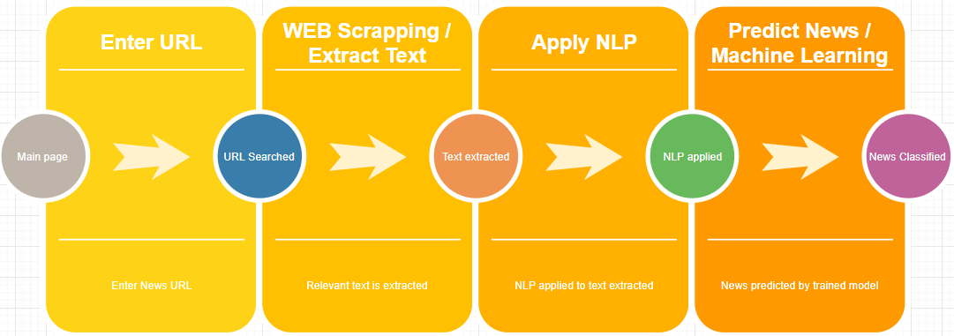

Slide 4
Result
38 features used in total.
      Around 6500 News Articles used for training.
      85.7% maximum accuracy achieved.
            Working to achieve more.
            Can be increased with larger dataset.

Slide 5
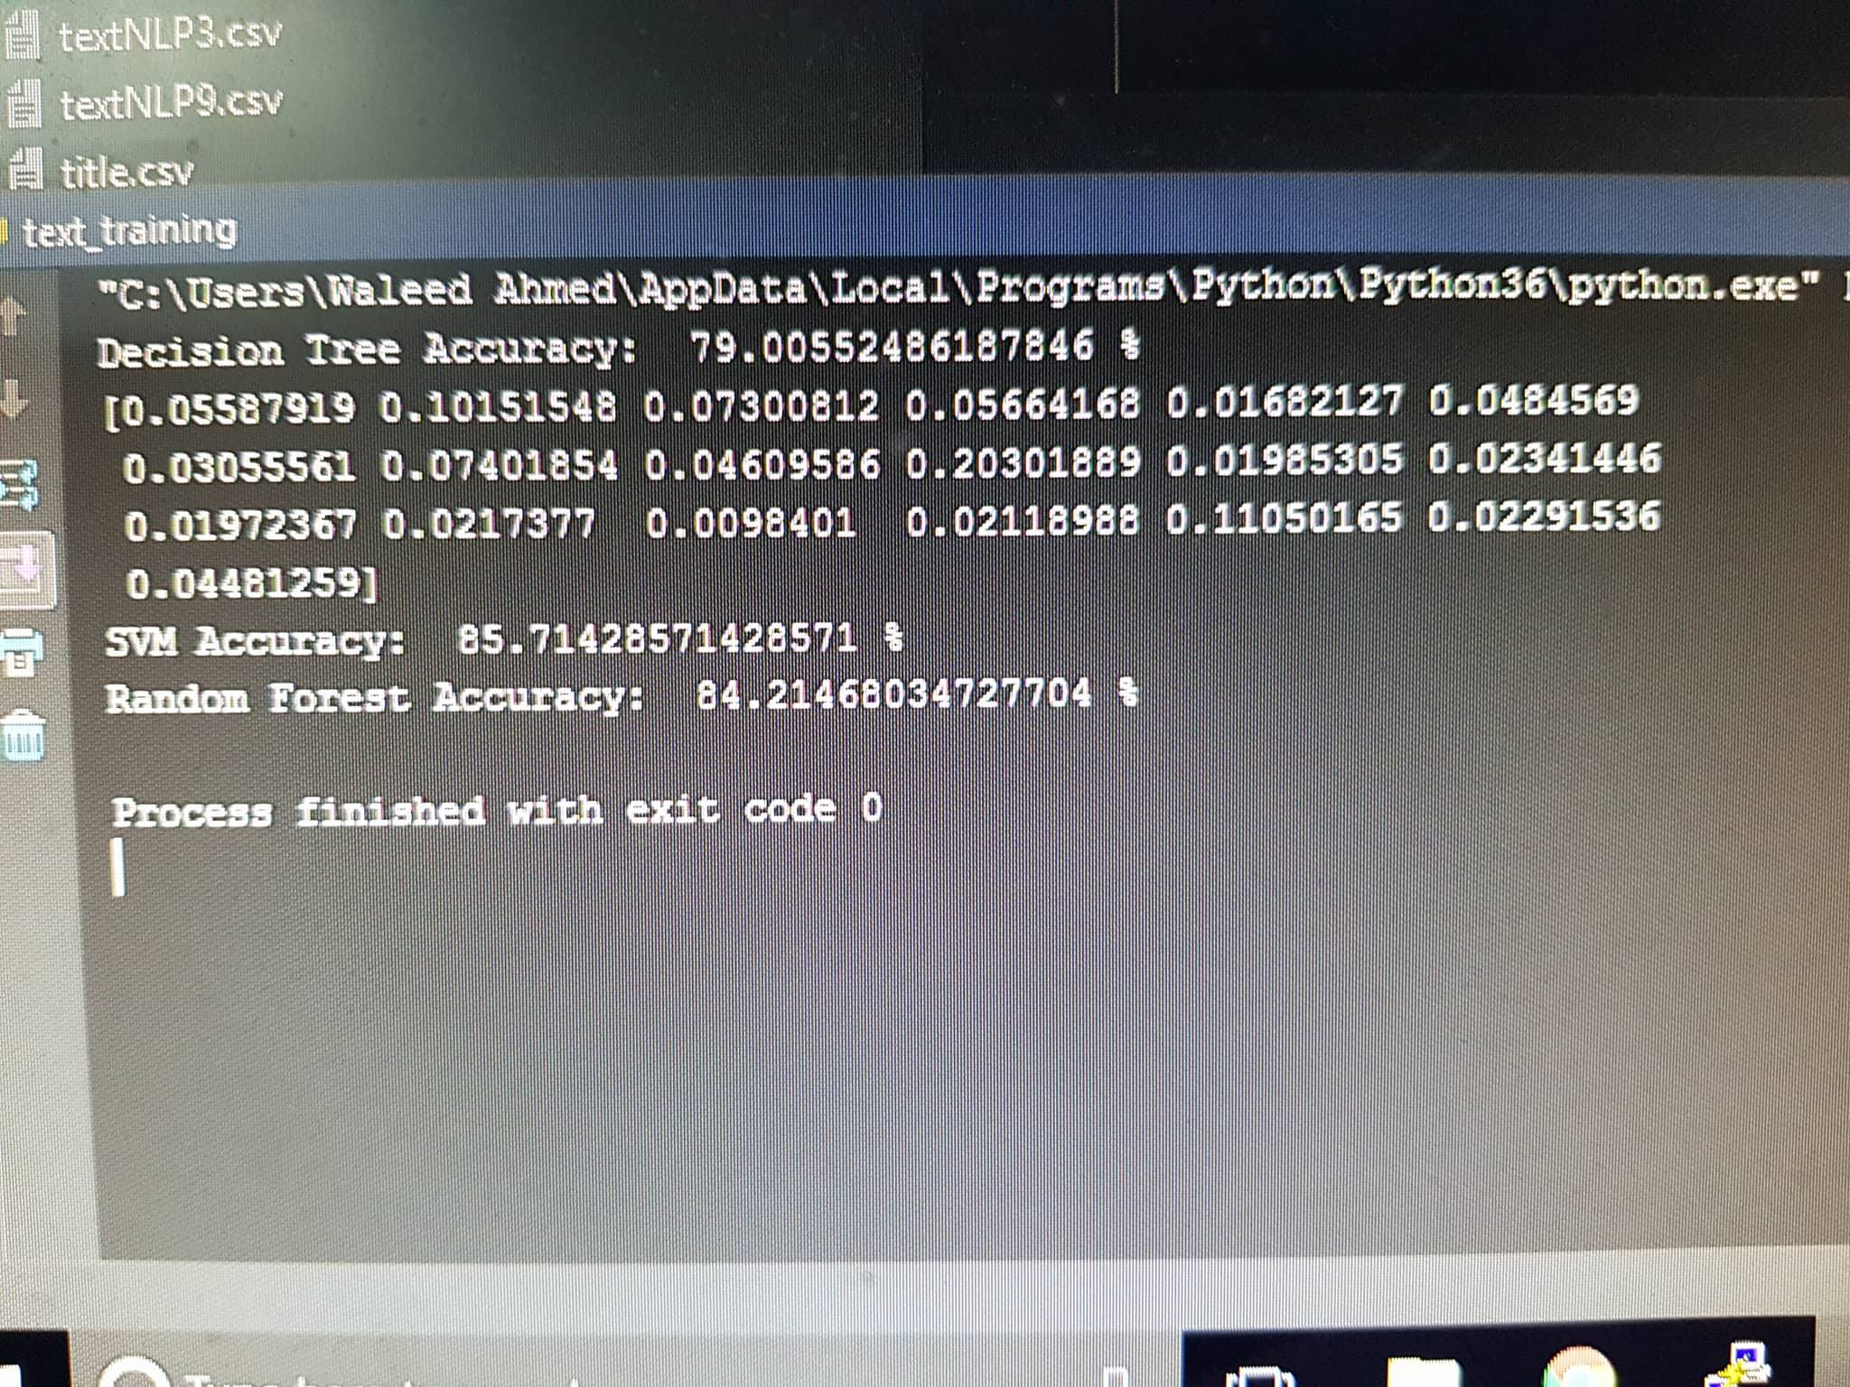

Slide 6
Accuracy

Slide 7
THANK YOU

