Slide 1


Voting System Project (C Language)
Detailed Explanation | File Handling |
Admin & User Panels
BY:
Mr. Waleed Ahmed
Mr. Arqam Shariq

Slide 2
Project Introduction
This project is a complete voting system developed in C language.
Uses file handling to permanently store candidate names.
Ensures each CNIC votes only once
Admin and User modules included

Slide 3
Main Modules
1. Admin Panel (Add / Delete Candidate)
2. User Panel (Vote / View)
3. File Management System

Slide 4
Admin Panel Features
✔ Add Candidate
✔ Delete Candidate
✔ Protected with Password
✔ Automatically updates data files

Slide 5
User Panel Features
✔ User can vote for a candidate
✔ Must enter Name and 13-digit CNIC
✔ CNIC checked to prevent duplicate voting

Slide 6
File Management System
• candidates.txt: Stores candidates
All files load automatically when program starts

Slide 7
Important C Functions in Project
int addcandidate( ); - Add candidate
void viewCandidates( ); - view candidate list
void showResults( ); calculate & determine winner
void deleteCandidate( ); - Delete Candidate
int isValidName( ); - Validates name
void showVotes( ); - show who voted for whom

Slide 8
Important C Functions in Project
void saveCandidateToFile( ); - save candidate name in .txt file.
void rewriteCandidatesFile( ); - Update Candidate list in .txt file.
int loadCandidatesFromFile( );- load .txt contents in to the code.

Slide 9
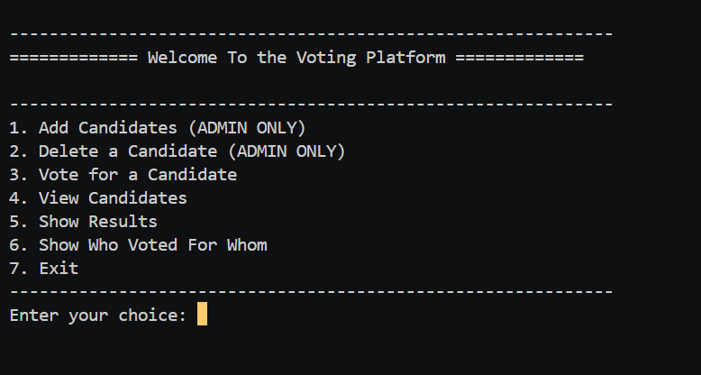
Voting Platform:

Slide 10
addcandidate() – Detailes:
1. Checks admin password
2. Takes candidate name
3. Verifies name has no numbers
4. Saves to array + writes to candidates.txt
5. Increases total candidate count

Slide 11
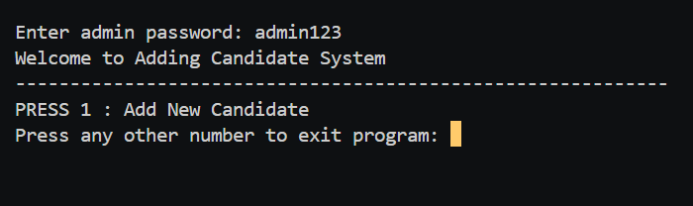
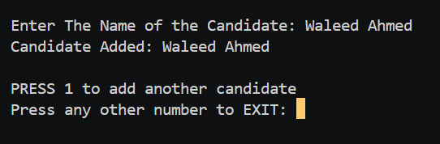
Add Candidate:

Slide 12
deleteCandidate() – Detailes
1. Password authentication
2. Shows list of all candidates
3. User enters number to delete
4. Shifts array elements upward
5. Updates candidates.txt by rewriting file

Slide 13

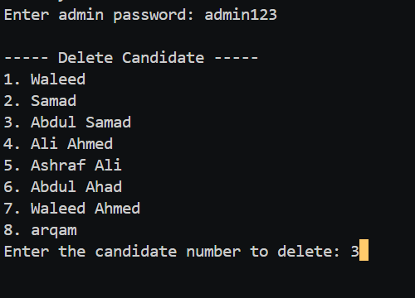
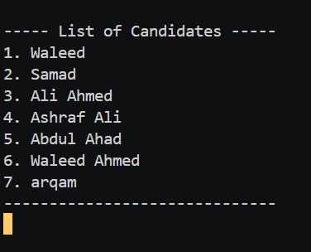
Deleting a candidate:

Slide 14
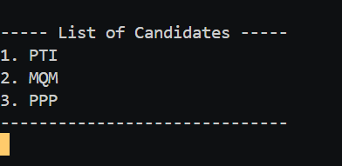
ViewCandidate() –Detailes:
1.Checks if there are candidate stored or not.
2.If stored, Shows list of all candidates

Slide 15
Voting Process
1. User enters name
2. User enters 13-digit CNIC
3. CNIC checked against previous voters
4. Displays candidate list
5. User selects candidate number
6. Vote saved in votes array + stored in file

Slide 16
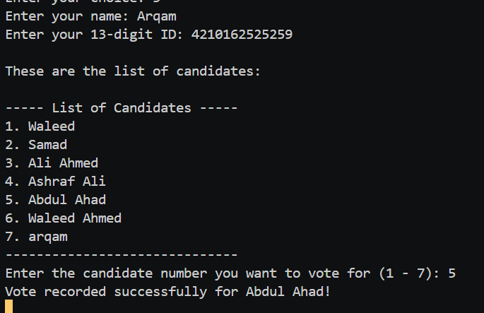
Voting:

Slide 17
showResults() Function
Displays each candidate and their vote count
Finds the candidate with maximum votes
Prints the winner name + vote count

Slide 18
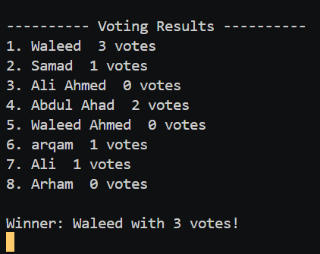
Show Result:
✔ User can vote for a candidate
✔ Must enter Name and 13-digit CNIC
✔ CNIC checked to prevent duplicate voting

Slide 19
showVotes() Function
Displays list of all voters
Shows which candidate they voted for
Data fetched from arrays and files

Slide 20
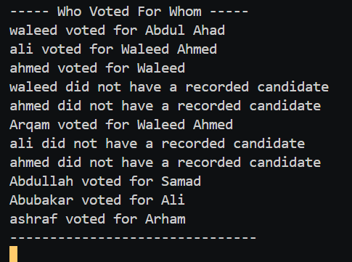
Who voted for whom :

Slide 21
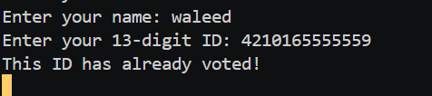
Security Features
✔ Password protection for admin
✔ No voter can vote twice
✔ CNIC format validation (13 digits)
✔ Safe file writing

Slide 22
Limitation & Future Prospect:
File Handling can be improved for full data storage.
Limited size of array which limit users and candidates.
Security Can be more enhanced.
GUI can be added.

Slide 23
Program Flow Summary
Start → Load Files → Display Menu → User/Admin Choice →
Perform Action → Update Files → Loop Until Exit

Slide 24
Conclusion
Fully functional voting management system
Uses arrays + file handling for data persistence

Slide 25
THANK YOU !

