Slide 1
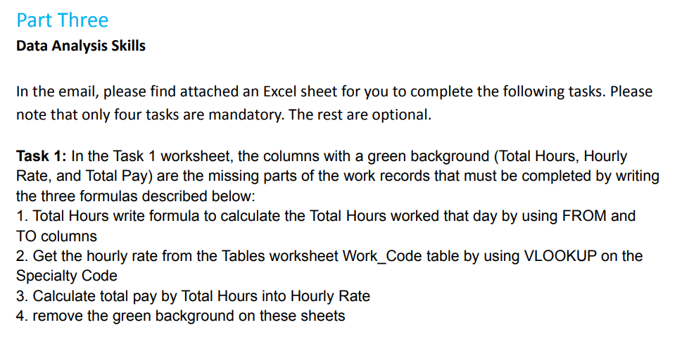
Notes:
This presentation is about business analysis of a startup airline company. The aim of this presentation is to give insights for CEO in the company by showing the status of the delay in the airports.

Slide 2
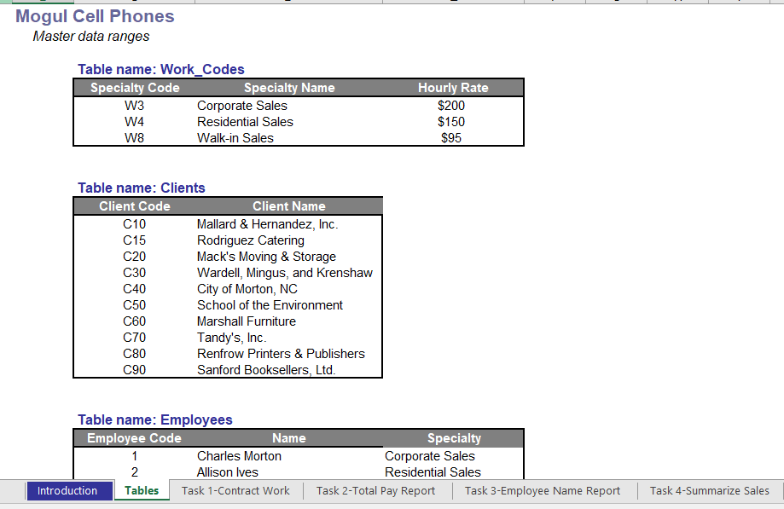
Notes:
This presentation is about business analysis of a startup airline company. The aim of this presentation is to give insights for CEO in the company by showing the status of the delay in the airports.

Slide 3
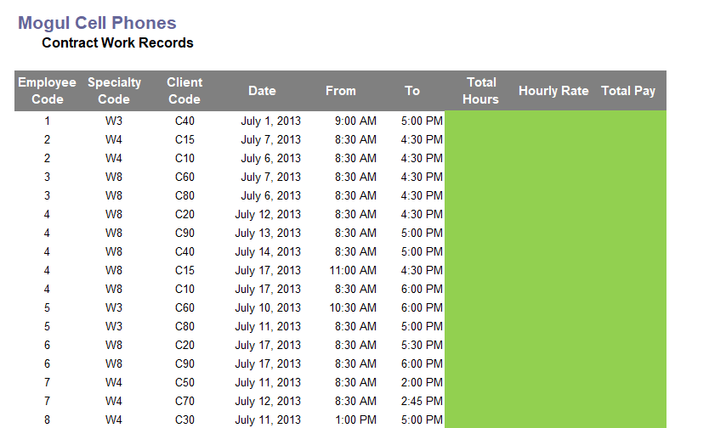
Notes:
This presentation is about business analysis of a startup airline company. The aim of this presentation is to give insights for CEO in the company by showing the status of the delay in the airports.

Slide 4
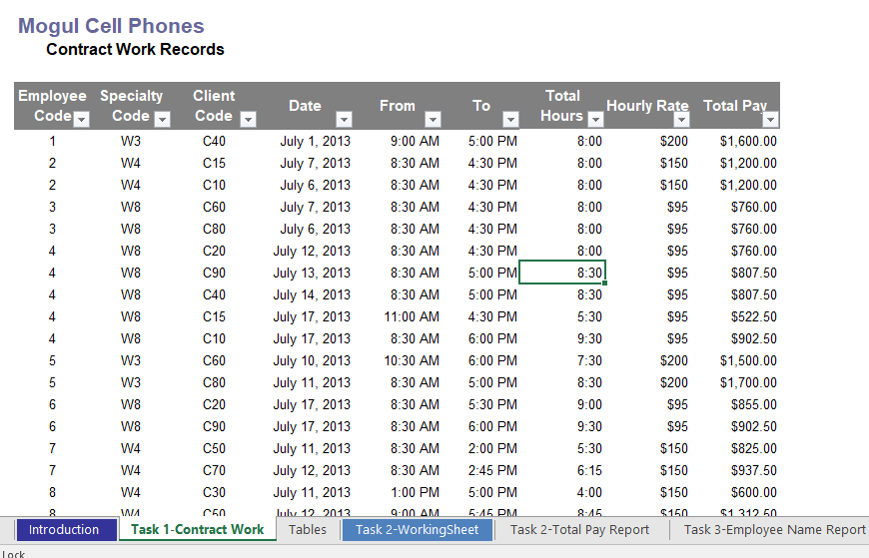
Answer
Notes:
This presentation is about business analysis of a startup airline company. The aim of this presentation is to give insights for CEO in the company by showing the status of the delay in the airports.

Slide 5
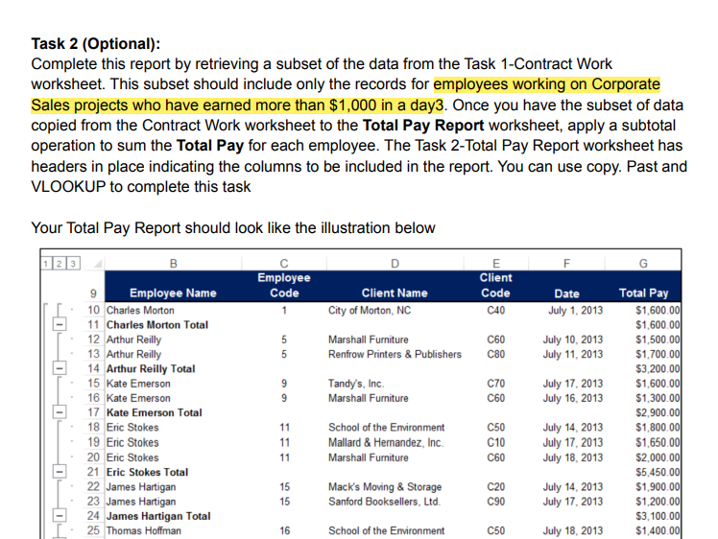
Notes:
This presentation is about business analysis of a startup airline company. The aim of this presentation is to give insights for CEO in the company by showing the status of the delay in the airports.

Slide 6
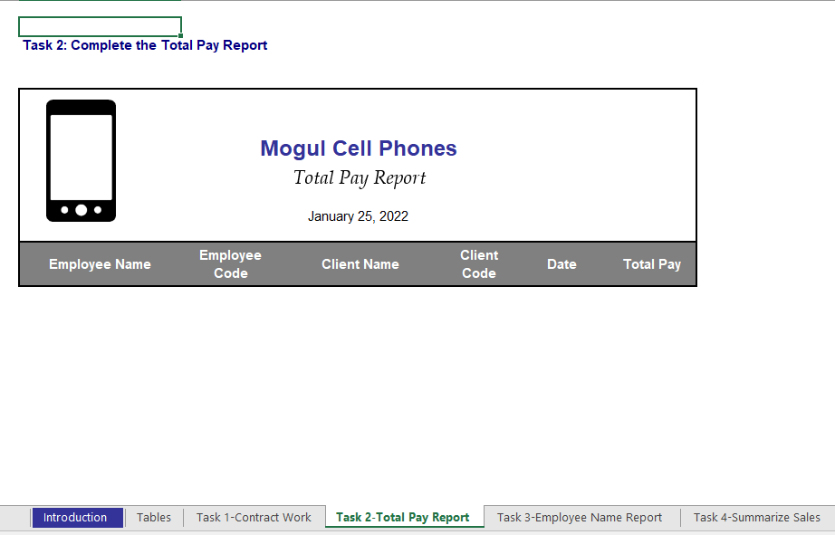
Notes:
This presentation is about business analysis of a startup airline company. The aim of this presentation is to give insights for CEO in the company by showing the status of the delay in the airports.

Slide 7
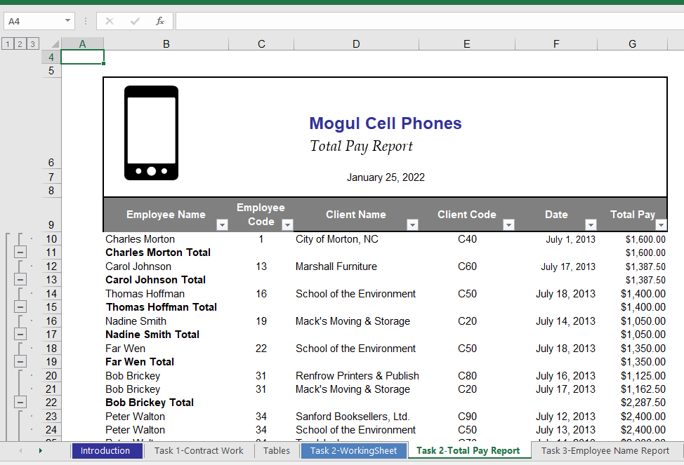
Answer
Notes:
This presentation is about business analysis of a startup airline company. The aim of this presentation is to give insights for CEO in the company by showing the status of the delay in the airports.

Slide 8
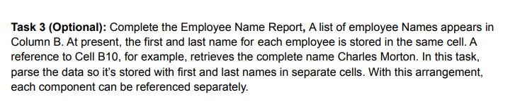
Notes:
This presentation is about business analysis of a startup airline company. The aim of this presentation is to give insights for CEO in the company by showing the status of the delay in the airports.

Slide 9
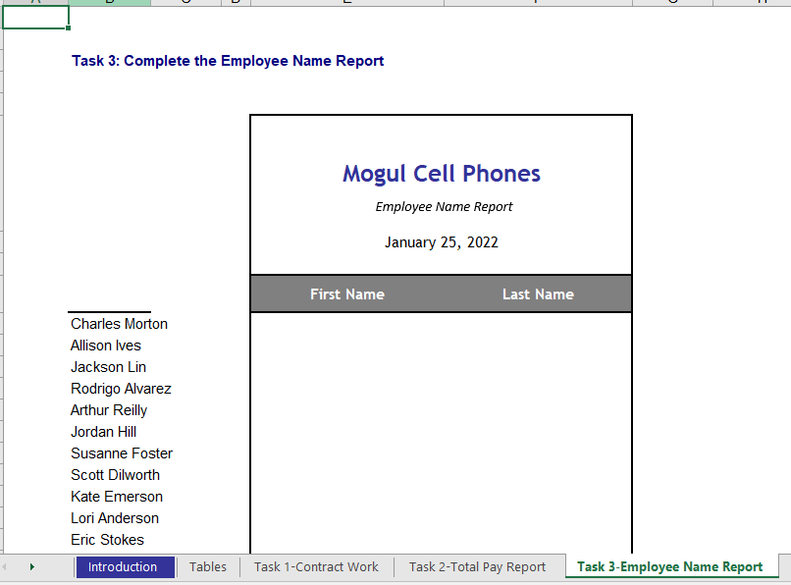
Notes:
This presentation is about business analysis of a startup airline company. The aim of this presentation is to give insights for CEO in the company by showing the status of the delay in the airports.

Slide 10
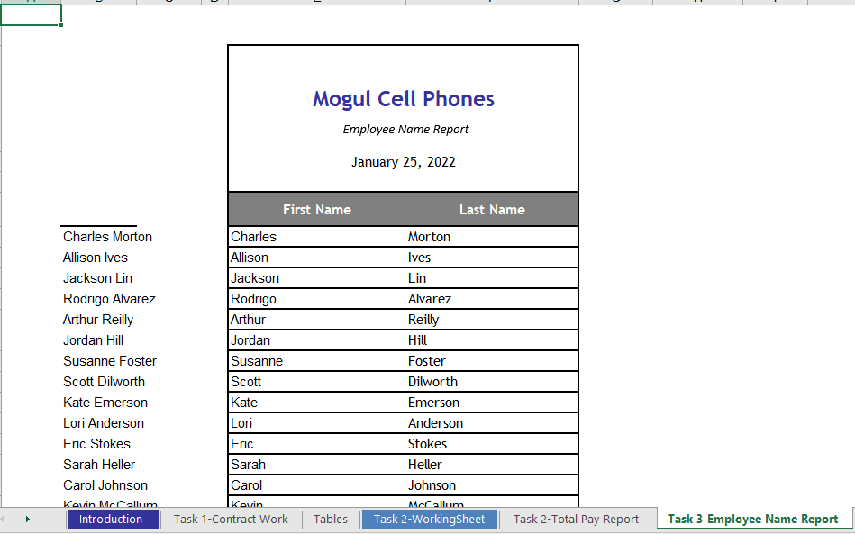
Answer
Notes:
This presentation is about business analysis of a startup airline company. The aim of this presentation is to give insights for CEO in the company by showing the status of the delay in the airports.

Slide 11
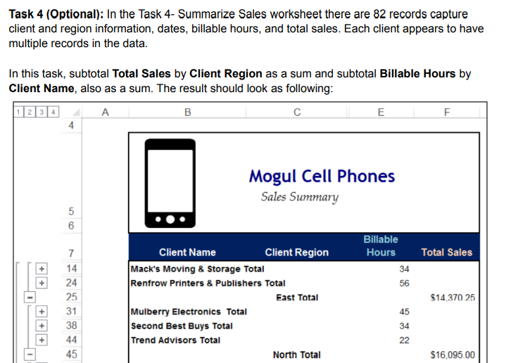
Notes:
This presentation is about business analysis of a startup airline company. The aim of this presentation is to give insights for CEO in the company by showing the status of the delay in the airports.

Slide 12
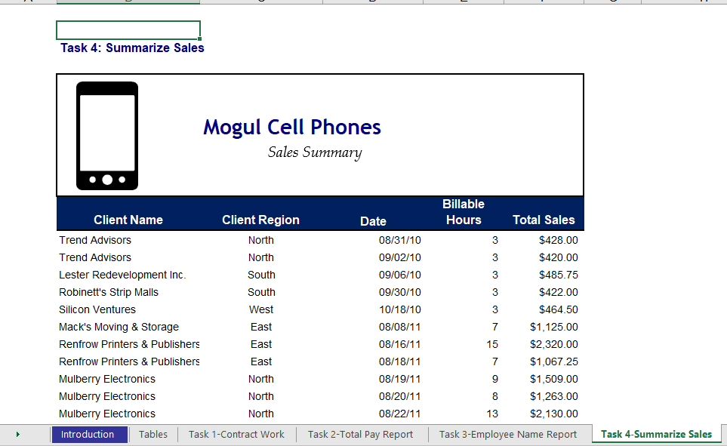
Notes:
This presentation is about business analysis of a startup airline company. The aim of this presentation is to give insights for CEO in the company by showing the status of the delay in the airports.

Slide 13
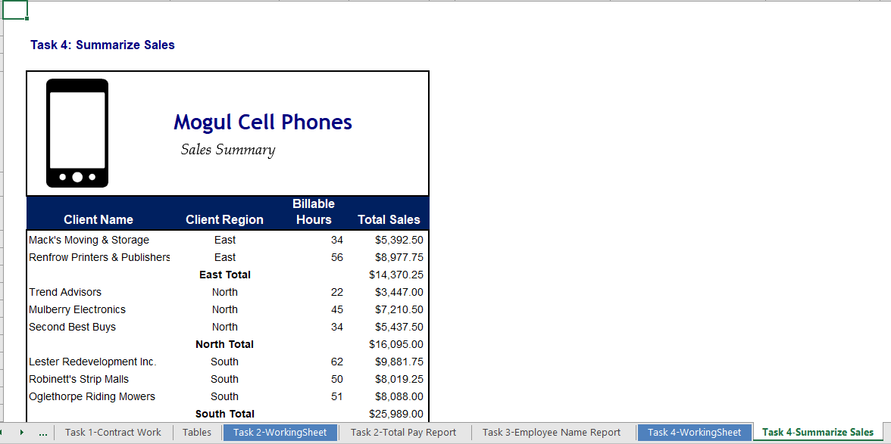
Answer
Notes:
This presentation is about business analysis of a startup airline company. The aim of this presentation is to give insights for CEO in the company by showing the status of the delay in the airports.

Slide 14
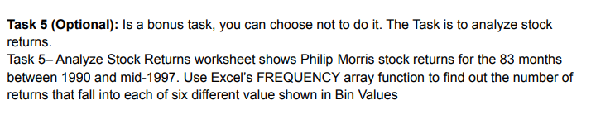
Notes:
This presentation is about business analysis of a startup airline company. The aim of this presentation is to give insights for CEO in the company by showing the status of the delay in the airports.

Slide 15
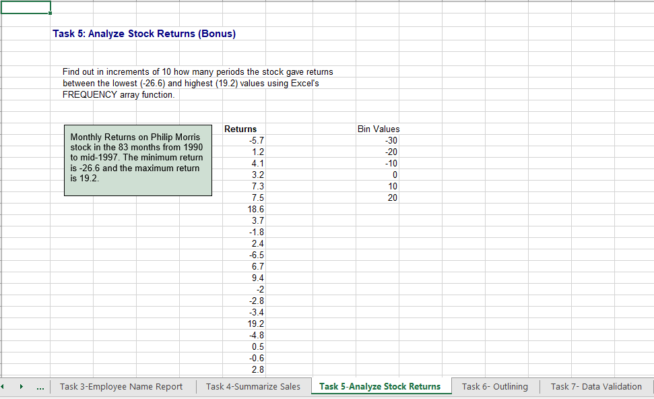
Notes:
This presentation is about business analysis of a startup airline company. The aim of this presentation is to give insights for CEO in the company by showing the status of the delay in the airports.

Slide 16
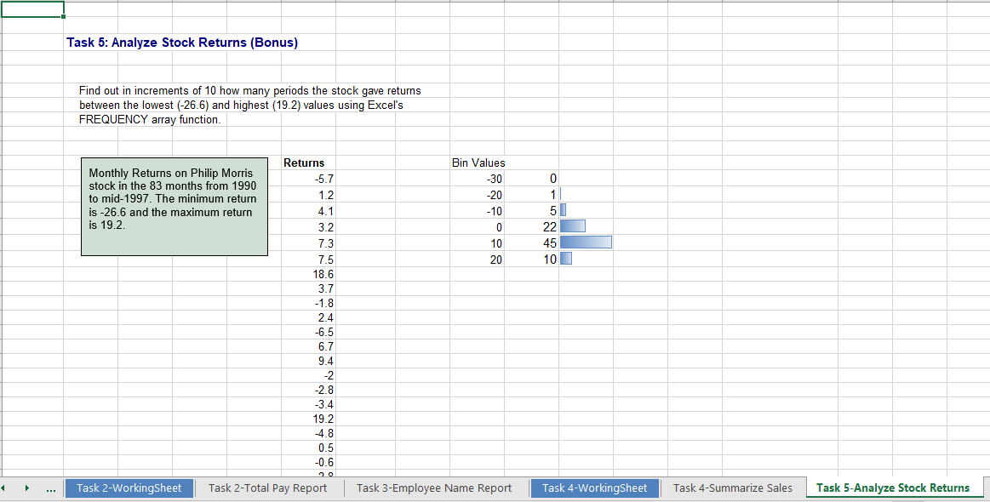
Answer
Notes:
This presentation is about business analysis of a startup airline company. The aim of this presentation is to give insights for CEO in the company by showing the status of the delay in the airports.

Slide 17
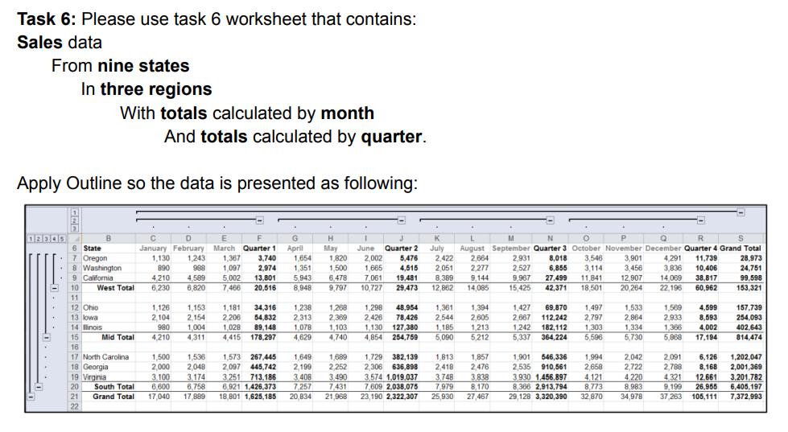
Notes:
This presentation is about business analysis of a startup airline company. The aim of this presentation is to give insights for CEO in the company by showing the status of the delay in the airports.

Slide 18
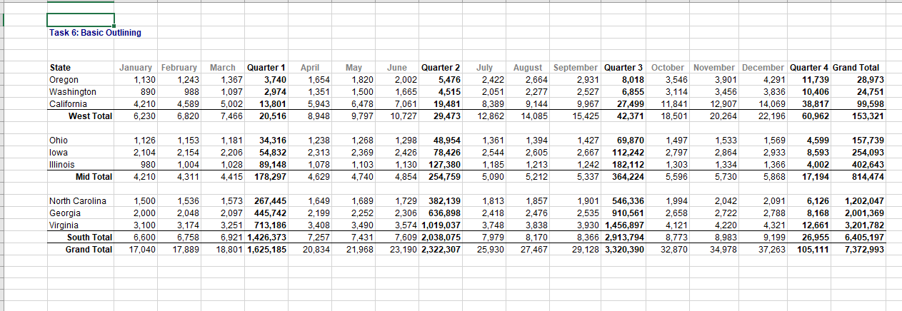
Notes:
This presentation is about business analysis of a startup airline company. The aim of this presentation is to give insights for CEO in the company by showing the status of the delay in the airports.

Slide 19
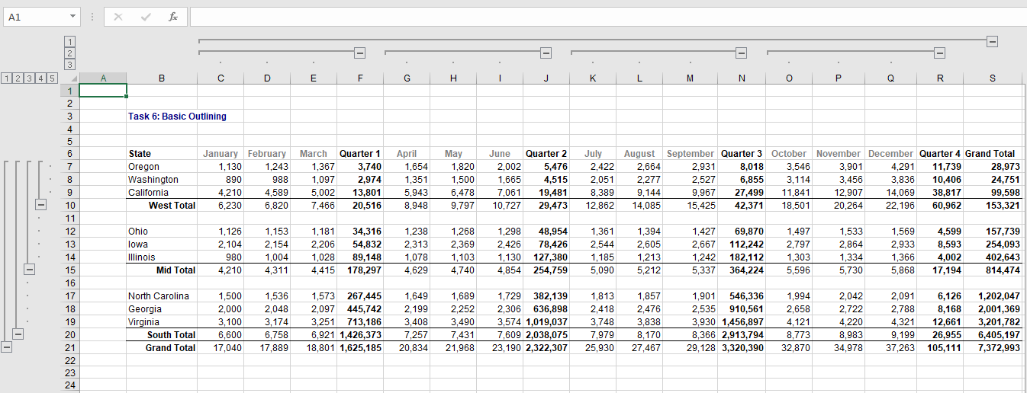
Answer
Notes:
This presentation is about business analysis of a startup airline company. The aim of this presentation is to give insights for CEO in the company by showing the status of the delay in the airports.

Slide 20
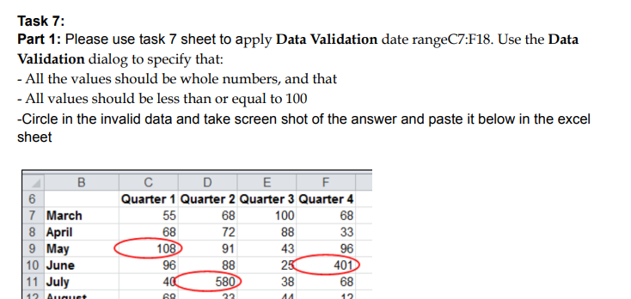
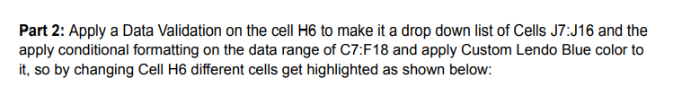
Notes:
This presentation is about business analysis of a startup airline company. The aim of this presentation is to give insights for CEO in the company by showing the status of the delay in the airports.

Slide 21
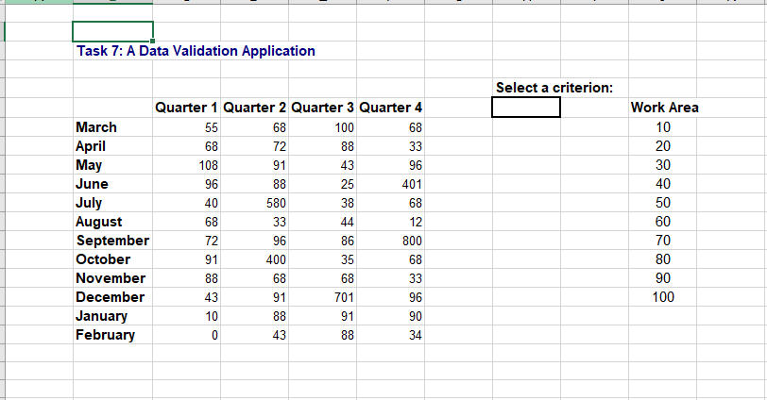
Notes:
This presentation is about business analysis of a startup airline company. The aim of this presentation is to give insights for CEO in the company by showing the status of the delay in the airports.

Slide 22
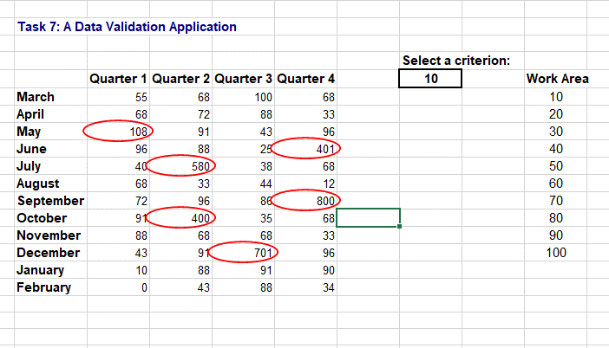
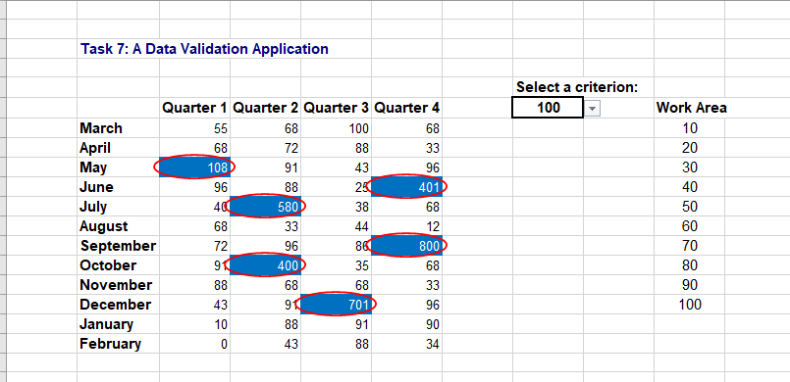
Answer
Notes:
This presentation is about business analysis of a startup airline company. The aim of this presentation is to give insights for CEO in the company by showing the status of the delay in the airports.

Slide 23
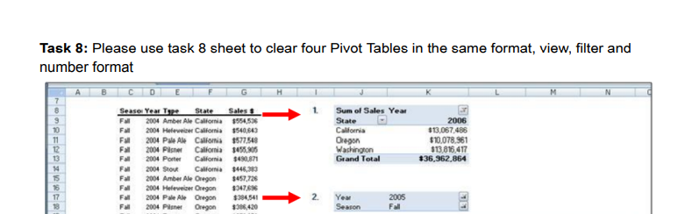
Notes:
This presentation is about business analysis of a startup airline company. The aim of this presentation is to give insights for CEO in the company by showing the status of the delay in the airports.

Slide 24
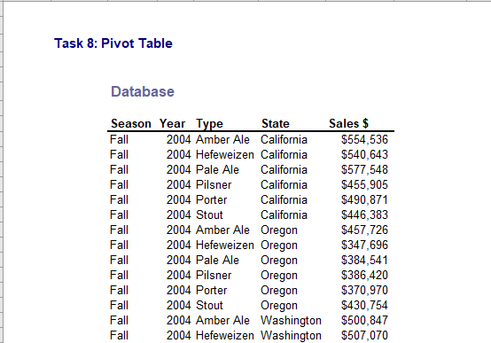
Notes:
This presentation is about business analysis of a startup airline company. The aim of this presentation is to give insights for CEO in the company by showing the status of the delay in the airports.

Slide 25
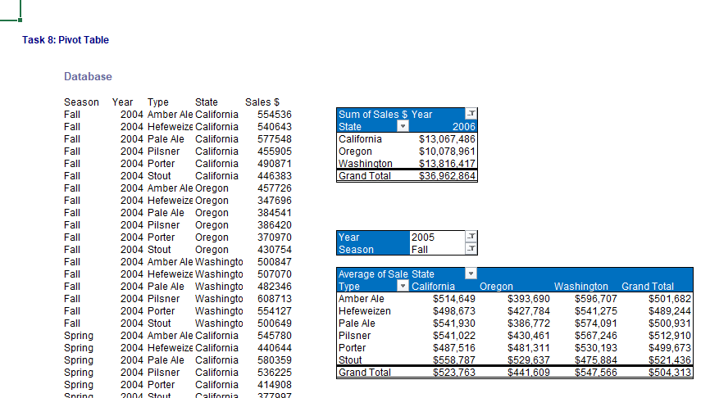
Answer
Notes:
This presentation is about business analysis of a startup airline company. The aim of this presentation is to give insights for CEO in the company by showing the status of the delay in the airports.

Slide 26
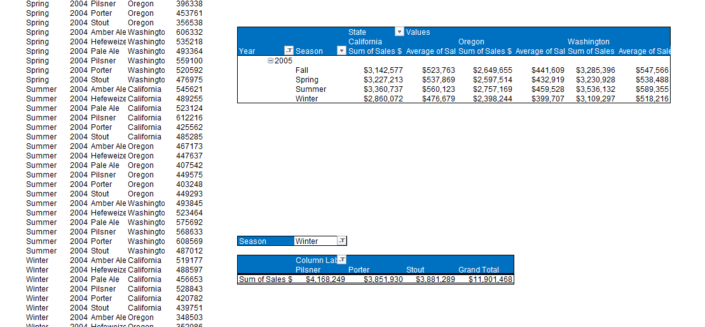
Answer
Notes:
This presentation is about business analysis of a startup airline company. The aim of this presentation is to give insights for CEO in the company by showing the status of the delay in the airports.

