Slide 1
SSIS PROJECT 2 INCREMENTAL LOADING OF EXCEL FILE INTO SQL SERVER DATABASE TABLE
Executed by: WALEED ABDULLA

Slide 2
Project Objectives and Understanding

Slide 3
Project Objectives & Specifications
Objective: To incrementally upload data from an Excel file into SQL Server table on daily basis.
Source File Specs:
Location: The source file is placed in a "Source" folder.
Target Specs:
Location: SQL Table
Frequency: Daily
Requirements:
- Update columns that may be changed frequently
- Maintain history for columns that may be critical and have impacts on other metrics
- Do not change but record all exceptions raised in the Fixed Key columns

Slide 4
Project Understanding and Planning
Identification of the Business Keys columns:
- Id
Identification of the Fixed Columns:
- Segment, Category, Product, Date, Month Number, Month Name, Year
Identification of Changing Columns:
- Units Sold, Manufacturing Price, Sales Price, Gross Sales, Sales, Profit, COGS
Requirements:
- Update columns that may be changed frequently
- Maintain history for columns that may be critical and have impacts on other metrics
- Do not change but record all exceptions raised in the Fixed Key columns
Project General Data Flow:
Data Source
Slowly Changing Dimension
Data Destination

Slide 5
Tasks
In this project, I:
Understood the project objectives and specifications
Added an Excel connection and configured it.
Made a SQL Server Database Table
Added Slowly Changing Dimension component to the data flow and configured it.
Added Excel destination connection to register the exceptions.
Deployed the project to my localhost SQL Server.
Automated the process and scheduled it on a weekly basis.

Slide 6
Project Designing

Slide 7
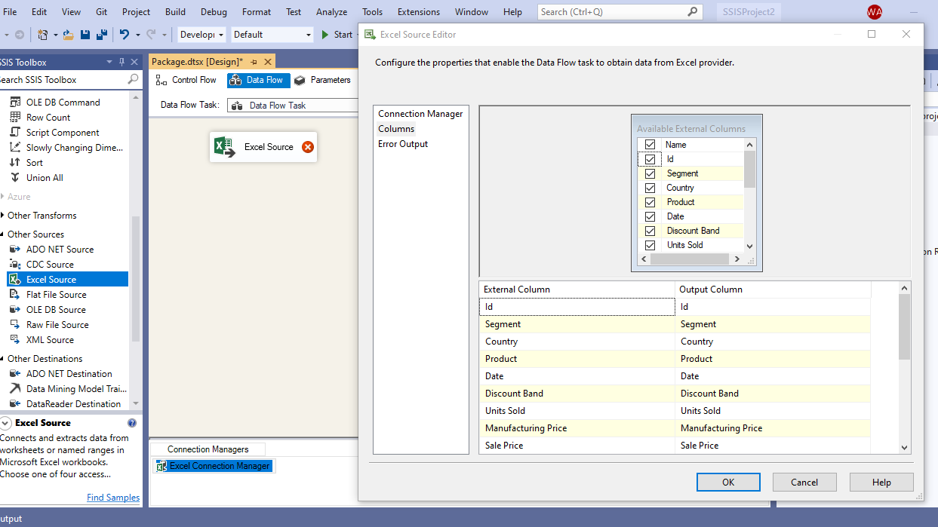
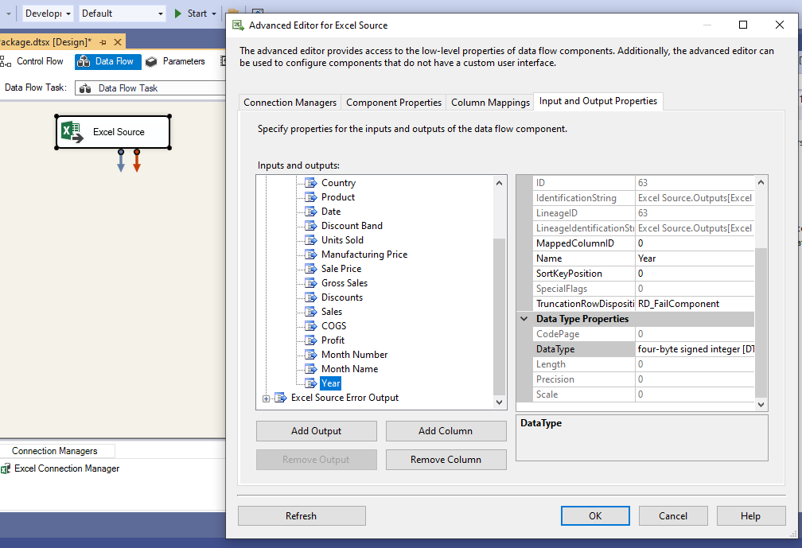
Step 1: - Added new Data Flow task to the Control Flow. - Added Excel File Source Connection and configured it. During the configuration process, I verified and changed some the data types of the output columns to make sure that they fit in SQL Server DB Table.
Project Designing

Slide 8
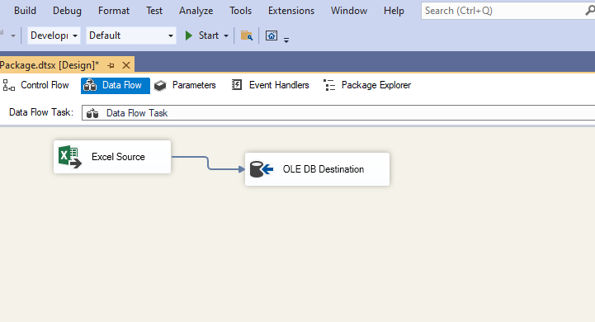
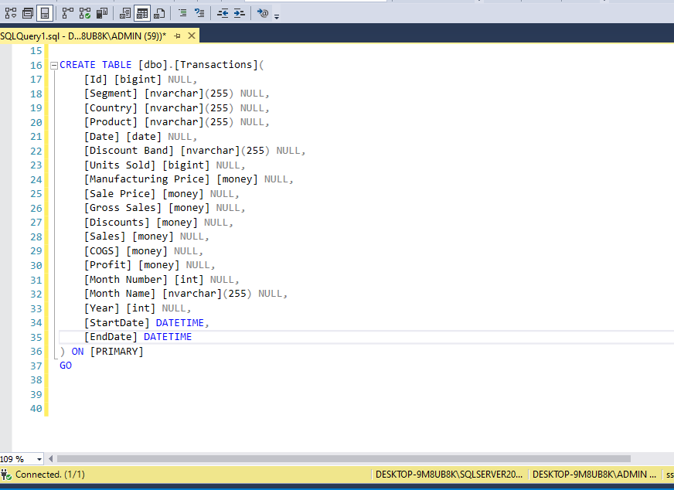
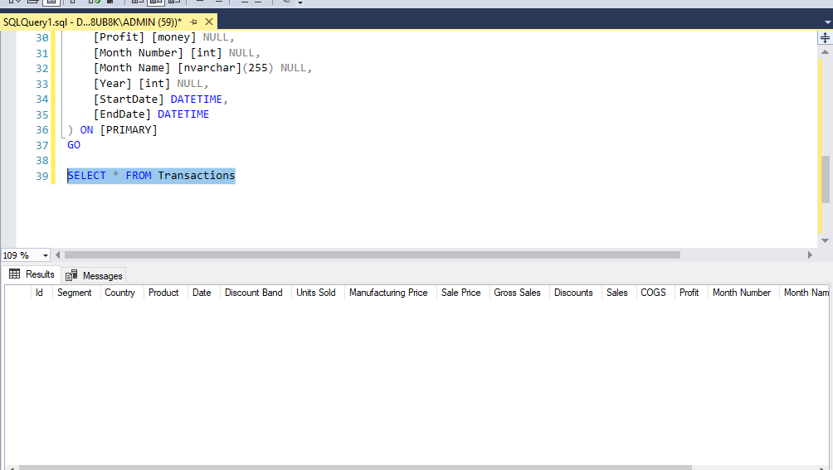
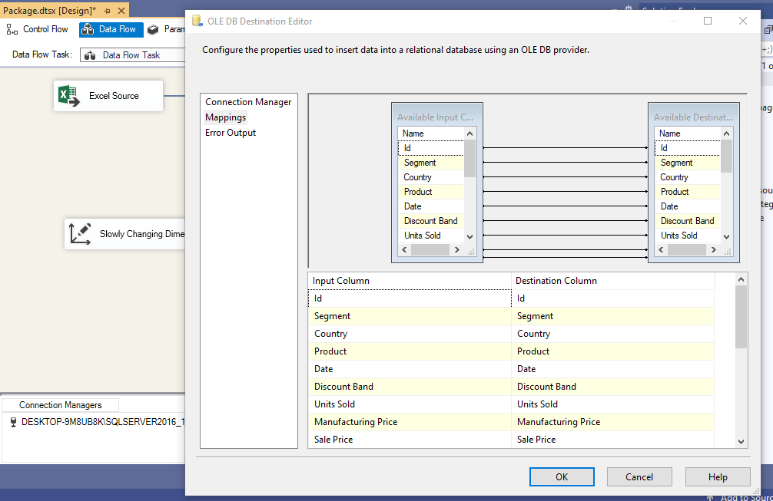
Step 2: - Added OLE DB temporary destination to make a SQL Server database table. - Modified the SQL code to add two new columns ; StartDate and EndDate. -Mapped the input columns to the output columns - Deleted the OLE DB Destination connection
Project Designing

Slide 9
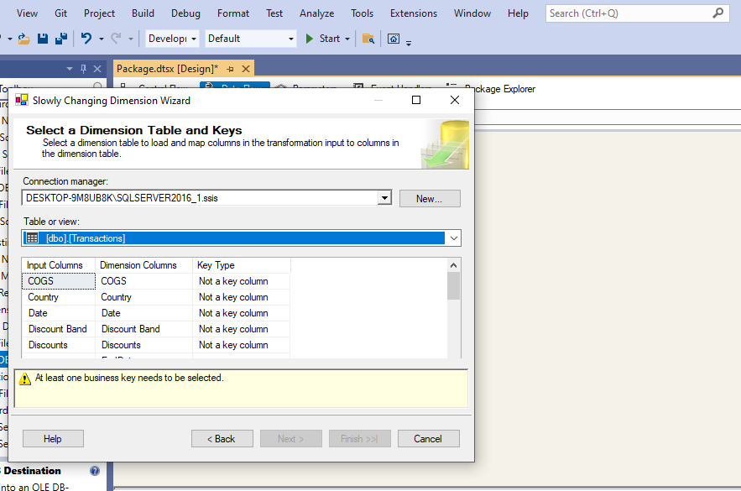
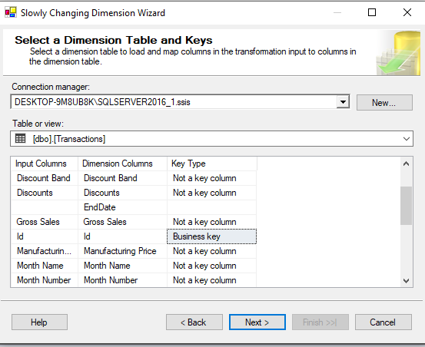
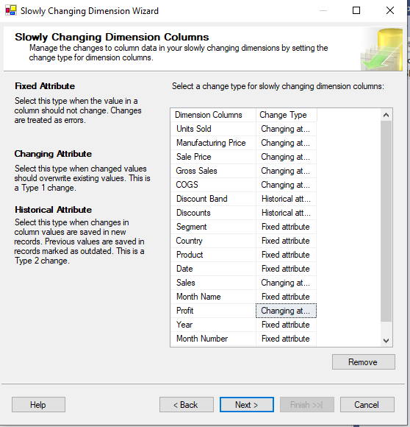
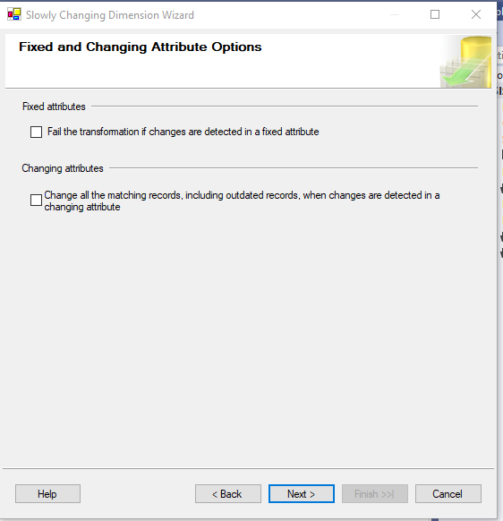
Step 4: - Added Slowly Changing Dimension destination and configured it. - Configured the business key, fixed keys, changing keys, fixed keys and historical keys.
Project Designing

Slide 10
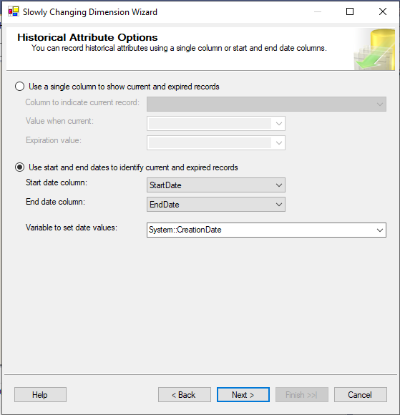
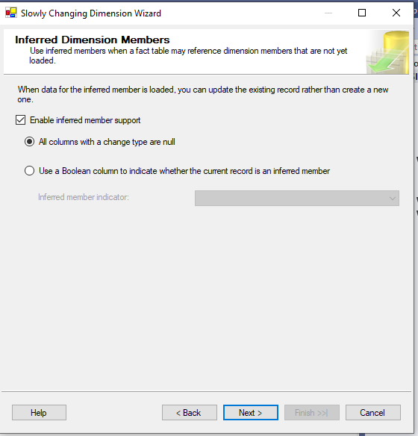
- For the historical data option, I used start and end dates to identify current and expired records. - Enabled inference of member support
Project Designing

Slide 11
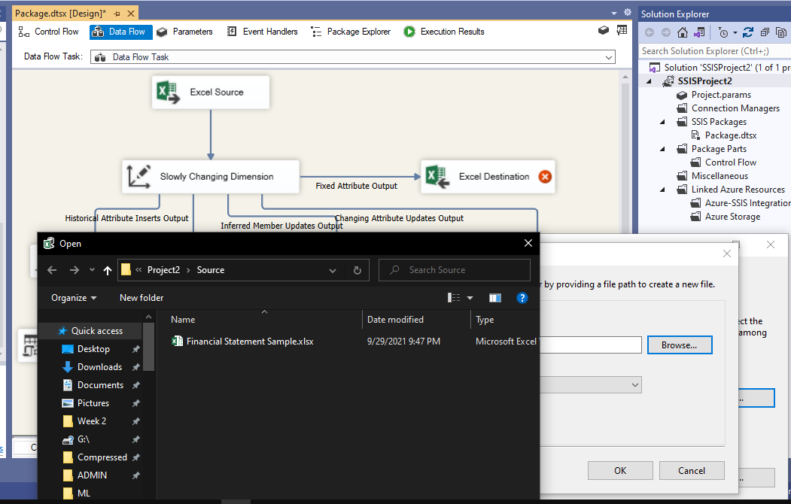
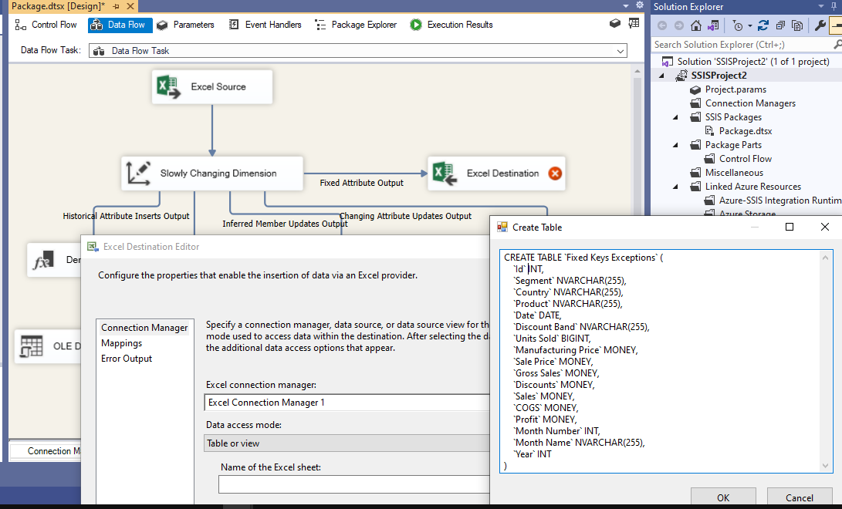
- Added new Excel destination to record the errors when changing the fixed columns
Project Designing

Slide 12
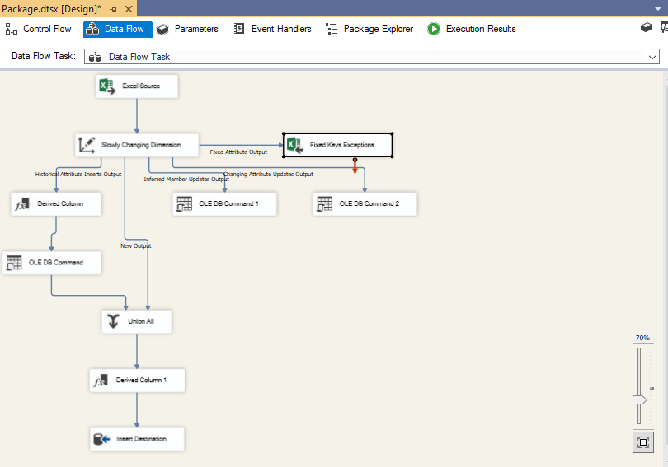
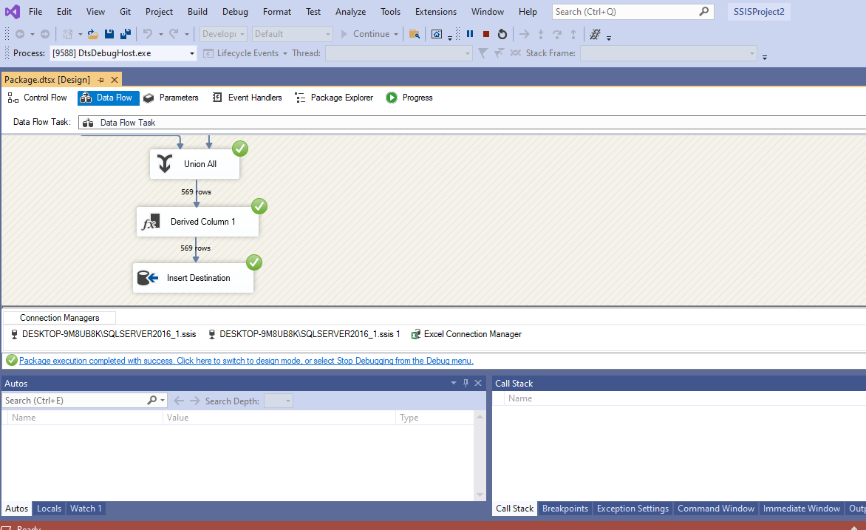
Step 5: - Executed the package to see if it is working
Project Designing

Slide 13
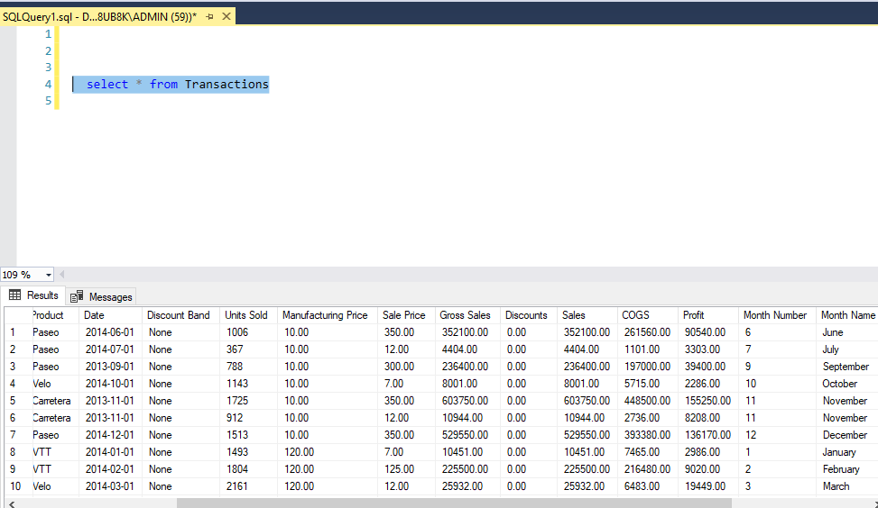
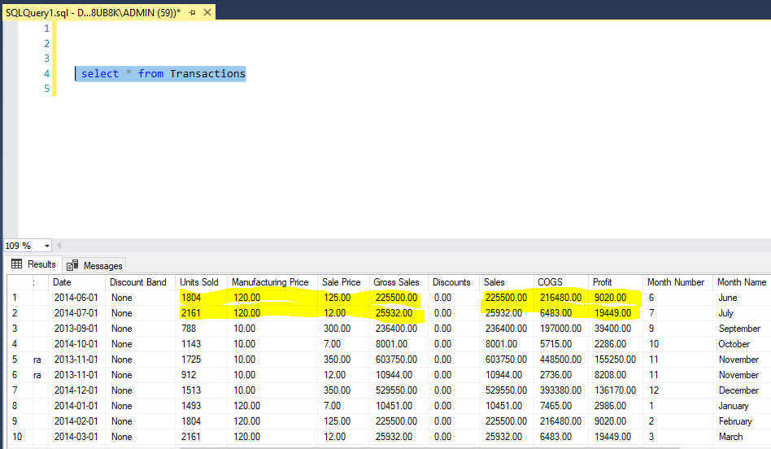
Step 6: - Tested the package by changing some of the changing keys in few records and executing the package. - Verified the correct functionality of the package (the changing columns were changed without inserting new records.)
Project Designing

Slide 14
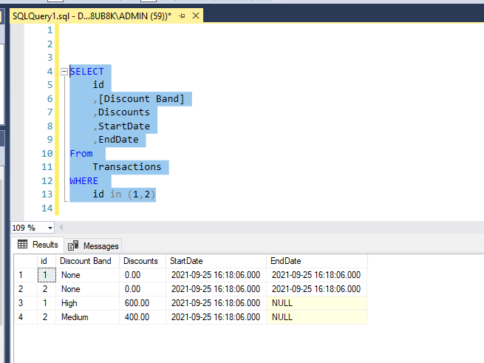
Step 7: - Tested the package by changing the historical keys in some rows and see if the are old rows are recorded and the new rows are inserted
Project Designing

Slide 15
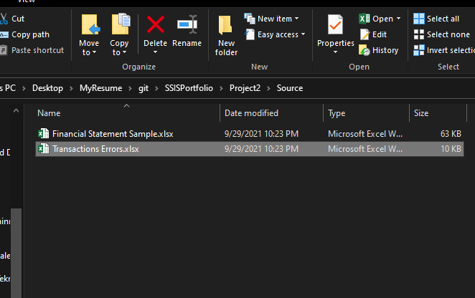
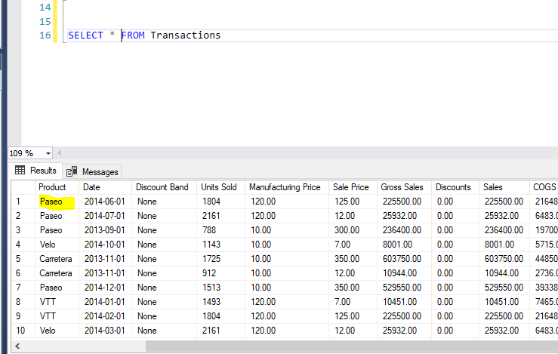
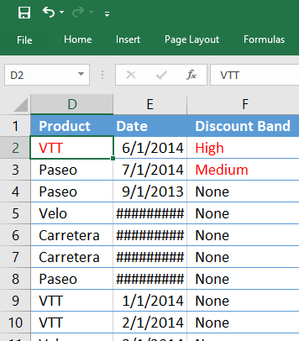
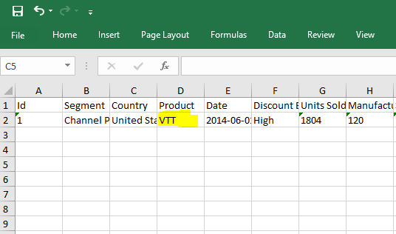
Step 8: - Tested the package by changing the a value in a fixed key and see if the package executed and the exception is recorded in other excel file
Project Designing

Slide 16
Project Deployment & Automation

Slide 17
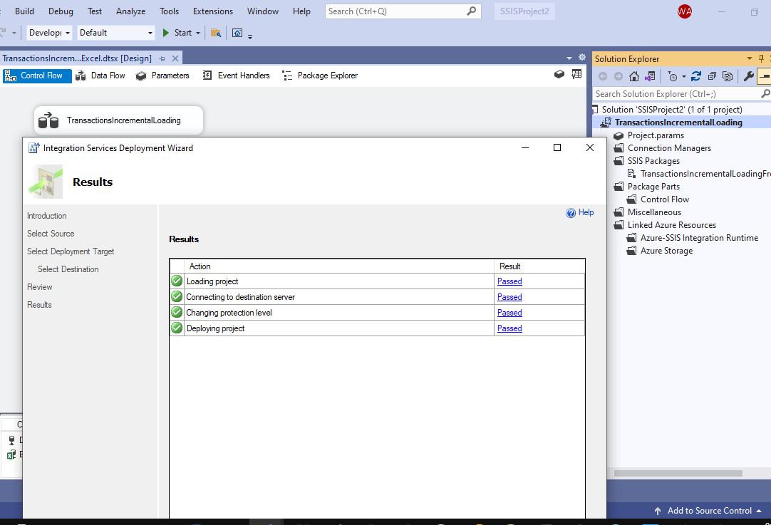
Step 1: - Deployed the project to SQL Server
Project Deployment and Automation

Slide 18
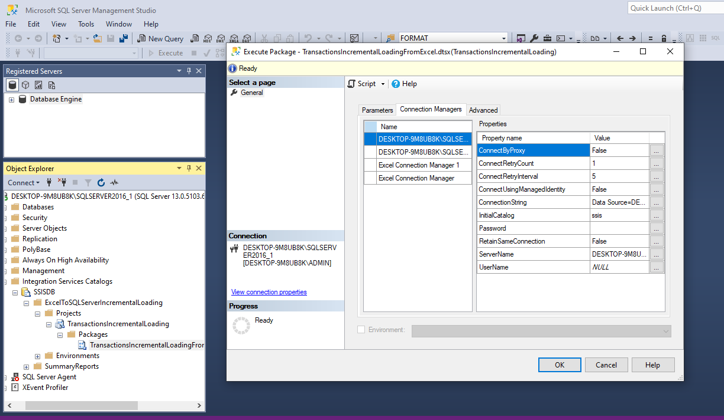
Step 2: - Verified the project in my localhost SQL Server
Project Deployment and Automation

Slide 19
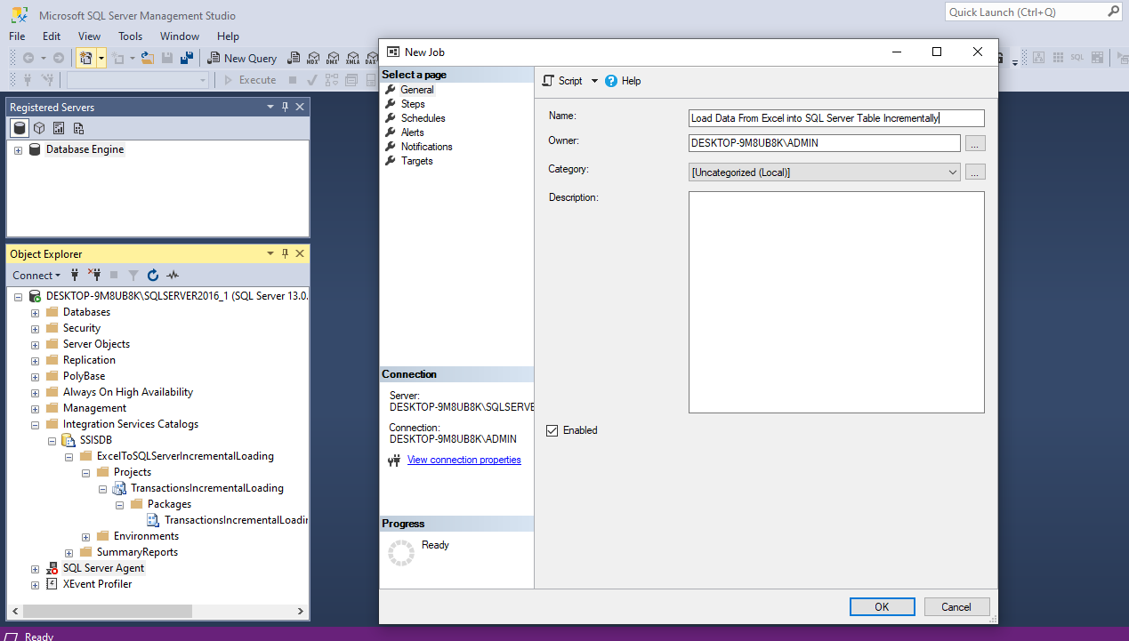
Step 3: - Added new job in the SQL Server Agent.
Project Deployment and Automation

Slide 20
Step 3: - Added new job in the SQL Server Agent.
Project Designing

Slide 21
Conclusion
By using SSIS to incrementally load data from Excel to SQL Server Database on weekly basis, I managed to automate the process and to be executed with maintaining control for further customization of the process. This enables the IT Team to focus on other important issue within the organization.

