Slide 1
FitConnect
Capstone 2
By: Waleed Mohammed Althubyani

Slide 2
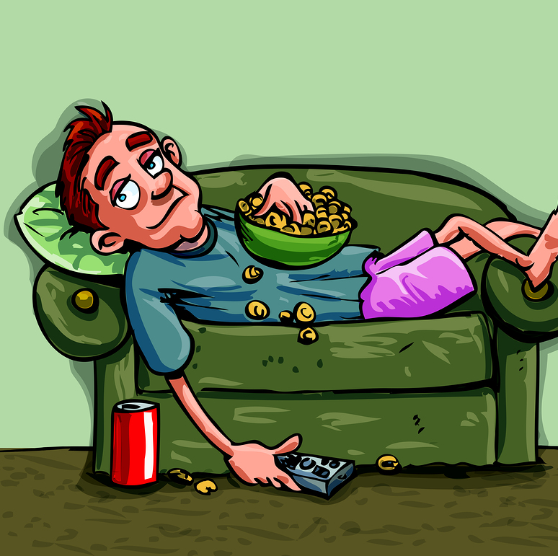
Why Do People Give Up on Fitness?
Lack of motivation.
No noticeable progress.
Lack of clear goals.
Laziness.

Slide 3

Introducing FitConnect
This platform combine fitness tracking and social media.
Users can track their workout, share progress and interact with other fitness focused individuals.

Slide 4
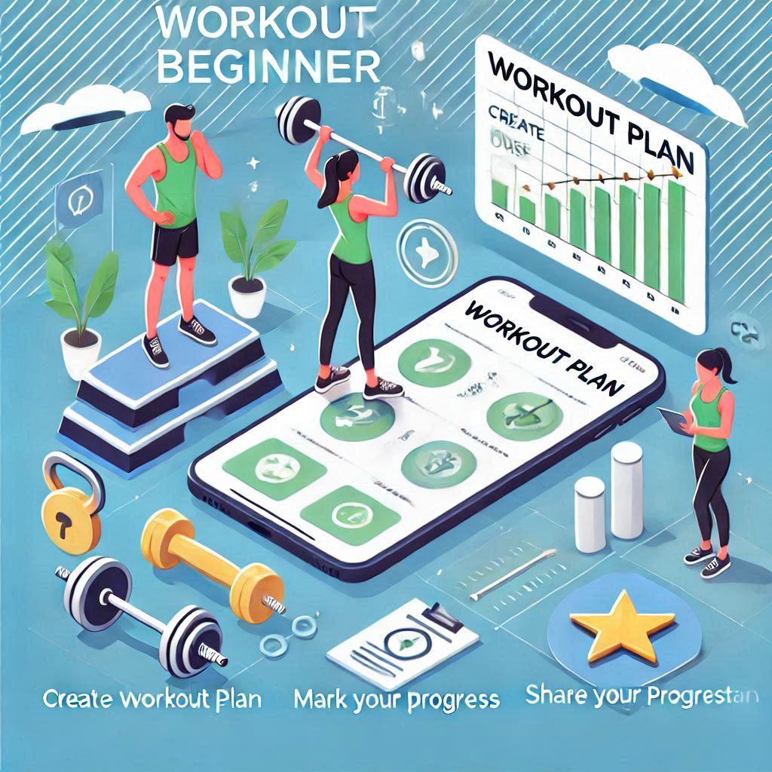
Trainee flow
Create or use a workout plan.
Mark their progress.
Set their goals.
Getting achievements.
Share their workout plan
Share their progress

Slide 5
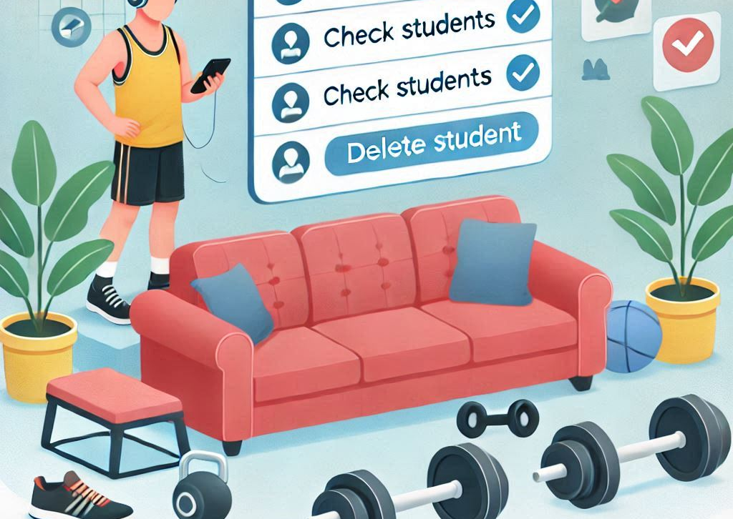
Instructor/Couch flow
Suggest a workout plan
Check their students
Delete student
Check students who completed their workout plan

Slide 6
Admin flow
Approve coach.
Create achievement.

Slide 7

Future Improvements
Coaches can create classes.
Shops can show and advertise their healthy food.
Private messaging.

Slide 8

Thank you for listening

