Slide 1
NMF based emg synergy extraction

Slide 2
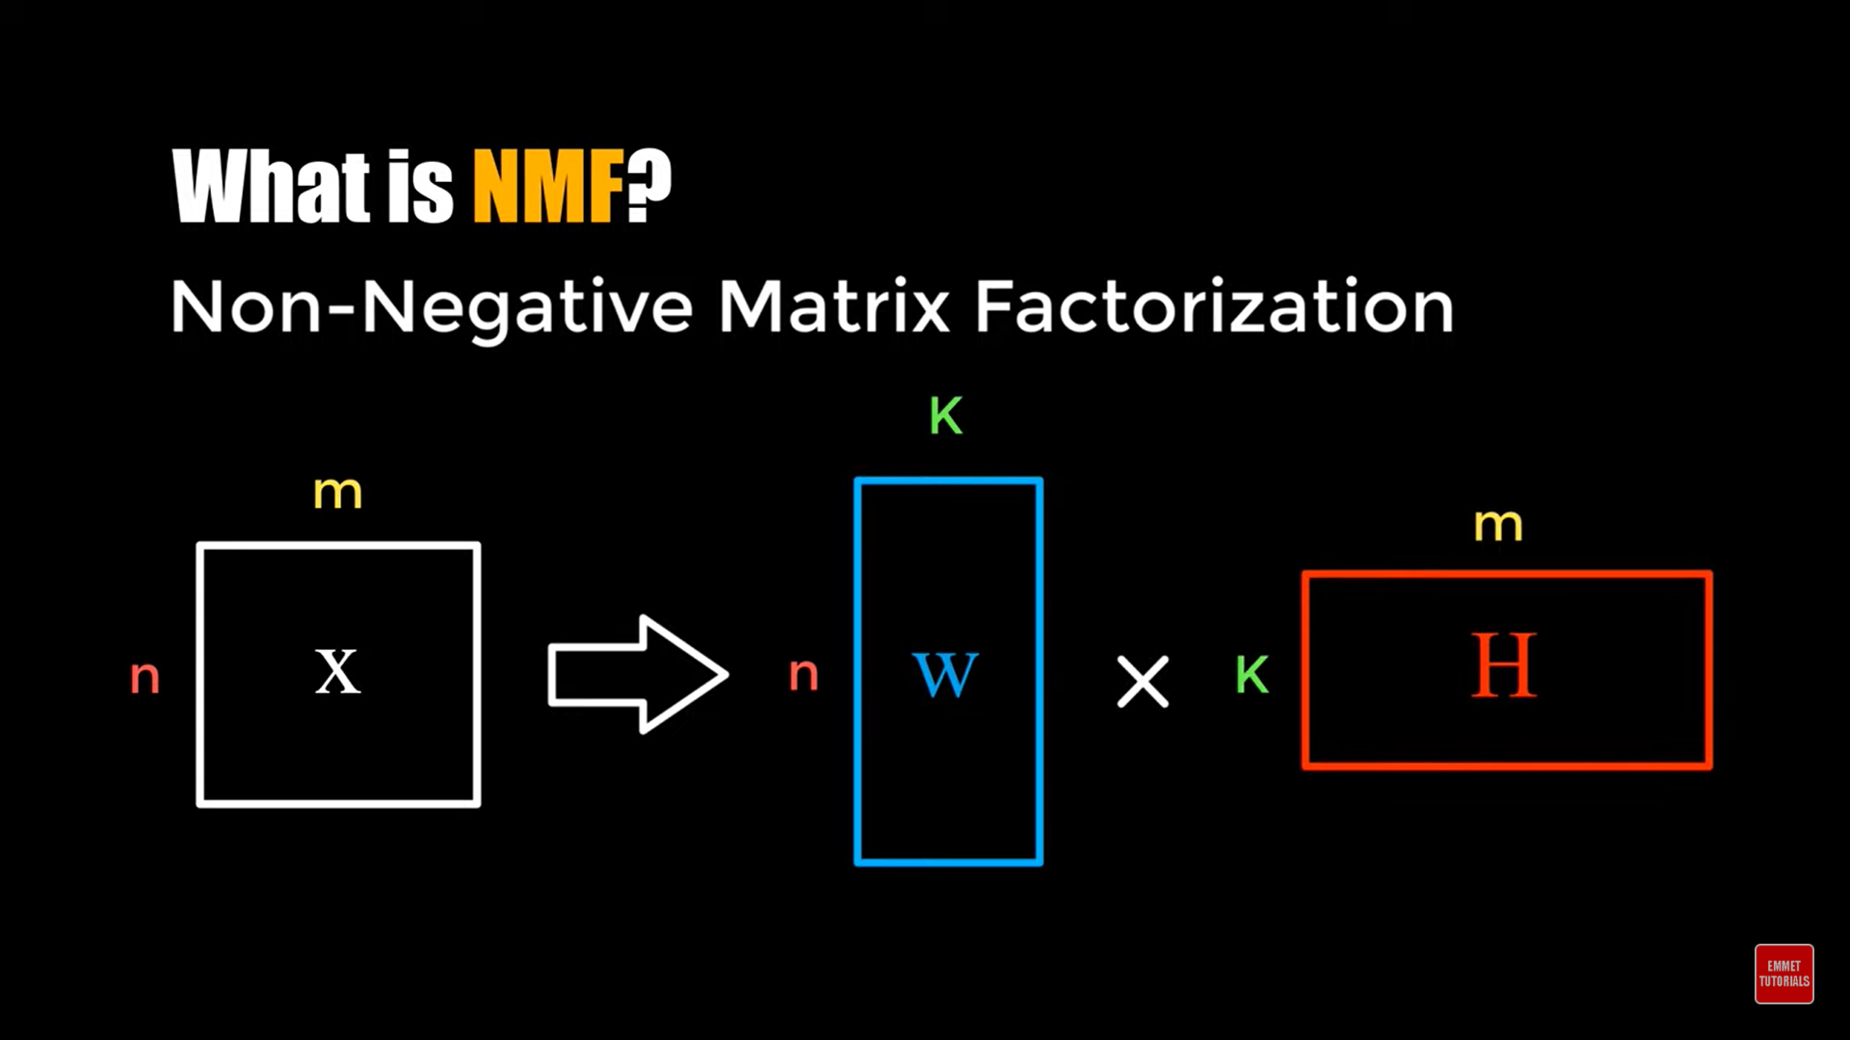
NMF
Nonnegative Matrix Factorization (NMF) is a technique in
machine learning and signal processing that factorizes
a nonnegative matrix into two nonnegative matrices,
where one matrix represents a set of basis functions
and the other represents the activation coefficients of these basis functions.
NMF has been widely used in applications such as
image processing, audio signal processing, text mining, and bioinformatics.

Slide 3
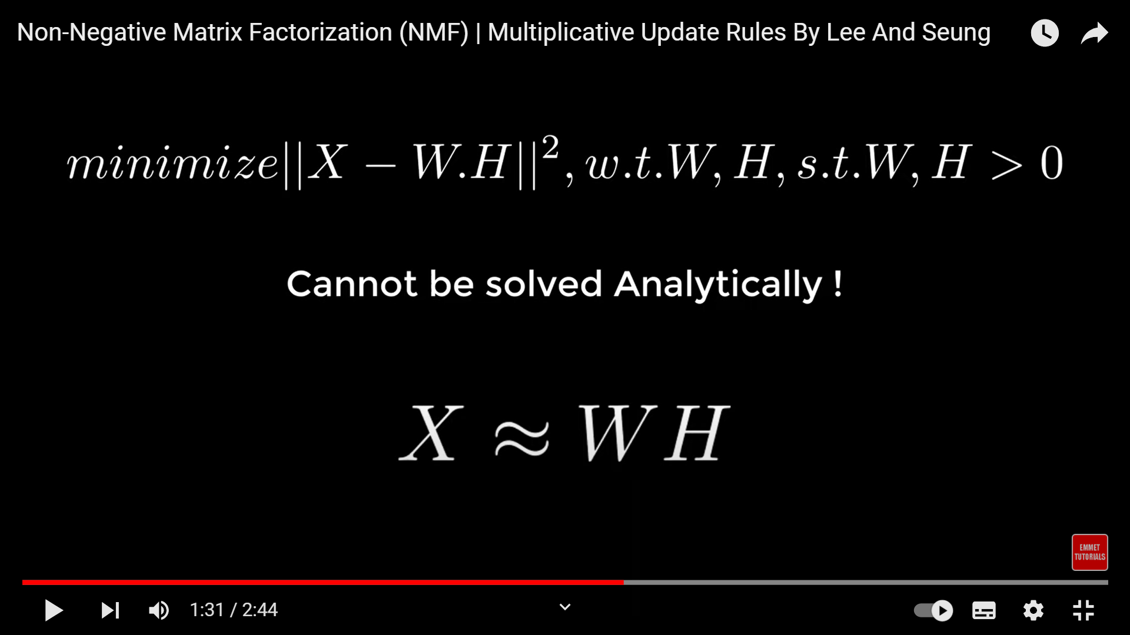
How it works
Given a nonnegative matrix X, NMF seeks to find two nonnegative matrices W and H such that:
X ≈ WH
-W is the matrix of activation coefficients,
which represents the contribution of each basis function to each time point in the input data.
Each row of W corresponds to a time point in the input data, and each column corresponds to a basis function.
The values in W are non-negative and indicate the strength of the contribution of each basis function to each time point in the input data.
In other words, W tells us how much of each basis function is present at each time point in the input data.
-H is the matrix of basis functions, which represents the templates that are learned from the input data.
Each row of H corresponds to a basis function, and each column corresponds to a channel in the input data.
The values in H are also non-negative and indicate the shape or waveform of each basis function.

Slide 4
The goal of NMF is to find a low-rank approximation of the input matrix X by factorizing it into two smaller matrices W and H. The rank r of the approximation is determined by the number of basis functions.
The factorization is done by minimizing a cost function that measures the distance between X and the approximation WH subject to the nonnegativity constraints:
minimize ||X - WH||_F^2 subject to W >= 0, H >= 0 where ||.||_F is the Frobenius norm.(The Frobenius norm of a matrix M is defined as the square root of the sum of the squared elements of M.)

Slide 5
limitations
NMF is a non-convex optimization problem, which means that there may be multiple local minima and the algorithm may get stuck in a suboptimal solution.
NMF assumes that the input data is nonnegative, which may not always be the case in practice.

Slide 6
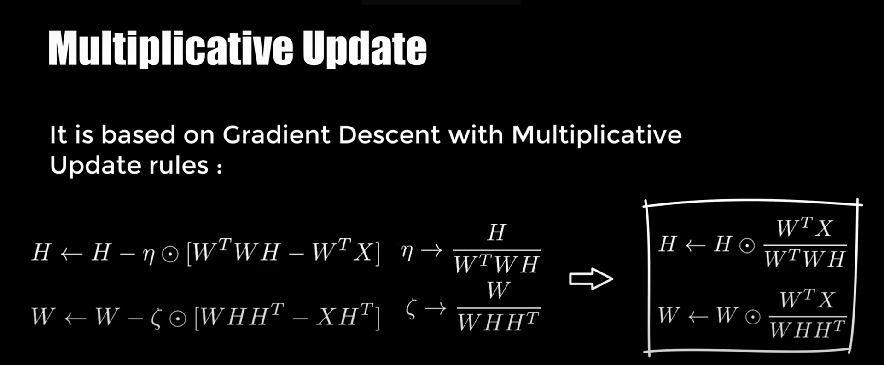

Slide 7
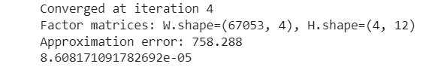
USING NINAPRO

Slide 8
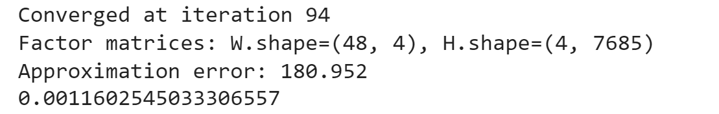
Using SR_index.mat

Slide 9
Code
https://colab.research.google.com/drive/1ZeAcuWlj1W65FMrOwKkO1gVA6LUGSeCx?usp=sharing

