Slide 1
ScaleUp
Facility Monitoring Software

Slide 2
What’s the problem we’re looking to solve?
The operations team needs to know where they might have potential room for expansion
R&D wants room to create their latest invention
QA needs room to test and shatter R&D’s latest dream
Sales wants to expand manufacturing capacity of that product you hate to make, because they just promised someone 1,000 more units by next month
Accounting wants to know if they can cut back on the utilities “they’re” paying for in Building #2, they never walk over there and aren’t convinced it’s being used

Slide 3
That’s where ScaleUp comes in!
We support facility operations with visual insights by:
Gathering usage data for various utilities
Sorting these utilities by their corresponding zones & buildings
Displaying the data in a user friendly manor
Enabling operations teams to make expansion decisions based on their current capacities

Slide 4
That sounds good, but what’s it look like?

Slide 5
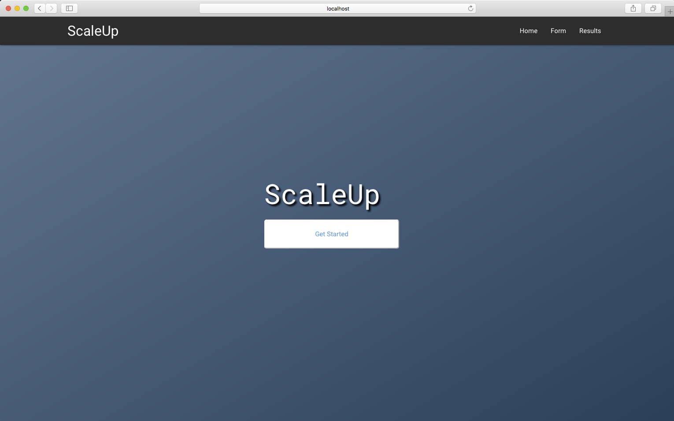
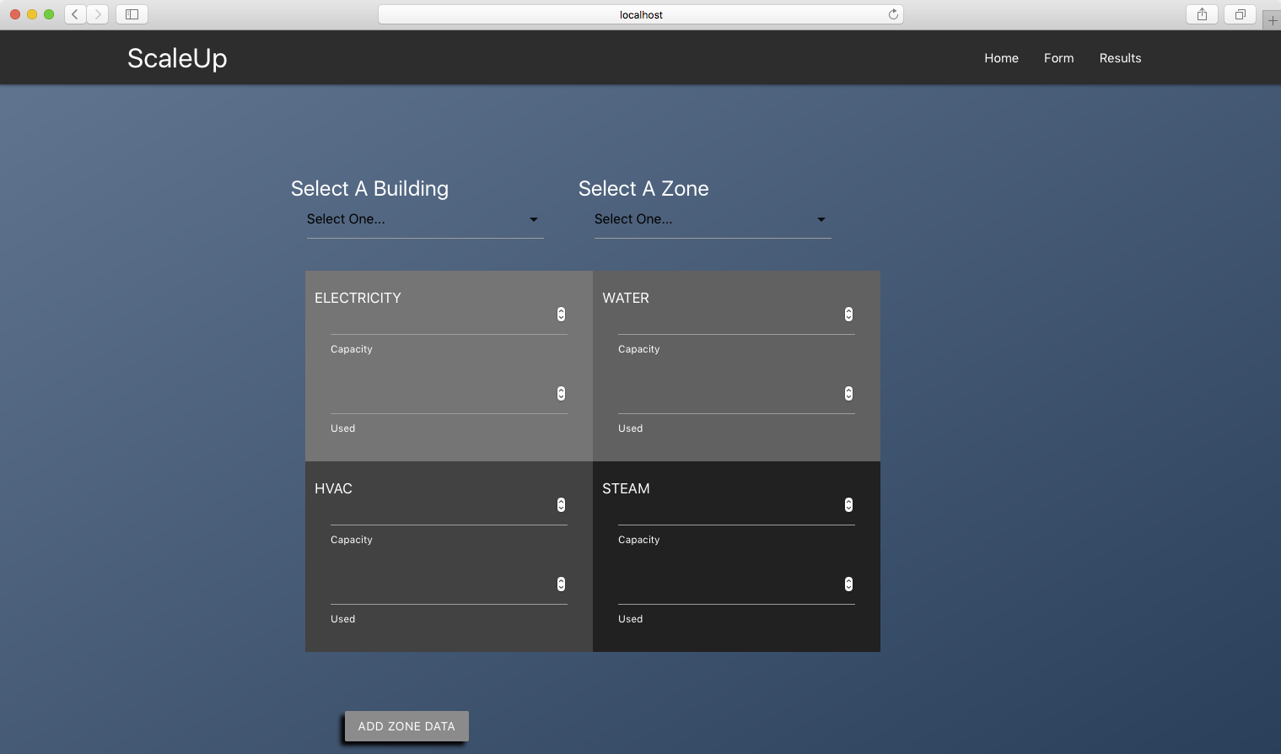
Insert some screenshots here

Slide 6
Data Flow
Users input utilities data in html form
We use API routes to move this data into MySQL
Foreign keys associate various buildings/zones/utilities in MySQL
API routes pull this data from MySQL, then display the data visually using chart.js
Form
Sequelize
MySQL
Sequelize
Chart.js

Slide 7
Questions ?

