Slide 1
LatFlow Home Testing Resource Model
Report produced By Cignpost Diagnostics Data Insights Department Waleed Idrees (Data Scientist) ,Ben Neffendorf (Head of Insight)

Slide 2
Introduction to Model
This model aims to use historical home testing LatFlow data to create an efficient resourcing model.
Using an Arima forecasting model, a forecast is produced to give us an expected hourly number of tests.
We build our resourcing model based on the hourly forecast and using following assumption:
Mvine test are 60% of total home tests Webform based tests are 40% of total home tests.
Mvine tests take approximately 2 mins to complete
Webform tests take approximately 10 mins to complete
Based on this a test resulted can cater for 12 tests per hour
(60minutes / (2*0.6 + 10*0.4)) = 11.5 tests per hour
Shifts are on 4 hour basis - 8-12, 12-16, 16-20, 20-24.

Slide 3
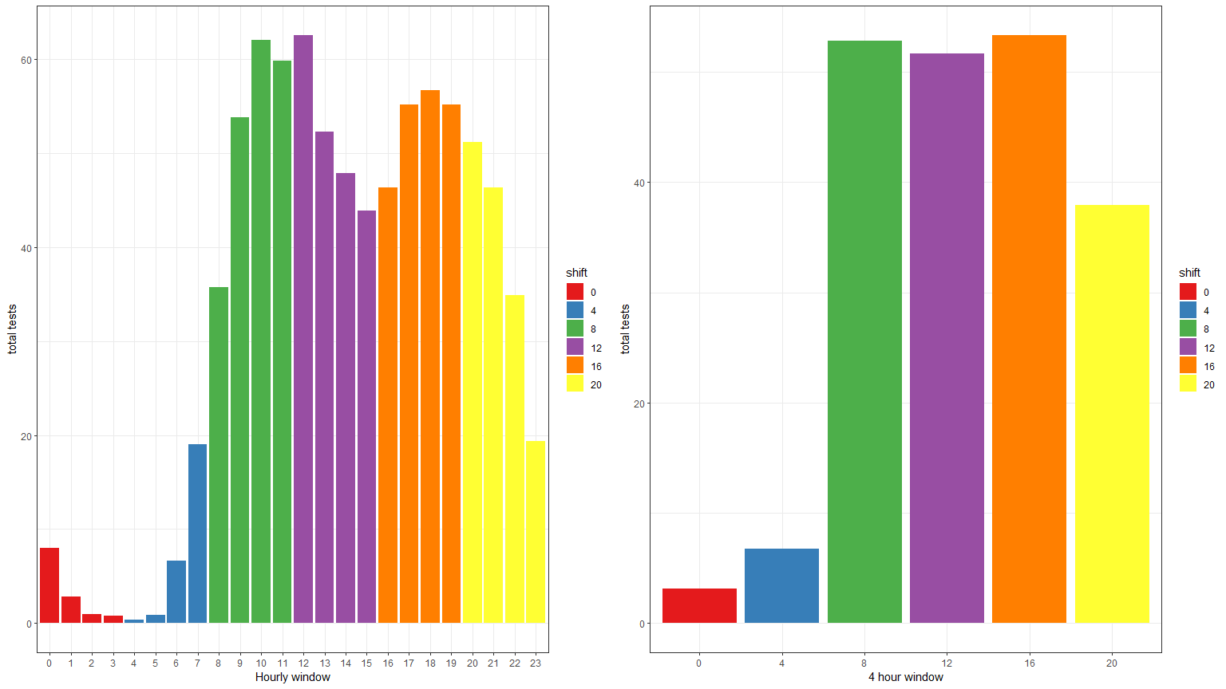
Hourly Patterns
We Can See The 8-12 And 16-20 Shifts Are The Busiest Periods Of The Day.

Slide 4
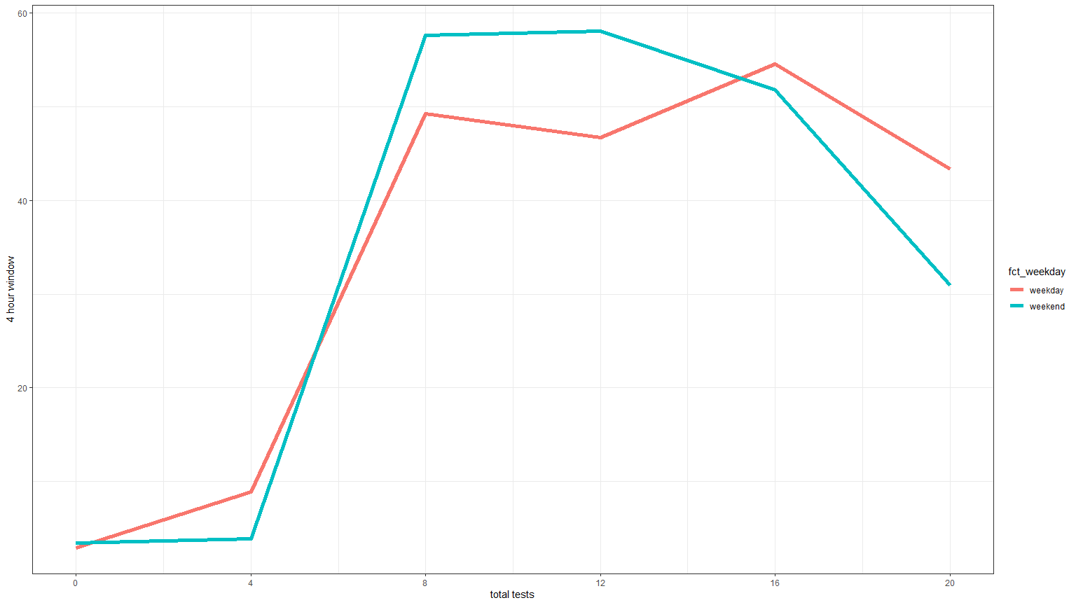
Comparison between weekdays and weekends
Having examined individual days, we saw Mon-Thu have a similar distribution, as do Fri-Sun. As such we split the model into Weekday (Mon-Thu) vs Weekend (Fri-Sun). Between the two we see a higher number of tests are booked over the weekend from 8am to 12pm and weekdays demonstrate a double peak

Slide 5
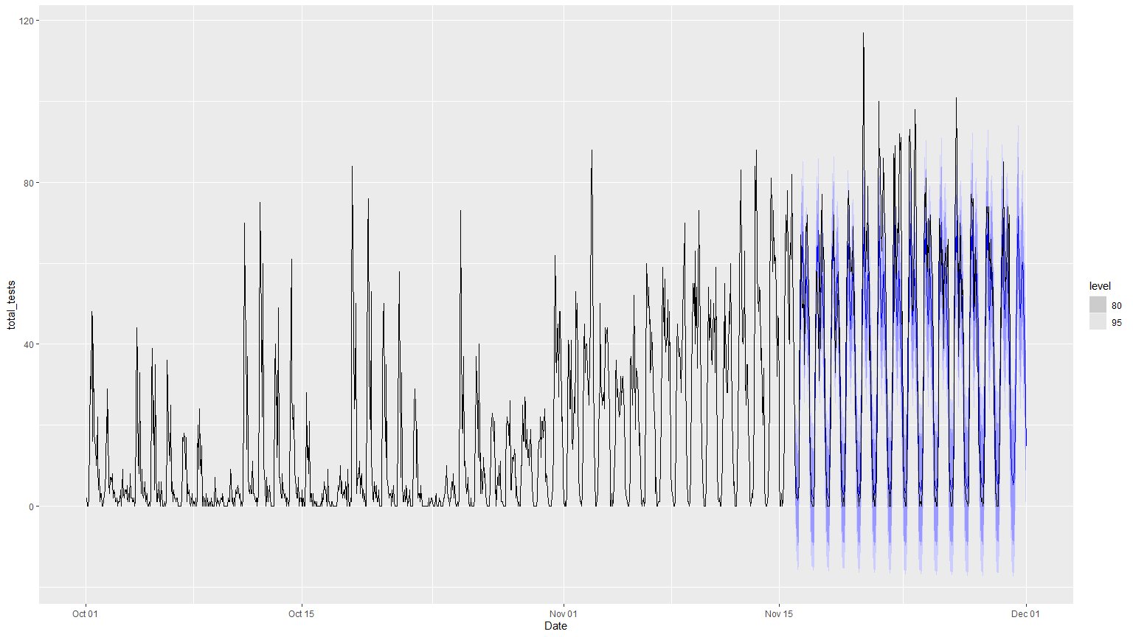
Forecast vs Actuals
Forecast is produced and then compared with actual data. Blue line is the no of tests forecasted and the black line is the actual tests. Graph shows that forecast is capturing the patterns closely as blue line is following black line closely.

Slide 6
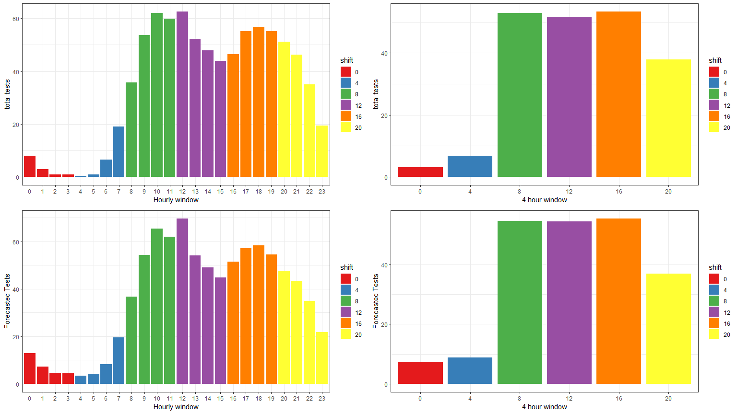
Actuals vs Forecast – Hourly and Shift Split
Based on the above we can see the forecast accurately represents the actuals

Slide 7
Resourcing Model
Having become comfortable with our forecasting model. We evaluate two methods to produce final number of workers required per shift:
Avg tests per 4 hour shift
Max tests per 4 hour shift
Each of the above give us one number for each shift, which we can divide by the 12 tests per hour per resulted in order to give a recommended number of resulting staff for each shift

Slide 8
Example Dataset For 1 Shift
Date | forecast | shift | average_tests | max_test | avg_resource | max_resource
2021-11-16 12:00:00 | 68 | 12 | 53 | 68 | 5 | 6
2021-11-16 13:00:00 | 52 | 12 | 53 | 68 | 5 | 6
2021-11-16 14:00:00 | 47 | 12 | 53 | 68 | 5 | 6
2021-11-16 15:00:00 | 43 | 12 | 53 | 68 | 5 | 6

Slide 9
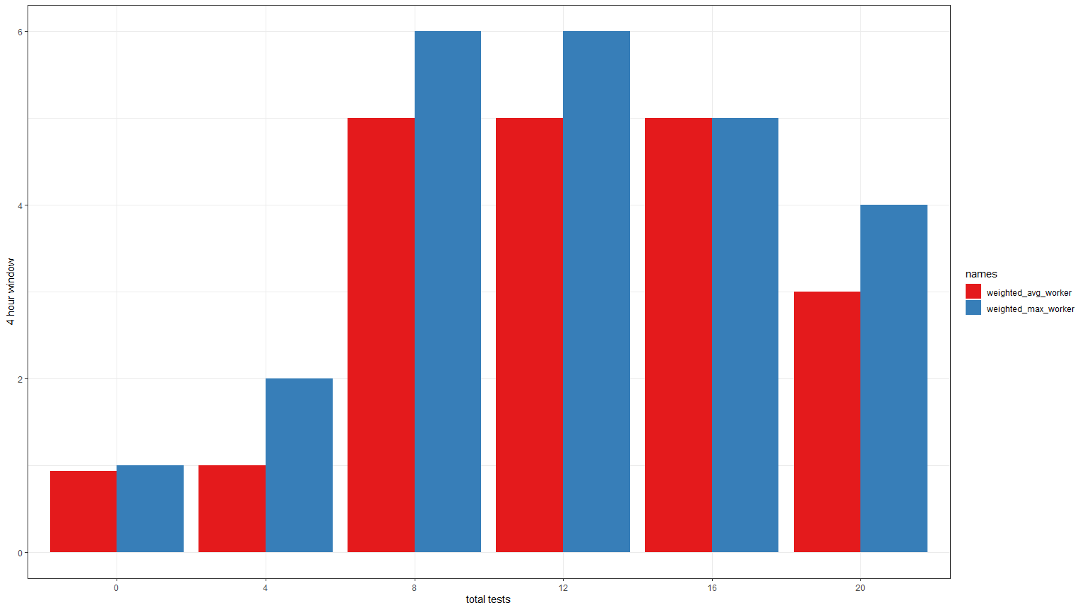
Comparison of Average and Max Resourcing Model

