Slide 1

PROGRAMMING FUNDAMENTALS SEMESTER PROJECT
MADE BY : Waleed Khalid
F24CSC002

Slide 2

Library Management System
Overview:
- Efficient management of student accounts and library books.
- Features include student registration, book issuance, and data persistence.
Purpose:
- Simplify library operations.
- Ensure accurate record-keeping

Slide 3
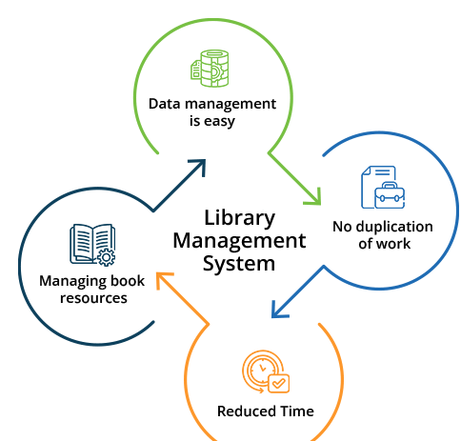
Features of the System
Student Management:
- Create new accounts.
- View and update balances.
- Deposit funds.
Book Management:
- Add and edit book records.
- View available books.
- Issue books to students.

Slide 4
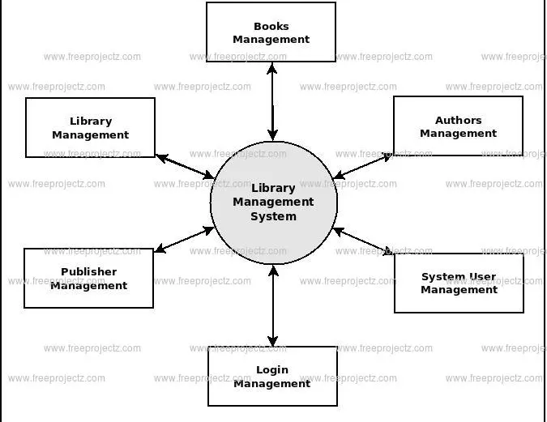
Functions In The C++ Library Management System
Functions :
Create_account()
Display(int roll)
Deposit_amount(int roll, double amount)
Issue_item(int roll)
Issue_item(int roll)
Return_item(int roll)
Display_sorted()
Find_student(int roll)
Find_book(int isbn)
Add_book()

Slide 5
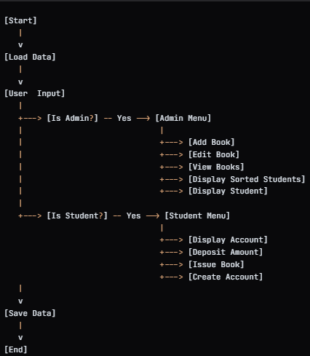
System workflow
Admin Workflow:
- Log in with admin credentials.
- Add or update book records.
- View all students and books.
Student Workflow:
- Log in with roll number.
- View account details and balances.
- Issue available books.

Slide 6
Implementations
Programming Language: C++
Key Components:
- Data structures for students and books.
- File handling for persistence.
- Sorting and searching algorithms.
User Interface:
- Menu-driven console interface.

Slide 7
Advantages
Efficiency:
- Reduces manual record-keeping.
- Automates common library tasks.
Scalability:
- Supports up to 20 students and 15 books (modifiable).
User-Friendly:
- Clear menu navigation for both admins and students.

Slide 8
Future Enhancements
Database Integration:
- Replace text files with a relational database for scalability.
Web Interface:
- Create a web-based or GUI application.
Enhanced Security:
- Add encryption for sensitive data.

Slide 9
Demonstration
Live Demo:
- Show system initialization.
- Demonstrate admin and student functionalities.
- Illustrate file persistence with example data.

Slide 10
Conclusion
Summary:
- Library Management System simplifies operations.
- Combines essential features with robust error handling.
Thank You:
- Questions and feedback are welcome.

