Slide 1
Voice operated calculator

Slide 2
AGENDA
Introduction
Problem statement
Libraries
Result/Output
Summary

Slide 3
INTRODUCTION
Speaker-independent voice recognition systems have a very strong probability of becoming a necessity in the workplace in the future. Such systems would be able to improve productivity and would be more convenient to use.

Slide 4
Continue
VOC looks and functions like a common calculator. However, this assistive technology system has a voice to text and text to voice functions so that each time we give command our voice command will convert to text and the result will appear in text and also in in the form voice. This can help the user to verify that the numbers and operands have been entered correctly. The calculator also speaks the answer to the math problem.

Slide 5
Problem statement

Slide 6
We are targeting the special people around us we want to empower and provide ease to them all most everyone encountered a person without hands how they calculate and audit the daily expenses or budget that person could be shopkeeper, student, housewife etc. Everyone need check and balance we are hopping with help of VOC we can minimize their struggle if not end.

Slide 7
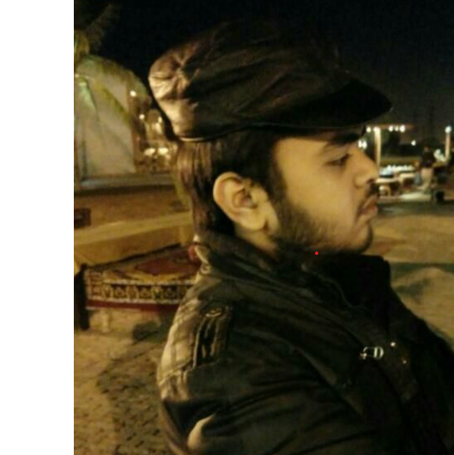

MEET OUR TEAM
Waleed khan
Azim Haider

Slide 8
Libraries
Operator
Speech recognition
gTTS
Pydub
Winsound

Slide 9
Operators
Operators are used to perform operations on variables and values.
Python divides the operators in the following groups:
Arithmetic operators
Assignment operators
Comparison operators
Logical operators
Identity operators
Membership operators
Bitwise operators

Slide 10
Speech recognition
Speech Recognition incorporates computer science and linguistics to identify spoken words and converts them into text. It allows computers to understand human language. Speech recognition is a machine's ability to listen to spoken words and identify them. You can then use speech recognition in Python to convert the spoken words into text, make a query or give a reply. You can even program some devices to respond to these spoken words.

Slide 11
gTTS
gTTS (Google Text-to-Speech), a Python library and CLI tool to interface with Google Translates text-to-speech API.
Customizable speech-specific sentence tokenizer that allows for unlimited lengths of text to be read, all while keeping proper intonation, abbreviations, decimals and more.
Customizable text pre-processors which can, for example, provide pronunciation corrections

Slide 12
Pydub
Audio files are a widespread means of transferring information. So let’s see how to work with audio files using Python. Python provides a module called pydub to work with audio files. pydub is a Python library to work with only .wav files. By using this library we can play, split, merge, edit our .wav audio files.

Slide 13
Winsound
Winsound module is a built-in module in python. The module is already available in python, so it is not necessary to install it again. This is useful to generate some specified sounds at a specific time. This module is specially made for Windows.

Slide 14
THANK YOU

