Slide 1


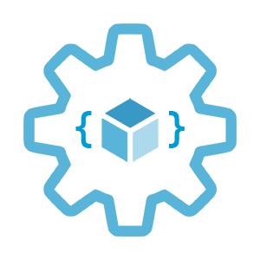

Scaling options
for applications and clusters in AKS
Infrastructure as Code User Group Oslo
27.01.2022
with Evgeny Borzenin

Slide 2
Infrastructure as Code User Group roadmap
AKS workshops roadmap:
[x] AKS and Kubernetes 101
[x] Advanced AKS configuration
[x] Implement Immutable AKS Infrastructure on Azure with Bicep
[x] GitOps in AKS with Flux
[ ] Scaling options for applications and clusters in AKS
[ ] Monitoring options in AKS
[ ] Service mesh in AKS with linkerd
[ ] Security in AKS
+ “regular” events (work in progress)

Slide 3
Practical information
Mix of slides and labs with focus on labs
I don’t have moderator
Let’s help each other, the one who finished earlier can help others
Keep the same names as in labs -> easier to troubleshot
Share your screen if you stack with some issues
Labs are available after the event

Slide 4
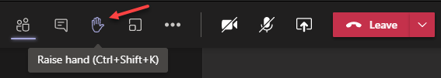
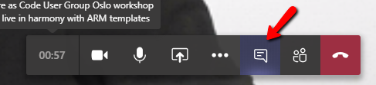

Microsoft Teams 101
Mute your mic (but don’t forget to unmute when you speak)
Feel free to use video
«Rise your hand» if you need some attention
Conversation/chat
Share screen

Slide 5
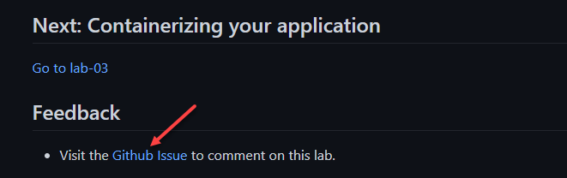
Practical information
Each lab is time-boxed (ish…)
When you done with lab, post to the Conversation channel
lab-01 (lab-02, lab-03 etc…)
Feel free to contribute to the labs content by fixing gramma, typos, wrong commands etc..
Feel free to comment on each lab

Slide 6
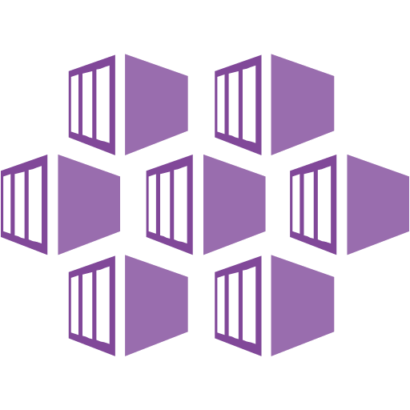
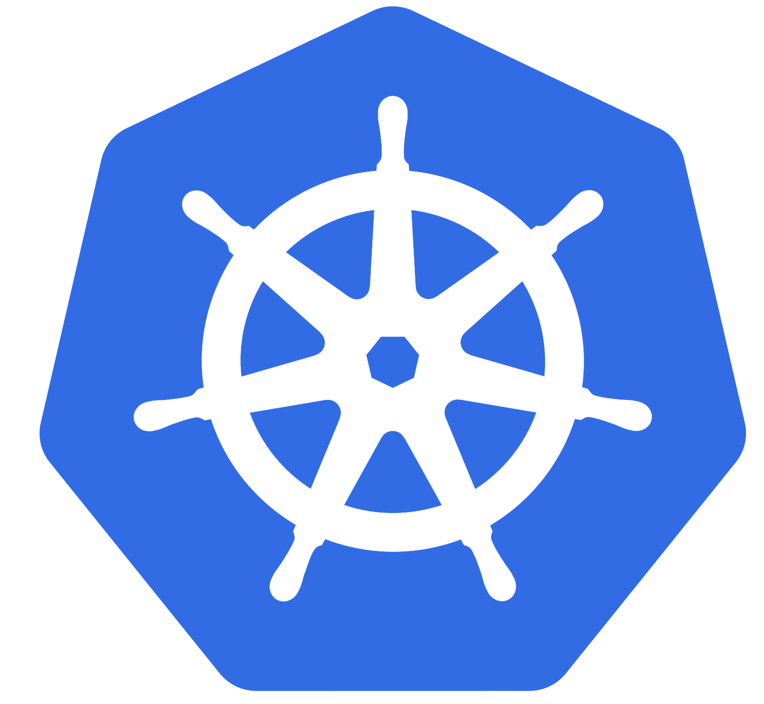
Kubernetes and AKS introduction

Slide 7
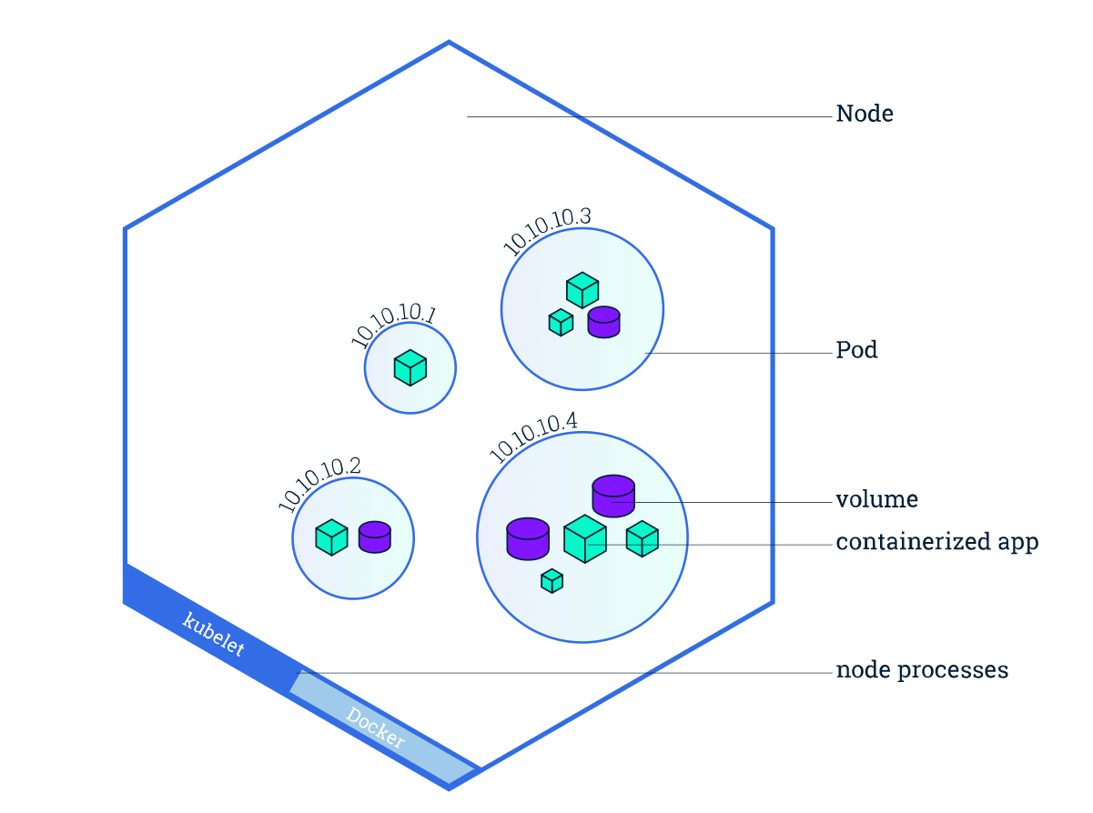
Kubernetes concepts
Cluster
Nodes
Pods
Desired state (Imperative vs. Declarative)
Deployments
Services
Image from https://kubernetes.io/docs/tutorials/kubernetes-basics/explore/explore-intro/

Slide 8
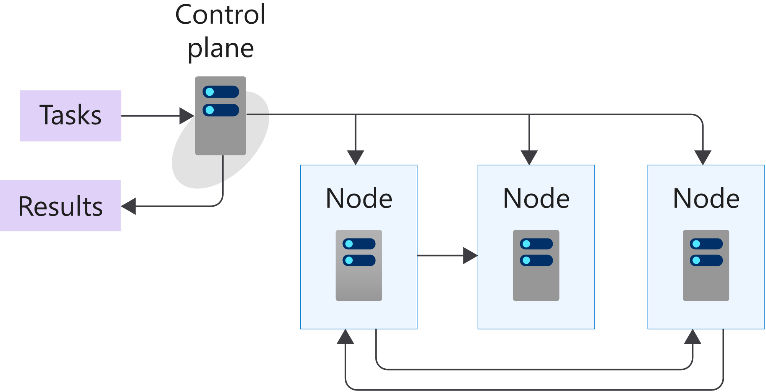
K8s 101: Cluster and Nodes
Azure-managed
Nodes are machines (VM) in your cluster
Nodes are where your workloads run
Nodes can come and go
Customer-managed
Image from https://docs.microsoft.com/en-us/learn/modules/intro-to-kubernetes/3-how-kubernetes-works
Notes:
A cluster is a set of computers that you configure to work together and view as a single system. The computers configured in the cluster will typically do different type of tasks. For example, they'll host websites, APIs, or run compute-intensive batches.
A cluster uses centralized software that's responsible for scheduling and controlling these tasks. The computers in a cluster that run the tasks are called nodes, and the computers that run the scheduling software are called control planes.
A node in a Kubernetes cluster is where your compute workloads run.
Each node communicates with the control plane via the API server to inform it about state changes on the node.

Slide 9
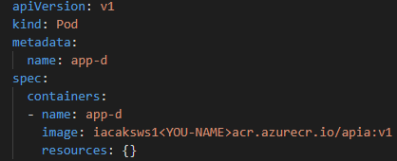
K8s 101: Pods
Pod is the smallest object that you can create
A single Pod can hold a group of one or more containers
Node1
Node2
Node3
pod
pod
pod
pod
app-a
app-b
app-b
app-a
app-d
Notes:
Unlike in a Docker environment, you can't run containers directly on Kubernetes.
You package the container into a Kubernetes object called a pod. A pod is the smallest object that you can create in Kubernetes.
A single pod can hold a group of one or more containers. However, a pod typically doesn't contain multiples of the same app.
You use Kubernetes pod templates to define the information about the pods that run in your cluster.
Pod templates are YAML-coded files
A pod includes information about the shared storage and network configuration, and a specification about how to run its packaged containers.

Slide 10
K8s 101: Desired State
Imperative vs. Declarative - tell Kubernetes what you want, not what to do
Kubernetes always tries to steer the cluster to its desired state
You: “Hey, k8s, I want 3 replicas of app-a”
K8s: “Here are 3 replicas of app-a”
K8s: “Upps, one replica just died, I will try to find a node where I can spin up a new replica”
K8s: “Here are 3 replicas of app-a”
Notes:
(Imperative vs. Declarative)
One of the core concepts of Kubernetes - Desired State. Tell Kubernetes what you want, not what to do.

Slide 11
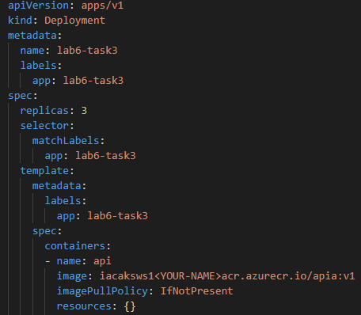
K8s 101: Deployment
Pod templates
Replica Sets
Deployments
Notes:
There are several options to manage the deployment of pods in a Kubernetes cluster
A pod template enables you to define the configuration of the pod you want to deploy.
The template contains information, such as the name of container image, and which container registry to use to fetch the images.
The template may also include runtime configuration information, such as ports to use.
Templates are defined by using YAML.
You can use templates to deploy pods manually. However, a manually-deployed pod isn't relaunched after it fails, is deleted, or is terminated.
To manage the lifecycle of a pod, you need to create a higher-level Kubernetes object.
A replica set uses pod templates and defines a specified number of pods that must run
A deployment creates a management object one level higher than a replica set and enables you to deploy and manage updates for pods in a cluster.

Slide 12
K8s 101: Deployment
Deployments are requirements you give to Kubernetes regarding your applications (Pods)
k8s: I need 2 replicas of app-a and 3 replicas of app-b
Node1
Node2
Node3
pod
pod
pod
pod
pod
app-a
app-b
app-b
app-a
app-b

Slide 13
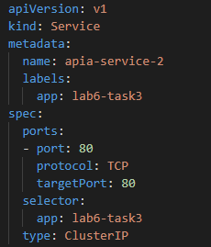
K8s 101: Services
Service is an abstract way to expose an application running on a set of Pods
A Service has a name and maps to a dynamic set of Pods defined by a label selector
service-a
service-b
Node1
Node2
Node3
pod
pod
pod
pod
pod
app-a
app-b
app-b
app-a
app-b
Notes:
A Kubernetes service is a Kubernetes object that provides stable networking for pods. A Kubernetes service enables communication between nodes, pods, and users of your app, both internal and external, to the cluster.

Slide 14
Lab-01, 02, 03

Slide 15


