Slide 2
Chapter 1 Outline
Types of Databases and Database Applications
Basic Definitions
Typical DBMS Functionality
Example of a Database (UNIVERSITY)
Main Characteristics of the Database Approach
Types of Database Users
Advantages of Using the Database Approach
When Not to Use Databases

Slide 3
Types of Database Applications
Traditional Applications:
  Numeric and Textual Databases in Business Applications
More Recent Applications:
  Multimedia Databases (images, videos, voice, etc.)
  Geographic Information Systems (GIS)
  Data Warehouses (OLAP)
  Real-time and Active Databases
  Many other applications
Initial part of book focuses on traditional applications
A number of recent applications are described later in the book (for example, Chapters 26,27,28,29)
Notes:
Traditional Applications - Bank deposit, Hotel/airline reservation, library catalogue, purchasing items in super market
Multimedia databases – youtube,
GIS – maps, weather data, satellite images
DW/OLAP – analyze very large dataset for business intelligence and decision making
Real-time databases – click stream databases, manufacturing process, sensor data management

Slide 4
Basic Definitions
Database:
  A collection of related data.
Data:
  Known facts that can be recorded and have an implicit meaning.
Mini-world or Universe of Discourse (UoD):
  Some part of the real world about which data is stored in a database. For example, student registration, grades and transcripts at a university.
Database Management System (DBMS):
  A software package/system to facilitate the creation and maintenance of a computerized database.
Database System:
  The DBMS software together with the data itself. Sometimes, the application programs and interfaces are also included.
Notes:
Mini world – a DB reflects some aspect of the real world, a logically coherent collection of data with inherent meaning.
DBMS – general purpose software system that facilitates the process of defining, constructing, and manipulating databases for various applications.
Defining – specifying data types, structures and constraints
Constructing – storing
Manipulating – querying, updating and generating reports

Slide 5

Simplified database system environment
(Figure 1.1)

Slide 6
Typical DBMS Functionality
Define a particular database in terms of its data types, structures, and constraints
Construct or Load the initial database contents on a secondary storage medium (typically hard disk)
Manipulating the database:
  Retrieval: Querying, generating reports
  Modification: Insertions, deletions and updates to its content
  Accessing/changing the database through Web applications
Processing and Sharing by a set of concurrent users and application programs – yet, keeping all data valid and consistent

Slide 7
Typical DBMS Functionality (cont.)
Other features:
  Protection or Security measures to prevent unauthorized access
  “Active” processing to take internal actions on data
  Presentation and Visualization of data
  Maintaining the database and associated programs over the lifetime of the database application
    Called database, software, and system life-cycle maintenance

Slide 8
Example of a Database UNIVERSITY Application
Mini-world for the example:
  Part of a UNIVERSITY environment.
Some mini-world entities:
  STUDENTs
  COURSEs
  SECTIONs (of COURSEs)
  (academic) DEPARTMENTs
  INSTRUCTORs

Slide 9
Example of a Database UNIVERSITY Application (cont.)
Some mini-world relationships:
  SECTIONs are of specific COURSEs
  STUDENTs take SECTIONs
  COURSEs have prerequisite COURSEs
  INSTRUCTORs teach SECTIONs
  COURSEs are offered by DEPARTMENTs
  STUDENTs major in DEPARTMENTs
Note: The above entities and relationships are typically expressed in a conceptual data model, such as the ENTITY-RELATIONSHIP data model (see Chapters 7, 8)

Slide 10
Example of a Database UNIVERSITY Application (cont.)
The next two slides (Figure 1.2 from textbook) show what a simple UNIVERSITY database may look like

Slide 11
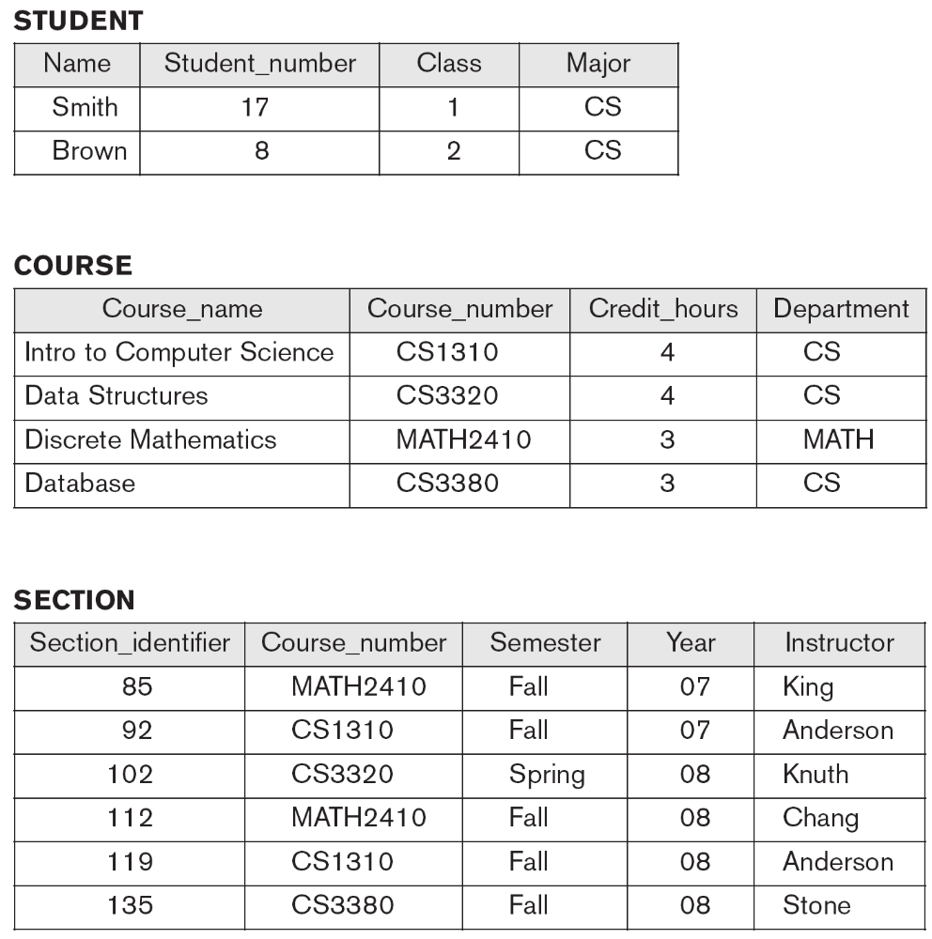
Continued next page…

Slide 12
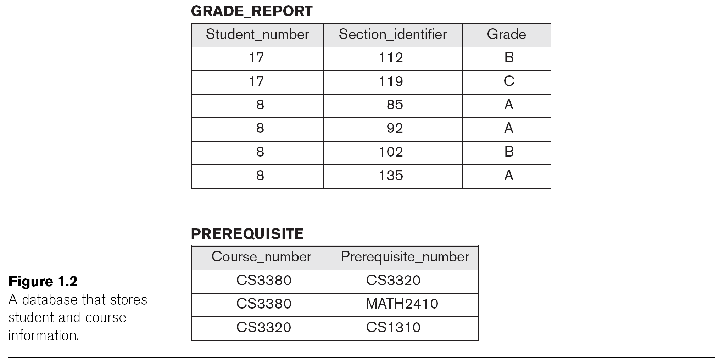

Slide 13
Main Characteristics of the Database Approach
Self-describing nature of a database system:
  A DBMS catalog stores the description of a particular database (e.g. data structures, types, and constraints)
  The description is called meta-data (see next slide).
  This allows the DBMS software to work with different database applications (university, bank, airlines, etc.)
Insulation between programs and data:
  Called program-data independence.
  Allows changing data structures and data storage organization without having to change the DBMS access programs.
Notes:
Catalogue is used by DBMS software and database users who need information about database structure. DBMS is general purpose software and refers the catalogue to know the structure of files – type and format of data. So same DBMS can work on university database, banking database etc.
Data independence – e.g. addition of a new piece of data ‘birthday’ to STUDENT record, only modifies the catalog, no program change is needed in DBMS

Slide 14

Example of meta-date in a simplified database catalog (Figure 1.3)

Slide 15
Main Characteristics of the Database Approach (cont.)
Insulation between programs and data (cont.):
  Accomplished through data abstraction
  A data model is used to hide storage details and present the users with a conceptual view of the database.
  Programs refer to the data model constructs rather than data storage details
Support of multiple views of the data:
  Each user may see a different view of the database, which describes only the data of interest to that user.
Notes:
A view may be a subset of the data in the database or may contain virtual data that is derived from database files.
Student transcripts & course pre-requisites

Slide 16
Main Characteristics of the Database Approach (cont.)
Sharing of data and multi-user transaction processing:
  Allowing a set of user transactions to access and update the database concurrently (at the same time).
  Concurrency control within the DBMS guarantees that each transaction is correctly executed or aborted
  Recovery subsystem ensures each completed transaction has its effect permanently recorded in the database
  OLTP (Online Transaction Processing) is a major part of database applications (allows hundreds of concurrent transactions to execute per second)

Slide 17
Types of Database Users
Users may be divided into
  Those who actually use and control the database content, and those who design, develop and maintain database applications (called “Actors on the Scene”), and
  Those who design and develop the DBMS software and related tools, and the computer systems operators (called “Workers Behind the Scene”).

Slide 18
Database Users: End-users
Actors on the scene
  End-users: Use the database for queries, reports, and updating the database content. Can be categorized into:
    Casual end-users: access database occasionally when needed
    Naïve (or Parametric) end-users: largest section of end-user population.
      Use previously implemented and tested programs (called “canned transactions”) to access/update the database.
      Examples are bank-tellers or hotel reservation clerks or sales clerks.

Slide 19
Database Users: End-users (cont)
    Sophisticated end-users:
      These include business analysts, scientists, engineers, others thoroughly familiar with the system capabilities.
      Many use tools in the form of software packages that work closely with the stored database.
    Stand-alone end-users:
      Mostly maintain personal databases using ready-to-use packaged applications.
      An example is a tax program user that creates its own internal database.
      Another example is a user that maintains an address book

Slide 20
Database Users: DB Administrators (DBAs) and Designers
Actors on the scene (continued)
  Database administrators:
    Responsible for authorizing/controlling access to the database; coordinating and monitoring its use; acquiring software and hardware resources; and monitoring efficiency of operations.
  Database Designers:
    Responsible for defining database structure, constraints, and transactions; communicate with users to understand their needs.

Slide 21
Workers behind the scene
  DBMS system designers and implementers:
    Design and implement DBMS modules, modules for catalog, query language, accessing, concurrency control, recovery and security.
  Tool developers:
    Tools for database modeling and design.
  Operators and maintenance personnel

Slide 22
Advantages of Using the Database Approach
Controlling redundancy in data storage and in development and maintenance efforts.
  Sharing of data among multiple users.
Restricting unauthorized access to data.
Providing persistent storage for program Objects
  In Object-oriented DBMSs – see Chapter 11
Providing Storage Structures (e.g. indexes) for efficient Query Processing

Slide 23
Advantages of Using the Database Approach (cont.)
Providing backup and recovery services.
Providing multiple interfaces to different classes of users.
Representing complex relationships among data.
Enforcing integrity constraints on the database.
Drawing inferences and actions from the stored data using deductive and active rules
Allowing multiple “views” of the same data (see next slide, Figure 1.5 from textbook)

Slide 25
Additional Implications of Using the Database Approach
Potential for enforcing standards:
  Crucial for the success of database applications in large organizations. Standards refer to data item names, display formats, screens, report structures, meta-data (description of data), Web page layouts, etc.
Reduced application development time:
  The time needed to add each new application is reduced.

Slide 26
Additional Implications of Using the Database Approach (cont.)
Flexibility to change data storage structures:
  Storage structures may evolve to improve performance, or because of new requirements.
Availability of up-to-date information:
  Extremely important for on-line transaction systems such as airline, hotel, car reservations.
Economies of scale:
  Wasteful overlap of resources and personnel can be avoided by consolidating data and applications across departments.

Slide 27
Historical Development of Database Technology
Early Database Applications:
  The Hierarchical and Network Models were introduced in mid 1960s and dominated during the seventies.
  Some worldwide database processing still occurs using these models; particularly, the hierarchical model.
Relational Model based Systems:
  Relational model was introduced in 1970, and heavily researched and experimented with at IBM Research and several universities.
  Relational DBMS Products emerged in the early 1980s and now dominate the market.
Notes:
Issue with early database systems – intermixing of conceptual relationships with physical storage. No data abstraction. Example – student record and grade record next to each other. Other issue was programming language. In contrast to high level query language for relational databases.
Early systems – hierarchical systems, network model based systems, inverted file systems

Slide 28
Historical Development of Database Technology (cont.)
Object-oriented and emerging applications:
  Object Databases (ODBs) were introduced in late 1980s and early 1990s to cater to the need of complex data and applications, and the proliferation of object-oriented programming languages.
    Their use has not taken off much.
  Many relational DBMSs have incorporated object database concepts, leading to a new category called object-relational databases (ORDBs) (see Ch. 11)
  Extended relational systems add further capabilities (e.g. for multimedia data, XML, spatial, and other data types)
Notes:
OODBs – abstract data types, encapsulation of operations, inheritance, but failed due to complexity of the model and lack of early standard.

Slide 29
Historical Development of Database Technology (cont.)
Data on the Web and E-commerce Applications:
  Static Web pages often specified in HTML (Hypertext markup language) with links among pages.
  Dynamic Web pages have portions of their content extracted from databases, and allow user interaction with databases by typing in form boxes.
  Script programming languages such as PHP and JavaScript allow generation of dynamic Web pages (see Ch. 14), and provide for user querying of databases by typing selection keywords (e.g. flight number or student id).
    Also allow database updates through Web pages

Slide 30
Extending Database Capabilities
New functionality is being added to DBMSs in the following areas:
  Scientific Applications
  XML (eXtensible Markup Language)
  Image Storage and Management
  Audio and Video Data Management
  Data Warehousing and Data Mining
  Spatial Data Management and Geographic Information Systems
  Time Series and Historical Data Management
  Collecting and fusing data from distributed sensors
The above led to new research and development in incorporating new data types, complex data structures, new operations/query languages, and new storage and indexing schemes (see Chapter 26).
Notes:
Scientific – human genome, protein structures, astrophysics and high energy physics
Images – Xray, MRI
Time series – economic data at regular point in time, daily sales, monthly gross product figures
Databse back ends – ERPs, CRMs

Slide 31
When not to use a DBMS
Main inhibitors (costs) of using a DBMS:
  High initial investment and possible need for additional hardware.
  Overhead for providing generality, security, concurrency control, recovery, and other functions.
When a DBMS may be unnecessary:
  If the database and applications are simple, well defined, and not expected to change.
  If there are stringent real-time requirements that may not be met because of DBMS overhead.
  If access to data by multiple users is not required.

Slide 32
When not to use a DBMS (cont.)
When no DBMS may suffice:
  If the database system is not able to handle the complexity of data because of modeling limitations
  If the database users need special operations not supported by the DBMS
  When DBMS overhead makes it impossible to achieve the needed application performance

Slide 33
Chapter 1 Summary
Types of Databases and Database Applications
Basic Definitions
Typical DBMS Functionality
Example of a Database (UNIVERSITY)
Main Characteristics of the Database Approach
Different Types of Database Users
Advantages of Using the Database Approach
When Not to Use Databases

