Slide 1

Psychology
Lecturer: Huma ittefaq

Slide 2

Introduction to psychology
Psychology is the scientific study of mind (mental processes) and behavior. The word “psychology” comes from the Greek words “psyche,” meaning life, and “logos,” meaning explanation.
The Challenges of Studying Psychology
Relation to you

Slide 3
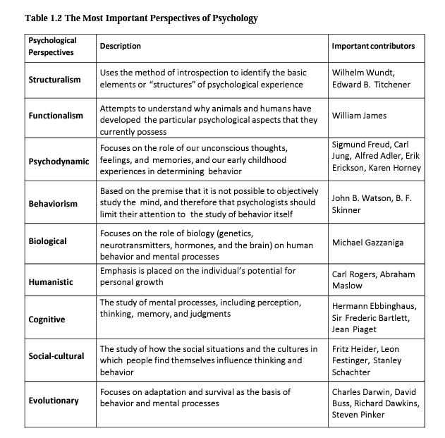

Slide 4

Psychological theories for you
Information processing theory
Information processing theory is a cognitive theory that uses computer processing as a metaphor for the workings of the human brain. Initially proposed by George A. Miller and other American psychologists in the 1950s, the theory describes how people focus on information and encode it into their memories.
Memory
Encoding
Storage
Retrieval
Limitations

Slide 5
Psychological theories for you
Classical conditioning theory
Russian physiologist Ivan Pavlov, classical conditioning is a type of unconscious or automatic learning. This learning process creates a conditioned response through associations between an unconditioned stimulus and a neutral stimulus.
Stimulus
Response

Slide 6
Psychological theories for you
Classical conditioning—also sometimes referred to as Pavlovian conditioning—uses a few different terms to help explain the learning process. Knowing these basics will help you understand classical conditioning.
An unconditioned stimulus is a stimulus or trigger that leads to an automatic response. If a cold breeze makes you shiver, for instance, the cold breeze is an unconditioned stimulus; it produces an involuntary response (the shivering).
A neutral stimulus is a stimulus that doesn't initially trigger a response on its own. If you hear the sound of a fan but don't feel the breeze, for example, it wouldn't necessarily trigger a response. That would make it a neutral stimulus.
A conditioned stimulus is a stimulus that was once neutral (didn't trigger a response) but now leads to a response. If you previously didn't pay attention to dogs, but then got bit by one, and now you feel fear every time you see a dog, the dog has become a conditioned stimulus.
An unconditioned response is an automatic response or a response that occurs without thought when an unconditioned stimulus is present. If you smell your favorite food and your mouth starts watering, the watering is an unconditioned response.
A conditioned response is a learned response or a response that is created where no response existed before. Going back to the example of being bit by a dog, the fear you experience after the bite is a conditioned response.

Slide 7
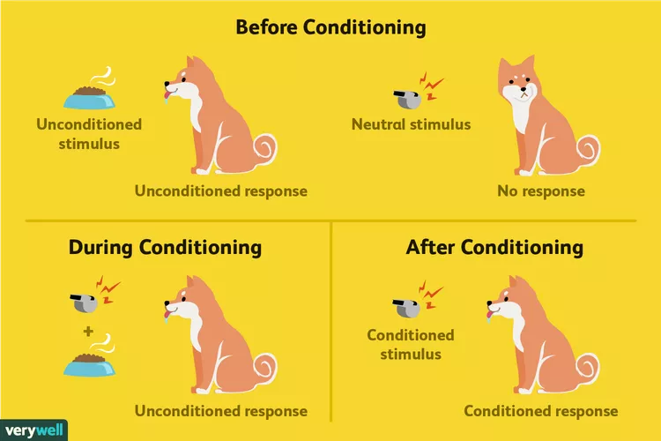

Slide 8
Psychological theories for you
Hierarchy of needs
Abraham Maslow created the hierarchy of needs as a theory of motivation. This motivational theory is often helpful in the workplace and many managers may implement it while developing motivational strategies.

Slide 9
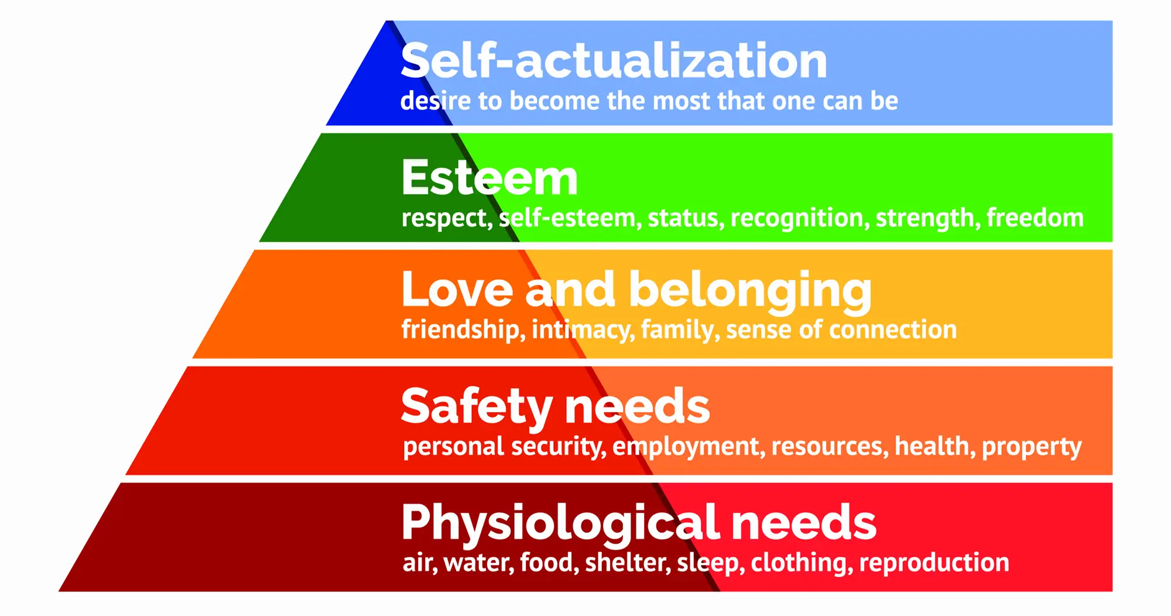

Slide 10
Psychological theories for you
Theory of moral development
Kohlberg's theory of moral development involves three levels of morality. The theory that individuals navigate through these levels of moral reasoning to make a decision or perform an action.
A manager may refer to this theory while identifying what motivates an employee to make specific decisions and become a high-functioning, productive individual in the workplace.

Slide 11
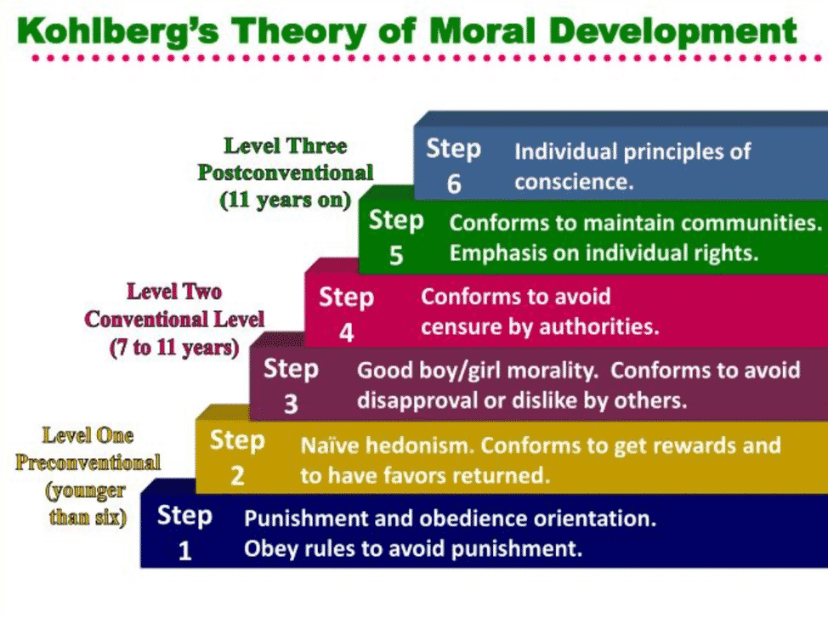

Slide 12
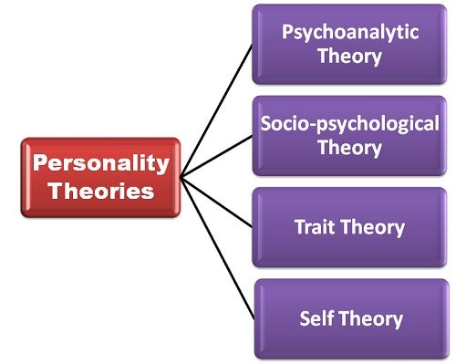

Slide 13
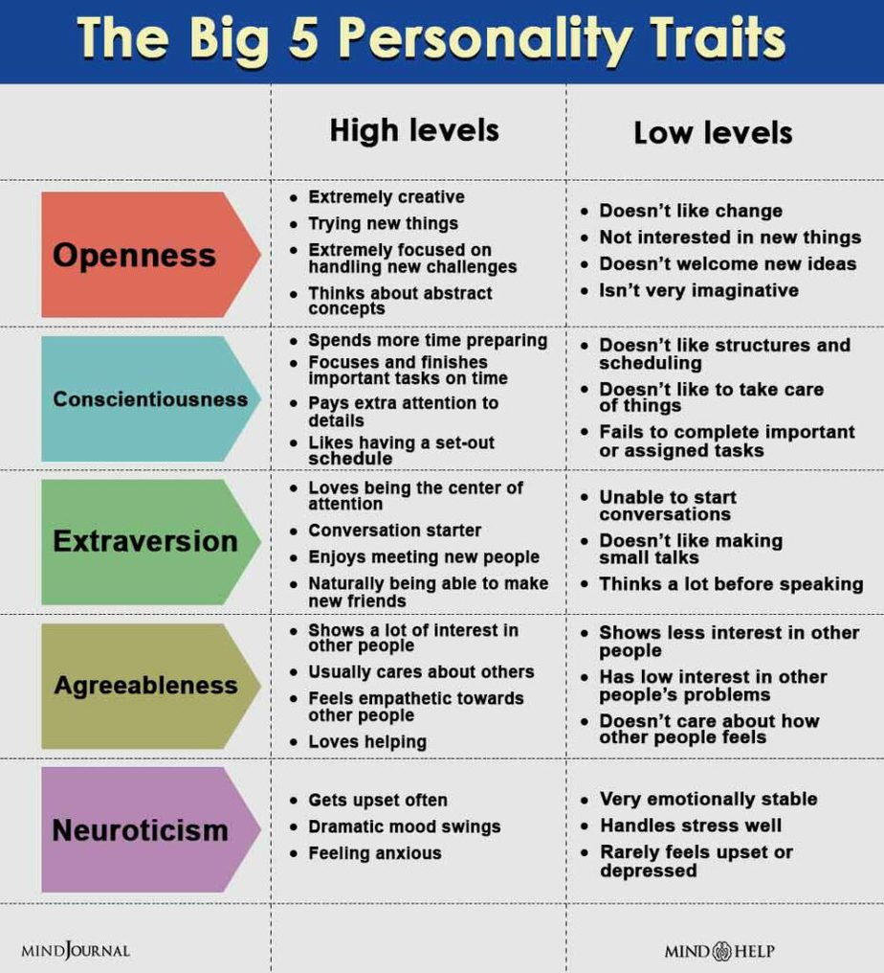

Slide 14
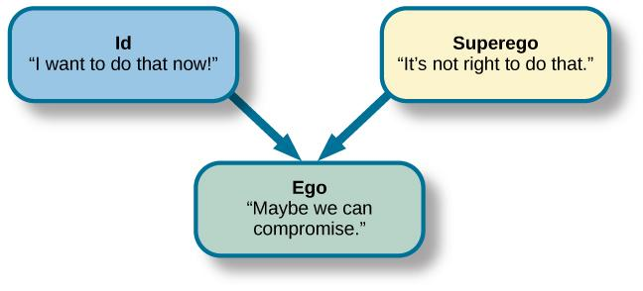
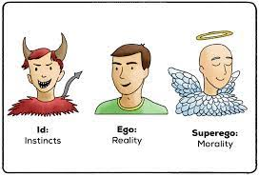

Slide 15
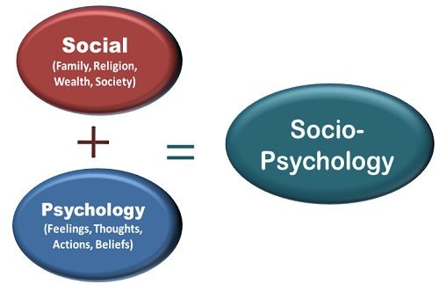

Slide 16
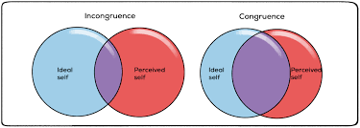

Slide 17
Social cognitive theory
Albert Bandura’s (1986) Social cognitive theory explains personality development as learning that occurs through interactions with other people

Slide 18
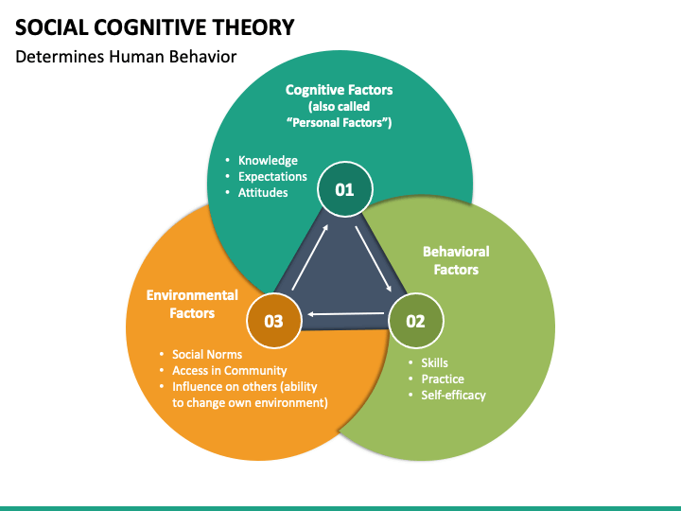

Slide 19
LOCUS OF CONTROL
Locus of control refers to the belief that consequences are either the result of our own actions, or due to outside forces beyond our control. Rotter noted that individuals who have an internal locus of control assume that their behavior is responsible for the consequences they experience. Whereas, individuals with an external locus of control believe that they are at the whim of luck, chance, or the actions of other people.

Slide 20
Personality and Culture
Culture greatly affects how individuals perceive themselves, and one important distinction is where a culture falls on the continuum between individualism and collectivism (Vazire, 2014). Individualistic cultures, such as the mainstream culture in the United States, focus on the self more than relationships. Independence and personal rights are valued over obligations to others. In contrast, collectivistic cultures, such as those in eastern Asia, value obligation to one’s group over personal rights and desires. Cultural traditions and hierarchies are stronger in collectivistic cultures. Additionally, personality differences typically assessed, such as the Big Five, appear less noticeable in collectivistic cultures. However, within any culture there will be some members who exhibit more individualism than collectivism and vice versa. Consequently, individualism collectivism may be a personality trait itself.

