Slide 1
A Discipline of Software Design

Slide 2
Objectives
To explain what design is and how various types of design deal with different aspects of a product
To present design as problem solving and outline the roles of abstraction and modeling in design
To place design in the software life cycle
To survey software engineering design methods

Slide 3
Topics
Software products and software design
Abstraction and modeling
Varieties of design
Software design in the life cycle
Software engineering design methods

Slide 4
Importance of Software Design
We live in a designed world.
Design is economically important and effects our quality of life.
Software is becoming ubiquitous.
The quality of software design has important consequences that software designers should be aware of and take seriously.

Slide 5
Software Products
A software product is an entity comprised of one or more programs, data, and supporting materials and services that satisfies client needs and desires either as an independent artifact or as essential ingredient in some other artifact.

Slide 6
Software Design Defined
Software designers do what designers in other disciplines do, except they do it for software products.
Software design is the activity of specifying the mature and composition of software products that satisfy client needs and desire, subject to constraints.

Slide 7
Design as Problem Solving
An especially fruitful way to think about design is as problem solving.
Advantages
  Suggests partitioning information between problem and solution
  Emphasizes that there may be more than one good solution (design)
  Suggests techniques such as changing the problem, trial and error, brainstorming, etc.

Slide 8
Abstraction
Abstraction is an important problem-solving technique, especially in software design.
Abstraction is suppressing or ignoring some properties of objects, events, or situations in favor of others.

Slide 9
Importance of Abstraction
Problem simplification
  Abstracting allows us to focus on the most important aspects of a problem in (partially) solving it.
Structuring problem solving
  Top-down strategy: Solve an abstract version of the problem, then add details (refinement)
  Bottom-up strategy: Solve parts of a problem and connect them for a complete solution

Slide 10
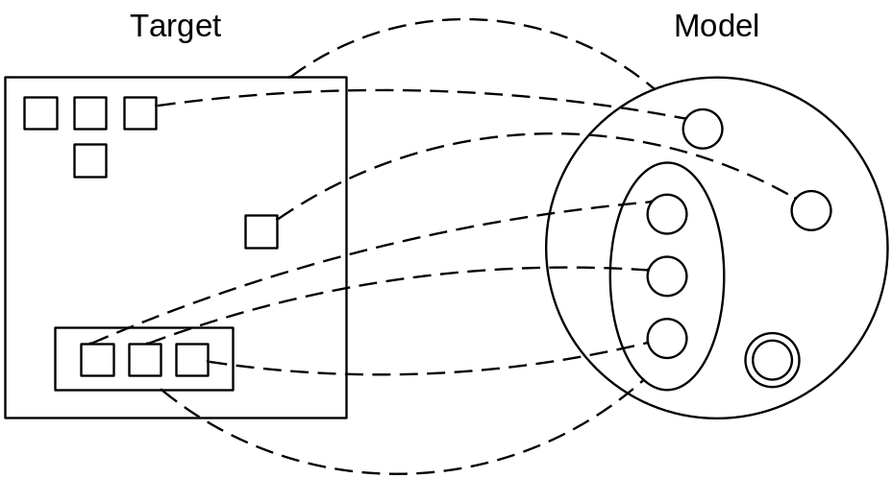
Modeling
A model represents a target by having model parts corresponding to target parts, with relationships between model parts corresponding to relationships between target parts.

Slide 11
Modeling in Design
Modeling is used for the following purposes:
  Problem understanding
  Design creation
  Design investigation
  Documentation
Modeling work because models abstract details of the target.
Models can fail if important and relevant details are left out.

Slide 12
Static and Dynamic Models
A static model represents aspects of programs that do not change during program execution.
A dynamic model represents what happens during program execution.
Static model examples include class and object models.
Dynamic model examples include state diagrams and sequence diagrams.

Slide 13
Product vs. Engineering Design
Product designers are concerned with styling and aesthetics, function and usability, manufacturability and manageability.
  Industrial designers, (building) architects, interior designers, graphic designers, etc.
Engineering designers are concerned with technical mechanisms and workings.
  Structural, mechanical, chemical, and electrical engineers
Design teams often include both product and engineering designers.

Slide 14
Software Product Design
Software product design is the activity of specifying software product features, capabilities, and interfaces to satisfy client needs and desires.
Requires skills in user interface and interaction design, communications, industrial design, and marketing

Slide 15
Software Engineering Design
Software engineering design is the activity of specifying programs and sub-systems, and their constituent parts and workings, to meet software product specifications.
Requires skills in programming, algorithms, data structures, software design principles, practices, processes, techniques, architectures, and patterns

Slide 16
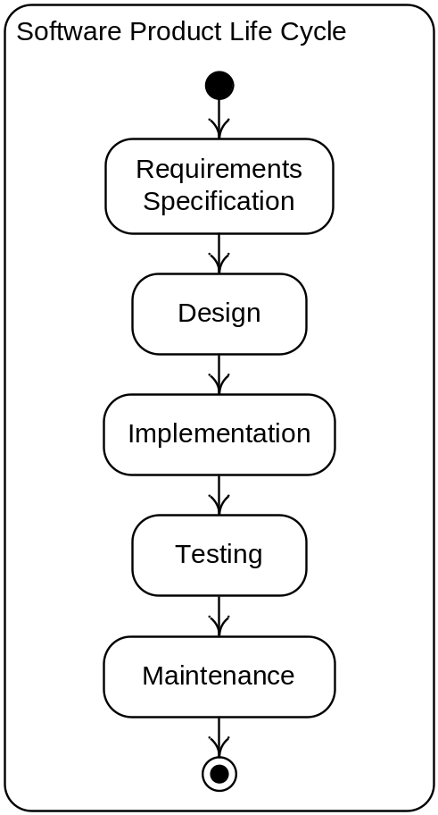
Waterfall Life Cycle Model
The waterfall model captures the logical, but not the temporal, relationships between software development activities.

Slide 17
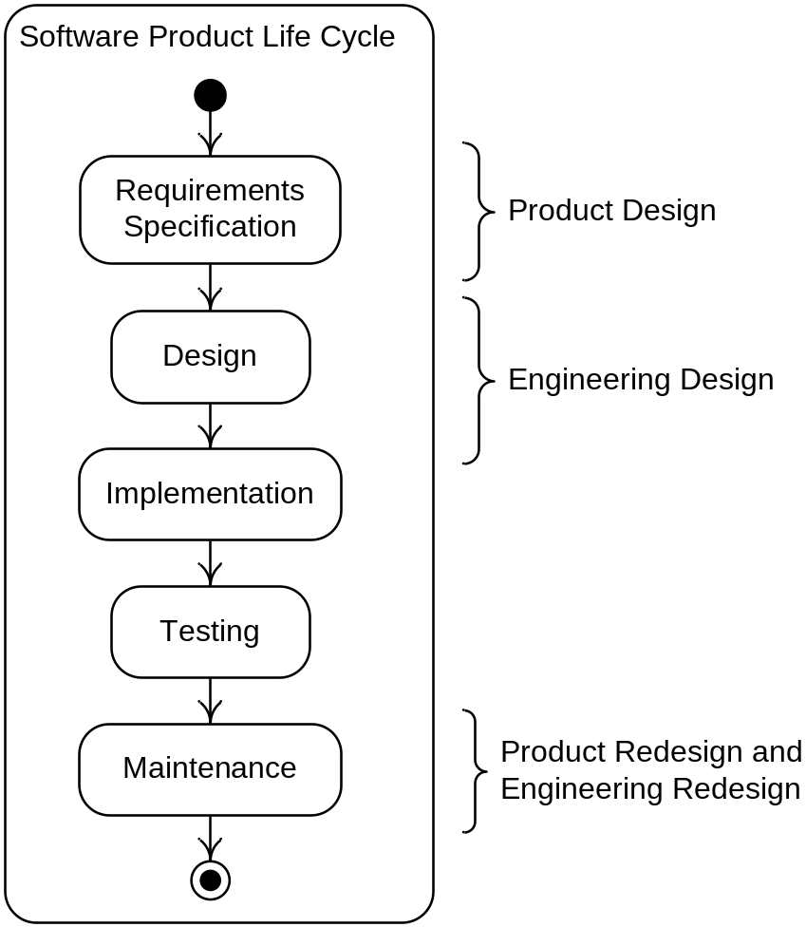
Design Across the Life Cycle

Slide 18
“What” Versus “How”
Traditional way to make the distinction between requirements and design activities
Not adequate because
  Many “what” specifications turn out to be design decisions
  Many “how” specifications turn out to be client or customer needs or desires
Distinguish requirements from design based on problem solving: requirements activity formulates a problem solved in design

Slide 19
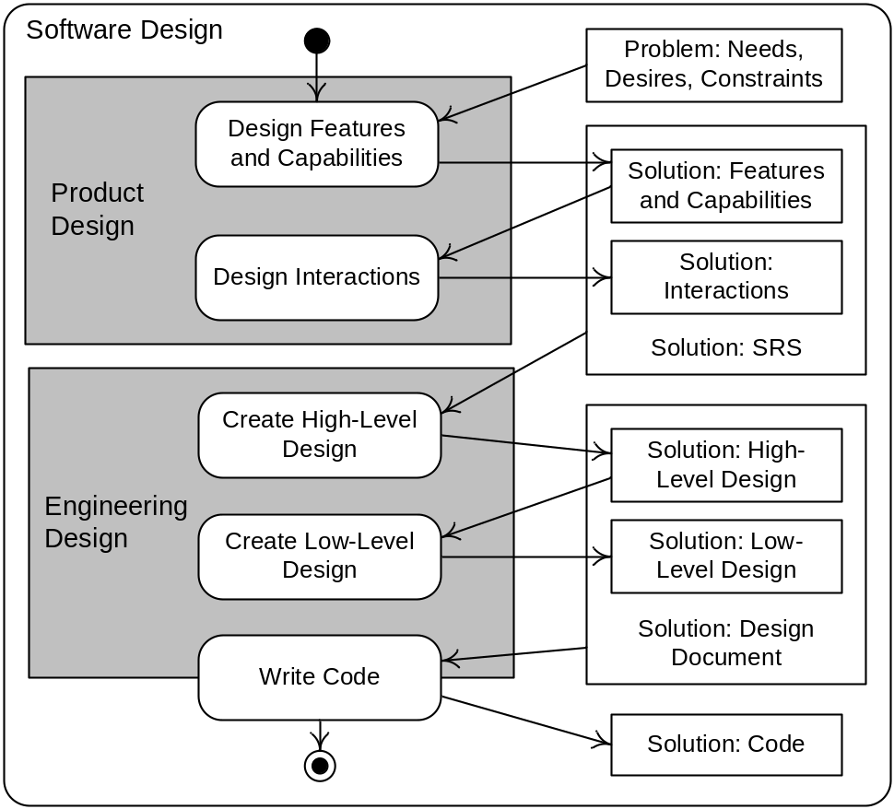
Design Problems and Solutions

Slide 20
Software Design Method
A software design method is an orderly procedure for generating a precise and complete software design solution that meets clients needs and constraints.

Slide 21
Design Method Components
Design Process—A collection of related tasks that transforms a set of inputs into a set of outputs
Design Notations—A symbolic representational system
Design Heuristics—Rules providing guidance, but no guarantee, for achieving some end
Design methods also use design principles stating characteristics of design that make them better or worse.

Slide 22
Design Method Timeline
Niklaus Wirth introduces stepwise refinement.
Stevens, Myers, Constantine introduce structured design.
Late 1970s to early 1980s Structured analysis and design methods are dominant.
Late 1980s Object-oriented analysis and design methods rise to prominence.
1995 UML 0.8 is released.
2004 UML 2.0 is released.

Slide 23
Summary
Software design is important.
Software design is best thought of as problem solving.
Abstraction is a fundamental design technique.
Modeling (which relies on abstraction) is a basic design tool.
Software design comprises both product and engineering design.
Product design occurs mainly in the requirements specification phase; engineering design mainly in the design and implementation phases.
OO analysis and design methods are now dominant.

