Slide 1
Software Design Processes and Management

Slide 2
Objectives
To understand how design consists of analysis and resolution activities
To illustrate and explain generic processes for software product and engineering design
To explain the five main tasks of project management
To understand iterative planning and tracking
To see how to apply project management principles to software design projects

Slide 3
Topics
Analysis and resolution
Generic problem-solving and design processes
Generic software product and engineering design processes
Project management
Iterative planning and tracking
Applying project management to software design projects

Slide 4
Analysis and Resolution
Confusion arises around the term design.
This confusion is removed by adopting the following terminology.
Analysis is breaking down a
design problem to understand it.
Resolution is solving a design problem.

Slide 5
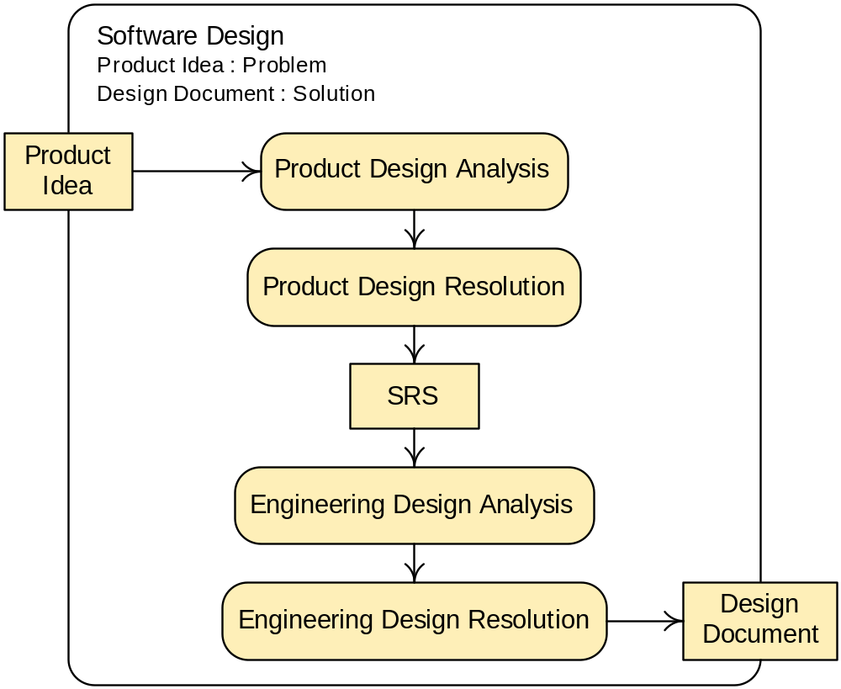
Analysis and Resolution in Software Design

Slide 6
A Problem-Solving Process
Understand the problem
Generate candidate solutions
Evaluate candidate solutions
Select the best solution(s)
Iterate if no solution is adequate
Ensure the solution is complete and well-documented, and deliver it

Slide 7
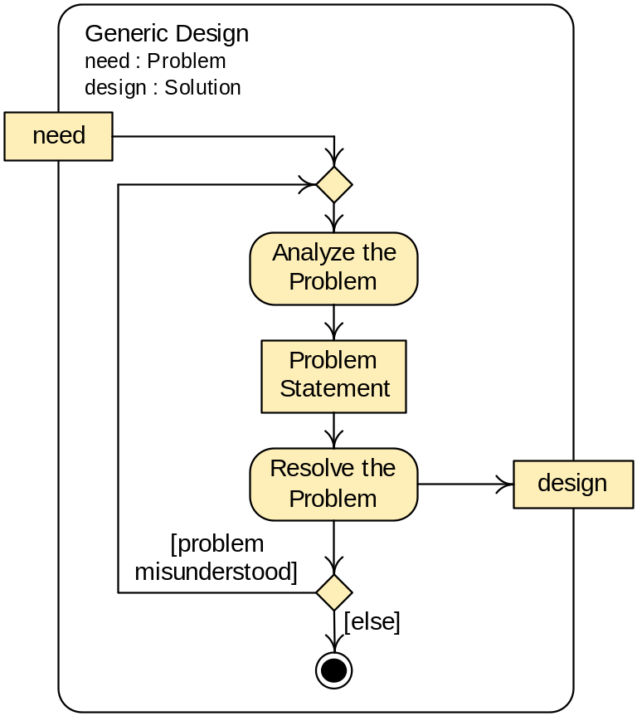
A Generic Design Process

Slide 8
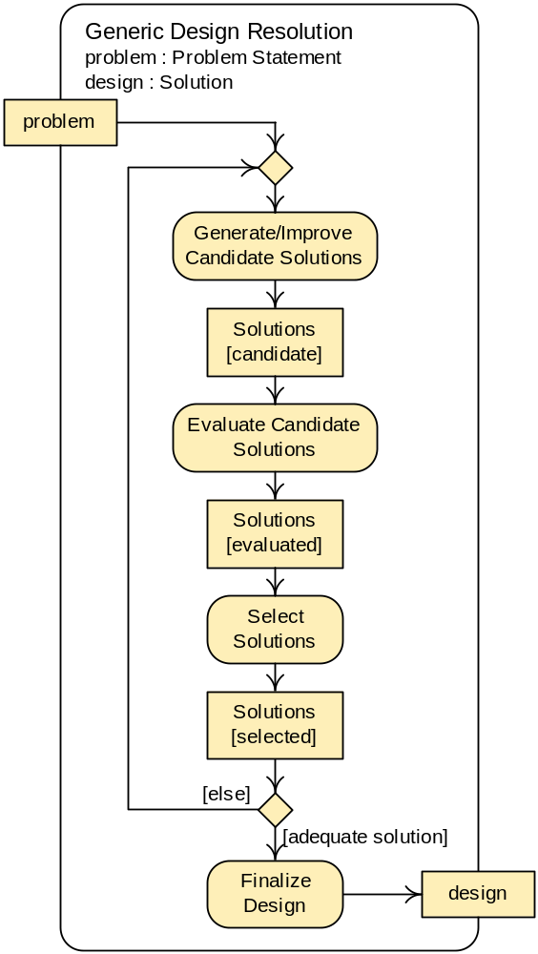
A Design Resolution Process
This diagram shows details of the resolution activity from the previous diagram.

Slide 9
Design Process Characteristics
The best solutions are rarely the first solutions designers think of.
  Designers should generate many candidate solutions.
The design process is highly iterative.
  Designers must frequently reanalyze the problem and must generate and improve solutions many times.

Slide 10
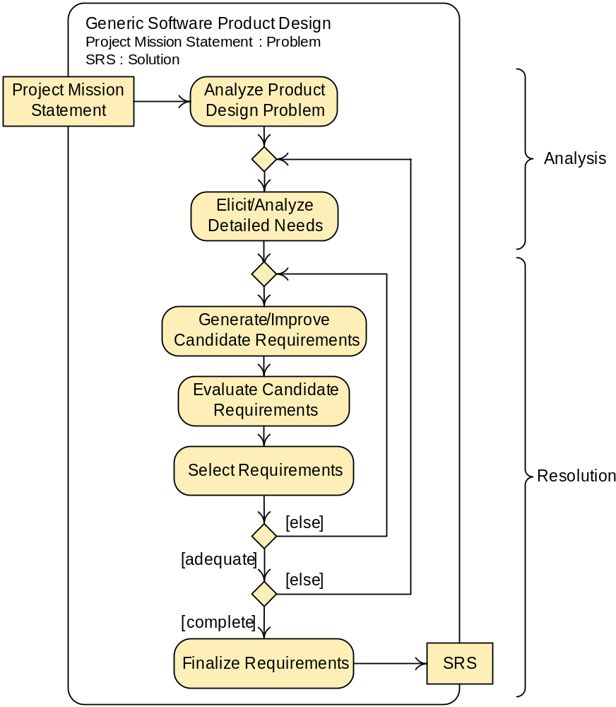
A Generic Software Product Design Process

Slide 11
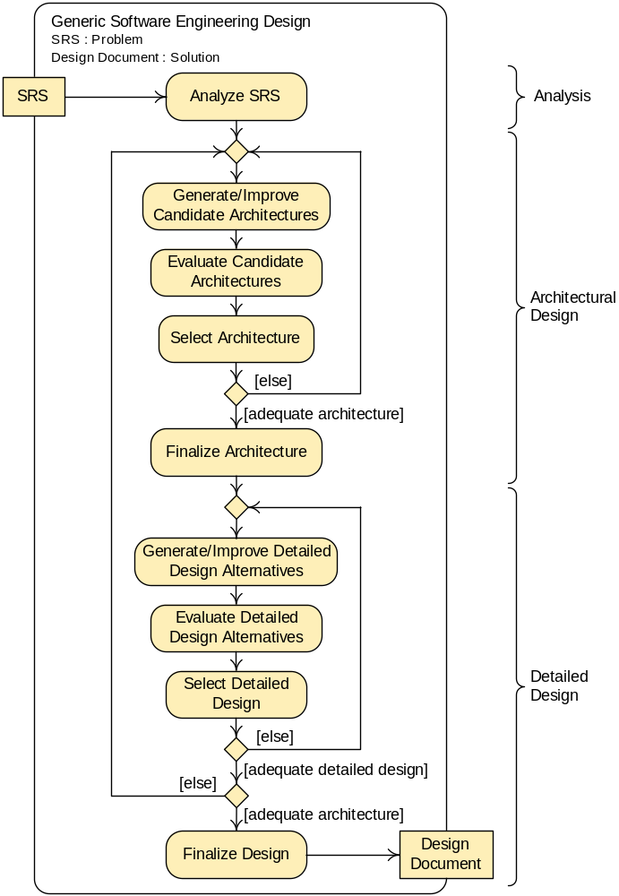
A Generic Software Engineering Design Process

Slide 12
Architectural and Detailed Design
Architectural design is high-level software engineering design resolution.
Detailed design is low-level software engineering design resolution.
Later discussions will consider architectural and detailed design, the latter being further divided into mid-level and low-level detailed design.

Slide 13
Operations versus Projects
Operations are standardized activities that occur continuously or at regular intervals.
  Payroll
  Hiring and performance evaluation
  Shipping and receiving
Projects are one-time efforts to achieve a particular current goal.
  Process improvement
  Business restructuring
  New product introduction (including design)

Slide 14
Project Management Activities
Planning—Formulating a scheme for doing a project.
Organizing—Structuring the organizational entities involved in a project and assigning them authority and responsibilities.
Staffing—Filling the positions in an organizational structure and keeping them filled.
Tracking—Observing the progress of work and adjusting work and plans accordingly.
Leading—Directing and supporting people doing project work.

Slide 15
Project Planning
Estimation is calculation of the approximate cost, effort, time or resources required to achieve some end.
A schedule specifies the start and duration of work tasks.
Tasks are allocated resources based on the schedule and estimates.
Risk analysis is an orderly process of identifying, understanding, and assessing risks (any occurrence with negative consequences).
Policies, procedures, tools, and techniques are specified to govern work.

Slide 16
Project Organization and Staffing
Organizational structures
  Project organization
  Functional organization
  Matrix organization
Team structures
  Hierarchical teams
  Democratic teams
Staffing
  Often the single most important factor in success is having good people to do the work.

Slide 17
Project Tracking
Projects may not go as planned for many reasons.
  Resource consumption is not as expected.
  Tasks do not take as long as expected.
  Policies, procedures, tools, or techniques cause problems.
  Something bad occurs (illness, budget cuts, equipment failures, etc.
When plans fail they must be adjusted.

Slide 18
Leading a Project
Direction is needed to follow plans, use resources efficiently, etc.
Directing people is not enough—people need inspiration, help, a congenial work environment, emotional support, etc.

Slide 19
Iterative Planning and Tracking
Good planning requires knowledge of tasks and their costs, risks, and other details not known until the project is under way—but this is not known when plans are made.
Iterative planning and tracking is making a rough base or initial project plan and refining it at fixed periods during a project in light of tracking data and completed work products.

Slide 20
Design Project Management
All five project a management activities are needed to manage a design project.
Iterative planning and tracking is the best approach to planning and tracking.
The design project decomposition on the next slide is useful for planning, organization, staffing, and tracking.
Design constitutes the largest activity in software development, so design can drive an entire development project.

Slide 21
Design Project Decomposition
Work Phase |  | Typical Work Products
Product Design | Analysis: Design Problem | Statement of interested parties, product concept, project scope, markets, business goals Models (of the problem) Prototypes (exploring the problem)
 | Analysis: Detailed Needs | Client surveys, questionnaires, interview transcripts, etc. Problem domain description Lists of needs, stakeholders Models (of the problem) Prototypes (exploring needs)
 | Resolution: Product Speciﬁcation | Requirements speciﬁcations Models (of the product) Prototypes (demonstrating the product)
Engineering Design | Analysis | Models (of the engineering problem) Prototypes (exploring the problem)
 | Resolution: Architectural Design | Architectural design models Architectural design speciﬁcations Architectural prototypes
 | Resolution: Detailed Design | Detailed design models Detailed design speciﬁcations Detailed design prototypes

Slide 22
Summary
Analysis is breaking a design problem down to understand it; resolution is solving a design problem.
Design processes begin with analysis and have a highly iterative resolution phase.
Designers should generate many candidate solutions and expect to reanalyze and resolve the problem repeatedly.
Design management is project management and hence requires planning, organization, staffing, tracking, and leadership.
Iterative planning and tracking is the best way to make and revise plans during a project.

