Slide 1


Slide 2

Social inequality is a perennial problem, and therefore, it is found universally in one form or the other.
Such a conception of the social inequality, built on the distribution of property, wealth, honour and power among individual members, would imply a certain ideological basis and a structural arrangement of the people based upon those inegalitarian institutionalized norms
This produces social stratification

Slide 3
Raymond Murray: “Social stratification is a horizontal division of society in to higher and lower social units”.
Gisbert: “Social stratification is the division of society into permanent groups or categories linked with each other by the relationship of superiority and subordination”.
Williams: “…the ranking of individuals on a scale of superiority, equality according to some commonly accepted basis of valuation”.

Slide 4
Sorokin: “ it is manifested in the existences of upper and lower social layer. Its basis and very essence consists in an unequal distribution of rights and privileges duties and responsibilities, social values and privations, social power and influences among the members of a society.”
Lundberg :“a stratified society is one marked by inequality, by differences among people that are accepted by them as being ‘lower’ and ‘higher’. Thus, it is clear that social inequality is the basis of social stratification.
Melvin Tumin :“an arrangement of any social group or society into a hierarchy of positions that are unequal with regard to power, property, social evaluation and psychic gratification”.

Slide 5

It is the ranking of the groups of people in a society, which is related to the differences in access to resources & life chances in a society.
Society can be seen as consisting of strata, in a hierarchy, with the more favored at the top & the less privileged nearer the bottom.

Slide 6
Firstly, Social stratification is ‘social’ as it does not represent biologically caused inequalities.
Secondly, the practice of social stratification is rooted in antiquity.
Thirdly, and most importantly, the concept of social stratification is characterized by universality. All societies in the world are stratified, although differently, based on different bases. It is in this connection that Sorokin once observed: “All permanently organized societies are stratified”.
Fourthly, the rankings apply to social categories of people who share a common characteristic without necessarily interacting or identifying with one another.
Fifthly, people’s life experiences & opportunities depend heavily on how their social category is ranked.
Finally, The ranks of different social categories tend to change very slowly overtime.

Slide 7

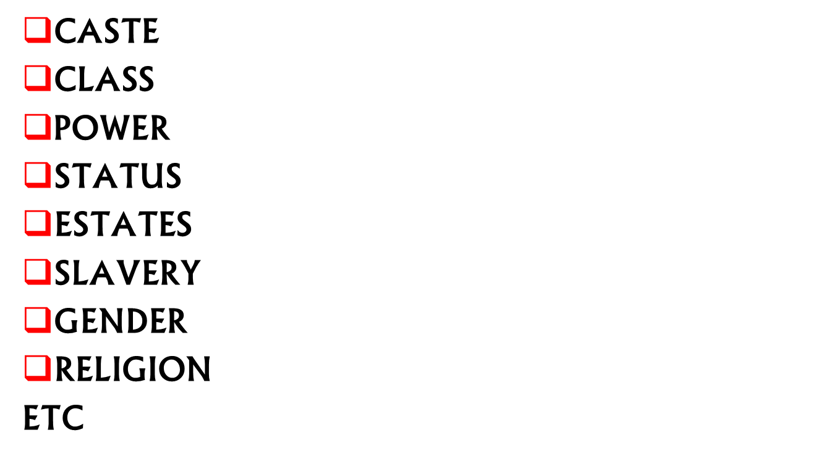

Slide 8
It is a large scale grouping of people, who share common economic resources, which strongly influence the type o lifestyle they are able to lead.
It is an economic stratification system, as the ranks of people determine their access to higher education, high paying jobs. & premium health care.
Therefore, ownership of wealth & occupation are chief basis of class difference.
Karl Marx viewed class differentiation as the crucial determinant of social, economic & political inequality.
His main focus was on the effects of class on all aspects of the 19th century Europe.
According to Marx, people have false consciousness (an attitude that doesn’t reflect its objective position).
A worker with false consciousness may feel that he is being treated fairly by his boss.
He felt that a revolution is possible only if people replace the false consciousness with class consciousness (a subjective awareness held by members of a class about the need for collective action to bring about social change).

Slide 9
Max Weber insisted that no single characteristic (such as class) totally defines a person’s position in the stratification system.
He identified 3 components of stratification”
  Class: refers to people having similar level of wealth & income
  Status: refers to people having similar prestige or lifestyle.
  Power: ability to exercise one’s will over others.

Slide 10

According to Max Weber, the basis of social stratification is the unequal power of the society in an organized way.
Power in the society is not equally divided among all its members. It is on the basis of the division of power that some become high and others become low, and those who enjoy more powers become superior to others.
Thus, according to Weber, the basis of social stratification is power, which may be economic power, political power, or social power.

Slide 11

Slavery was prevalent in the ancient and middle ages
Hobhouse defined a slave “as a man whom law and custom regard as the property of another.”
it is an economic form of inequality in which some people are the property of others. Their lives are owned, controlled, coerced & restricted.
As slaves are considered possessions, they are denied the rights & life chances that other people take for granted.

Slide 12

One way of stratification through gender is the “gender roles”.
These are the expectations regarding the proper behavior. Attitudes & activities of males & females.
Margaret Mead’s research pointed out to the importance of cultural conditioning in defining the social roles of males & females.

Slide 13
caste is ascribed at birth, & can’t be changed. It determines lifestyle, prestige & occupational choices.
The different social levels are closed, so that all individuals must remain at the social level of their birth throughout life.
In caste system, intimate contact with members of other castes is strongly discouraged.

