Slide 1
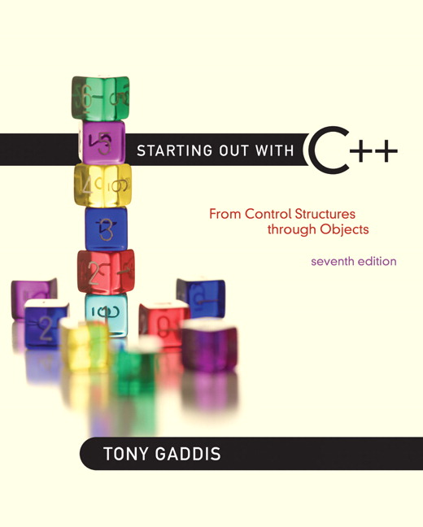

Chapter 2:
Introduction to C++

Slide 2
2.1
The Part of a C++ Program

Slide 3
The Parts of a C++ Program
// sample C++ program
#include <iostream>
using namespace std;
int main()
{
cout << "Hello, there!";
return 0;
}
comment
preprocessor directive
which namespace to use
beginning of function named main
beginning of block for main
output statement
string literal
send 0 to operating system
end of block for main

Slide 4
Special Characters
Character | Name | Meaning
// | Double slash | Beginning of a comment
# | Pound sign | Beginning of preprocessor directive
< > | Open/close brackets | Enclose filename in #include
( ) | Open/close parentheses | Used when naming a function
{ } | Open/close brace | Encloses a group of statements
" " | Open/close quotation marks | Encloses string of characters
; | Semicolon | End of a programming statement

Slide 5
2.2
The cout Object

Slide 6
The cout Object
Displays output on the computer screen
You use the stream insertion operator << to send output to cout:
cout << "Programming is fun!";

Slide 7
The cout Object
Can be used to send more than one item to cout:
cout << "Hello " << "there!";
Or:
cout << "Hello ";
cout << "there!";

Slide 8
The cout Object
This produces one line of output: cout << "Programming is "; cout << "fun!";

Slide 9
The endl Manipulator
You can use the endl manipulator to start a new line of output. This will produce two lines of output: cout << "Programming is" << endl; cout << "fun!";

Slide 10
The endl Manipulator
cout << "Programming is" << endl; cout << "fun!";
Programming is
fun!

Slide 11
The endl Manipulator
You do NOT put quotation marks around endl
The last character in endl is a lowercase L, not the number 1.
endl
This is a lowercase L

Slide 12
The \n Escape Sequence
You can also use the \n escape sequence to start a new line of output. This will produce two lines of output: cout << "Programming is\n"; cout << "fun!";
Notice that the \n is INSIDE
the string.

Slide 13
The \n Escape Sequence
cout << "Programming is\n"; cout << "fun!";
Programming is
fun!

Slide 14
2.3
The #include Directive

Slide 15
The #include Directive
Inserts the contents of another file into the program
This is a preprocessor directive, not part of C++ language
#include lines not seen by compiler
Do not place a semicolon at end of #include line

Slide 16
2.4
Variables and Literals

Slide 17
Variables and Literals
Variable: a storage location in memory
Has a name and a type of data it can hold
Must be defined before it can be used:
int item;

Slide 18
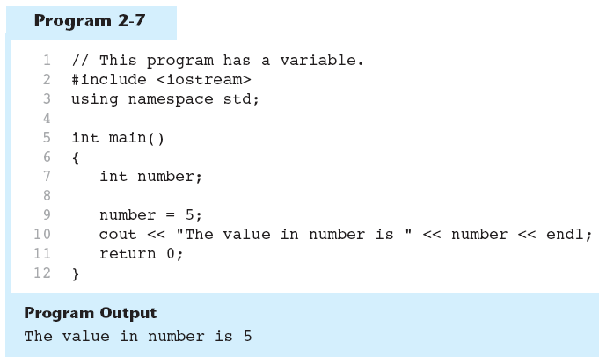
Variable Definition in Program 2-7
Variable Definition

Slide 19
Literals
Literal: a value that is written into a program’s code.
"hello, there" (string literal)
12 (integer literal)

Slide 20
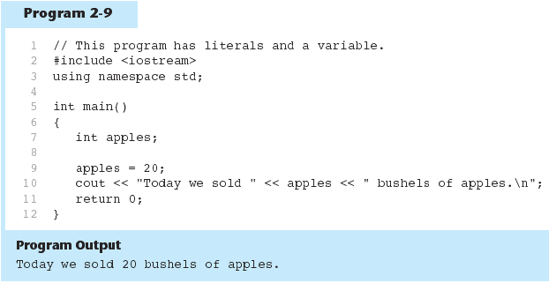
Integer Literal in Program 2-9
20 is an integer literal

Slide 21
String Literals in Program 2-9
These are string literals

Slide 22
2.5
Identifiers

Slide 23
Identifiers
An identifier is a programmer-defined name for some part of a program: variables, functions, etc.

Slide 24
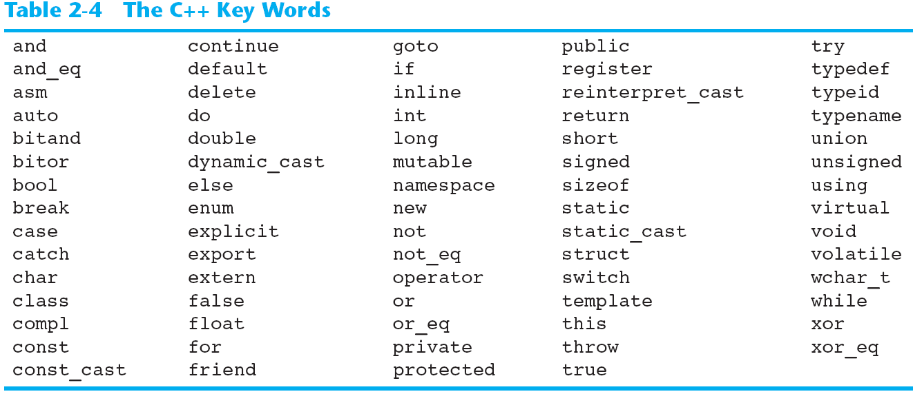
C++ Key Words
You cannot use any of the C++ key words as an identifier. These words have reserved meaning.

Slide 25
Variable Names
A variable name should represent the purpose of the variable. For example: itemsOrdered The purpose of this variable is to hold the number of items ordered.

Slide 26
Identifier Rules
The first character of an identifier must be an alphabetic character or and underscore ( _ ),
After the first character you may use alphabetic characters, numbers, or underscore characters.
Upper- and lowercase characters are distinct

Slide 27
Valid and Invalid Identifiers
IDENTIFIER | VALID? | REASON IF INVALID
totalSales | Yes
total_Sales | Yes
total.Sales | No | Cannot contain .
4thQtrSales | No | Cannot begin with digit
totalSale$ | No | Cannot contain $

Slide 28
2.6
Integer Data Types

Slide 29
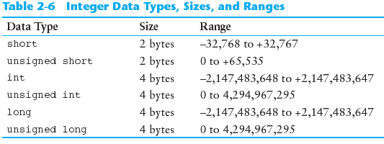
Integer Data Types
Integer variables can hold whole numbers such as 12, 7, and -99.

Slide 30
Defining Variables
Variables of the same type can be defined
- On separate lines:
int length;
int width;
unsigned int area;
- On the same line:
int length, width;
unsigned int area;
Variables of different types must be in different definitions

Slide 31
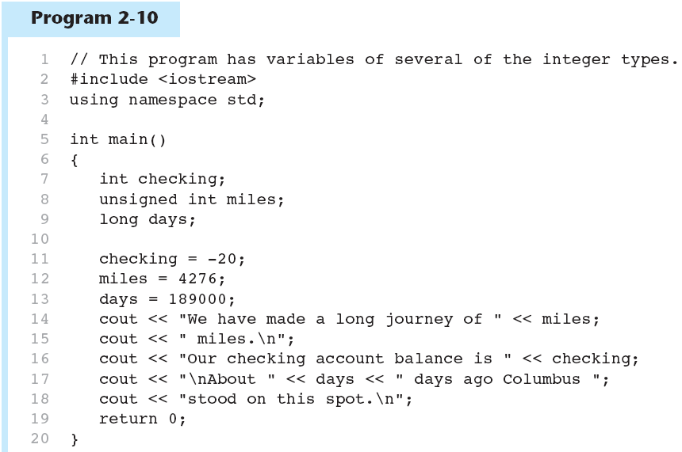
Integer Types in Program 2-10
This program has three variables: checking, miles, and days

Slide 32
Integer Literals
An integer literal is an integer value that is typed into a program’s code. For example: itemsOrdered = 15; In this code, 15 is an integer literal.

Slide 33
Integer Literals in Program 2-10
Integer Literals

Slide 34
Integer Literals
Integer literals are stored in memory as ints by default
To store an integer constant in a long memory location, put ‘L’ at the end of the number: 1234L
Constants that begin with ‘0’ (zero) are base 8: 075
Constants that begin with ‘0x’ are base 16: 0x75A

Slide 35
2.7
The char Data Type

Slide 36
The char Data Type
Used to hold characters or very small integer values
Usually 1 byte of memory
Numeric value of character from the character set is stored in memory:
CODE:
char letter;
letter = 'C';
MEMORY:
letter
67

Slide 37
Character Literals
Character literals must be enclosed in single quote marks. Example: 'A'

Slide 38
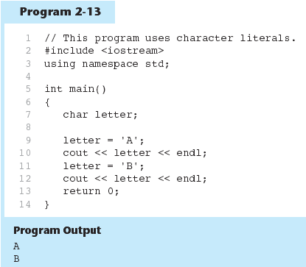
Character Literals in Program 2-13

Slide 39
Character Strings
A series of characters in consecutive memory locations:
"Hello"
Stored with the null terminator, \0, at the end:
Comprised of the characters between the " "
H | e | l | l | o | \0

Slide 40
2.8
The C++ string Class

Slide 41
The C++ string Class
Special data type supports working with strings
#include <string>
Can define string variables in programs:
string firstName, lastName;
Can receive values with assignment operator:
firstName = "George";
lastName = "Washington";
Can be displayed via cout
cout << firstName << " " << lastName;

Slide 42
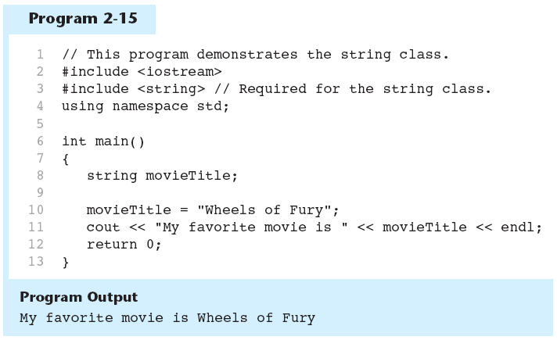
The string class in Program 2-15

Slide 43
2.9
Floating-Point Data Types

Slide 44
Floating-Point Data Types
The floating-point data types are: float double long double
They can hold real numbers such as:
12.45 -3.8
Stored in a form similar to scientific notation
All floating-point numbers are signed

Slide 45
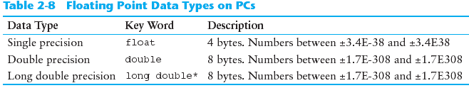
Floating-Point Data Types

Slide 46
Floating-Point Literals
Can be represented in
Fixed point (decimal) notation:
31.4159 0.0000625
E notation:
3.14159E1 6.25e-5
Are double by default
Can be forced to be float (3.14159f) or long double (0.0000625L)

Slide 47
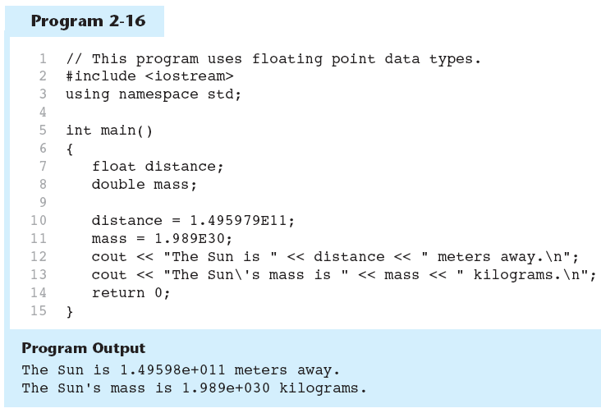
Floating-Point Data Types in Program 2-16

Slide 48
2.10
The bool Data Type

Slide 49
The bool Data Type
Represents values that are true or false
bool variables are stored as small integers
false is represented by 0, true by 1:
bool allDone = true;
bool finished = false;
allDone
finished
1
0

Slide 50
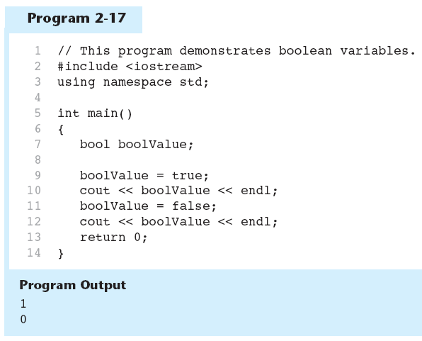
Boolean Variables in Program 2-17

Slide 51
2.11
Determining the Size of a Data Type

Slide 52
Determining the Size of a Data Type
The sizeof operator gives the size of any data type or variable:
double amount;
cout << "A double is stored in "
<< sizeof(double) << "bytes\n";
cout << "Variable amount is stored in "
<< sizeof(amount)
<< "bytes\n";

Slide 53
2.12
Variable Assignments and Initialization

Slide 54
Variable Assignments and Initialization
An assignment statement uses the = operator to store a value in a variable. item = 12;
This statement assigns the value 12 to the item variable.

Slide 55
Assignment
The variable receiving the value must appear on the left side of the = operator.
This will NOT work: // ERROR! 12 = item;

Slide 56
Variable Initialization
To initialize a variable means to assign it a value when it is defined:
int length = 12;
Can initialize some or all variables:
int length = 12, width = 5, area;

Slide 57
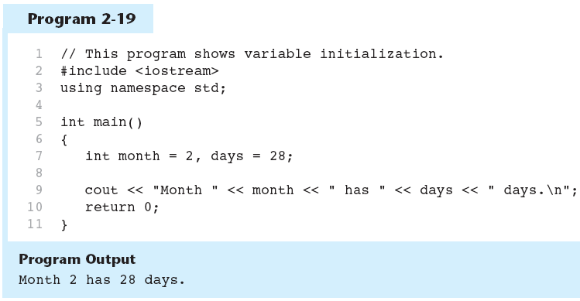
Variable Initialization in Program 2-19

Slide 58
2.13
Scope

Slide 59
Scope
The scope of a variable: the part of the program in which the variable can be accessed
A variable cannot be used before it is defined

Slide 60
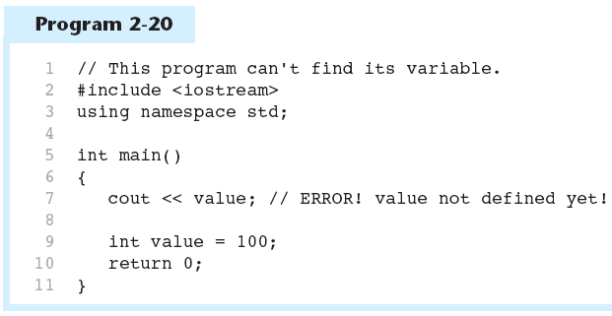
Variable Out of Scope in Program 2-20

Slide 61
2.14
Arithmetic Operators

Slide 62
Arithmetic Operators
Used for performing numeric calculations
C++ has unary, binary, and ternary operators:
unary (1 operand) -5
binary (2 operands) 13 - 7
ternary (3 operands) exp1 ? exp2 : exp3

Slide 63
Binary Arithmetic Operators
SYMBOL | OPERATION | EXAMPLE | VALUE OF ans
+ | addition | ans = 7 + 3; | 10
- | subtraction | ans = 7 - 3; | 4
* | multiplication | ans = 7 * 3; | 21
/ | division | ans = 7 / 3; | 2
% | modulus | ans = 7 % 3; | 1

Slide 64
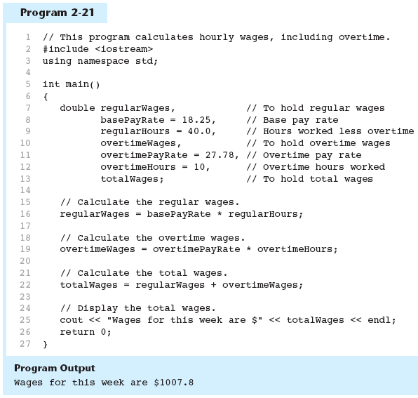
Arithmetic Operators in Program 2-21

Slide 65
A Closer Look at the / Operator
/ (division) operator performs integer division if both operands are integers
cout << 13 / 5; // displays 2
cout << 91 / 7; // displays 13
If either operand is floating point, the result is floating point
cout << 13 / 5.0; // displays 2.6
cout << 91.0 / 7; // displays 13.0

Slide 66
A Closer Look at the % Operator
% (modulus) operator computes the remainder resulting from integer division
cout << 13 % 5; // displays 3
% requires integers for both operands
cout << 13 % 5.0; // error

Slide 67
2.15
Comments

Slide 68
Comments
Used to document parts of the program
Intended for persons reading the source code of the program:
Indicate the purpose of the program
Describe the use of variables
Explain complex sections of code
Are ignored by the compiler

Slide 69
Single-Line Comments
Begin with // through to the end of line:
int length = 12; // length in inches
int width = 15; // width in inches
int area; // calculated area
// calculate rectangle area
area = length * width;

Slide 70
Multi-Line Comments
Begin with /*, end with */
Can span multiple lines:
/* this is a multi-line
comment
*/
Can begin and end on the same line:
int area; /* calculated area */

Slide 71
2.16
Named Constants

Slide 72
Named Constants
Named constant (constant variable): variable whose content cannot be changed during program execution
Used for representing constant values with descriptive names:
const double TAX_RATE = 0.0675;
const int NUM_STATES = 50;
Often named in uppercase letters

Slide 73
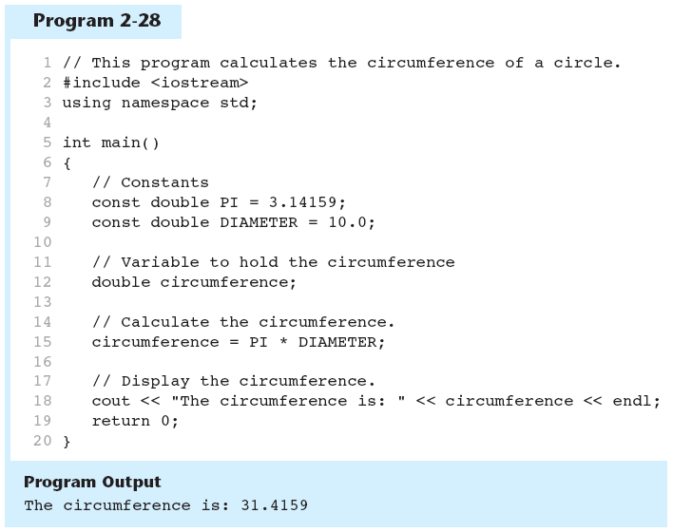
Named Constants in Program 2-28

Slide 74
2.17
Programming Style

Slide 75
Programming Style
The visual organization of the source code
Includes the use of spaces, tabs, and blank lines
Does not affect the syntax of the program
Affects the readability of the source code

Slide 76
Programming Style
Common elements to improve readability:
Braces { } aligned vertically
Indentation of statements within a set of braces
Blank lines between declaration and other statements
Long statements wrapped over multiple lines with aligned operators

Slide 77
2.18
Standard and Prestandard C++

Slide 78
Standard and Prestandard C++
Older-style C++ programs:
Use .h at end of header files:
#include <iostream.h>
Use #define preprocessor directive instead of const definitions
Do not use using namespace convention
May not compile with a standard C++ compiler

Slide 79
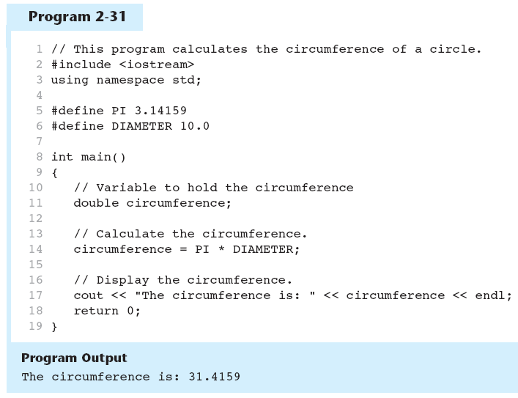
#define directive in Program 2-31

