Slide 1


Slide 2
Computer Vision and Image Processing (CSEL-393) Lecture 8
Dr. Qurat ul Ain Akram
Assistant Professor
Computer Science Department (New Campus) KSK, UET, Lahore

Slide 3
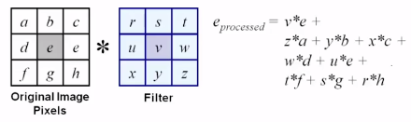
Correlation Vs Convolution
Convolution: Similar to the correlation operation but has a slight difference. In Convolution operation, the kernel is first flipped by an angle of 180 degrees and is then applied to the image.

Slide 4
Sharpening spatial Filters
Sharpening filter highlights or enhances details of objects in images
Sharpening filter enhances the quality to get clear/refined details of individual objects (either small or large)
Sharpening filter removes blurring from images
Sharpening filter highlights edges
Sharpening filters are based on spatial differentiation i.e. processing the rate of change. Edge s are very effectively extracted using differentiation filters.
Notes:
We have applied different filters like, Avg filters, median filters, Min, Max filter etc.
We are given an image, and using a mask, we apply mask and SOP we improve the quality of the an image
What do we mean by enhance image: There are two parameters
1) All the objects of an image are correlate with the each other.
2: Individual objects should preserve their appearance. Means each object should be separable, highlighted etc
For this we use image sharpening.
Image Sharpening:
Same as sharpen, enhance the boundary of the image.
, All elements are

Slide 5
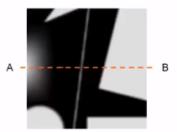
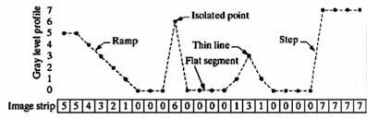
Sharpening spatial Filters
Spatial Derivative: calculate rate of change of neighboring pixels intensities.
Highlight inside content of the objects

Slide 6
Spatial Differentiation
1 Dimensional Image: Lets consider the a simple 1-D example in x-direction
Intensity levels are from 0-7
Terminologies
Ramp: Gradually change in intensity values
Isolated point: only one pixel of black in white region or white pixel in black region
Thin line: Appose to isolated point, more than one points are thin line
Flat Segment: No change in the intensity values continuously for a specific period of time (either black or white)
Step: Change from white to black or from black to white is called STEP

Slide 7
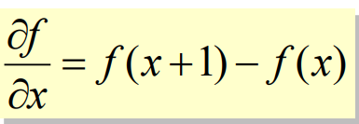
First Order Derivative
Rate of change
The formula for the 1st derivative of a function is as follows:
Its just the difference between subsequent values and measures the rate of change of the function
Notes:
IN formula Delta x is missing… As it is constant therefore we ignore this
8 feb 2022

Slide 8
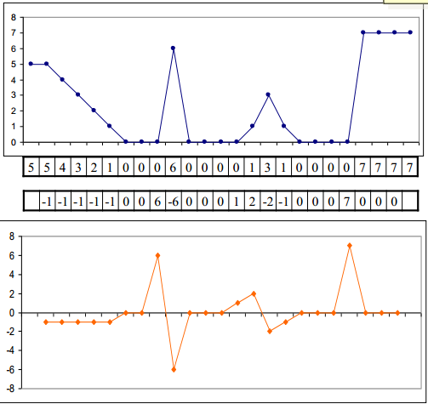
First Order Derivative
Notes:
Explain the diagram
Ramp it is constant
For isolated point, effect is double as can be seen
Thin line is also more clear as far as identification is concern
Step is also signal upward
is continiou

Slide 9
1st Derivative
Observations
Must be zero in flat segments(area of constant gray levels)
Must be non-zero at the onset of a gray level step or ramp
Must be non zero along ramps

Slide 10
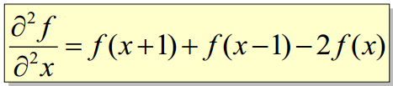
2nd order derivative
The 2nd derivative of a function is given by:
Simply takes into account the values both before and after the current value

Slide 11
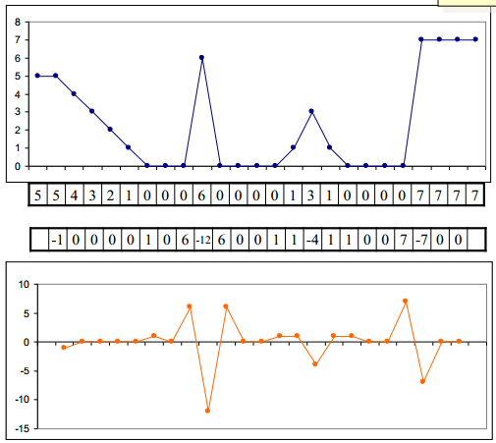

Slide 12
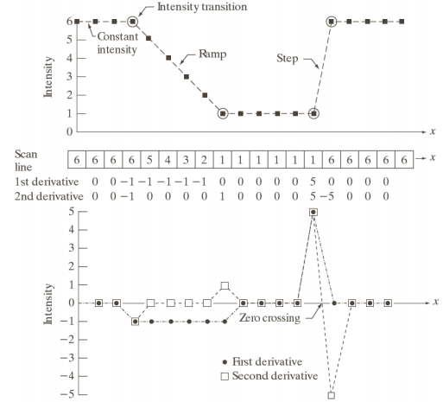
2nd Order Derivative
Observations
Must be zero in flat segments
Must be non-zero at the onset and end of a gray level step or ramp
Must be non zero along ramps of constant slope

Slide 13
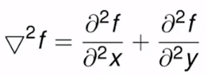


Filters for Derivatives to sharpen the image
Laplacian Filter
Finding of derivatives with respect to both directions x and y i.e.
Where partial 1st derivative in x direction is defined as
And in y direction is defined as

Slide 14
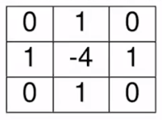
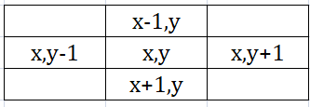
Laplacian Filter
By taking sum of both directions we have
Laplacian filter can be built as

Slide 15
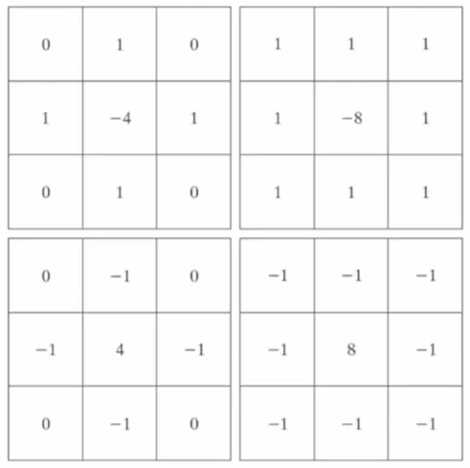
Different types of Laplacian Filters
To give priority to the center pixels
and give less priority to neighboring pixels

Slide 16
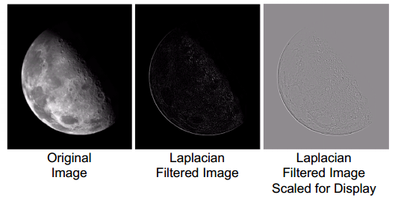
Sharpening using Laplacian Filter
After applying Laplacian filter on an image
The new image contains highlighted edges and discontinuities.
However image is not giving an enhanced view

Slide 17

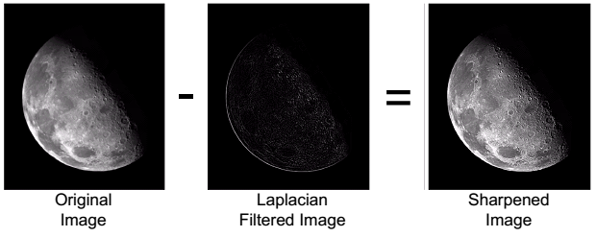
Image Sharpening using Laplacian
Solution
Subtract the resultant image( after application of Laplacian filter) from the original Image
Sharpe Image= Original Image- Resultant Image
Notes:
Details and egdea are enahnced

Slide 18
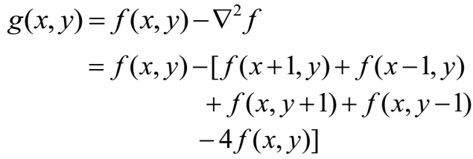
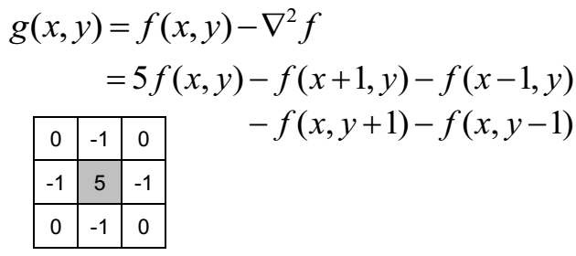
Simplified Filter

Slide 19
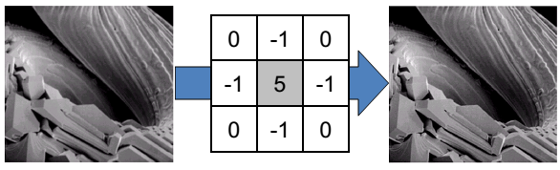
Simplified Filter

Slide 20
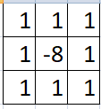
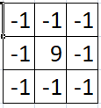
Variants of Simplified Filter
Notes:
Only add 1 in center of the pixel

Slide 21
Reading from book
Chapter # 3 of book.
Book:
Gonzalez, R. C. and Woods, R. E., Digital Image Processing, Second Edition, Pearson-Prentice Hall, Inc., 2002. ISBN 81-7758-168-6

Slide 22
THANK YOU

